Slide 1

NAME: AKANKSHA KUMARI ROLL: akanksha_2312res61@iitp.ac.in ID: IITP000334 PROJECT TITLE: MOVIE RECOMMENDATION SYSTEM
.

Slide 2
OBJECTIVES:
To build a Movie Recommendation System using data science techniques.
To analyze genres, ratings, cast, and user preferences.
To recommend movies that match user interests.
To provide useful insights into viewing patterns and movie trends.
INTRODUCTION:
A data science-based Movie Recommendation System that analyses genres, ratings, cast, and user preferences to suggest similar movies and provide insights on viewing trends.

Slide 3
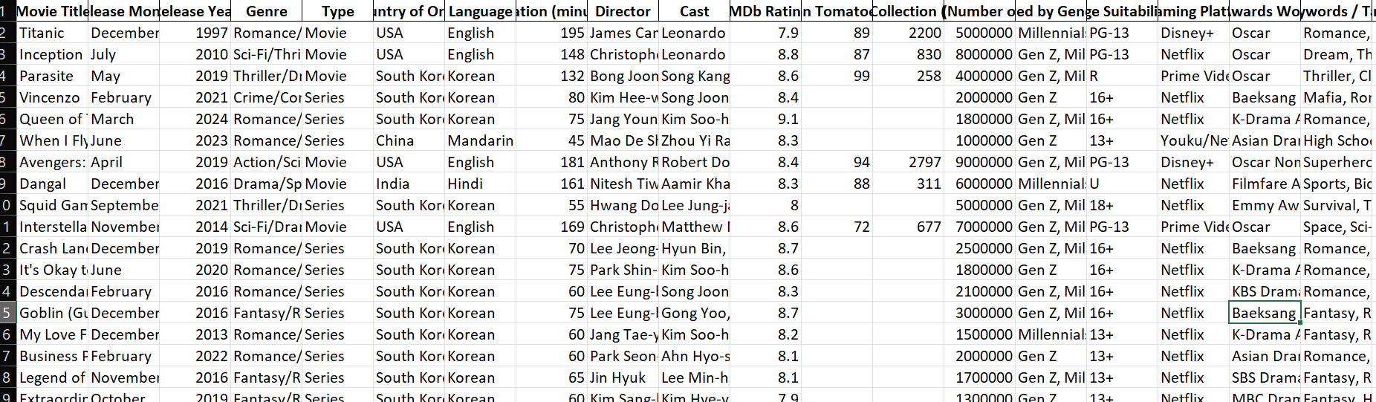
DATASET OVERVIEW source: self created

Slide 4
CODE FUNCTIONS:
Load and clean the movie data.
Analyze genres, ratings, and trends with charts.
Find movie similarities using content features.
Suggest movies based on user input.
Provide movie links for trailers

Slide 5
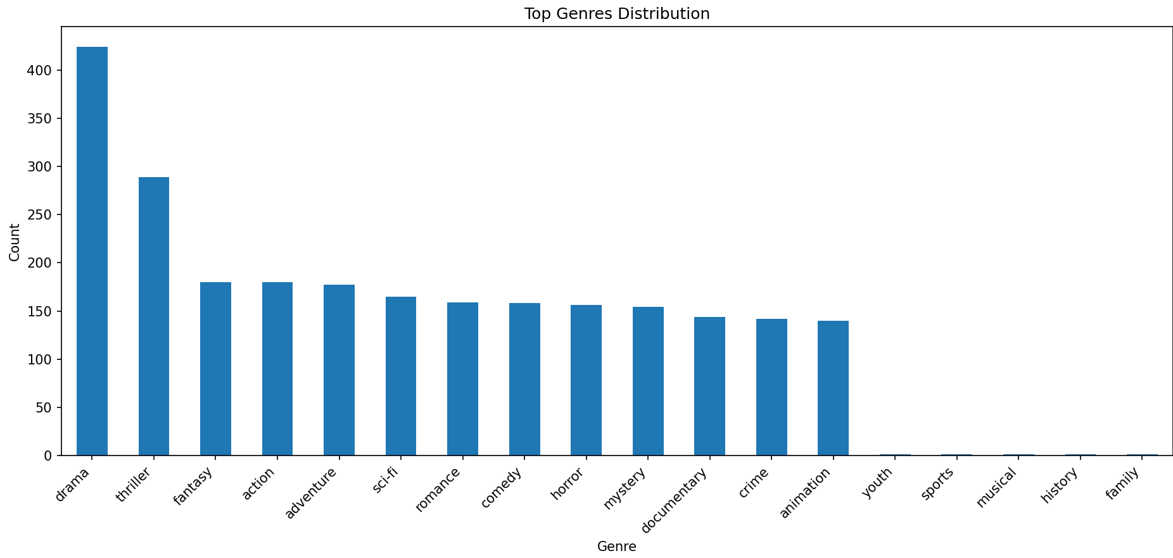
DATA VISUALIZATIONS:

Slide 6
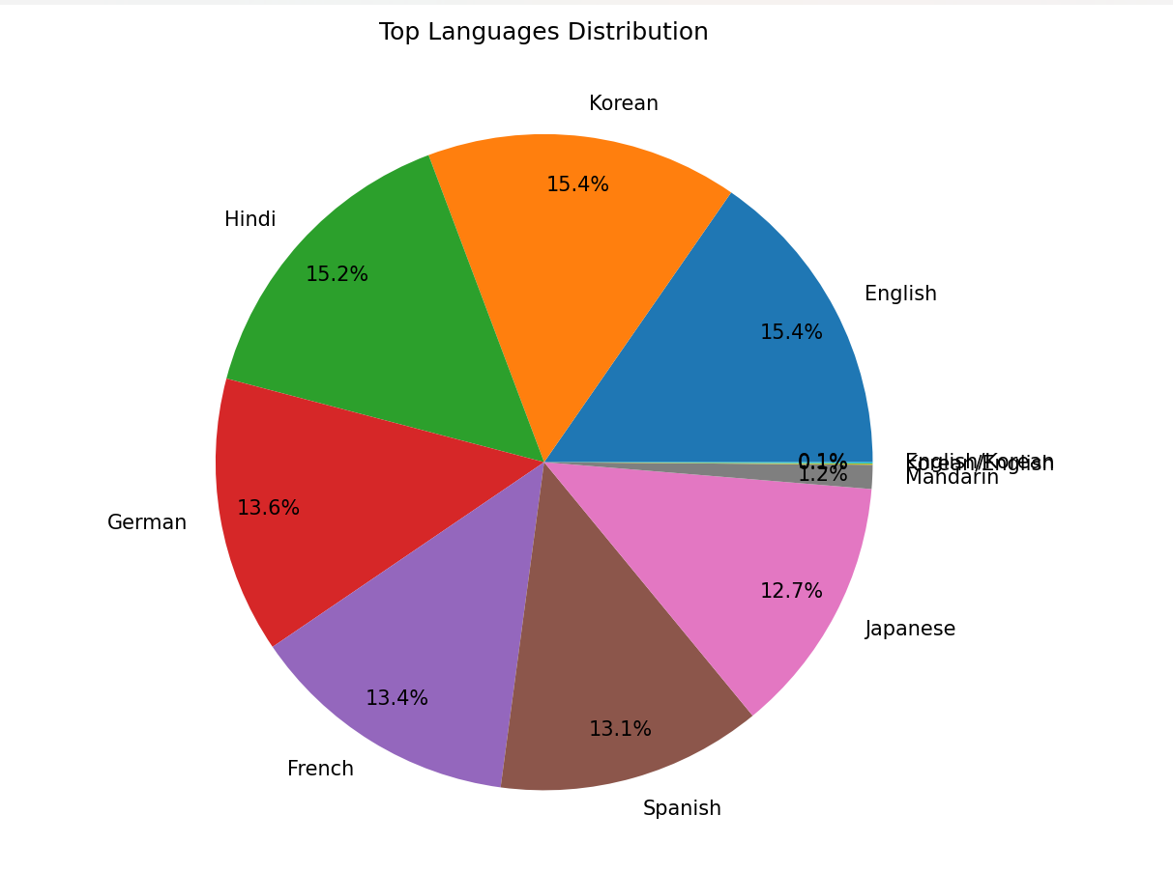
.
.

Slide 7
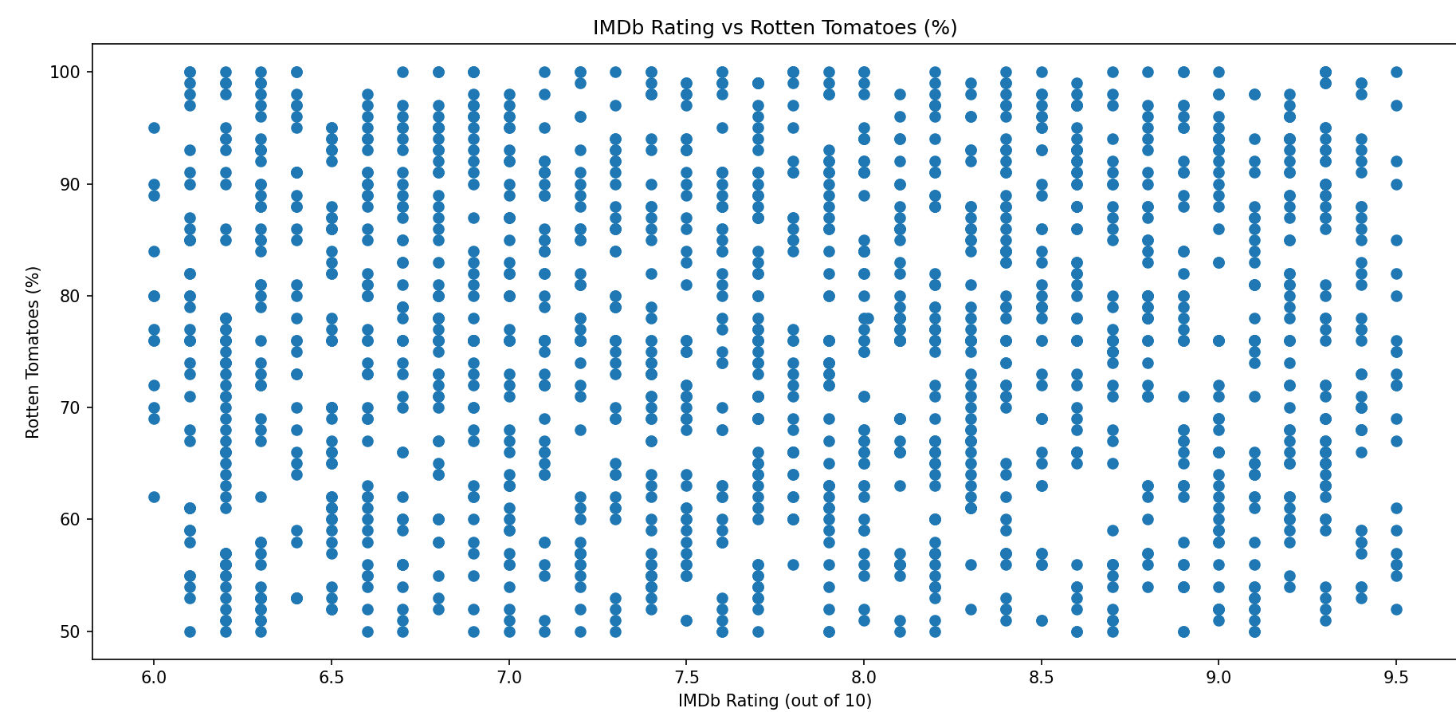

Slide 8
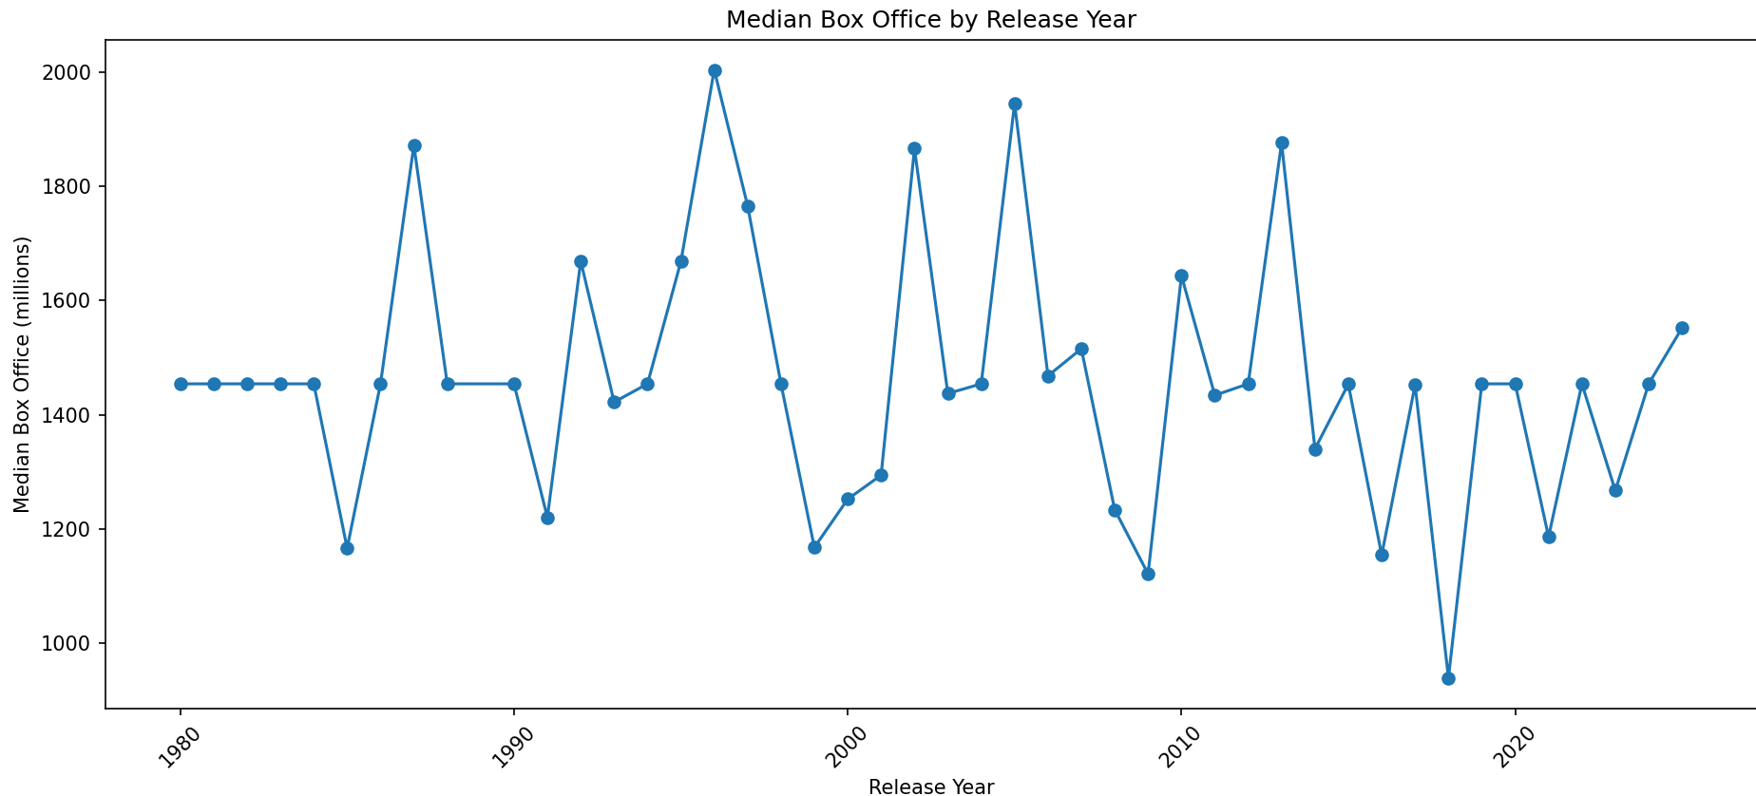

Slide 9
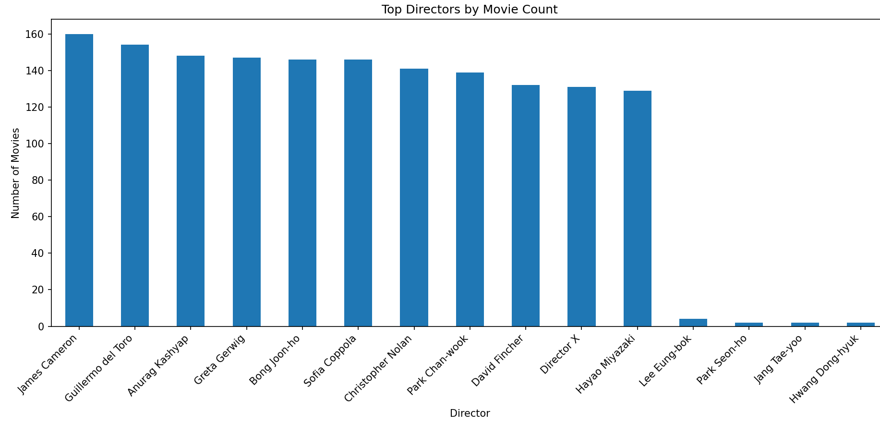

Slide 10
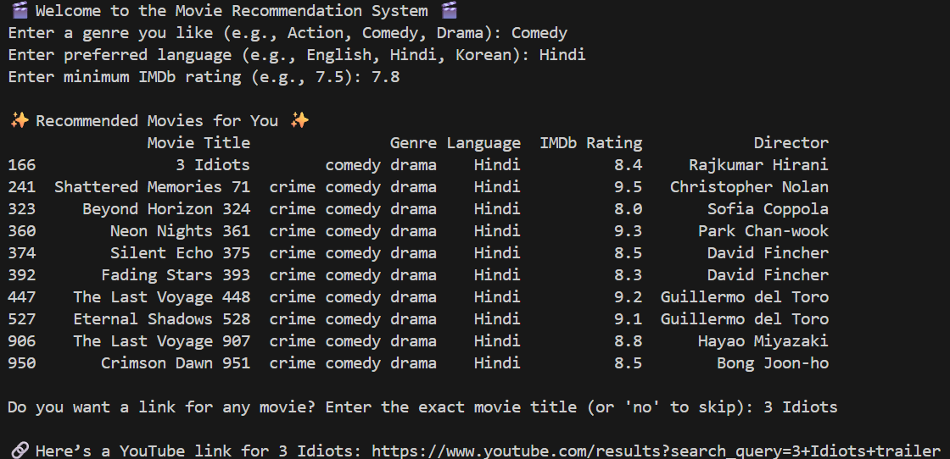
USER INTERACTION
This project reduces manual searching by suggesting movie according to the user reference by asking few questions quite easy to answer.
It also asks for if the user need movie link and directs them to movie.

Slide 11
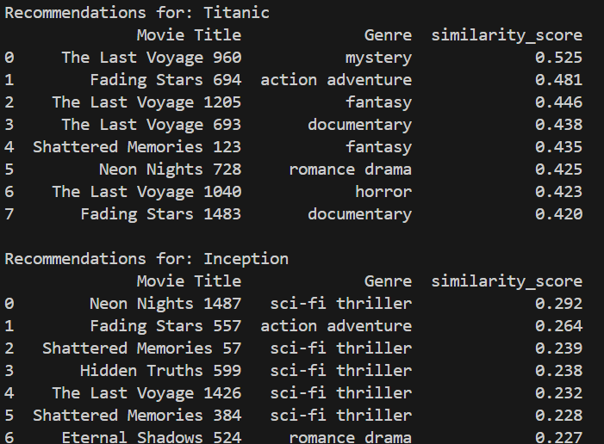
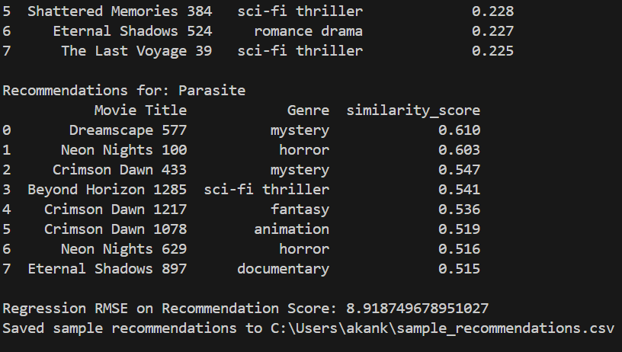
Insights:

Slide 12
FUTURE SCOPE / CONCLUSION:
Add collaborative filtering for better personalization
Integrate real-time data from streaming platforms
Improve recommendations with deep learning models
The project creates a Movie Recommendation System that suggests movies based on user preferences and trends. It makes finding movies easier, faster, and more personalized.

Slide 13
SUMMARY:
THIS PROJECT:
Analyzes a movie dataset to identify patterns in genres, ratings, languages, and box office trends.
Automates cleaning and exploration of data for faster insights.
Uses TF-IDF & Cosine Similarity to recommend movies based on content features (genre, cast, director, etc.).
Reduces manual searching by suggesting personalized movie options.
Allows user interaction to input preferences (genre, language, rating) and get tailored results
Provides YouTube trailer links for selected movies to enhance user experience.

