Slide 1


Student Marks and Grade Summary
A Data Science Internship Project by Akanksha kumari
Roll: akanksha_2312res61
Prepared by Akanksha

Slide 2
Project Objective
• Design a Python-based system to calculate and summarize student marks and grades.
• Perform basic data analysis and visualization.
• Output student-level performance, class average, and grade distribution.
Prepared by Akanksha

Slide 3
Data Handling and Processing
• Loaded data from CSV using Pandas.
• Checked for null values and data types.
• Calculated total and average marks for each student.
• Assigned grades based on average marks.
Prepared by Akanksha

Slide 4
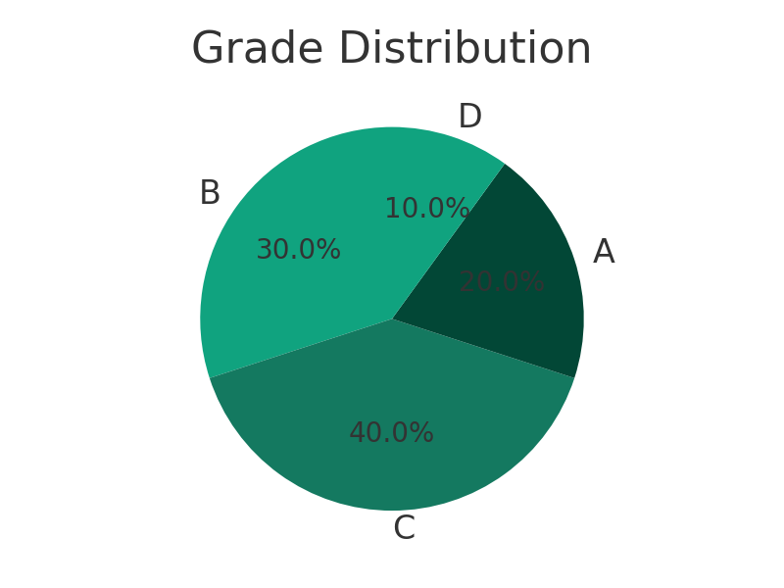
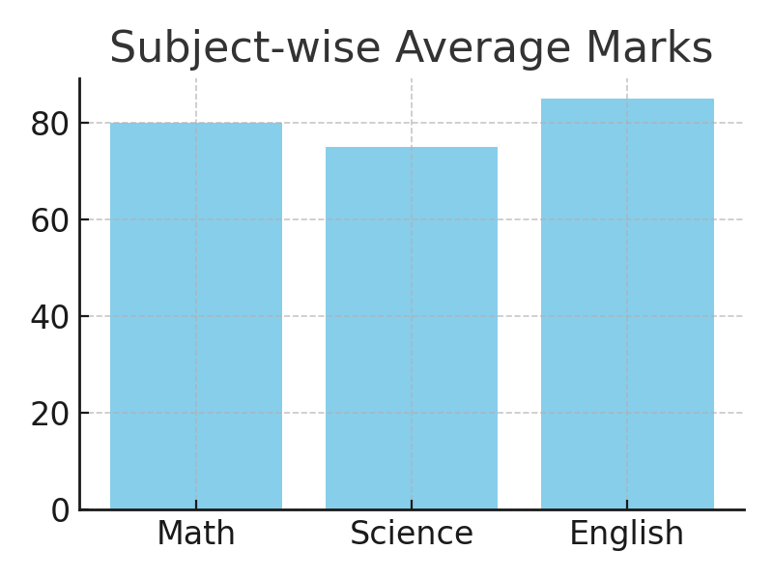
Analysis and Visualizations
• Identified class average and top performers.
• Visualized subject-wise average using a bar chart.
• Visualized grade distribution using a pie chart.
• Exported results to CSV for documentation.
Prepared by Akanksha

