Slide 1
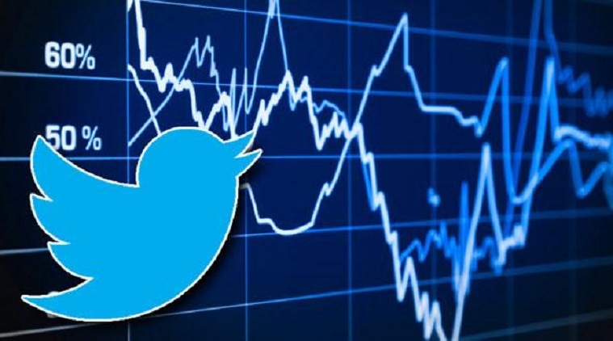
Analysis of Stock Market Trends and Sentiment on Twitter: Successful Individuals vs. General Public
Team members:
Akanksha Cheeti
Meghana Chava

Slide 2
Introduction
Research question: How does the correlation between social media sentiment and stock trends vary for successful tech individuals compared to random individuals with tech knowledge?
What are the reasons and properties behind such results, and how can we gain a deeper understanding of how different categories of people’s sentiment align with stock trend?
Previous studies have used machine learning to classify tweets into positive, negative, or neutral sentiments, and analyzed the correlation between social media sentiment and stock trends to predict stock prices.
Not trivial: type of people tweeting, discussed topics, and analysis period."

Slide 3
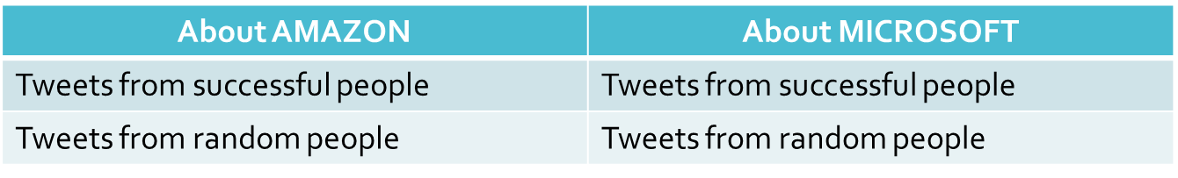
Data Collection
Successful people usernames – Forbes and Business Insider
Random people usernames – Usernames with tech related words in their twitter bio.
Scraped data from their user timelines.
Utilized twitter API to extract tweets resulting in four distinct datasets.

Slide 4
Technical implementation
Sentiment Analysis Methodology:
Lexicon-based approach using off-the-shelf tools such as TextBlob and VADER methods in Python for sentiment scoring.
NLTK library used for tokenization and lemmatization.
Sentiment scores compared with real-time stock prices using Yahoo Finance package.
Plotted sentiment scores against stock prices to analyze trends and differences in correlation between sentiment and stock among two groups of people

Slide 5
Reasons that affected the correlation?
Topic Modeling:
Used BERT to generate embeddings for tweets.
K-means clustering applied to group tweets into topics.
Most frequent keywords identified for each cluster.
LDA method used for additional analysis to categorize tweets into specific topics.
Histogram plotted to visualize tweet distribution among topics for successful and random individuals

Slide 6
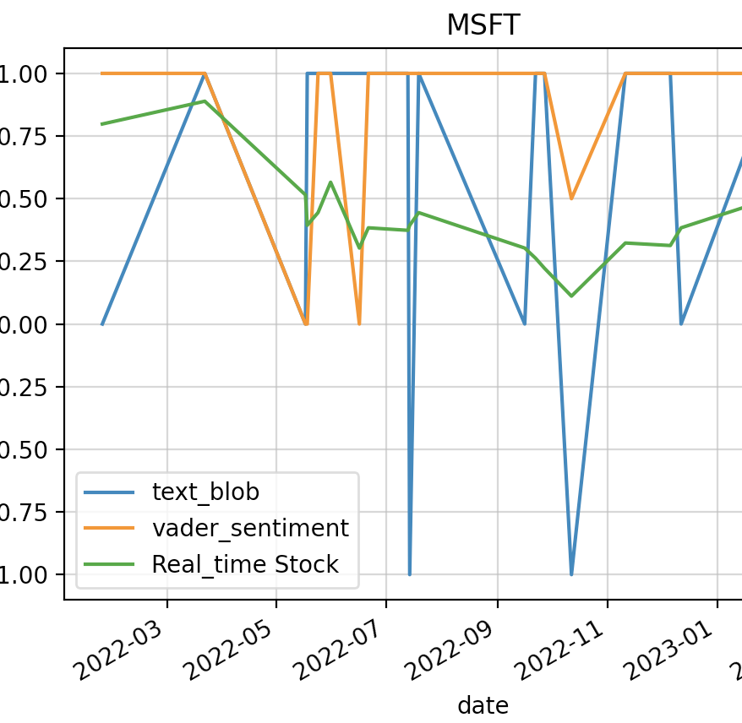
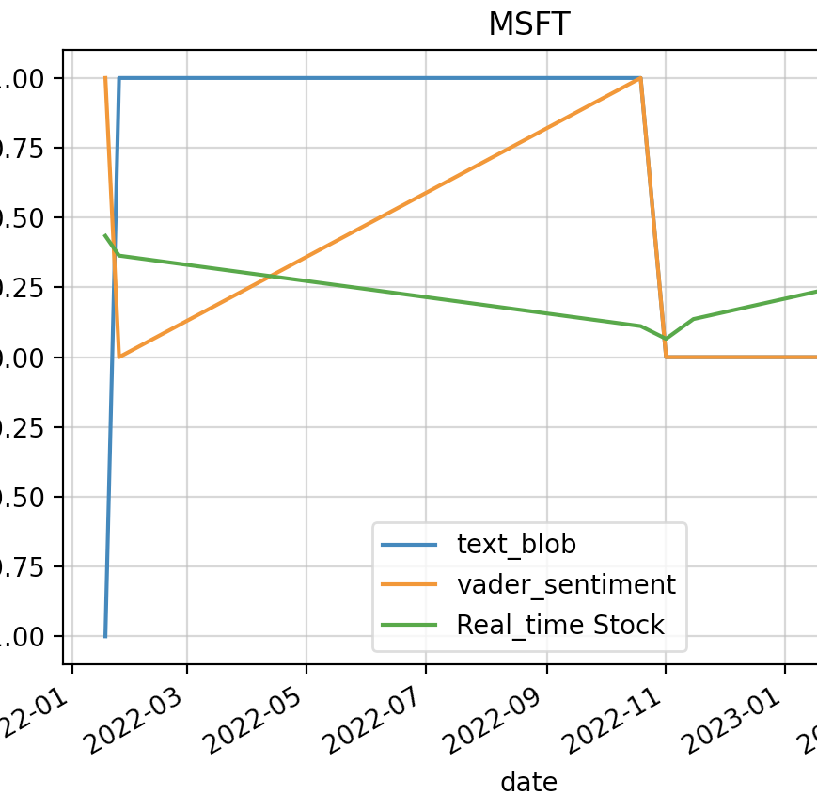
Experiments and Results
We conducted experiments to explore the correlation, and factors contributing to the difference in correlation for successful vs. random people.
Sentiment Correlation
We compared positive and negative sentiment counts among tweets extracted from successful and random tech people handles.
For Microsoft and Amazon, sentiment scores of successful people followed a similar pattern to the stock price trend, while those of random people did not.
Pearson correlation coefficient showed positive correlation (0.4) between sentiment and stock trends for successful people but negative for random people.

Slide 7

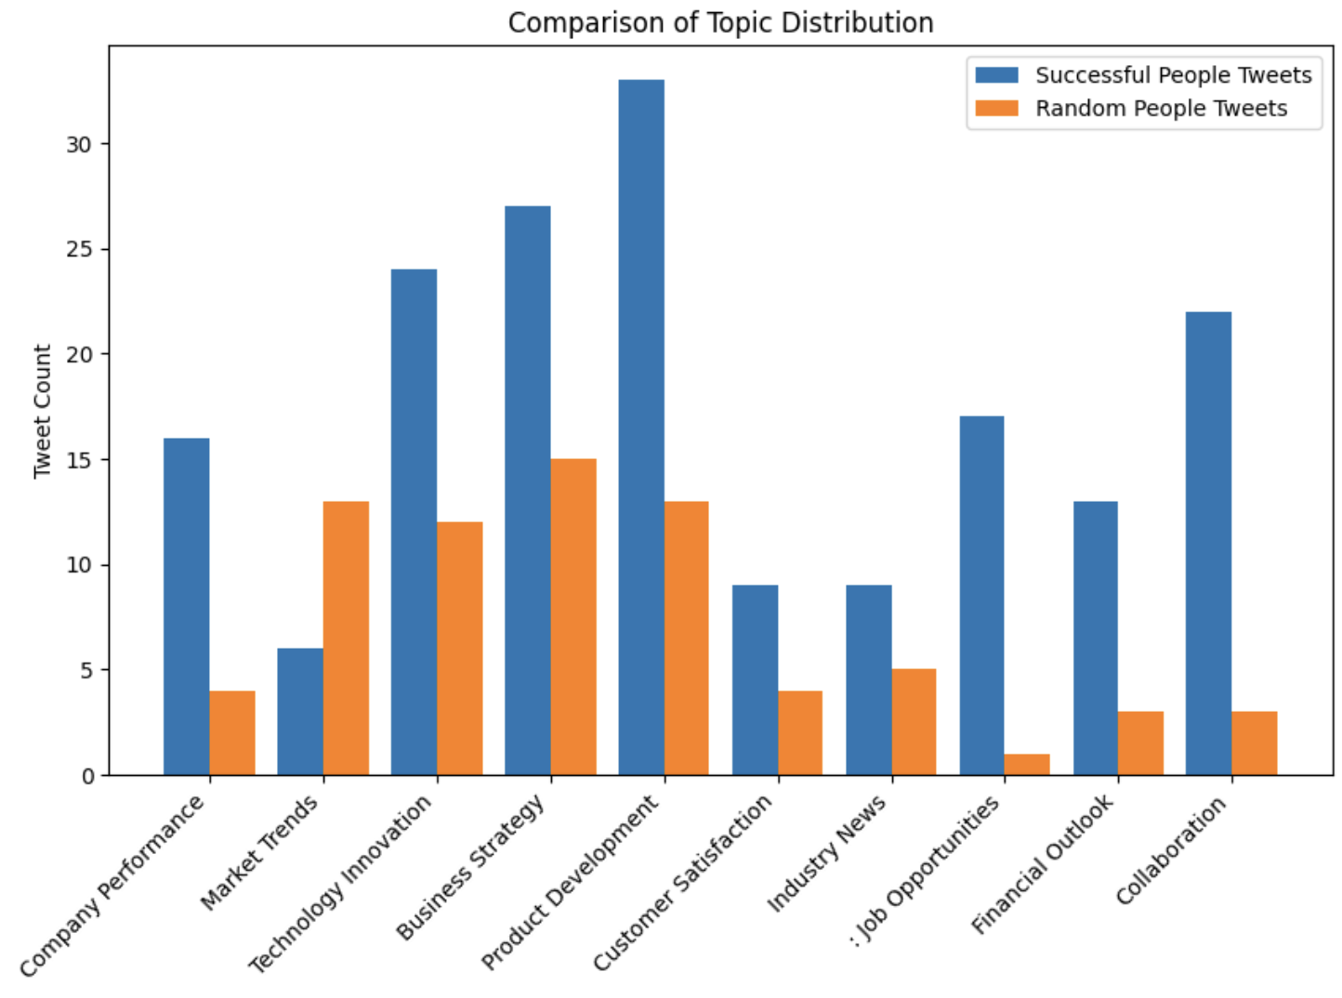
Experiments and Results(cont.)
Topic modeling with BERT and k-means clustering revealed differences in topic distribution between successful and random people.
Histogram analysis showed that successful people tweeted more about company performance, financial outlook, and business strategies, while random people tweeted more about daily market trends and current events.
The difference in topic distribution could explain the varying correlation between social media sentiment and stock trends for these two groups.

Slide 8
Conclusion and Future work
Successful people on Twitter showed a stronger correlation between sentiment and stock prices than random people, due to differences in topics and keywords discussed.
Data scarcity and limited time period analyzed may affect the generalizability of our findings.
Future work includes expanding our analysis to include sentiment data from other platforms and increasing the number of users analyzed.
We plan to incorporate advanced NLP techniques to gain deeper insights into tweet sentiment, and explore other factors such as news articles and financial reports to provide a more comprehensive view of stock market trends.

