Slide 1
Assignment 1-Implementation of Backpropagation and Training a Palindrome Network
Srihari K B, 23M0754
Frederic J Maliakkal, 23M0745
Shariq Faraz, 23M0779
Akanksha Dadhich, 23M0830
20th February, 2024

Slide 2
Problem Statement
Input: 10-bit String (of numbers)
Output: 1 if Palindrome, 0 otherwise

Slide 3
Architecture and hyperparameter details
Architecture:
Input Layer: 10
Hidden Layer:
ReLU - 2
Sigmoid - 7
Output Layer: 1
Hyperparameter details:
Learning rate: 0.05
No of epochs: 500
Dataset:
Train: 1488
Test: 496
Total: (992+992=1984)

Slide 4
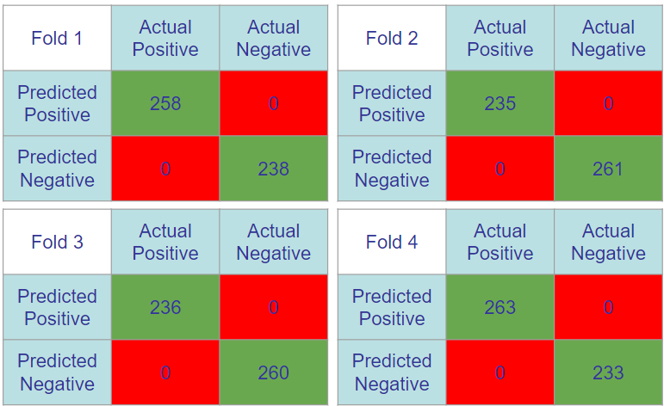
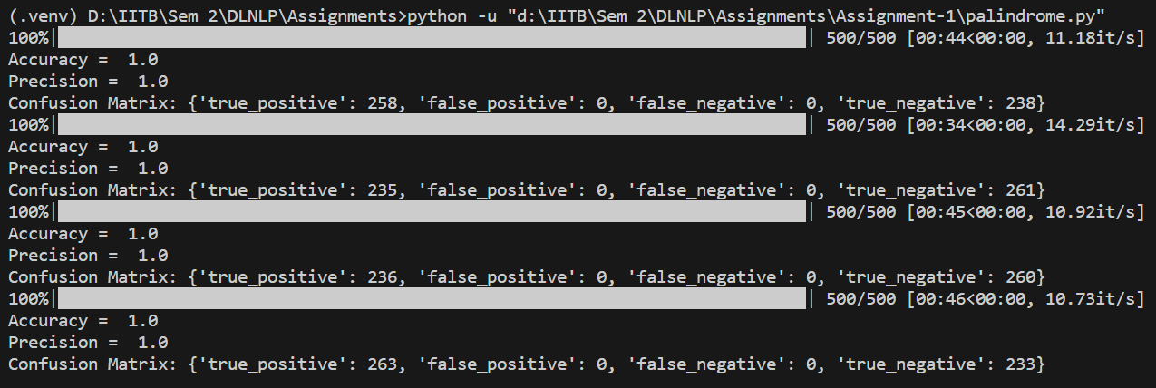
Overall performance
Accuracy: 100%
Precision: 100%
Confusion Matrix:

Slide 5
Interpretability of middle layer
Let the string S = L + R
S - complete bit string (e.g. 1001000110)
L - First 5 bits (10010)
R - Last 5 bits (00110)
S is palindrome if and only if L == reverse(R)
Hidden Layer Neurons:
Neuron 1: Outputs > 0 if L > reverse(R) else 0 Calculating (X1X10bar +X2X9bar…)
Neuron 2: Outputs > 0 if L < reverse(R) else 0 Calculating (X1barX10 +X2barX9…)
L == reverse(R) if and only if both the neurons output 0
Computation of L > reverse(R)
value(L) = x₁.b⁴ + x₂.b³ + x₃.b² + x₄.b¹ + x₅.b⁰
value(R) = -x₁₀.b⁴ - x₉.b³ - x₈.b² - x₇.b¹ - x₆.b⁰
If value(L) + value(R) > 0,
then L > reverse(R), so Neuron 1 outputs > 0
which makes the output neuron to classify as non-palindrome
It works for all bases b >= 2

Slide 6
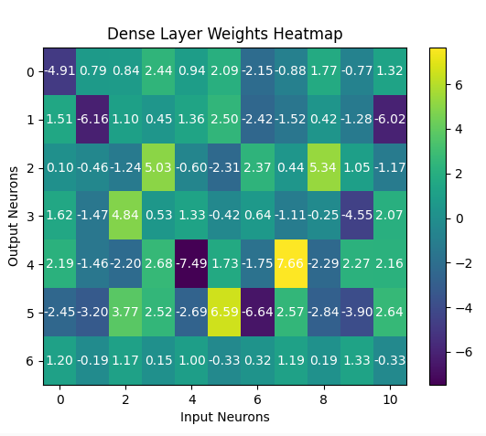
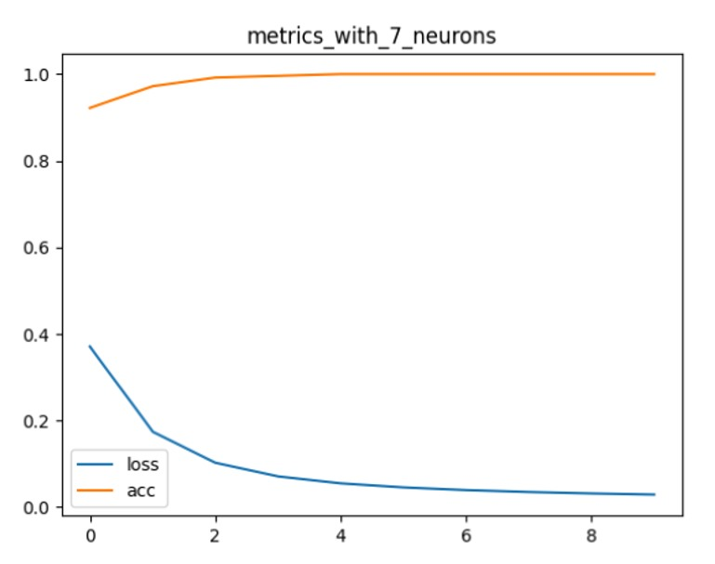
Learnings
Data Preprocessing:
Data Distribution (Class 1 - 32, Class 0 - 992)
Used oversampling to avoid dominance
Power of activation functions:
Introduces non-linearity into the network
ReLU : based on the inputs it will activate or deactivate some neuron, makes it to fit non-linear decision boundaries.
Sigmoid : in order to learn complex decision boundaries, it introduces non-linearities in the network

Slide 7
Evaluation Scheme
Correct implementation of BP from scratch: 10 marks (show the code parts that implement weight change rules)
Theory of BP clarity: 10
Overall Performance: accuracy >=90: 10 marks; 80-89: 9; 70-79: 8; 60-69: 7; 50-59: 40-49: 5; 30-39: 4. And so on
Interpretability of middle layer: 10
Demo -10

Slide 9
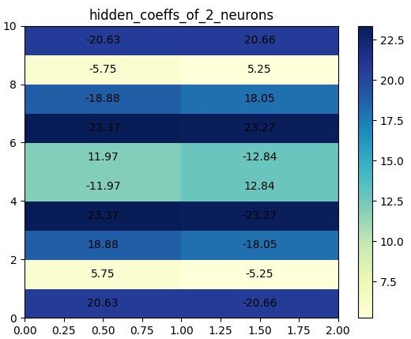
Fold 1 | Actual Positive | Actual Negative
Predicted Positive | 258 | 0
Predicted Negative | 0 | 238
Fold 2 | Actual Positive | Actual Negative
Predicted Positive | 235 | 0
Predicted Negative | 0 | 261
Fold 3 | Actual Positive | Actual Negative
Predicted Positive | 236 | 0
Predicted Negative | 0 | 260
Fold 4 | Actual Positive | Actual Negative
Predicted Positive | 263 | 0
Predicted Negative | 0 | 233

