Slide 1
Assignment 2 - Implementation of Recurrent Perceptron
Srihari K B, 23M0754
Frederic J Maliakkal, 23M0745
Shariq Faraz, 23M0779
Akanksha Dadhich, 23M0830
31st March, 2024

Slide 2
Problem Statement
Input: POS-tagged input tokens
Output: Noun chunk labels on tokens .The beginning of the chunk will be labeled 1 and the rest of the words in the chunk will be labeled 0. All other words are labeled 1.

Slide 3
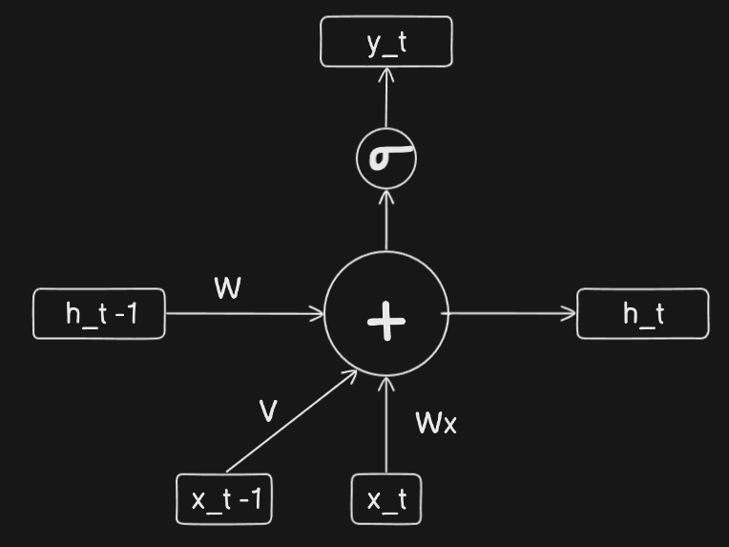
Implementation Details
Architecture Model Weights
Weight | Value
Θ | -1.13182
W | -0.840382
V_HAT | 2.8506
V_OT | -0.659793
V_NN | -1.52165
V_JJ | -1.33765
V_DT | 2.43404
W_OT | -1.99494
W_NN | 1.02471
W_JJ | -1.32869
W_DT | 1.83249
Notations:
x_t-1 : One hot vector of previous word
x_t : One hot vector of current word
h_t-1: Feedback from previous state
h_t: Feedback to next state
y_t: Output of current state

Slide 4
Overall performance
Accuracy (Total and class-wise)
Precision, recall and F1 score
5-fold cross validation (Metric: Accuracy)
 | Class 0 (Negative) | Class 1 (Positive) | Total
Accuracy | 0.56 | 0.993 | 0.84
Precision | Recall | F1 | Accuracy
0.81 | 0.99 | 0.89 | 0.84
 | Fold 1 | Fold 2 | Fold 3 | Fold 4 | Fold 5
Train | 0.86 | 0.88 | 0.88 | 0.87 | 0.86
Validation | 0.89 | 0.82 | 0.84 | 0.88 | 0.89

Slide 5
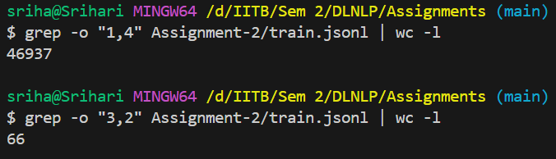
Language constraint table
Constraint | Validity
V_HAT + W_DT> Θ | True
V_HAT + W_JJ > Θ | True
V_HAT + W_NN > Θ | True
V_HAT + W_OT > Θ | True
W + V_DT + W_JJ < Θ | False
W + V_DT + W_NN < Θ | False
V_JJ + W_JJ < Θ | True
V_JJ + W_NN < Θ | False
Constraint | Validity
W + V_JJ + W_JJ < Θ | True
W + V_JJ + W_NN < Θ | True
V_NN + W_OT > Θ | False
W + V_NN + W_OT > Θ | False
W + V_OT + W_DT > Θ | True
W + V_OT + W_JJ > Θ | False
W + V_OT + W_NN > Θ | True
W + V_OT + W_OT > Θ | False
Reason for constraint failure:
Wide Distribution of Pairs: For example, there are 46,937 pairs of (OT, DT), but only 66 pairs of (JJ, NN).

Slide 6
Error Analysis
Reasons for Error:
Distribution of classes: Positive class count is twice as much as negative class count.
Distribution of POS Tags: 46,937 pairs of (OT, DT), but only 66 pairs of (JJ, NN).
Solutions:
Data Cleaning: Over sampling the minority classes and pairs.
Confusion Matrix for Test dataset | Actual Positive | Actual Negative
Predicted Positive | 30034 | 7044
Predicted Negative | 224 | 9133
Confusion Matrix for Test dataset
Dataset Distribution | Positive | Negative
Train set | 136976 | 66645
Test set | 30258 | 16177
Dataset Distribution

Slide 7
Learnings
BPTT Implementation: Successfully implemented Backpropagation Through Time (BPTT) from scratch.
Creative Input Approach: Used current and previous word as input, enhancing model performance.
RNN Power: Demonstrated the effectiveness of Recurrent Neural Networks (RNNs) in modeling sequential data.
Key Learnings: Gained insights into RNN architecture and training through hands-on implementation.
Future Applications: Potential real-world applications of the techniques learned.
Conclusion: Emphasized the importance of experimentation and creativity in machine learning.

Slide 8
Evaluation Scheme
Correct implementation of BPTT from scratch: 10 marks (show the code parts that implement weight change rules)
Overall Performance: accuracy >=90: 10 marks; 80-89: 9; 70-79: 8; 60-69: 7; 50-59: 40-49: 5; 30-39: 4. And so on
Error Analysis: 10
Inequality Table: 10
Demo: 10

Slide 9
Project - Knowledge enhanced Visual Question Answering
Task - To extract relevant triples for a given Image (I) and Multiple Choice Question (Q) from various Knowledge graphs (e.g. Conceptnet, Wordnet, Wikidata, Babelnet) and compare their results.
The key steps involved are as follows:
Textual Information Extraction: Applying triple extraction techniques to question text.
Visual Information Extraction: Apply triple extraction techniques to visual content.
Integration of Textual and Visual Triples: Combining extracted textual and visual triples.
Query Formulation: Formulating queries based on integrated triples and question text.
Answer Inference: Inferring answers by integrated triples. Deriving the most appropriate answer based on extracted information.
Results: Comparing the results obtained over various Knowledge graphs.

Slide 10
Thank you

