Slide 1
Shree L. R. Tiwari College of Engineering Department of Computer Engineering
Shree Rahul Education Society’s
SuperCert - An Anti-fraud Identity Intelligence Blockchain Solution for educational certificates
A Major Project Mid-term Presentation Submitted in partial fulfilment of the requirements of the degree of
BACHELOR OF ENGINEERING IN COMPUTER ENGINEERING
Class & Semester: BECS SEM-VIII
Group Unique ID: AY23BECSP80107
Sr. No. | Roll no. | MT | Name of the Group Members
1 | 41 | GL | GAIROLA AKANKSHA ABHAYARAM
2 | 48 | M1 | MALVE SHANKAR DINANATH
3 | 61 | M2 | SALIAN SHRIYA PAVITRA
4 | 29 | M3 | SHAIKH AMIRA
Under the Guidance of
Mr. Pravin Jangid,
Assistant Professor, CS, SLRTCE
Academic Year: AY2023-2024

Slide 2

Vision and Mission (SLRTCE)
To be a world class institute and a front runner in educational and socioeconomic development of the nation by providing high quality technical education to students from all sections of society.
Mission
To provide superior learning experiences in a caring and conducive environment so as to empower students to be successful in life & contribute positively to society.

Slide 3
Vision and Mission (CS)
To be a department of high repute focused on quality education, training and skill development in the field of computer engineering to prepare professionals and entrepreneurs of high caliber with human values to serve our nation and globe.
Mission
M1: To provide fertile academic environment for the development of skilled professionals and empowered with knowledge, skills, values, and confidence to take the leadership role and to bridge the gap between industry institute and society in the field of Computer engineering.
M2: To promote caring and interactive teaching practices in a rejoicing learning ambience with richly supported modern educational tools and techniques.
M3: To enhance and revitalize research culture to provide practical exposure and to establish synergy between teaching and research and make it an enabler for speedy progress.
M4: To pursue intensification of soft skills and personality development through interplay of achievers of all segments of our society.
M5: To provide human values to students by promoting lifelong learning ability.

Slide 4
Programme Educational Objectives (PEOs)
Programme Educational Objectives
PEO-1: To prepare the Learner with a sound foundation in the mathematical, scientific and engineering fundamentals.
PEO-2: To motivate the Learner in the art of self-learning and to use modern tools for solving real life problems
PEO-3: To equip the Learner with broad education necessary to understand the impact of Computer Science and Engineering in a global and social context.
PEO-4: To encourage, motivate and prepare the Learner’s for Lifelong¬ learning.
PEO-5: To inculcate professional and ethical attitude, good leadership qualities and commitment to social responsibilities in the Learner’s thought process.

Slide 5
Programme Outcome
Programme Outcome (Graduate Attributes)
PO-1 Engineering knowledge
PO-2 Problem analysis
PO-3 Design/ development of solutions
PO-4 Conduct investigations of complex problems
PO-5 Modern tool usage
PO-6 The engineer and society
PO-7 Environment and sustainability
PO-8 Ethics
PO-9 Individual and team work
PO-10 Communication
PO-11 Project management and finance
PO-12 Life-long learning
Programme Outcomes are the skills and knowledge which the students have at the time of graduation. This will indicate what student can do from subject-wise knowledge acquired during the programme.

Slide 6
Programme Specific Outcome
Programme Specific Outcome
PSO-1 - The graduate must be able to develop, deploy, test and maintain the software or computing hardware solutions to solve real life problems using state of the art technologies, standards, tools and programming paradigms.
PSO-2 - The graduate should be able to adapt Computer Engineering knowledge and skills to create career paths in industries or business organizations or institutes of repute.

Slide 7
Course Outcome with relevance of POs and Blooms Taxonomy Levels
CO's No. | Abbre. | Statement (Able to - ) | POs | Bloom Levels
CSM301.1 | CO1 | Apply engineering Knowledge and skill to solve Societal /Research /Innovation /Entrepreneurship problems in a group. (PO-1) | PO1 | L1, L2, L3
CSM301.2 | CO2 | Identify societal/research/innovation/entrepreneurship problems through appropriate literature surveys then evaluate problem statements and identifies objectives, processes/ modules/ algorithms/ existing solutions /alternate solutions /methods to solve the problem with best methods and processes. (PO-2) | PO2 | L4, L4
CSM301.3 | CO3 | Review state-of-the-art literature and synthesize/develop system requirements, specifications, design constraints, from larger social and professional concerns. (PO-3) | PO3 | L4, L5, L6
CSM301.4 | CO4 | Validate, Verify the results using test cases/benchmark data/ theoretical /inferences /experiments /simulations.(PO-4) | PO4 | L5
CSM301.5 | CO5 | Identify/use/create/modify/extend modern engineering tools, techniques and resources required for solution implementation. (PO-5) | PO5 | L4, L5, L6
CSM301.6 | CO6 | Use standard norms of engineering practices and understand ethics and misconduct of publication. (PO-6 and 8) | PO6, PO8 | L3, L4
CSM301.7 | CO7 | Analyze the impact of solutions in a societal and environmental context for sustainable development. (PO-7) | PO7 | L4, L5
CSM301.8 | CO8 | Develop interpersonal skills to work as a member of a group or leader. (PO-9) | PO9 | L1, L2, L3
CSM301.9 | CO9 | Communicate through technical report writing and oral presentation as per engineering standards. (PO-10) The work may result in research/white paper/ article/blog writing and publication by understanding ethics and misconduct of publication. The work may result in a business plan for entrepreneurship products created. The work may result in the patent filing. | PO10 | L1, L2, L3
CSM301.10 | CO10 | Demonstrate project management principles and financial considerations during project work. (PO-11) | PO11 | L3, L4, L5
CSM301.11 | CO11 | Demonstrate the capabilities of self-learning in a group, which leads to lifelong learning. (PO-12) | PO12 | L1-L6

Slide 8
Table of Contents
20) Class diagram
21) Activity Diagram
22) Sequence Diagram
23) Pseudocode for each module
24) Implementation plan in the form of Gantt/PERT/CPM chart, which will cover the weekly activity of mini/major projects (Completed)
25) Conclusion
26) Table showing achieved project objectives till date.
27) Table showing Project outcomes attainment levels of each Group member
28) References
Introduction
Project Background and Motivation
Problem Statement and Definition
Project Objectives
Project Importance or Research Significance
Scope and Limitation of Project
Literature Review
Proposed System
Project methodology
Requirement Analysis and Specification (SRS)
Functional requirements (Requirement Diagram)
Non-functional requirements
Feasibility study report (FSR)
Implementation plan in the form of Gantt
Deliverable
References
System Architecture/Block Diagram
Use case diagram
Data Flow diagram Level -0
Data Flow diagram Level -1

Slide 9
Introduction
‘Certificates’ are a means of verifying the credentials of individuals across domains and geographies. A paper-based certification is fallible to manipulation and susceptible to fraud. According to a report by First Advantage, a background screening company, there are more than 7,500 organisations that provide fake employment and educational certificates. There are usually two problems at play:
degrees from fake universities and fake degrees from real universities.
For higher Education the other organization verifies it by approaching universities, and university approaches to colleges which can be a very time consuming.
Proposed blockchain solution can be used as a mechanism to verify the degree obtained by the students.
Supercert resolve the issues, including, utilizing a multi-signature scheme to ameliorate the authentication of certificates; exerting a safe revocation mechanism to improve the reliability of certificates revocation; establishing a secure federated identification to confirm the identity of the issuing institution.

Slide 10
Project Background and Motivation
Project Background:
The traditional method of paper-based certificates is susceptible to manipulation, forgery, and misrepresentation. This not only undermines the credibility of educational institutions but also poses risks to employers, students, and other stakeholders who rely on accurate and verified educational credentials.
Project Motivation:
The motivation behind SuperCert, an anti-fraud identity intelligence blockchain solution for educational certificates, stems from the need to address these challenges and establish a secure, tamper-proof, and transparent system for verifying educational credentials. This solution aims to leverage the unique properties of blockchain technology to enhance the trustworthiness and authenticity of educational certificates.

Slide 11
Problem Statement and Definition
To develop a blockchain based application that could be used by the college to create immutable ledger of student’s transcripts which can be used by organization to verify it for Higher education.

Slide 12
Project Objectives
Develop a digital ledger to store the degree information about the students graduated from the college.
To promote efficiency for other institutions and organizations to verify the student’s degree.
The objective is to create a solution that can be adopted globally, that will be accurate and immutable record.
It’s aim is to minimize verification delays that often occur with manual processes.
To create a unique hash for each and every documents of students enrolled in the college as an immutable entity.
Store ,manage and upload student information and documents in a way that meets the blockchain requirements (transparency, proof of consensus).
To restore trust and credibility in the education verification process, ensuring that qualifications are accurately represented and recognized.
To promote lifelong learning and application of concepts to develop real world solutions.
To develop a blockchain using IPFS protocol to store document.

Slide 13
Project Importance
The college admin will have to login.
The application is responsible for the main logic which includes the transcript signing and issuing. The application will be designed to merge the hash of the transcript in a Merkle tree and send the Merkle root to Blockchain amidst signing by the majority of community members.
The application will be used by the organization to store student performance information which can be uniquely identified by Hash (degree, grade card) and external institutions to verify the same.

Slide 14
Scope and Limitation of Project
Scope of the Project:
The scope of this project includes the development of a web-based interface for the Anti-fraud Identity Intelligence Blockchain Solution for educational certificates.
The proposed application will be a public blockchain only allowing verified members to add information blocks to the blockchain.
The system is intended to help us create the digital relationship that will reshape the world of education and transform the old order of human affairs for the better.
Documents will be identified based on their assigned CID hash or QR code this will be sent to the student’s email-id assigned by their college.
The system will be designed using React, with a backend powered by nodejs, IPFS protocol and database.

Slide 15
Cont..
Limitations of the Project:
Implementing a blockchain solution like SuperCert requires widespread adoption by the educational institution. Achieving this can be challenging due to inertia, cost, and technological barriers.
Proposed system presently will only work for verifying grade cards.
Difficulty in transferring data from existing system to private system.

Slide 16
Literature Review
SR NO | TITLE | AUTHOR | CITATION | CONCLUSION
[1]. | “A blockchain-based educational record repository” | Bessa, Emanuel E., and Joberto SB Martins. | Bessa, Emanuel E., and Joberto SB Martins. "A blockchain-based educational record repository." arXiv preprint arXiv:1904.00315 (2019). | Case study based information on “Blockchain-based Educational Records Repository” ,which provides the basic idea of a blockchain system that could be used for issuing, verifying, revoking all kinds of certificates obtained by students.
[2]. | "Blockchain-based academic certificate verification system—a review." | Pathak, Shivani, et al. | Pathak, Shivani, et al. "Blockchain-based academic certificate verification system—a review." Advanced Computing and Intelligent Technologies: Proceedings of ICACIT 2022 (2022): 527-539. | Bird eye view to the process of academic certificate storage and verification process review, web3js used for blockchain hash verification and strong digital signature used to hash the document
[3]. | "A review on digital degree certificate using blockchain technology." | Bele, Roshani S., and Jayant P. Mehare | Bele, Roshani S., and Jayant P. Mehare. "A review on digital degree certificate using blockchain technology." IJCRT 9.2 (2021): 2320-2882. | Systematic representation of the academic certificate verification using ER diagrams, use cases etc.

Slide 17
[4]. | “Blockchain based framework for Education certificate verification” | OMAR S. SALEH, OSMAN GHAZALI, MUHAMMAD EHSAN RANA | Saleh, Omar S., Osman Ghazali, and Muhammad Ehsan Rana. "Blockchain based framework for educational certificates verification." Journal of critical reviews (2020). | This research discussed the security themes required for educational certificates verification in the blockchain.In addition to that, blockchain-based framework for educational certificate verification focusing on specific themes is proposed based on Hyperledger Fabric Framework.
[5]. | “Electronic document authenticity verification of diploma and transcript using smart contract on Ethereum blockchain” | Nero Chaniago a Parman Sukarno b , Aulia Arif Wardana c | Chaniago, Nero, Parman Sukarno, and Aulia Arif Wardana. "Electronic document authenticity verification of diploma and transcript using smart contract on Ethereum blockchain." Register 7.2 (2021): 149-163. | The system uses Ethereum blockchain to verify electronic documents like diplomas and transcripts, preventing fraud and simplifying verification. Electronic files replace print versions, reducing paper use. Each file's integrity is preserved, ensuring any alterations are detected. Blockchain transparency reduces document falsification by handling publication and verification, ensuring accurate information.
[6]. | “Decentralised Smart Contract Certificate System Using Ethereum Blockchain Technology” | K. V Raghavender(B) , S. Alankruthi, A. Akhila, T. Preethi, and M. Ashritha | Raghavender, K. V., et al. "Decentralized Smart Contract Certificate System Using Ethereum Blockchain Technology." Second International Conference on Emerging Trends in Engineering (ICETE 2023). Atlantis Press, 2023. | The proposed solution establishes a federated blockchain system for businesses, academic institutions, and students. It streamlines certificate verification, prevents data tampering, and reduces manual effort. Using SHA2–256 hashing, it ensures data integrity. The InterPlanetary File System stores documents, while the blockchain stores certificate hashes, ensuring transparency. Future directions include expanding authentication systems and eliminating fraudulent certificates.

Slide 18
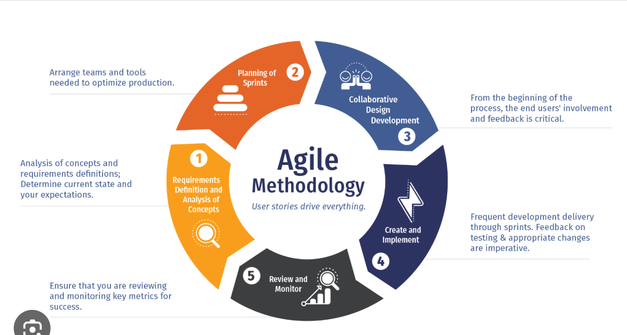
Project methodology

Slide 19







Role of Technology

Slide 20
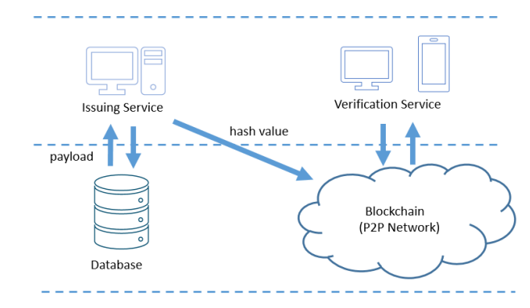

Slide 21
SRS – 1. Introduction
1.1 Purpose
The purpose of the software is to permanently store the degree information into a ledger for acquisition and verification. this document can be used to understand the working and idea for a blockchain based application system.
1.2 Document Conventions
Db: Database
1.3 Intended Audience and Reading Suggestions
The document is intended for anyone interested in understanding blockchain based application development. It can also be used by the project developer to understand the initial system design and purpose of the product.
1.4 Product Scope
A blockchain based application that will be used by the college to create immutable ledger that student’s transcripts which can be used by organization to verify the transcript for Higher education.
It will be used to eliminate cumbersome process for contacting college by the university for verification of student’s transcripts by higher education institutions in India as well as abroad.
1.5 References
https://intranet.birmingham.ac.uk/it/innovation/documents/public/experiments/blockchain-based-academic-certificate-authentication-system-overview.pdf
Bessa, Emanuel E., and Joberto SB Martins. "A blockchain-based educational record repository." arXiv preprint arXiv:1904.00315 (2019).
https://ijcrt.org/papers/IJCRT2107283.pdf (BLOCKCHAIN BASED ACADEMIC CERTIFICATE AUTHENTICATION SYSTEM)

Slide 22
SRS – 2. Overall Description
2.1 Product Perspective
SuperCert is based on the application of Indian Ministry of Education’s Inspired idea to prepare a ledger that would store the important documentation of student’s bachelors degree so it can be easily accessed and verified by the higher authority for integrity and authenticity.
2.2 Product Functions
College will a have a profile (Wallet-id) ie a login account. This will be used by the college to add the transcripts in a form of hash to the blockchain.
The student should receive the hash and QR code associated to the document uploaded to the blockchain as soon as it is added to the block.
The Institution where the student submits the transcript and verify these transcripts on the college website using the same hash and QR code.
2.3 User Classes and Characteristics
The user of this application is basically educational institutions which stores, identify and verify the transcripts.
2.4 Operating Environment
Windows 10 with high computational speed to add block to the blockchain

Slide 23
Requirement Analysis and Specification : Functional Requirements
Sr. No. | Function | User Story | Requirements | Priority
1 | Admin Login | As an existing user, I want to be able to log into my account | The system must allow users to log into their account by entering their email id and password. | Must have
2 | Upload pdf files | As an existing user, I want to be able to upload pdf files | The system must allow user to upload pdf files | Must have
3 | Generation of Hash Value | As an existing user, I want generation of unique Hash Value of respective document | The system must correctly process the information to load unique Hash Value. | Must have
4 | Mail Hash Value to respective student. | The generated hash must be sent to respective student email id | The system upon generating the unique Hash should be automatically mailed to respective student email. | Must have
5 | Provide Strong Hash Value | As an existing user, I want my generated digital signature to be unique and strong. | The system must provide unique and strong digital signature. | Must have

Slide 24
Non- Functional Requirements: Software Quality Attributes
CORRECTNESS: The system should generate an valid and appropriate hash and QR code for every student.
MAINTAINABILITY: The system should maintain all the record as well as the multiple digital signature.
USABILITY: The system should satisfy the maximum number of users needs.

Slide 25
Feasibility study report (FSR)
Sr. | Type | Description | Remark
1) | Scheduling Feasibility | The implementation of stages will be implemented in a flexible schedule. | Feasible
2) | Operational Feasibility | The application is operationally feasible because the user simply needs to log into their account by entering their college wallet id and password. | Feasible
3) | Legal Feasibility | We are going to use open sources and legal methods to develop the application. | Feasible
4) | Economic Feasibility | Maintaining and updating a blockchain system can be complex and costly. | Not feasible
5) | Technical Feasibility | The idea is very plausible because the application will be developed using open source applications which is freely available. | Feasible

Slide 26
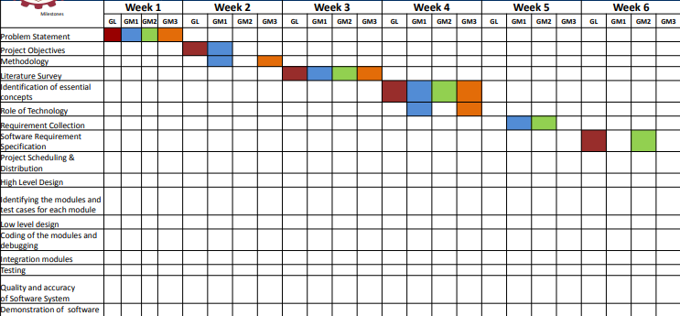
Implementation plan in the form of Gantt

Slide 27
Milestones | Week 7 |  |  |  | Week 8 |  |  |  | Week 9 |  |  |  | Week 10 |  |  |  | Week 11 |  |  |  | Week 12
 | GL | GM1 | GM2 | GM3 | GL | GM1 | GM2 | GM3 | GL | GM1 | GM2 | GM3 | GL | GM1 | GM2 | GM3 | GL | GM1 | GM2 | GM3 | GL | GM1 | GM2 | GM3
Problem Statement
Project Objectives
Methodology
Literature Survey
Identification of essential concepts
Role of Technology
Requirement Collection
Software Requirement Specification
Project Scheduling & Distribution
High Level Design
Identifying the modules and test cases for each module
Low level design
Coding of the modules and debugging
Integration modules
Testing
Quality and accuracy of Software System
Demonstration of software system

Slide 28
Milestones | Week 13 |  |  |  | Week 14 |  |  |  | Week 15 |  |  |  | Week 16 |  |  |  | Week 17 |  |  |  | Week 18
 | GL | GM1 | GM2 | GM3 | GL | GM1 | GM2 | GM3 | GL | GM1 | GM2 | GM3 | GL | GM1 | GM2 | GM3 | GL | GM1 | GM2 | GM3 | GL | GM1 | GM2 | GM3
Problem Statement
Project Objectives
Methodology
Literature Survey
Identification of essential concepts
Role of Technology
Requirement Collection
Software Requirement Specification
Project Scheduling & Distribution
High Level Design
Identifying the modules and test cases for each module
Low level design
Coding of the modules and debugging
Integration modules
Testing
Quality and accuracy of Software System
Demonstration of software system

Slide 29
Milestones | Week 19 |  |  |  | Week 20 |  |  |  | Week 21 |  |  |  | Week 22 |  |  |  | Week 23 |  |  |  | Week 24
 | GL | GM1 | GM2 | GM3 | GL | GM1 | GM2 | GM3 | GL | GM1 | GM2 | GM3 | GL | GM1 | GM2 | GM3 | GL | GM1 | GM2 | GM3 | GL | GM1 | GM2 | GM3
Problem Statement
Project Objectives
Methodology
Literature Survey
Identification of essential concepts
Role of Technology
Requirement Collection
Software Requirement Specification
Project Scheduling & Distribution
High Level Design
Identifying the modules and test cases for each module
Low level design
Coding of the modules and debugging
Integration modules
Testing
Quality and accuracy of Software System
Demonstration of software system

Slide 30
Deliverable
Prototype Application
Research Paper

Slide 31
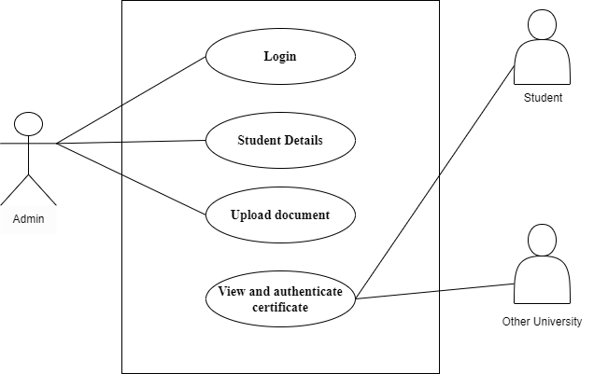
Use Case

Slide 32
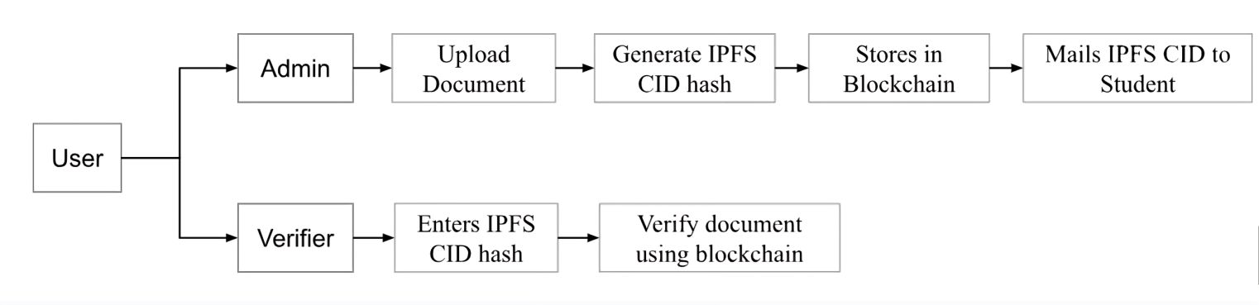
System Architectural/block diagram

Slide 33
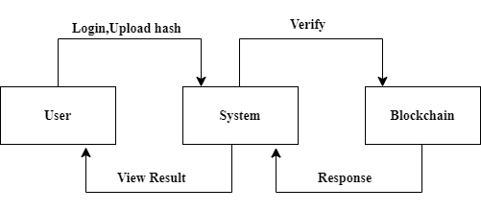
System Architectural/block diagram
For User:

Slide 34
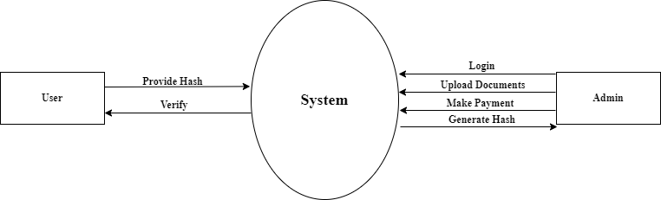
Data Flow diagram Level -0

Slide 35
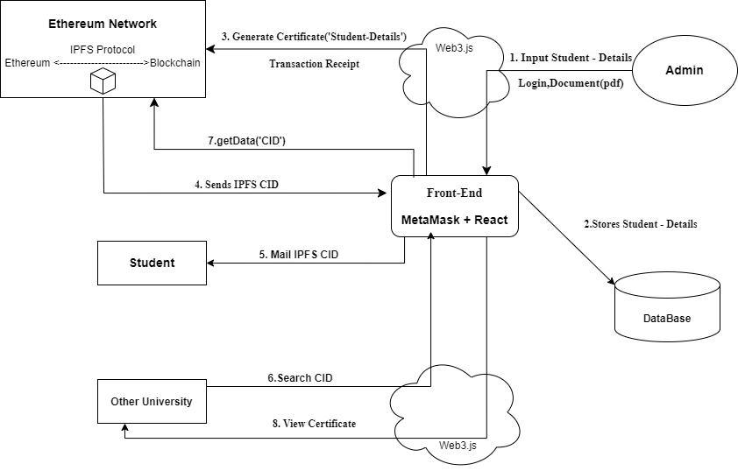
Data Flow diagram Level -1

Slide 36
Class Diagram
Admin
+email id: String
+Password:String
+upload_new_docs()

Slide 37
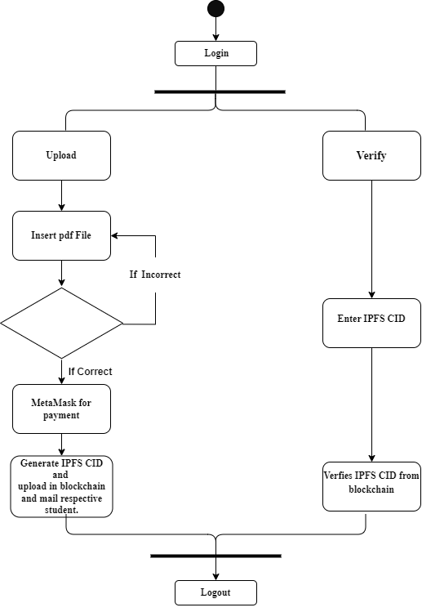
Activity Diagram

Slide 38
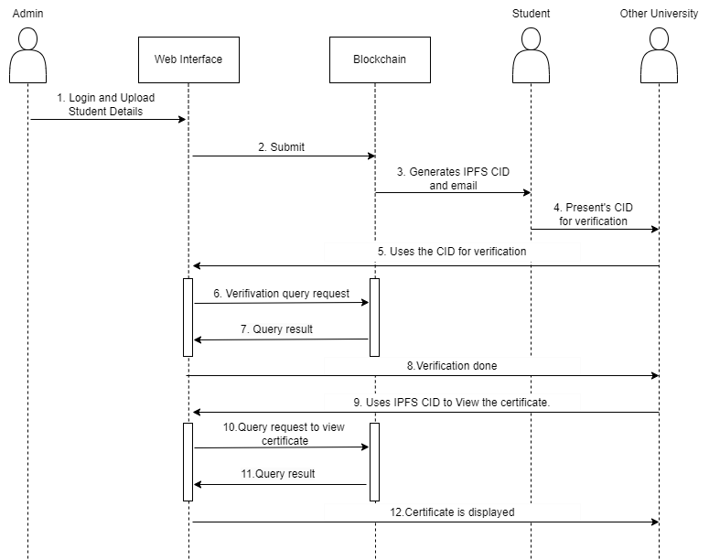
Sequence Diagram

Slide 39
Pseudocode for each module
For Admin:
// Admin enters credentials
credentialsForm = displayForm() // Display a form for the admin to enter credentials
pdfFile = credentialsForm.uploadPDF() // Admin uploads a PDF file of minimum 10MB
studentEmail = credentialsForm.getEmail() // Admin enters student email
studentName = credentialsForm.getName() // Admin enters student name
// Payment process through Metamask
paymentStatus = metamaskPayment() // Initiate payment process through Metamask
if paymentStatus == approved:
// Generate CID and store in IPFS
cid = generateCID(pdfFile) // Generate CID for the uploaded PDF file
ipfsStore(cid, pdfFile) // Store PDF file in IPFS with generated CID
// Send CID through email
sendEmail(studentEmail, "Your CID", cid) // Send generated CID to student's email

Slide 40
For Verifier:
// Verifier verifies CID
function verifyCID(cid, studentName, verifierName, organizationName):
if cidExistsInIPFS(cid):
// Open document
document = openDocument(cid) // Retrieve document associated with CID from IPFS
displayDocument(document) // Display the document to the verifier
logVerification(cid, studentName, verifierName, organizationName, "Verified") // Log verification status
return "Document opened"
else:
return "Credentials not found"

Slide 41
Conclusion
In conclusion, SuperCert represents an advanced and innovative solution for addressing the challenges associated with educational certificates, such as fraud, verification, and data security.
Certificates recorded on the blockchain becomes tamper-proof and can be easily verified by educational institutions and employers.
The system incorporates robust identity verification processes to validate the identity of applicants, making it difficult for fraudulent individuals to exploit the system.
Data security is a top priority, and SuperCert employs encryption and secure storage mechanisms to protect sensitive user information and certificates.
The use of blockchain technology enhances transparency in the certification process, fostering trust among educational institutions.
By automating the certificate verification process and reducing the administrative burden on educational institutions, SuperCert improves efficiency in the educational certification ecosystem.

Slide 42
References
[1] Bessa, Emanuel E., and Joberto SB Martins. "A blockchain-based educational record repository." arXiv preprint arXiv:1904.00315 (2019).
[2] Rustemi, Avni, et al. "A Systematic Literature Review on Blockchain-Based Systems for Academic Certificate Verification." IEEE Access (2023).
[3] K. B. Dubey and M. Goyal, ‘‘Smart certificate using blockchain,’’ J. Comput. Sci.,vol. 18, no. 9, pp. 877–884, Sep. 2022, doi: 10.3844/jcssp.2022.877.884.
[4] San, A. M., Chotikakamthorn, N., & Sathitwiriyawong, C. (2019). Blockchain-based Learning Credential Verification System with Recipient Privacy Control. 2019 IEEE International Conference on Engineering, Technology and Education (TALE).doi:10.1109/tale48000.2019.9225878
[5] Q. Tang, ‘‘Towards using blockchain technology to prevent diploma fraud,’’ IEEE Access,vol. 9, pp. 168678–168688, 2021, doi: 10.1109/ACCESS.2021.3137901.
https://intranet.birmingham.ac.uk/it/innovation/documents/public/experiments/blockchain-based-academic-certificate-authentication-system-overview.pdf
https://ijcrt.org/papers/IJCRT2107283.pdf BLOCKCHAIN BASED ACADEMIC CERTIFICATE AUTHENTICATION SYSTEM.

Slide 43
Table showing Project outcomes attainment levels of Project Group member
COs | Statement | Mapped POs | Mapped Bloom Levels | Achieved attainment level 3- Excellence, 2- Good, 1-Fair
 |  |  |  | GL | GM1 | GM2
CO1 | Able to - Apply engineering Knowledge and skill to solve Societal /Research /Innovation /Entrepreneurship problems in a group. (PO-1) | PO1 | L1, L2, L3 | 3 | 3 | 3
CO2 | Able to - Identify societal/research/innovation/entrepreneurship problems through appropriate literature surveys then evaluate problem statements and identifies objectives, processes/ modules/ algorithms/ existing solutions /alternate solutions /methods to solve the problem with best methods and processes. (PO-2) | PO2 | L4, L4 | 2 | 2 | 3
CO3 | Able to - Review state-of-the-art literature and synthesize/develop system requirements, specifications, design constraints, from larger social and professional concerns. (PO-3) | PO3 | L4, L5, L6 | 2 | 2 | 3
CO4 | Able to - Validate, Verify the results using test cases/benchmark data/ theoretical /inferences /experiments /simulations.(PO-4) | PO4 | L5 | 3 | 3 | 3
CO5 | Able to - Identify/use/create/modify/extend modern engineering tools, techniques and resources required for solution implementation. (PO-5) | PO5 | L4, L5, L6 | 3 | 2 | 3
CO6 | Able to - Use standard norms of engineering practices and understand ethics and misconduct of publication. (PO-6 and 8) | PO6, PO8 | L3, L4 | 3 | 3 | 3
CO7 | Able to - Analyze the impact of solutions in a societal and environmental context for sustainable development. (PO-7) | PO7 | L4, L5 | 3 | 3 | 3
CO8 | Able to - Develop interpersonal skills to work as a member of a group or leader. (PO-9) | PO9 | L1, L2, L3 | 3 | 3 | 3
CO9 | Able to - Communicate through technical report writing and oral presentation as per engineering standards. (PO-10) | PO10 | L1, L2, L3 | 2 | 2 | 2
 | The work may result in research/white paper/ article/blog writing and publication by understanding ethics and misconduct of publication. |  |  | 2 | 2 | 2
 | The work may result in a business plan for entrepreneurship products created. |  |  | 2 | 2 | 2
 | The work may result in the patent filing. |  |  | 2 | 2 | 2
CO10 | Able to - Demonstrate project management principles and financial considerations during project work. (PO-11) | PO11 | L3, L4, L5 | 3 | 3 | 3
CO11 | Able to - Demonstrate the capabilities of self-learning in a group, which leads to lifelong learning. (PO-12) | PO12 | L1-L6 | 3 | 3 | 3

Slide 44


