Slide 1
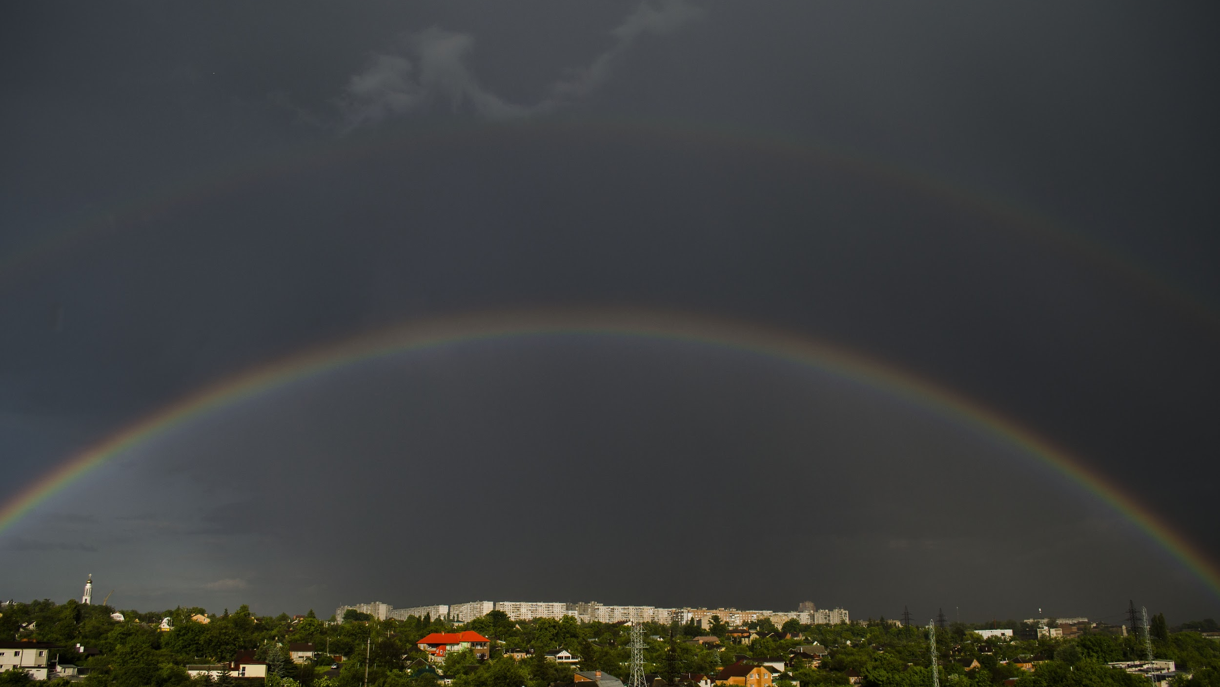
EXPLORE YOUR CITY

Slide 2
ABSTRACT
1. Know the importance of Exploring a new City.
2. Find new people and make a good social network.
3. Learn to adapt the change
4. Get Real life education
5. Understand the real concept of Exploring.

Slide 3
CONTENTS
1. Introduction
2. Importance of Exploring
3. Project
4. Comparison
5. Conclusion

Slide 4
INTRODUCTION
Exploring a new city refers to travel to a new place to learn about it and become familiar with it.
Nowadays, as we all think twice before stepping out from home due to covid-19 pandemic, it is good to know about new cities before moving in.

Slide 5
IMPORTANCE OF EXPLORING
Exploration leads to knowledge and wisdom. It makes you confident and also takes you at a stage where you know the place a bit closely than others as you explore.
You get real life education by meeting new people and learn about their language, culture & behaviour.

Slide 6
ABOUT PROJECT
This is a simple project made by using web development skills. The aim of this project is to display information about Yavatmal City it includes various domains like food, travel, education, etc
The project has been prepared keeping in mind that when a new student from a different city moves to Yavatmal. He/she should have all idea about whole Yavatmal city.

Slide 7
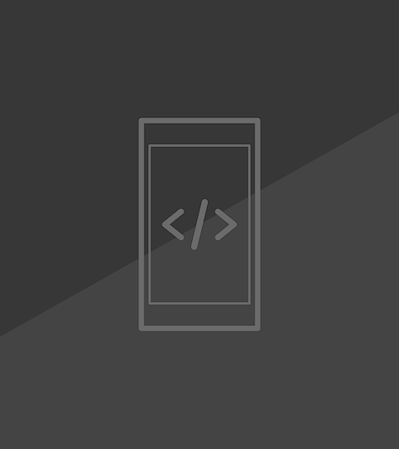
TECH USED IN PROJECT
HTML (Hyper Text Markup Language):
Defines the structure of the content.
CSS (Cascading Style Sheet):
Defines the look and feel of the content.

Slide 8
COMPARISON
Exploreytl .com
1. Shows the true data that you can trust.
2. Everything thing at one place.
3. Made especially for yavatmal city
4. No advertisements
Other platforms :
1. Shows a lot of fake & useless data
2. Different sites for different domains
3. Includes data of related cities
4. Contains interrupting advertisements

Slide 9
CONCLUSION
Thus we have understood the concept of exploring a new city. We have also seen a website project as an example for better understanding.

Slide 10
THANK YOU !
Bhavesh
Karnewar

