Slide 1
Machine Learning Assignment 2 Case Study Topic: Face Recognition Using Neural Networks
By
23B61A0553 R. Akanksha Rani
23B61A0544 N. Praveen
23B61A0546 N. Varun Teja
23B61A0547 N. Pushpan
23B61A0549 P. Lohith Reddy
23B61A0550 P. Prem Kumar

Slide 2
Introduction
Face recognition is an important application of Artificial Intelligence (AI) and Artificial Neural Networks (ANNs).
It is used to identify or verify a person based on facial images.
Face recognition systems are widely applied in security, surveillance, attendance systems, and authentication.
Artificial Neural Networks are effective in learning complex facial features and patterns.
This case study focuses on developing a face recognition system using an ANN model.
The system uses the AT&T Face Dataset along with custom face images.

Slide 3
Problem Statement & Objective
Traditional methods fail under variations in lighting, pose, and expressions need an intelligent system for accurate face recognition.
To study the working of neural networks in face recognition.
To preprocess facial image data for effective training.
To train a neural network model using backpropagation.
To test the trained model on unseen face images.
To analyze performance, challenges, and limitations of the system.

Slide 4
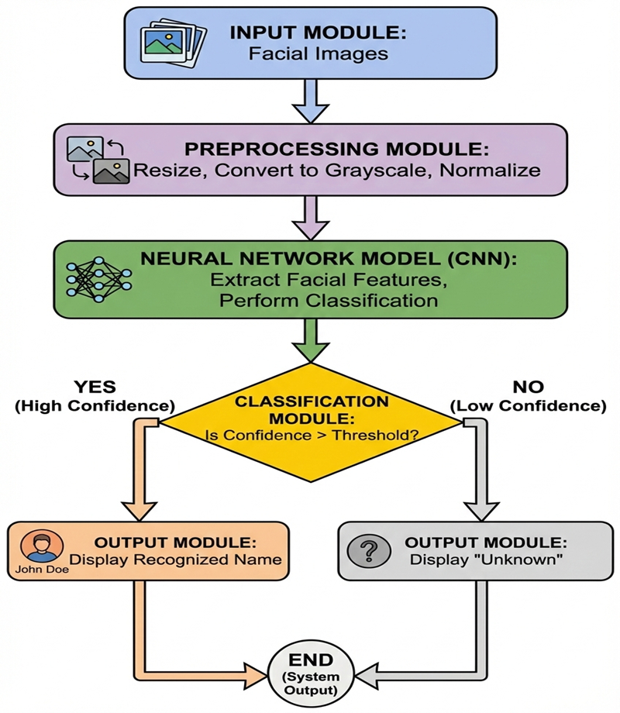
System Architecture
Input face image
Image preprocessing module
CNN-based feature extraction
Classification and confidence analysis
Output as recognized name or “Unknown”
Dataset Used:– AT&T Dataset https://www.kaggle.com/datasets/kasikrit/att-database-of-faces

Slide 5
Implementation
The face recognition system was implemented using Python due to its strong support for machine learning and image processing.
TensorFlow and Keras were used to design and train the neural network model.
OpenCV was used for image loading, resizing, grayscale conversion, and normalization.
A Convolutional Neural Network (CNN) was trained using supervised learning and backpropagation.
The trained model was tested on unseen images to evaluate recognition performance.
A confidence-based threshold was applied to classify faces as known or unknown.

Slide 6
Results and Output
Images were successfully preprocessed and standardized.
The model achieved 85–90% accuracy on test data.
Known faces were recognized correctly.
Unknown faces were detected using a threshold.
The system generalized well to unseen images.
Face verification (same/different) was successfully implemented.

Slide 7
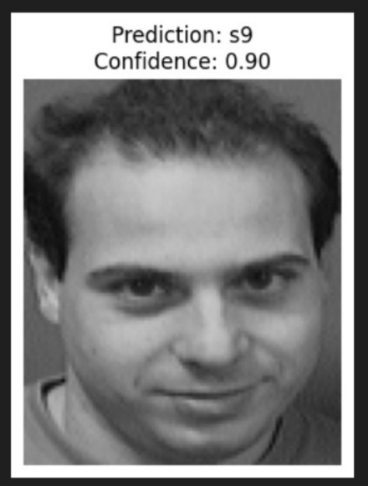

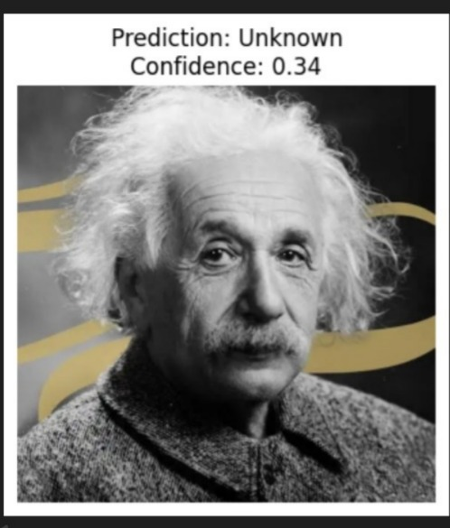
Face Recognition on AT&T Dataset
Face Recognition on Custom Dataset
Unknown Face Recognition

Slide 8
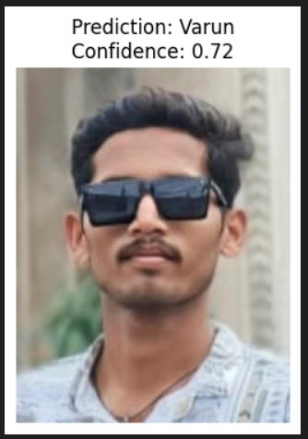
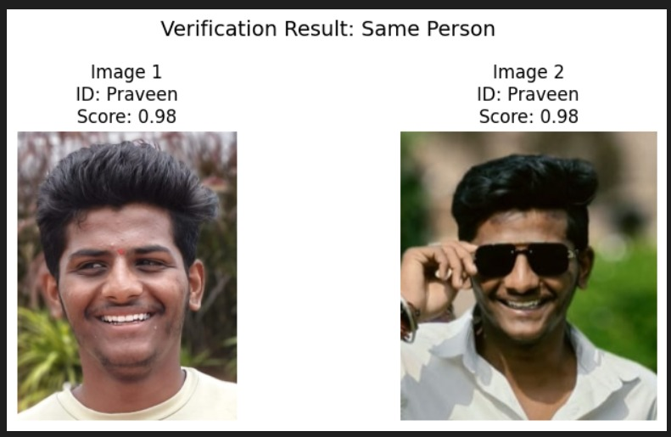
Face Recognition on Custom Dataset
Face Comparison – Same Person

Slide 9
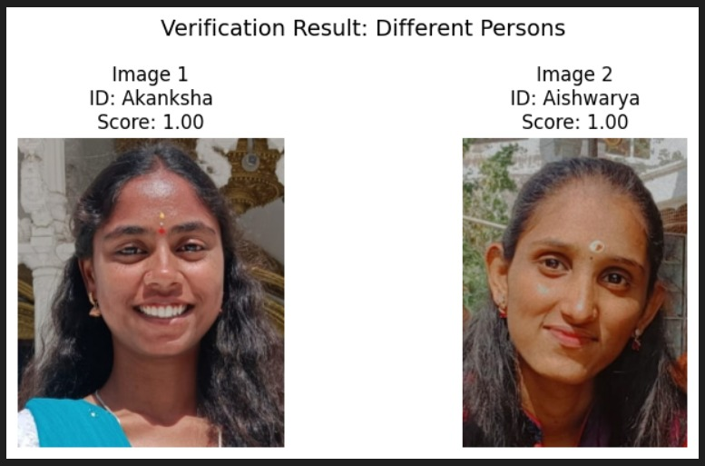
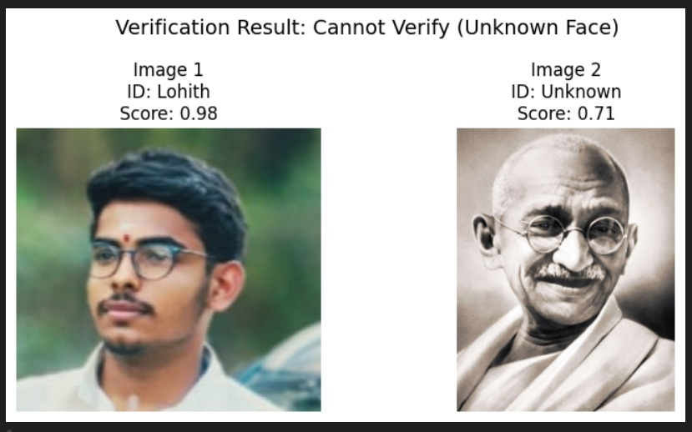
Face Comparison – Different Persons
Face Comparison – Unknown Persons

Slide 10
Limitations & Conclusion
The system was trained on a small dataset, which limits generalization.
Performance may vary with lighting, pose, and image quality.
Unknown faces may sometimes be mapped to the closest known class.
A neural network–based face recognition system was successfully implemented and evaluated. The system demonstrated effective recognition, unknown detection, and face verification.

