Slide 1

Sentiment Analyzer

Slide 2

Introduction
The primary goal of this application is to analyze movie reviews and determine whether they are positive or negative.
This is useful for understanding how people perceive a movie and can be applied in various contexts, such as recommendations, box office predictions, and social media analysis.

Slide 3

AI algorithms and techniques used
Naive Bayes Classifier The first technique is the Multinomial Naive Bayes classifier, a probabilistic algorithm based on Bayes' theorem. It works by calculating the probability of a review belonging to a certain class (positive or negative) given the words in the review. The algorithm makes the assumption that the presence of a word in a review is independent of the presence of other words, which simplifies the calculations.
VADER (Valence Aware Dictionary and sEntiment Reasoner The second technique is VADER, a sentiment analysis tool specifically designed for social media content. It is based on a dictionary of words with pre-assigned sentiment scores, taking into account the intensity of sentiment and the context of each word. VADER's SentimentIntensityAnalyzer calculates the sentiment score of a given text, which can then be used to classify the review as positive or negative. their predictions.

Slide 4
Libraries used in the application
Pandas: Pandas is a widely-used data manipulation library in Python. We use it to read the CSV files containing movie reviews and concatenate them into a single DataFrame.
Scikit-learn: Scikit-learn is a popular machine learning library in Python. We use several components from this library, including
nltk: NLTK (Natural Language Toolkit) is a powerful library for working with human language data. In this application, we use the SentimentIntensityAnalyzer class from the nltk.sentiment module to perform sentiment analysis using the VADER technique.

Slide 5

Alternate Algorithms for the Application.
Logistic Regression: Logistic Regression is a widely used algorithm for binary classification tasks. It models the probability of a certain class (e.g., positive sentiment) given the input features. Logistic Regression can perform well in sentiment analysis tasks, especially when the data is linearly separable. However, compared to Naive Bayes, Logistic Regression can be slower to train, especially with large datasets.
Support Vector Machines (SVM): SVM is another popular algorithm for binary classification tasks. It aims to find the hyperplane that best separates the classes with the largest possible margin. SVM can handle non-linear classification problems using kernel functions, making it more versatile than Naive Bayes. However, SVM can be computationally expensive, especially for large datasets and when using complex kernels.
Random Forest: Random Forest is an ensemble learning method that constructs multiple decision trees and combines their outputs to make a final decision. This approach can reduce overfitting and improve the generalization performance. Random Forest can also handle both linear and non-linear classification problems. However, compared to Naive Bayes, Random Forest can be slower to train and requires more memory due to the construction of multiple trees.

Slide 6
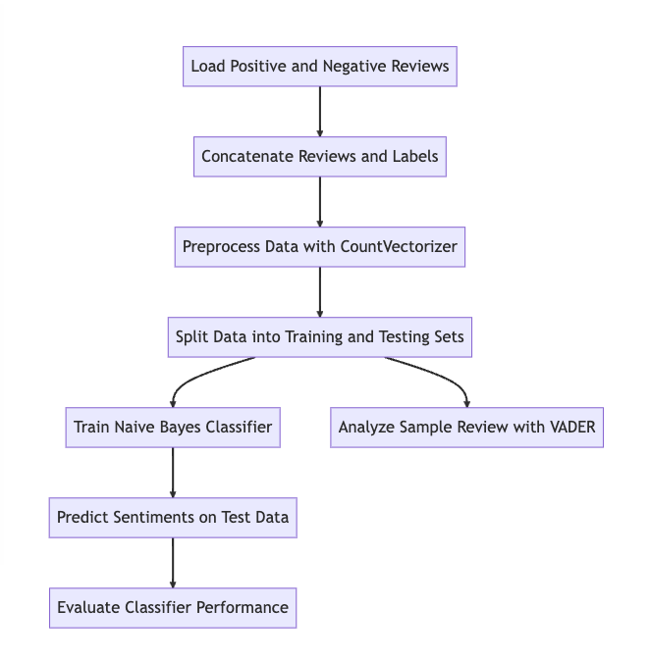
Flowchart Diagram

Slide 7
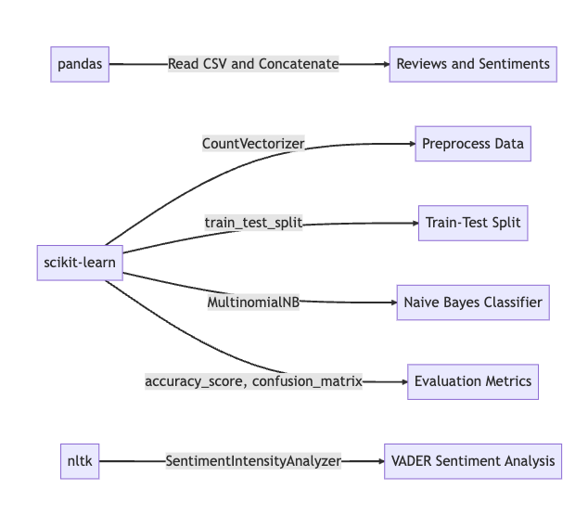
Components Diagram

Slide 8

Results

