Slide 1
NLP Project (Aspect Based Sentiment Analysis) - Group 18
^{Akanksha Shrimal (MT20055)}
^{Shivank Agrahari (MT20096)}
^{Taral Jain (2019392)}

Slide 2
Problem Statement
Aspect Based Sentiment Analysis = Aspect Term Extraction + Aspect Polarity Detection
Our goal is to identify the aspects of given target entities and the sentiment expressed towards each aspect..
Sentiment Analysis is used in process of analysing tweets, blog posts, or comments, categorising the users’ perspectives in order to determine consumer sentiment about the product.
In the sentence “The battery life of this smartphone is good but camera is poor”, ABSA assigns the aspect term battery as positive sentiment and camera as negative.

Slide 3
Related Works
Aspect Term Extraction
Filter based methods like noun, adj, adv indicate aspect ( manually modified features)
Sequential Models HMM and CRF (can learn features but require labelled data)
Deep Learning methods and sequence labelling (BIO) came into picture.
LSTMs and RNNs with CRF (conditional random field) and other sequence labelling models. Currently BERT also used.
Aspect Polarity Classification
Machine Learning based classification task : models SVM, etc features like lexicons, POS tagging (required to find features)
Deep Learning methods : LSTMs and RNNs without consideration of target (target sentence interaction is important for polarity detection)
TD-LSTM and TC-LSTM, PG-CNN models considering target in classification
Attention Based methods : AE-LSTM and ATE-LSTM
Attention and Best Based Models (self-Attention) to capture relationship between target and sentence

Slide 4
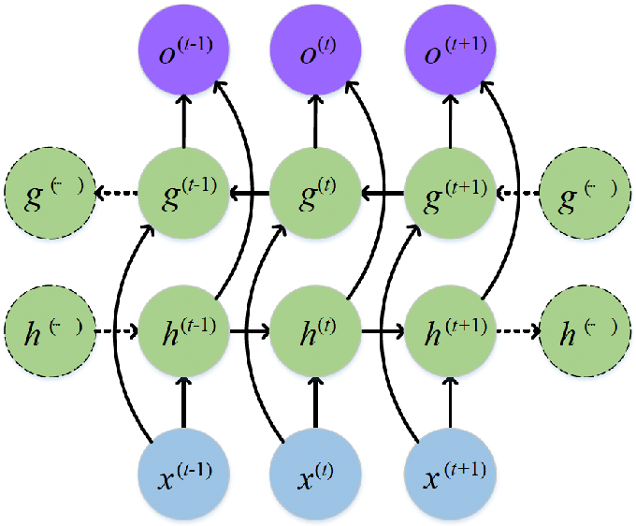
Methodology
For Aspect Term Extraction
Baseline: LSTM Model
B I O
Aspect Labels
Softmax
BiLSTM
Input Embedding
Image Source: https://www.researchgate.net/figure/Structure-of-a-bidirectional-RNN_fig2_318332317

Slide 5
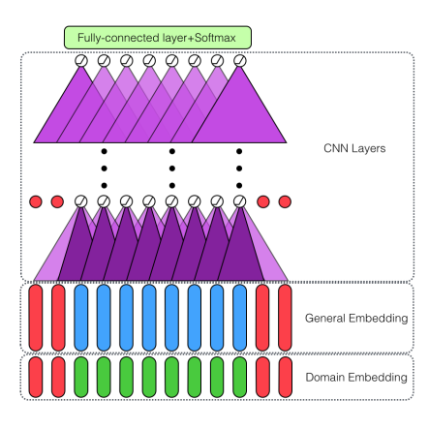
Methodology
For Aspect Term Extraction
Baseline: CNN Model
||||||||||||||||||||||||
Bert Embedding
Image is referenced from Double Embeddings and CNN-based Sequence Labeling for Aspect Extraction
Hu Xu, Bing Liu, Lei Shu, Philip S. Yu

Slide 6
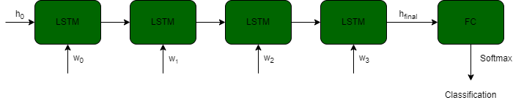

Methodology
APC : Aspect Polarity Classification
Baseline models
Standard LSTM without aspect consideration
LSTM with Aspect Embedding : AE- LSTM

Slide 7
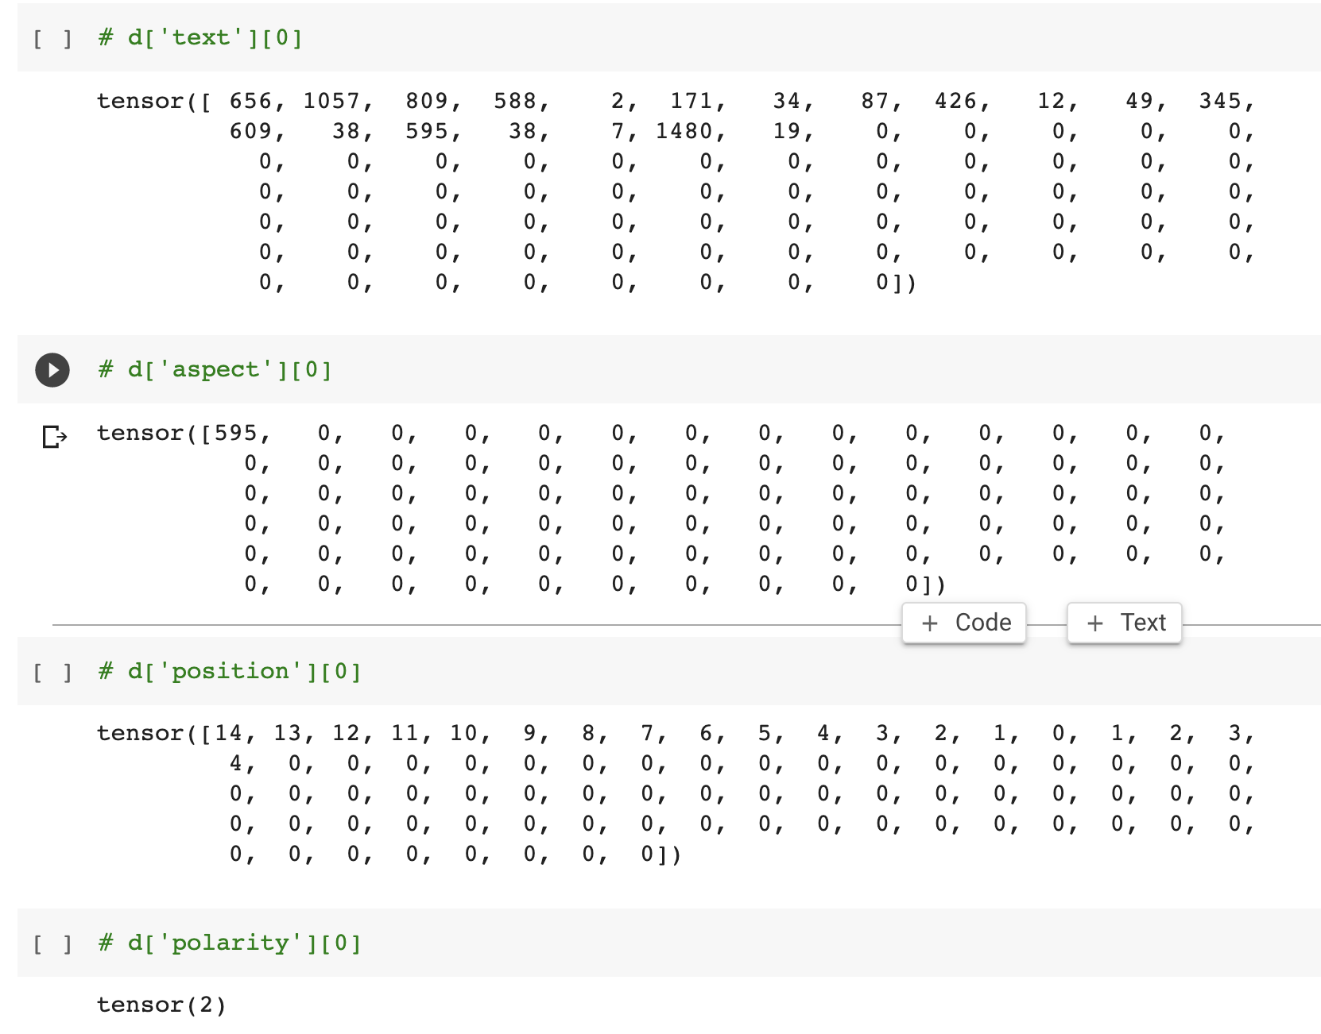
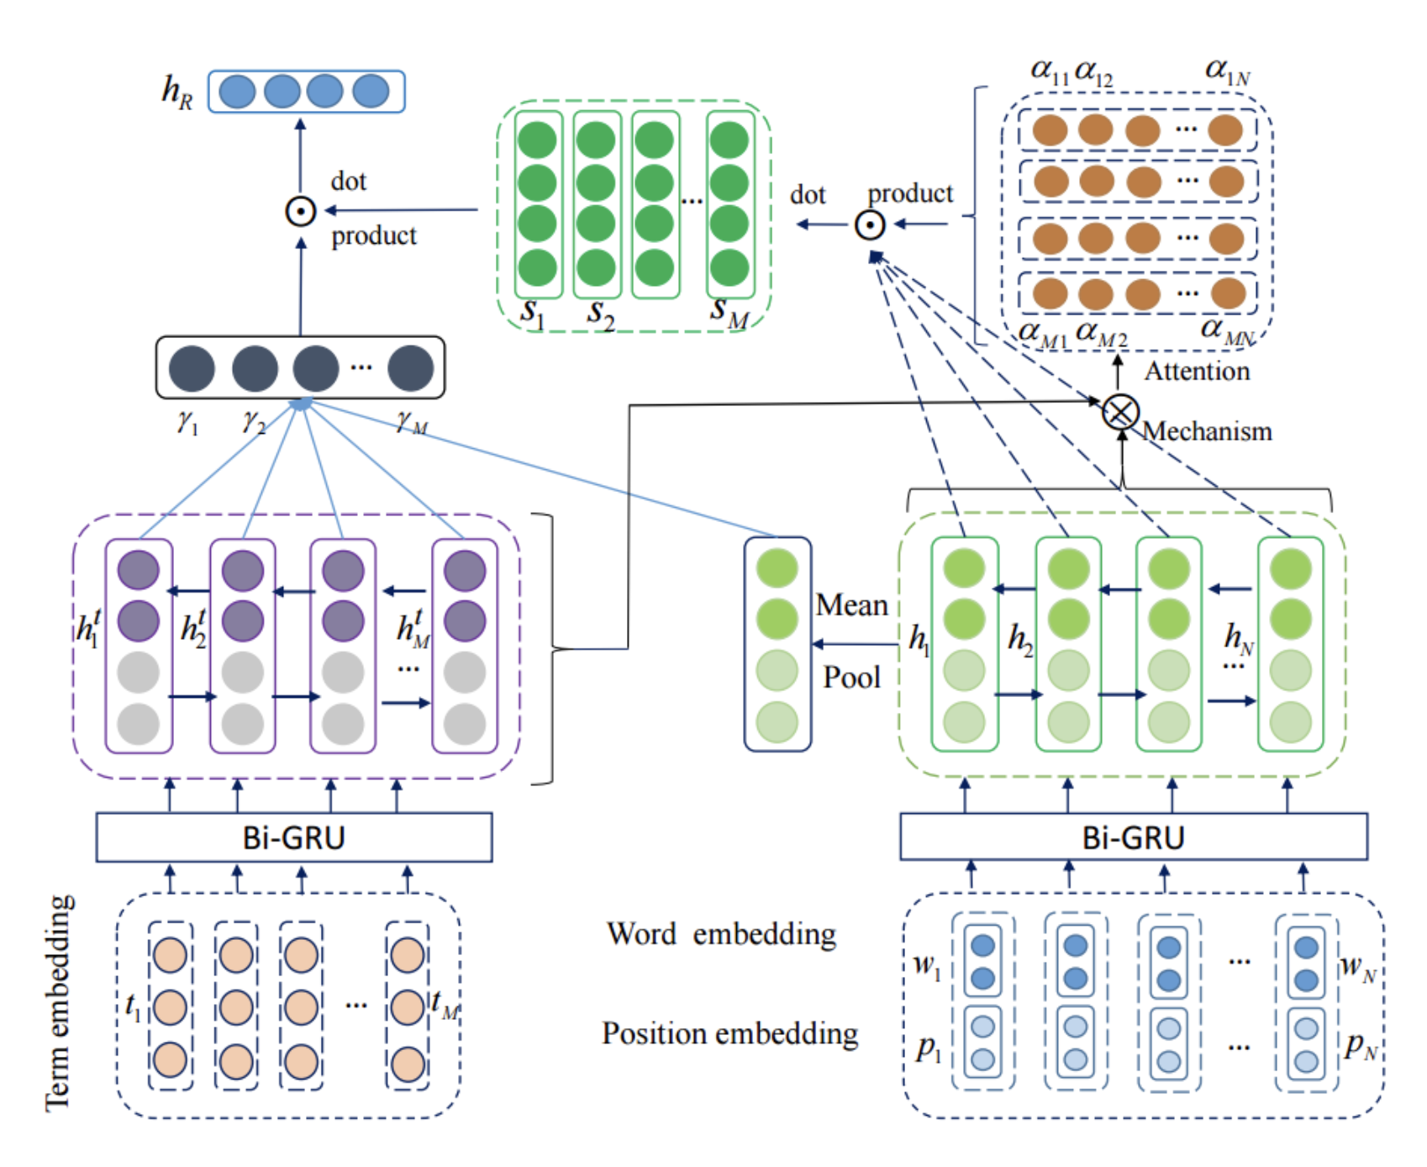
Methodology
APC : Aspect Polarity Classification
Final model : PBAN (Position Aware Bi-Directional Attention Network)
Data Model
Features
Position Embedding considered
Bi-directional Attention
2 GRU and Attention weights
Term and Word Embedding GLove
Captures relation between aspect and surrounding words

Slide 8
Dataset & Preprocessing
Datasets are SemEval 2014 Restaurant and Laptop, contains 3041 and 3045 customer reviews.
Data is preprocessed and sentiments are put into three major classes: Positive, Negative, and Neutral.
If a sentence contains two different aspects it is replicated into two different instances one concerning each aspect.
In total 4 different features are required namely: text, aspect_text, position_information and sentiment.
The text contains tokenized words (indices) padded to the maximum length sentence in the dataset.

Slide 9
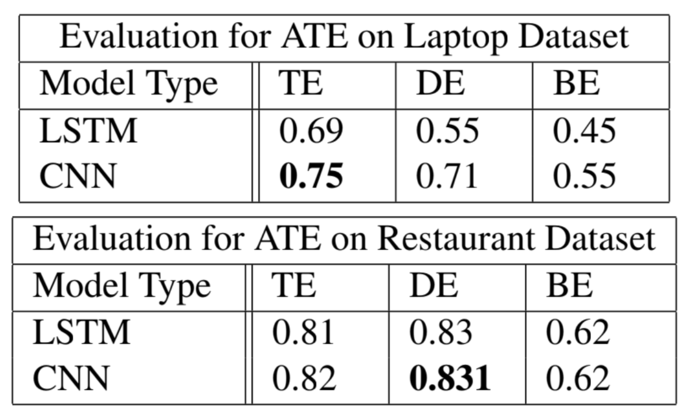
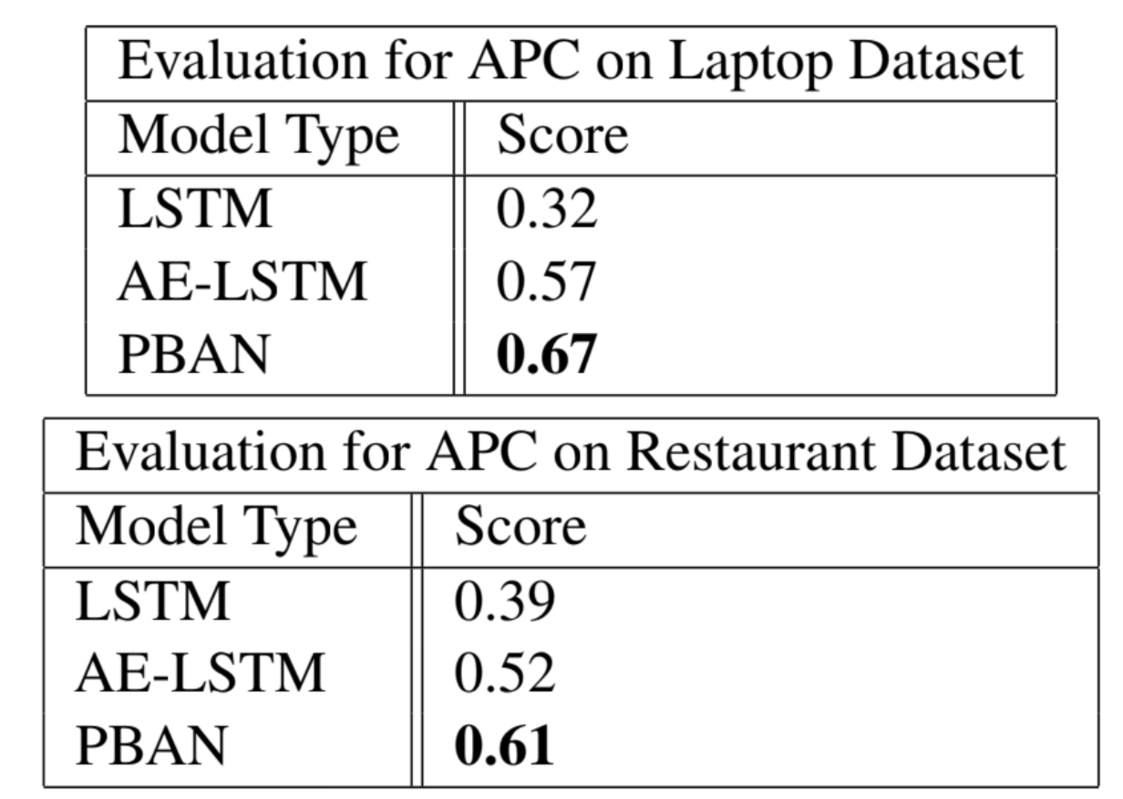
Results
ATE
APC

Slide 10
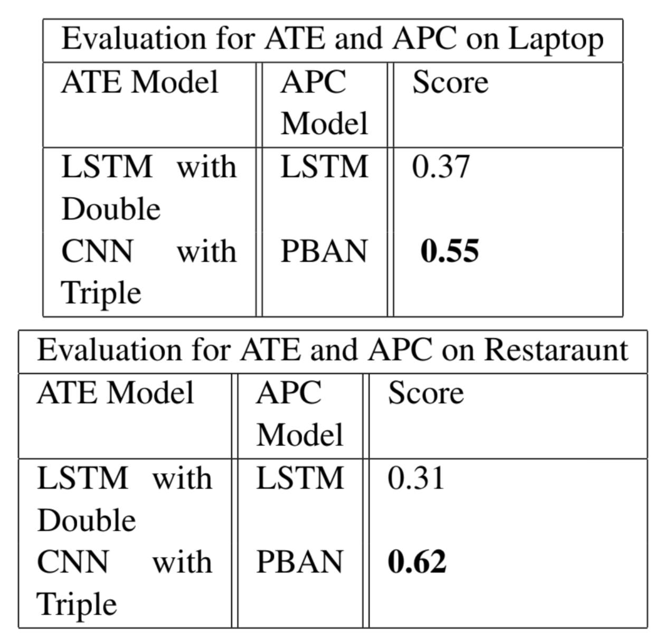
Results
ATE and APC Integrated Results

Slide 11
Analysis
Nature of datasets for this problem are always imbalanced as aspect terms are very less as compared to full length of sentence.
We have used different combination for embeddings for both the models, we noticed that triple embedding based input vectors improved model performance.
Adding Dropout or pooling layer wasn’t very helpful in aspect term extractraction and resulted into decrease in performance. Wu. et . al mentions , NLP tasks requires rich features.

Slide 12
Results
We present our analysis on both the sub-tasks separately.
CNN with Triple Embedding for ATE and PBAN for APC performs the best.
We concluded that embeddings play a crucial role in model training and with rich embeddings result can be improved.
Understanding the relationship between aspect and words is important for APC task which is done through Bi-Directional Attention.

Slide 13
Future Work
We can train Bert based Models which utilizes self attention and multi head attention for capturing refined information.
We can use different domain embedding depending upon prior sentence category classification for extracting aspects.

Slide 14
Project Contributions
Akanksha Shrimal
APC task, Literature Review, Report Work
Shivank Aghari
ATE task, Literature Review, Report Work
Taral Jain
Literature Review, Report Work, Middleware Code support, Frontend HTMl code.

Slide 15
Thank You

