Slide 1
Machine Learning (CSE543)
Distracted Driver Detection
Akanksha Shrimal (MT20055)
Akhil Majahan (MT20107)
Prabal Jain (MT20115)
End Term Presentation

Slide 2
Introduction :
Problem Domain:
Our Goal in this Project is to is to detect if the car driver is driving safe or performing any activity that might result in an accident or any harm to others.
Various Machine Learning , Deep Learning (CNN) Algorithms are used to classify the Provided images into Different category of Distraction.
Approximately 1.35 million people die every year as a result of road traffic crashes
Road traffic crashes cost most countries 3 % of their gross domestic Product
Road traffic injuries are the leading cause of death for children and young adults aged 5-29
Source : World Health Organization

Slide 3
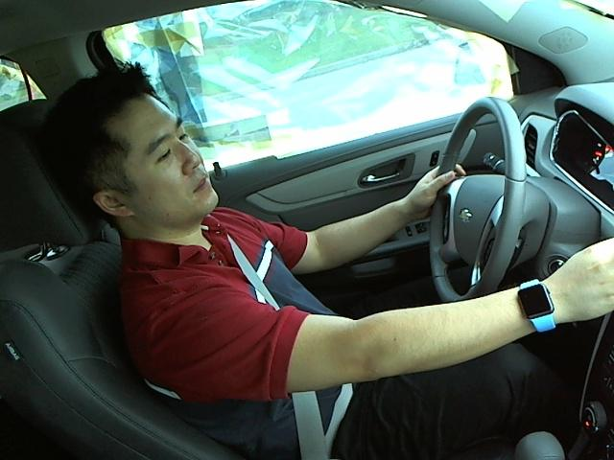

Dataset:
Data Preprocessing:
Here we will use pixels as features for our Training Algorithms :
Image Resize to 64x64 RGB Image
64x64 coloured Image will be used for Feature Extraction Algorithms
(Below Figure shows original image and resize image)
Also For Deep Learning Algorithms (CNN )we have Performed on 224x224x3 as well as 64x64x3
We have used the Dataset from Kaggle (State Farm Distracted Driver Detection)
The dataset contains 22424 driver images in total and has 10 classes
The 10 classes are Safe driving , Texting(right hand) ,Talking on the phone (right hand),Texting (left hand) ,Talking on the phone (left hand), Operating the radio ,Drinking , Reaching behind , Hair and makeup , Talking to passenger(s)
The images are coloured and have 640*480 pixels.
Approx 70k unlabelled images

Slide 4
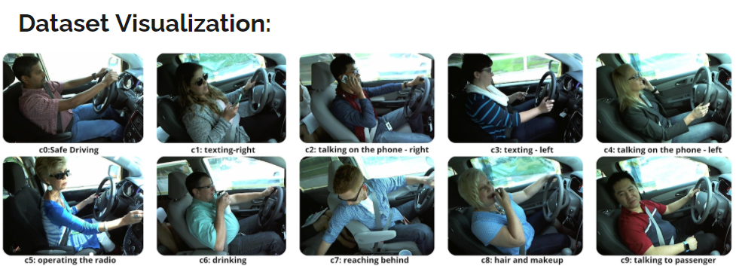
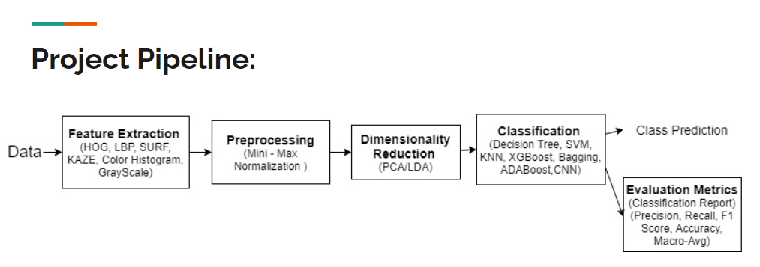

Slide 5
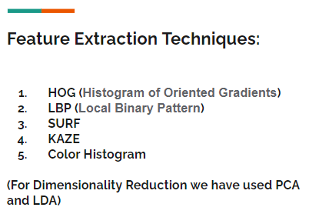
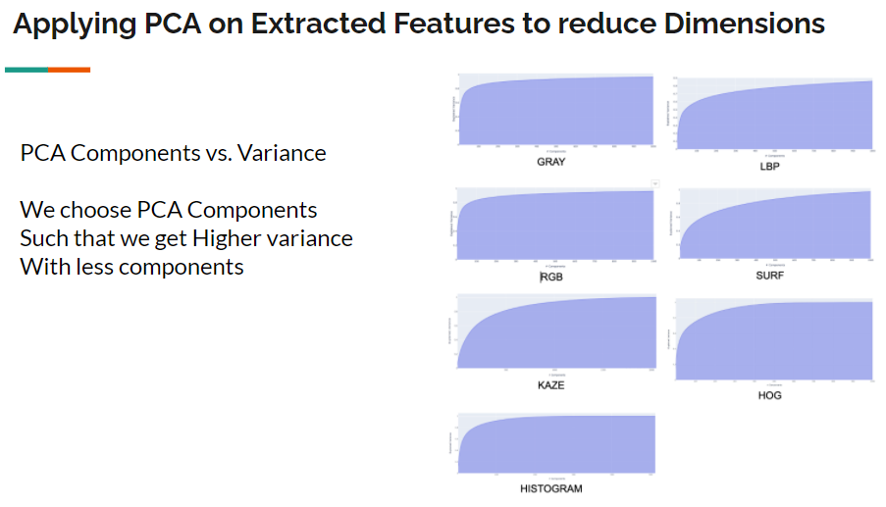
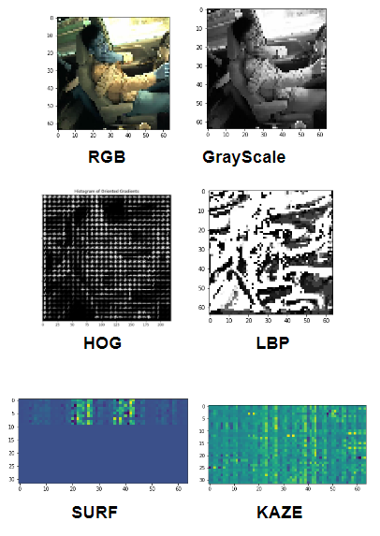
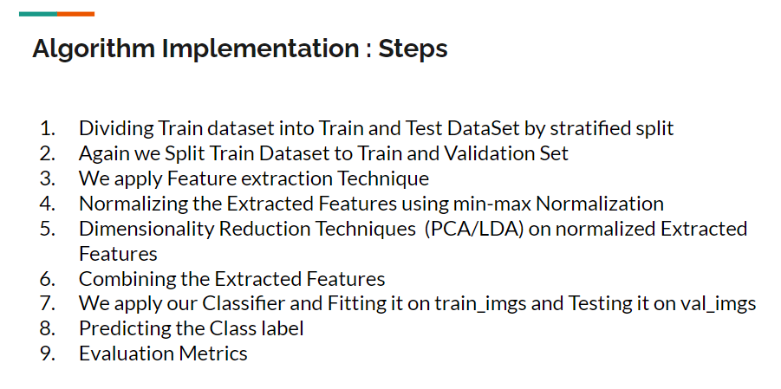
Visualization :
Feature Extraction Techniques:

Slide 6
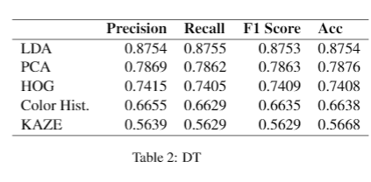
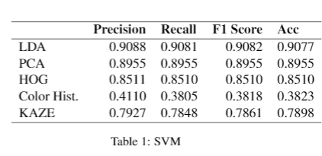
Mid Sem Report Recap : Results
Conclusion
As PCA was not able to capture class information so accuracy obtained with LDA is better
as compared to PCA .
As there are huge number of dimensions so Decision tree tends to overfit and performs
bad over the test set.
Combination of features from various feature extractions give better accuracy than taking
individual features.

Slide 7
Next Steps (Post mid term)
Training with other models
Comparison between performance of traditional ML algorithms and advanced algorithms

Slide 8
We have applied following Algorithms with Analysis :
Decision Tree
SVM
KNN
XGBoost
Bagging
ADABoost
Transfer Learning
CNN for [64x64x3]
CNN for [224x224x3]
ResNet

Slide 9
We have applied following Algorithms with Analysis :
Traditional ML, Ensembling, DeepLearning
Decision Tree
SVM
KNN
XGBoost
Bagging
ADABoost
Transfer Learning
CNN for [64x64x3]
CNN for [224x224x3]
ResNet

Slide 10
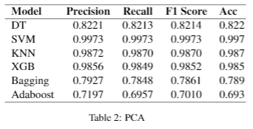
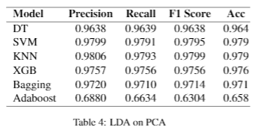
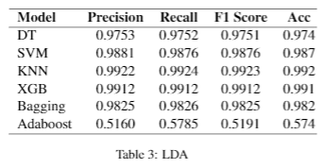
PCA
2. LDA On PCA
3. LDA
We have Performed on 3 Different Variations for every ML Algorithm Given Below

Slide 11
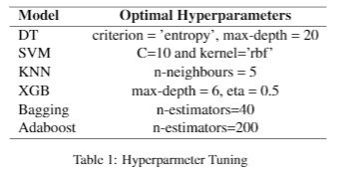
After Performing Hyperparameter Tuning For each ML Algorithms, Results are :

Slide 12
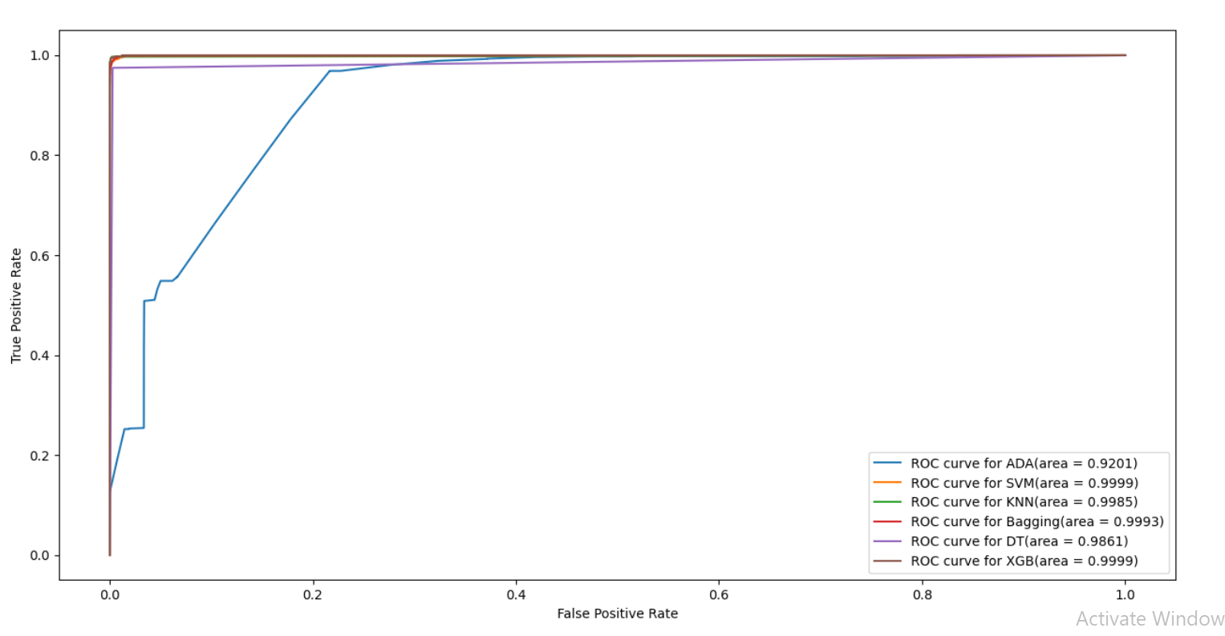
ROC Curve For the Applied Algorithms for 3 Variations.
LDA ROC Curve

Slide 13
ROC Curve For the Applied Algorithms for 3 Variations.
LDA ROC Curve

Slide 14
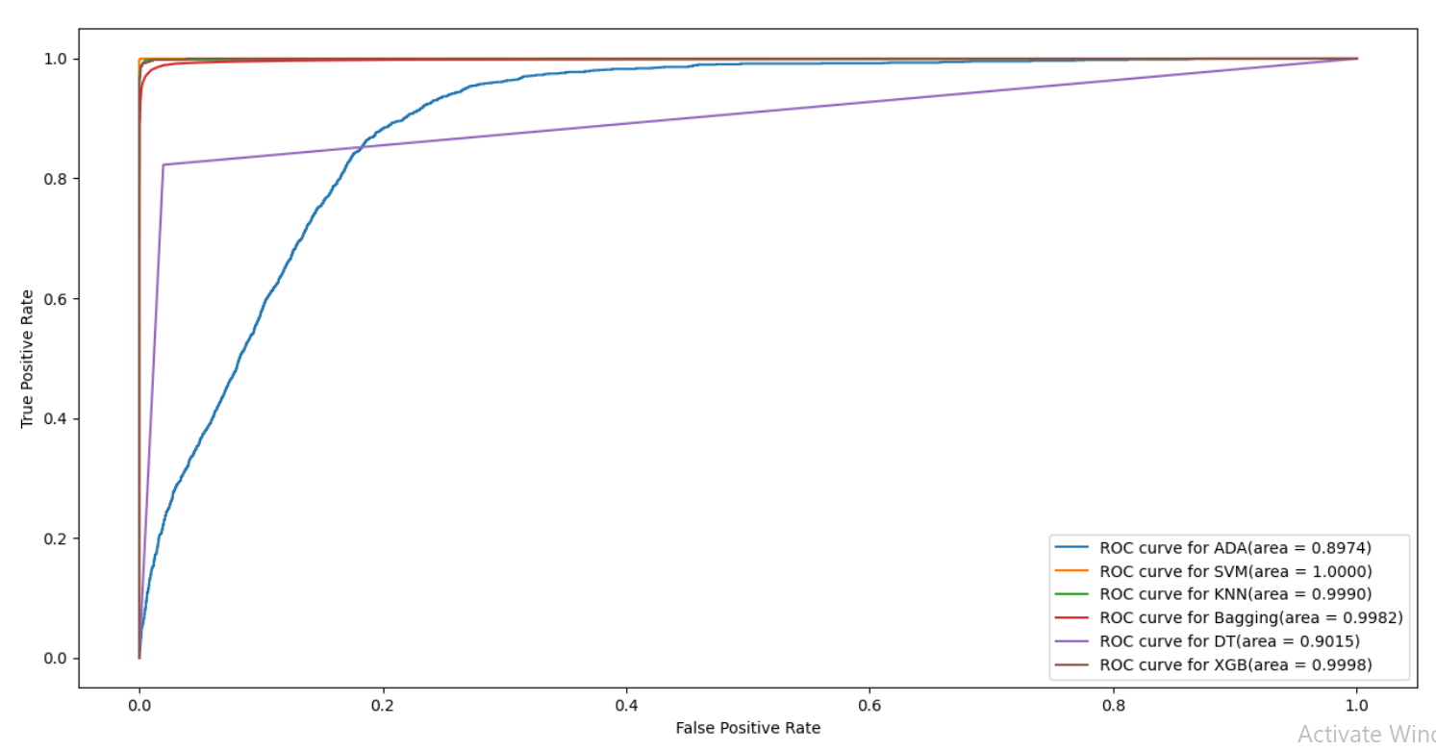
ROC Curve For the Applied Algorithms for 3 Variations.
PCA ROC Curve

Slide 15
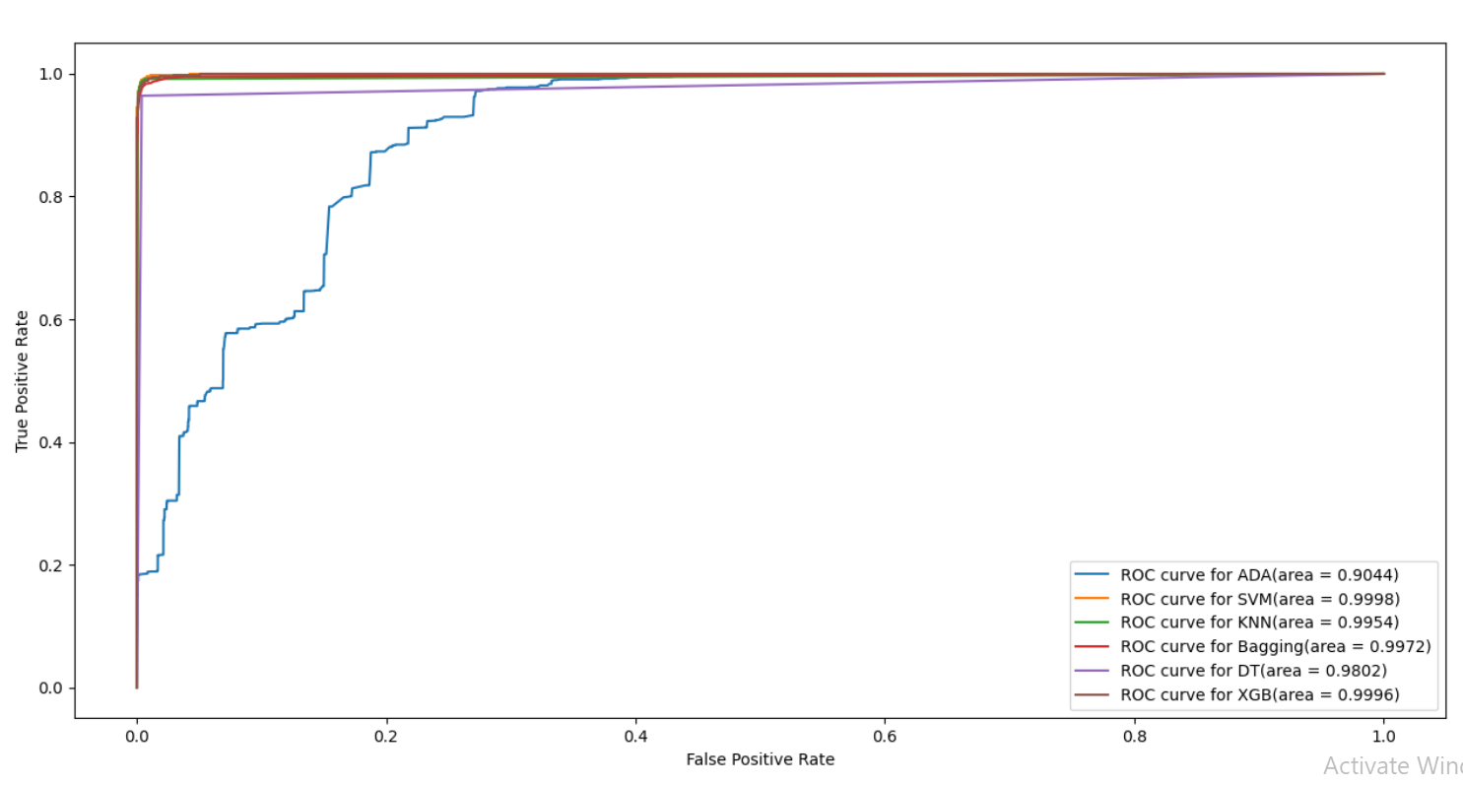
ROC Curve For the Applied Algorithms for 3 Variations.
LDA on PCA ROC Curve

Slide 16
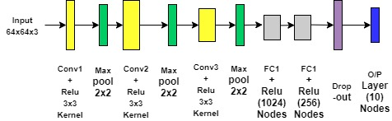
Deep Learning Techniques : CNN
Optimal CNN architecture for image size [64x64x3]

Slide 17
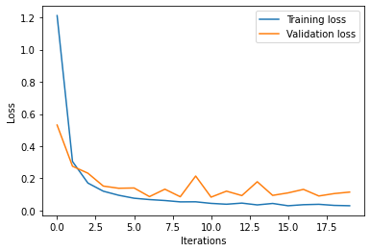
Deep Learning Techniques : CNN
Epochs vs. Loss Graph of CNN-64

Slide 18
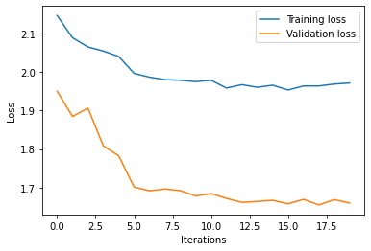
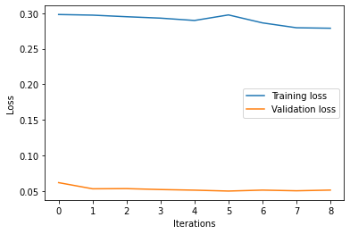
Deep Learning Techniques : Transfer Learning
(c) ResNet (101) Analysis : Loss vs. Iteration Graph
(i) Strategy-1 : S1
(ii) Strategy-2 : S2

Slide 19
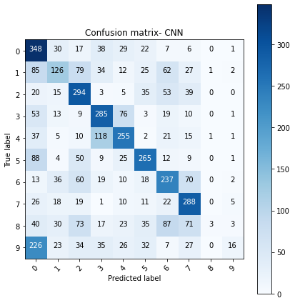
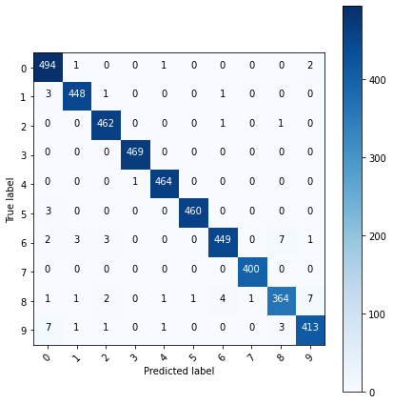
Deep Learning Techniques : Transfer Learning
(c) ResNet (101) Analysis : Classification Matrix
(i) Strategy-1 : S1
(ii) Strategy-2 : S2

Slide 20
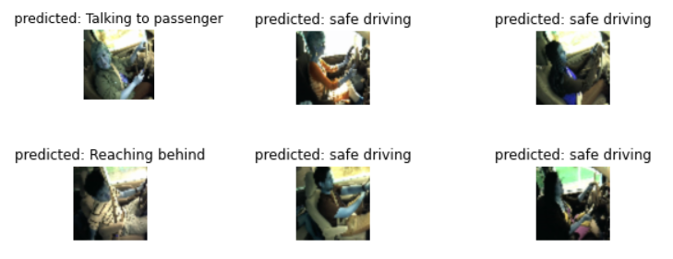
Deep Learning Techniques : Transfer Learning
(c) ResNet (101) Analysis : Prediction Visualization

Slide 21
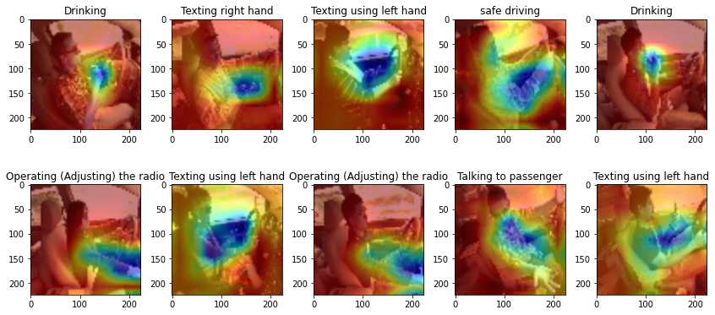
Deep Learning Techniques : Transfer Learning
(c) ResNet (101) Analysis : Class Activation Mappings

Slide 22
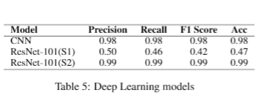
Deep Learning Techniques : Results

Slide 23
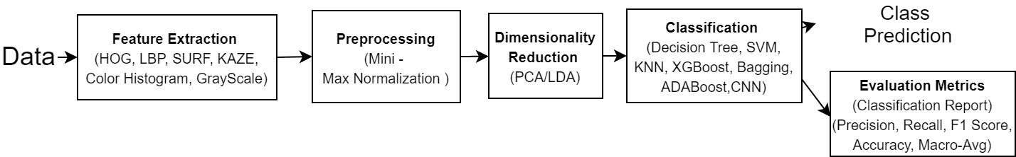
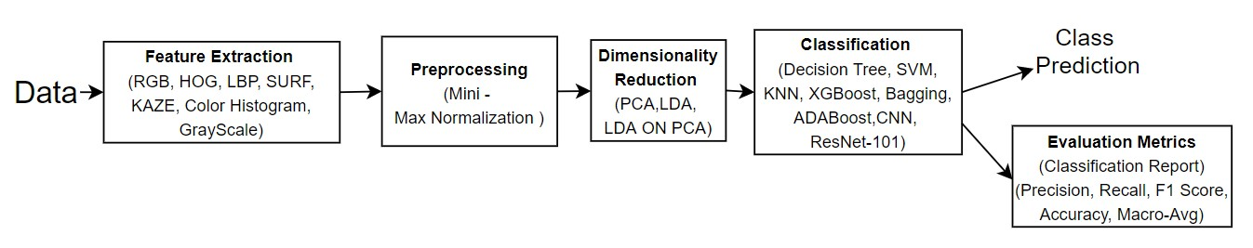
Comparison : Proposed Pipeline vs. Implemented Pipeline

Slide 24
Inference :
PCA gave better results than LDA and LDA on PCA.
After plotting the ROC curves for various models, best auc_roc score was found for SVM after applying PCA.
ResNet-101 S2 performed much better than ResNet-101 S1 which is also higher than the accuracy obtained using CNN.
Adaboost performed poorly for classification on this dataset as boosting techniques perform better on high variance datasets which is contrary to our data set which has low variance.
Data Augumentation and Data Extraction techniques helps the classifier to perform better.
Combining various feature extraction techniques gave much better results than using these techniques individually.

Slide 25
Learnings :
Implementing various Feature Extraction Techniques like HOG, LBP, SURF, KAZE etc.
Combining various features.
How to use classification report as a metric for a model.
Implementing traditional ML models like Decision Tree, SVM,KNN etc.
Implementing Deep Learning techniques like CNN, ResNet-101.
Plotting ROC curves for multi label classification.
Hyperparameter tuning using GridSearchCV.

Slide 26
Future Work :
Given more time and processing power, we can use ResNET-152 to classify the dataset.
More parameters can be tuned for different models.
Our model works on images which are taken from one angle. To increase the robustness of the model for real time detection, further work can be done on images which are taken from other angles.
More dataset can be collected containing images of drivers from different angles.
More feature extraction techniques can be implemented.

