Slide 1
HOTEL MANAGEMENT
MT20055 - AKANKSHA SHRIMAL
MT20066 - RAVI RATHEE

Slide 2
PROJECT DESCRIPTION

Slide 3
HOTEL MANAGEMENT
Our Hotel Reservation System allows customers to book a hotel room in a specific period with various facilities eg. breakfast included, laundry etc.
The user must first login into the system with login credentials or sign up if an account is not already created, following which the user is required to enter details such as date , Dacation or Night out or both and location.
Based on these fields all the hotels are displayed , also the user can further put filters like area , price, offers etc.
Finally as the user selects one hotel he is forwarded to further select among various kinds of rooms available with offers specific to each room. As the user finalises the room , he is asked for any additional facilities and finally a complete bill is generated.
As the user confirms the booking he or she is required to make the complete payment in advance for the first day of booking. Payment can be cash , card , net banking etc.
User will also be allowed to make cancellation and for the same amount will be refunded to the user.
Using All Bookings component user will also be able to look all bookings including current and past bookings and review them if he or she wants to. At the end a logout options is provided for user to logout of the system.

Slide 4
FEATURES
Login
User need to first login to be able to book and make payment for the hotels.
Searching Hotels
User can search the hotels at different locations and can also apply filters to customize the search according to one's needs.
Select Hotel Room
Within the hotel selected the user will be provided a list of different types rooms with offers and prices for each so user can select one room.
Booking
As per the selection done by user a bill is generated displaying the overall cost and booking is confirmed. At the time of booking the user can also request for any additional facility like laundry etc and accordingly the amount will be added to the final bill.
After the booking is completed a final confirmation is sent to the user.

Slide 5
FEATURES
Payment
User can select one of the bookings among all current bookings and then proceed with the payment selecting appropriate payment method.
Cancellation
User can select the booking to be cancelled from all the current bookings and refund is accordingly sent back to the user.After the cancellation is completed a confirmation is sent to the user.
Your Bookings
User will be able to look all the bookings made by him or her. Also user will be able to give review for all the past bookings.
Logout
User can logout of the system and login again whenever required.

Slide 6
ADDITIONAL FEATURES ADDED
Dacation or Night out
Generally in the current system available for hotels user have to book a hotel for atleast 24 hours and pay the money for same irrespective of the fact whether they are staying for complete 24 hours or not.
In our reservation system we have provided a flexibility to the user to be able to book the hotel in slots i.e Dacation or Night out or both
Dacation : From 9 am to 6 pm
Night out : From 8 pm to 7 am
Special Filters for searching hotels
Covid-19 Zones
We will provide filters based on zones of covid-19
Covid-19 safety and hygiene rating
All the customers will be providing a special rating called covid-19 safety and hygiene rating based on their experience in the respective hotel.
This rating can then be used as a filter for users making new bookings.

Slide 7
ADDITIONAL FEATURES ADDED
3. Addition facilities while booking
A option for additional facilities is also provided which includes laundry , complimentary breakfast etc.
In this pandemic situation we will also provide a special option here where user can request the hotel for additional sanitizers , masks , face shield in advance for their own safety purposes.

Slide 8
Object Oriented Design (Problem Statement)

Slide 9
Class Diagram
According to the problem statement the following objects can be identified briefly as shown in the class diagram.
A user object to book the hotel object and a room object in it.
User for booking hotel performs functions like sign up, login , inputs search values, selects hotel, selects room, performs booking and payments along with logout in the end. Thus classes have been created for each responsibility and accordingly association is displayed.
A separate class Load_data is present to load data.
Some other classes are also implemented to make the project realistic.

Slide 10
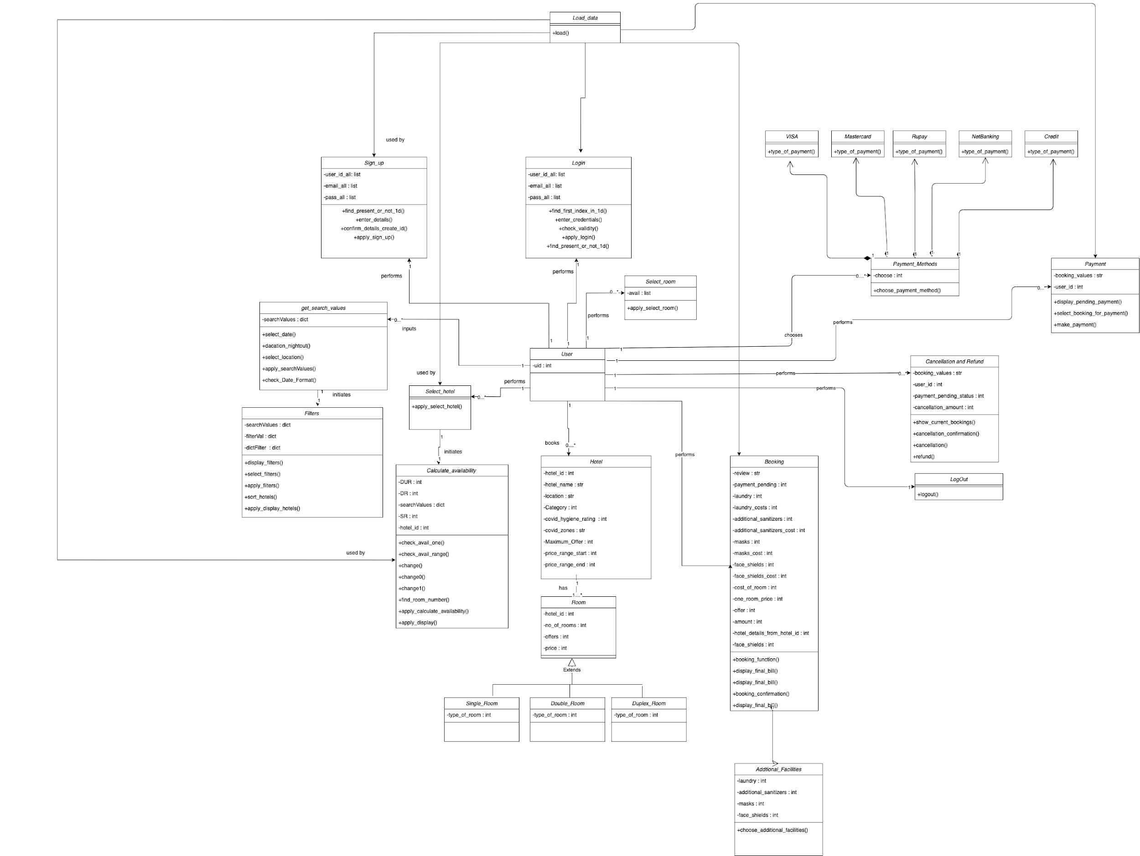

Slide 11
Object Oriented Design (SRP , OCP , LSP)

Slide 12
S.O.L.I.D Design Principles
SRP - Single Responsibility Principle
A class should have only one reason to change.
This principle simply states that a class or a module should have only a single responsibility and the functionality of it should be entirely encapsulated by that class/module. As simple as that sounds, it is easy to overlook it. The single responsibility principle enforces the small classes idea that was discussed earlier.
OCP - Open/Closed Principle
Software entities should be open for extension, but closed for modification.The states that classes, modules, functions and such should be extensible without the need to modify their code. It is not that simple to grasp without an example.
LSP - Liskov Substitution Principle
Subtypes must be substitutable for their base types.
To break it down, LSP states that the subclasses of a class should be substitutable for their base/original class.

Slide 13
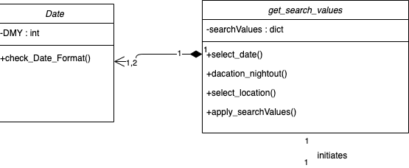
SRP
We ensured that each class performs only a single responsibility and thus will have only one reason change.
Thus the display code is separated from the booking as well as calculate_availabality as making change in these classes will not lead to a change in display code. Also this will ensure the class has either single responsibility of booking or displaying
Bookings same for calculate_availability.
Also the date related functions are put into separate class to ensure single responsibility of classes.
Cancellation and refund class is further split into two different classes to ensure single responsibility.

Slide 14
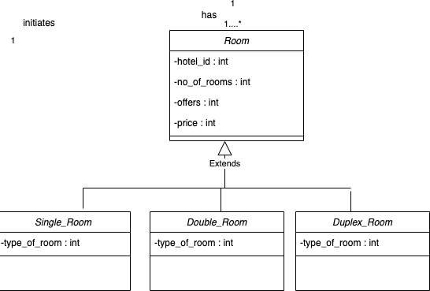
OCP - Open/Closed Principle
According to OCP, we should not modify the existing classes instead we should add more classes whenever and wherever required.
To follow OCP in our code, we observed Single Room, Double Room and Duplex Room can extend the common class Room as they all are types of Room and can fully utilize its properties and functions, here we can use all member variables in our inherited classes.
So this kind of inheritance helps us to follow OCP principle in our code in a effective manner.

Slide 15
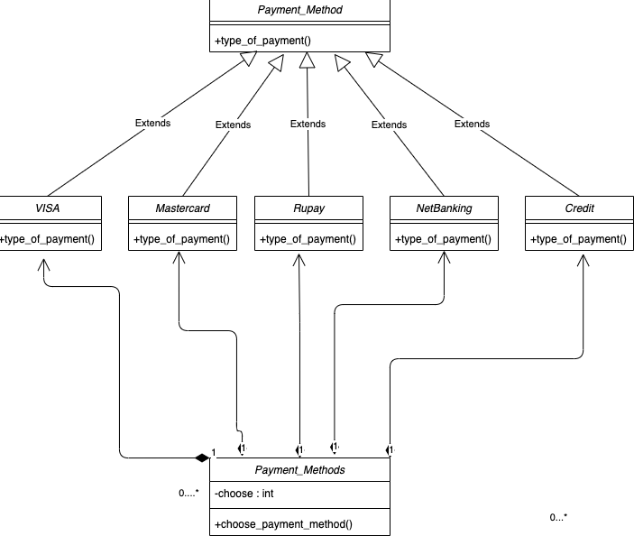
LSP - Liskov Substitution Principle
According to LSP, Subtypes must be substitutable for their base types.
To break it down, LSP states that the subclasses of a class should be substitutable for their base/original class.
To follow LSP in our code, we observed that VISA, MasterCard, Rupay, NetBanking, Credit all a type of Payment_Method, and they all share some common property i.e. type of payment which can be implemented in all of the classes but in a different manner. Payment via VISA can be a lot different from MasterCard and so on.
Abstract method Payment_method doesn’t has any object created instead all the classes which inherit the Payment_method(abstract class) would create its objects.

Slide 16
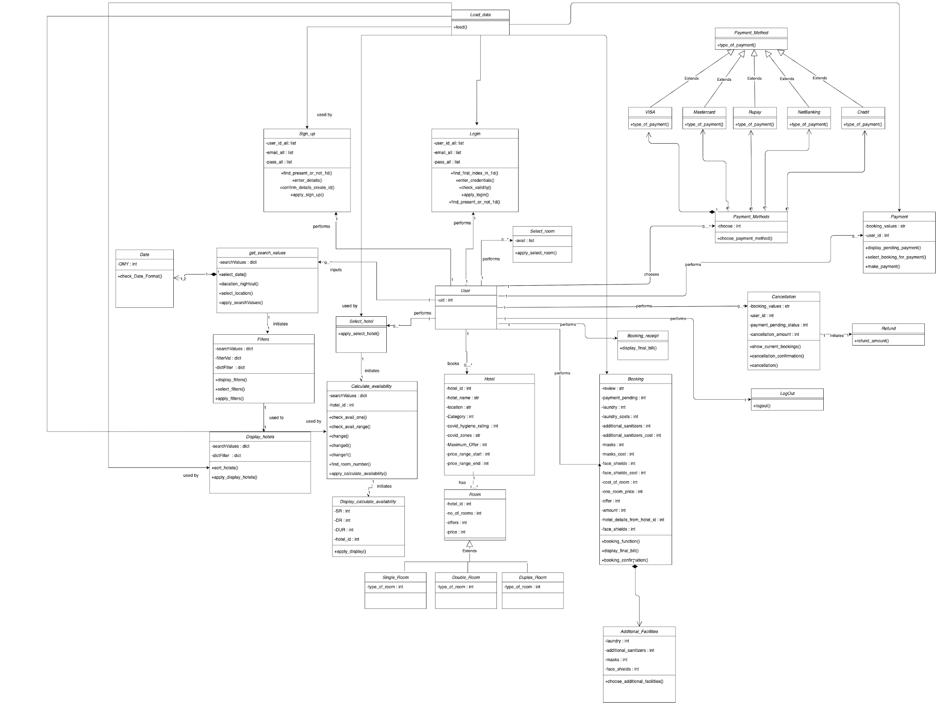

Slide 17
LIST OF FEATURES IMPLEMENTED

Slide 18
Login
Searching Hotels
Select Hotel Room
Booking
Payment
Cancellation
Logout
List of features

Slide 19
CODE FLOW

Slide 20
Login
Searching Hotels
Select Hotel Room
Booking
Payment
Cancellation
Logout
Code flow

Slide 21
LOGIN SIGNUP

Slide 22
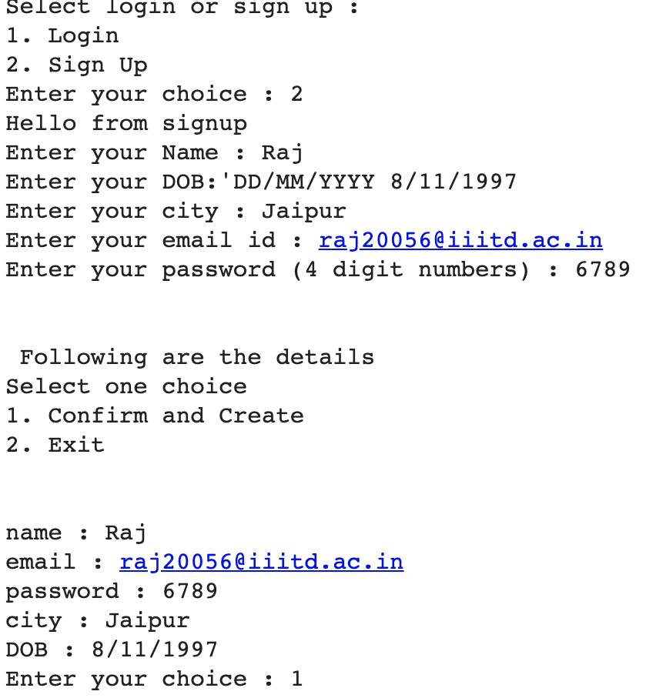
Singup

Slide 23
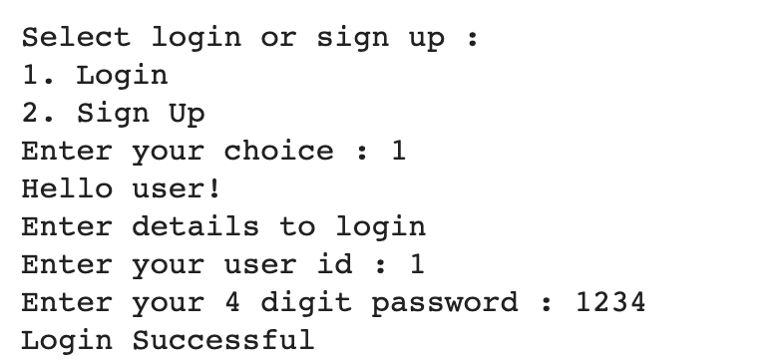
Enter Credentials

Slide 24
SEARCHING HOTELS

Slide 25
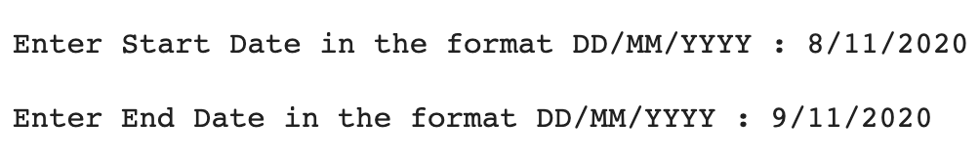
Select Date

Slide 26
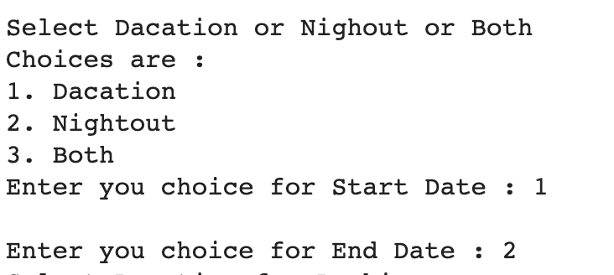
Select Dacation or Nightout

Slide 27
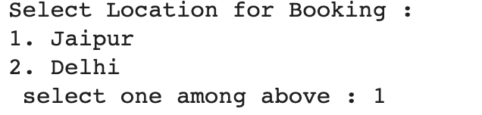
Select location

Slide 28
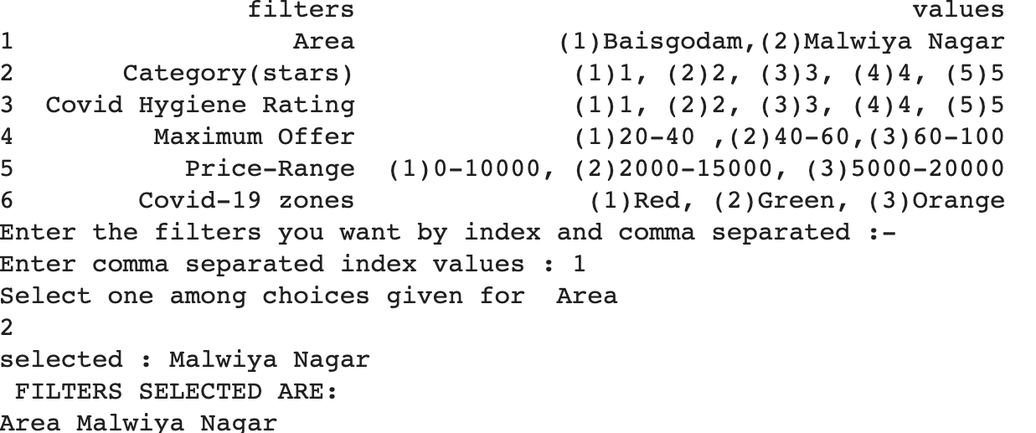
Apply filters

Slide 29
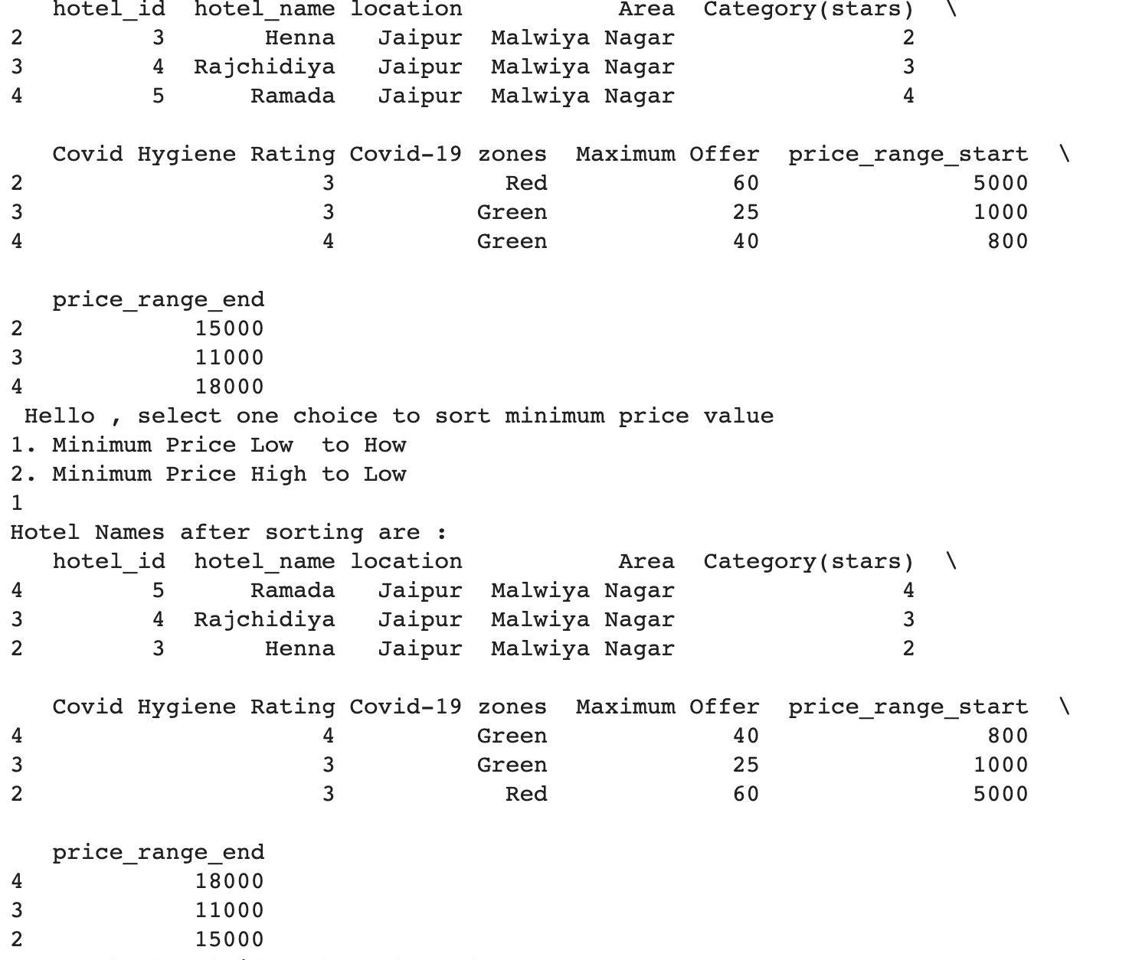
Display Hotels

Slide 30
Select Hotel

Slide 31
SELECT HOTEL ROOM

Slide 32
Here it is simply checked how many rooms are available as dates provided by user
Calculate Availability

Slide 33
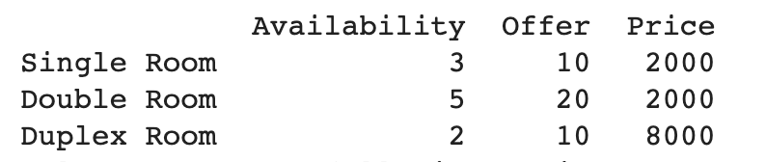
Display available rooms and offers

Slide 34
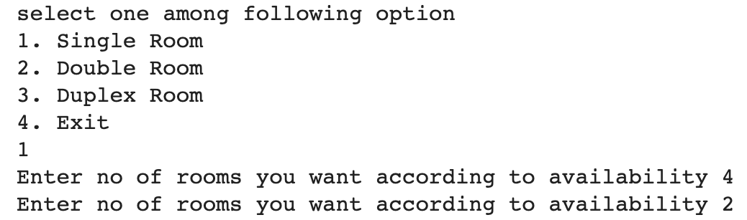
Select room

Slide 35
BOOKING

Slide 36
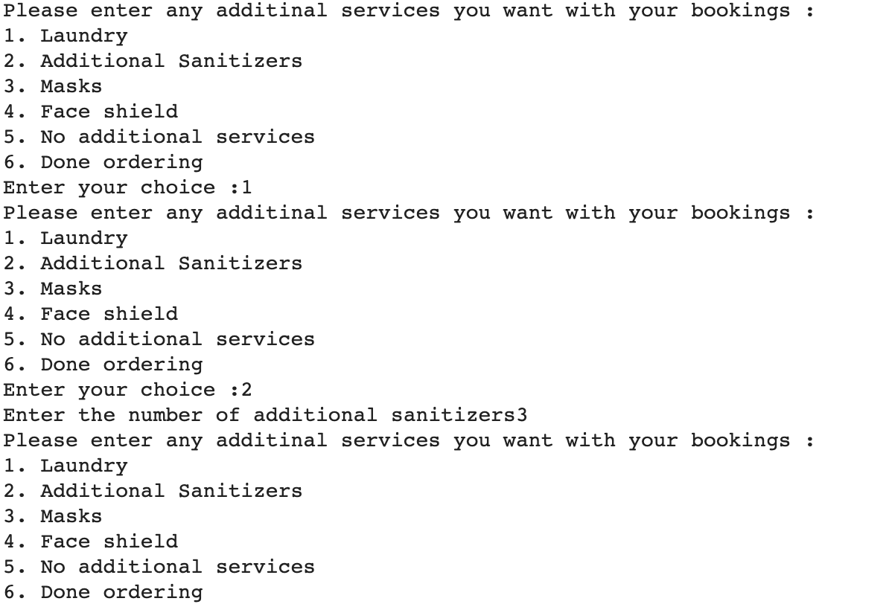
Choose Additional Facilities

Slide 37
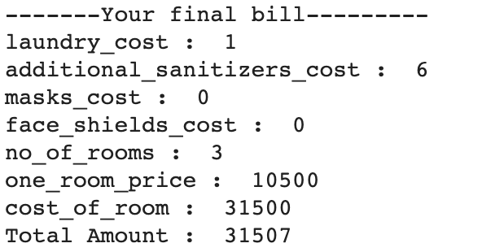
Displaying Final Bill

Slide 38
Booking Confirmation

Slide 39
Payment

Slide 40
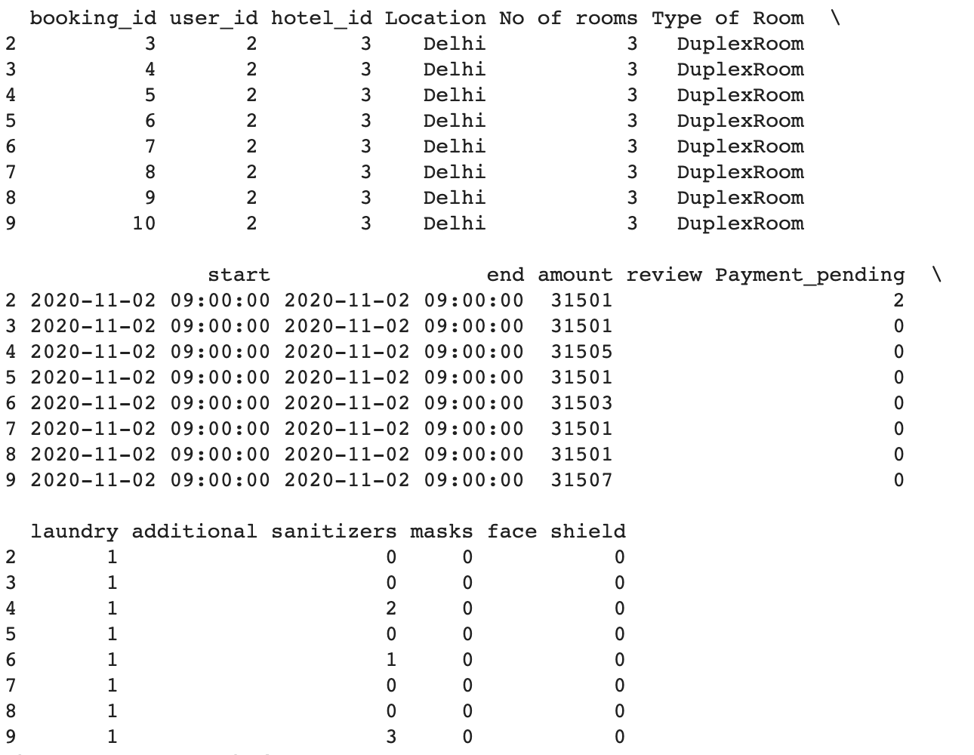
Displaying Pending Payment

Slide 41
Select Booking for Payment

Slide 42
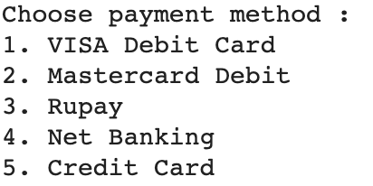
Make Payment

Slide 43
Payment Confirmation

Slide 44
Cancellation

Slide 45
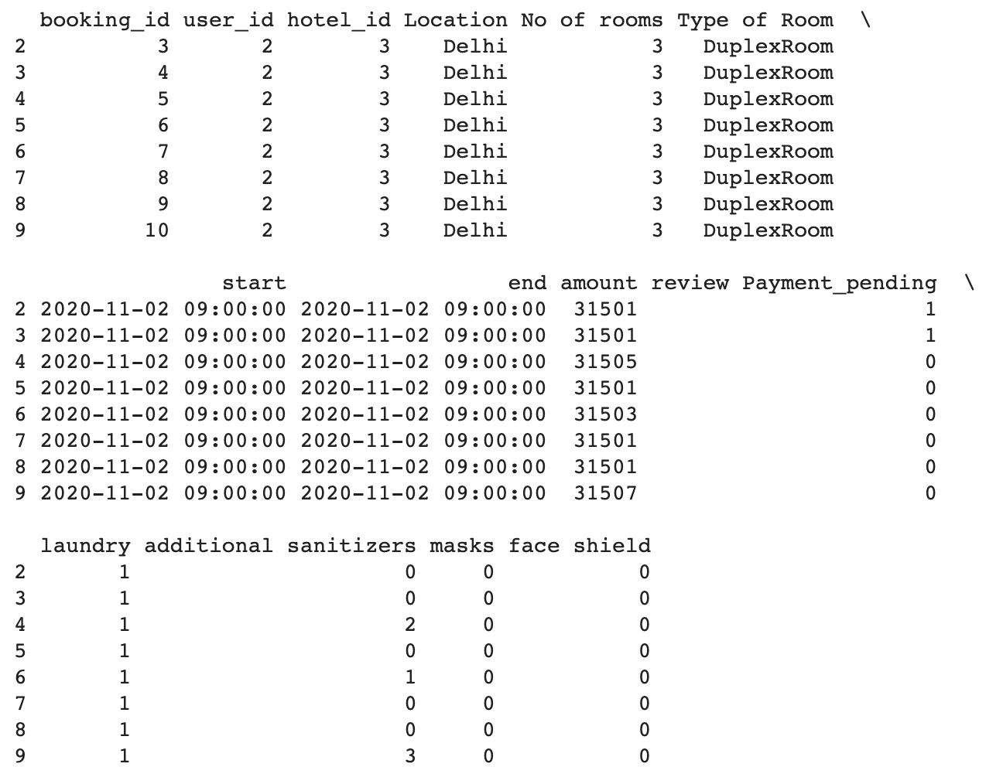
Displaying Current Bookings

Slide 46
Select Booking For Cancellation

Slide 47
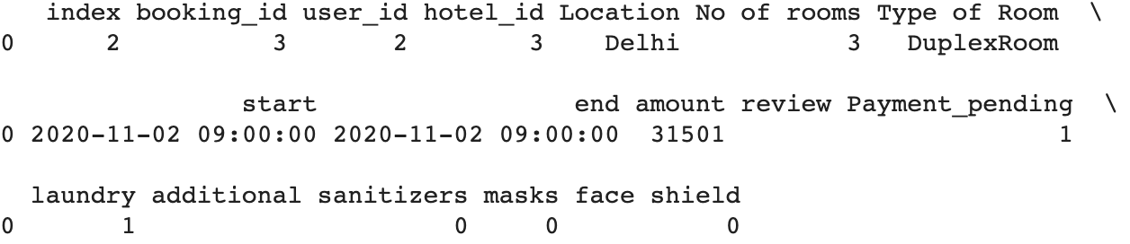
Cancellation and Refund

Slide 48
Cancellation Confirmation

Slide 49
CONTRIBUTION BY EVERY MEMBER

Slide 50
Akanksha Shrimal
Login
Searching Hotels
Select Hotel Room
Class Diagram
Ravi Rathee
Booking
Payment
Cancellation
Logout
Class Diagram

Slide 51
THANKS

