Slide 1
HOTEL MANAGEMENT
MT20055 - AKANKSHA SHRIMAL
MT20066 - RAVI RATHEE

Slide 2
PROJECT DESCRIPTION

Slide 3
HOTEL MANAGEMENT
Our Hotel Reservation System allows customers to book a hotel room in a specific period with various facilities eg. breakfast included, laundry etc.
The user must first login into the system with login credentials or sign up if an account is not already created, following which the user is required to enter details such as date , Dacation or Night out or both and location.
Based on these fields all the hotels are displayed , also the user can further put filters like area , price, offers etc.
Finally as the user selects one hotel he is forwarded to further select among various kinds of rooms available with offers specific to each room. As the user finalises the room , he is asked for any additional facilities and finally a complete bill is generated.
As the user confirms the booking he or she is required to make the complete payment in advance for the first day of booking. Payment can be cash , card , net banking etc.
User will also be allowed to make cancellation and for the same amount will be refunded to the user.
Using All Bookings component user will also be able to look all bookings including current and past bookings and review them if he or she wants to. At the end a logout options is provided for user to logout of the system.

Slide 4
FEATURES
Login
User need to first login to be able to book and make payment for the hotels.
Searching Hotels
User can search the hotels at different locations and can also apply filters to customize the search according to one's needs.
Select Hotel Room
Within the hotel selected the user will be provided a list of different types rooms with offers and prices for each so user can select one room.
Booking
As per the selection done by user a bill is generated displaying the overall cost and booking is confirmed. At the time of booking the user can also request for any additional facility like laundry etc and accordingly the amount will be added to the final bill.
After the booking is completed a final confirmation is sent to the user.

Slide 5
FEATURES
Payment
User can select one of the bookings among all current bookings and then proceed with the payment selecting appropriate payment method.
Cancellation
User can select the booking to be cancelled from all the current bookings and refund is accordingly sent back to the user.After the cancellation is completed a confirmation is sent to the user.
Your Bookings
User will be able to look all the bookings made by him or her. Also user will be able to give review for all the past bookings.
Logout
User can logout of the system and login again whenever required.

Slide 6
ADDITIONAL FEATURES ADDED
Dacation or Night out
Generally in the current system available for hotels user have to book a hotel for atleast 24 hours and pay the money for same irrespective of the fact whether they are staying for complete 24 hours or not.
In our reservation system we have provided a flexibility to the user to be able to book the hotel in slots i.e Dacation or Night out or both
Dacation : From 9 am to 6 pm
Night out : From 8 pm to 7 am
Special Filters for searching hotels
Covid-19 Zones
We will provide filters based on zones of covid-19
Covid-19 safety and hygiene rating
All the customers will be providing a special rating called covid-19 safety and hygiene rating based on their experience in the respective hotel.
This rating can then be used as a filter for users making new bookings.

Slide 7
ADDITIONAL FEATURES ADDED
3. Addition facilities while booking
A option for additional facilities is also provided which includes laundry , complimentary breakfast etc.
In this pandemic situation we will also provide a special option here where user can request the hotel for additional sanitizers , masks , face shield in advance for their own safety purposes.

Slide 8
EXPECTED CARTESIAN DECOMPOSITION

Slide 9
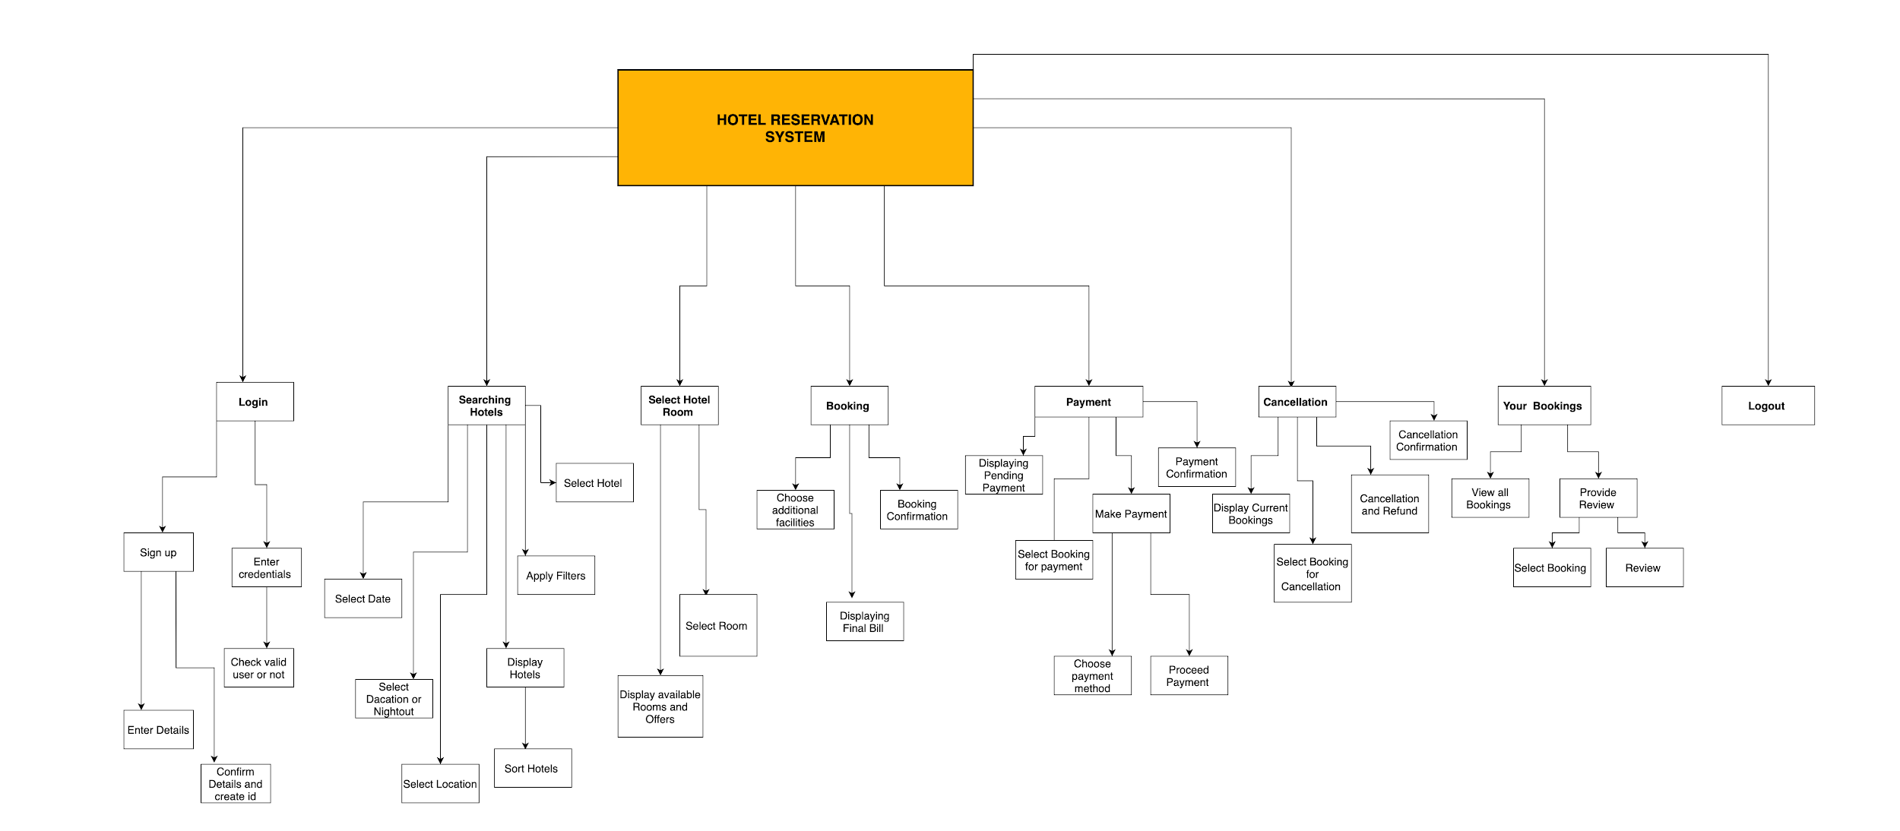

Slide 10
ACTUAL CARTESIAN DECOMPOSITION

Slide 11
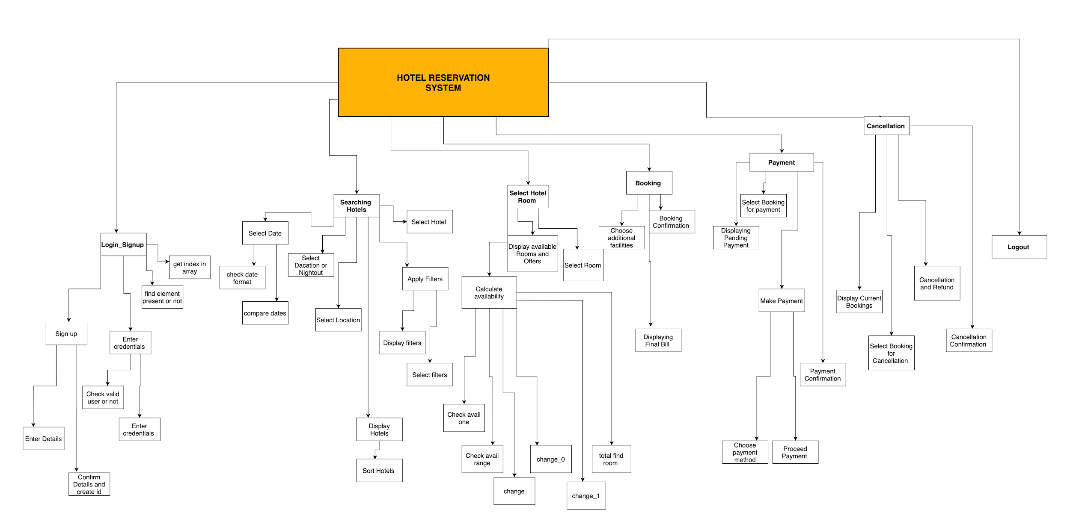

Slide 12
EXPECTED MODULAR STRUCTURE

Slide 13
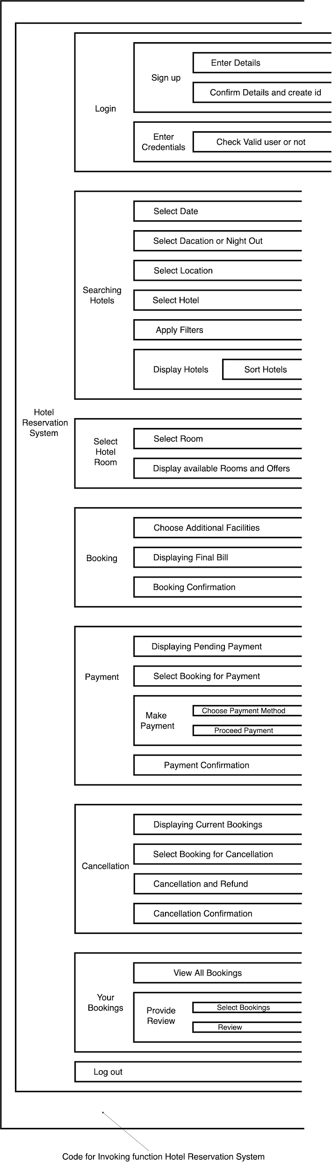

Slide 14
ACTUAL MODULAR STRUCTURE

Slide 15
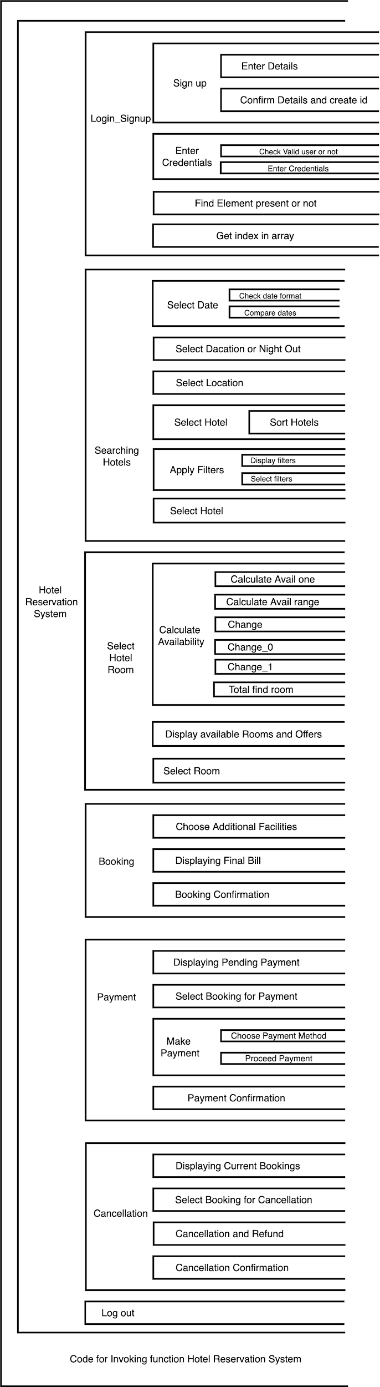

Slide 16
LIST OF FEATURES IMPLEMENTED

Slide 17
Login
Searching Hotels
Select Hotel Room
Booking
Payment
Cancellation
Logout
List of features

Slide 18
CODE FLOW

Slide 19
Login
Searching Hotels
Select Hotel Room
Booking
Payment
Cancellation
Logout
CODE FLOW

Slide 20
LOGIN SIGNUP

Slide 21
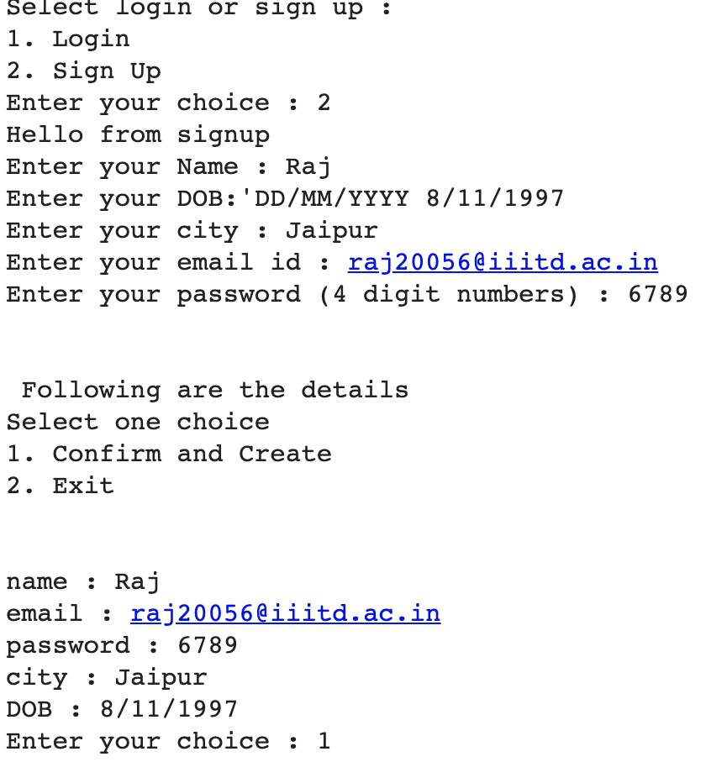
Singup

Slide 22
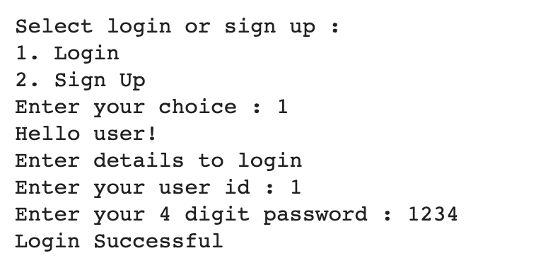
Enter Credentials

Slide 23
SEARCHING HOTELS

Slide 24
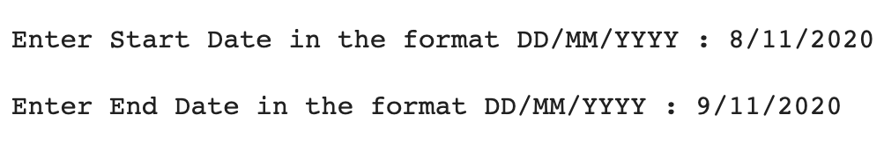
Select Date

Slide 25
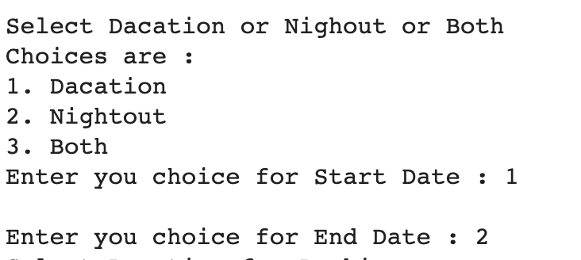
Select Dacation or Nightout

Slide 26
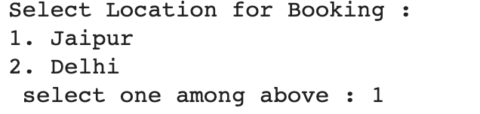
Select location

Slide 27
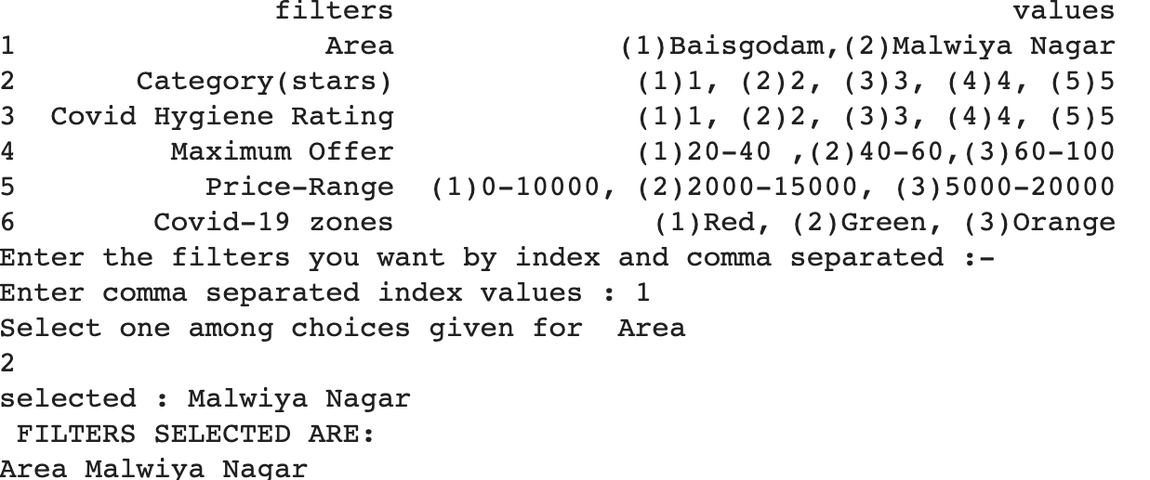
Apply filters

Slide 28
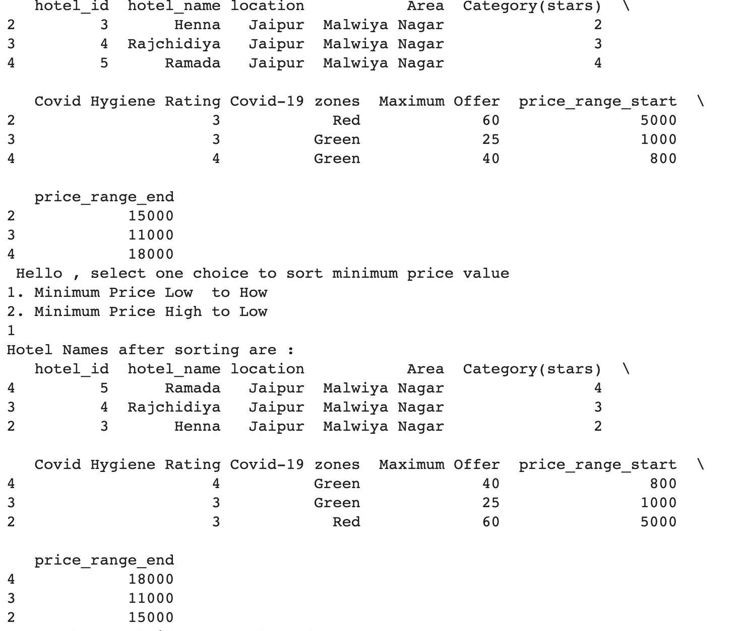
Display Hotels

Slide 29
Select Hotel

Slide 30
SELECT HOTEL ROOM

Slide 31
Here it is simply checked how many rooms are available as dates provided by user
Calculate Availability

Slide 32
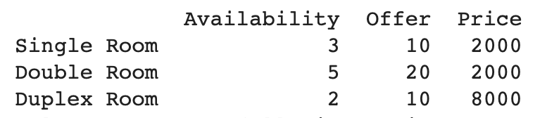
Display available rooms and offers

Slide 33
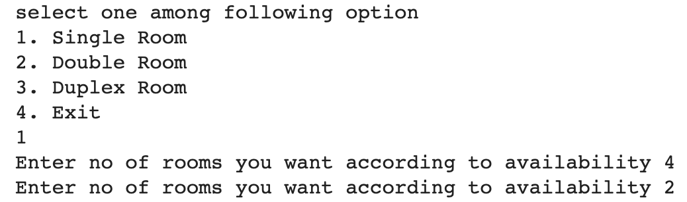
Select room

Slide 34
BOOKING

Slide 35
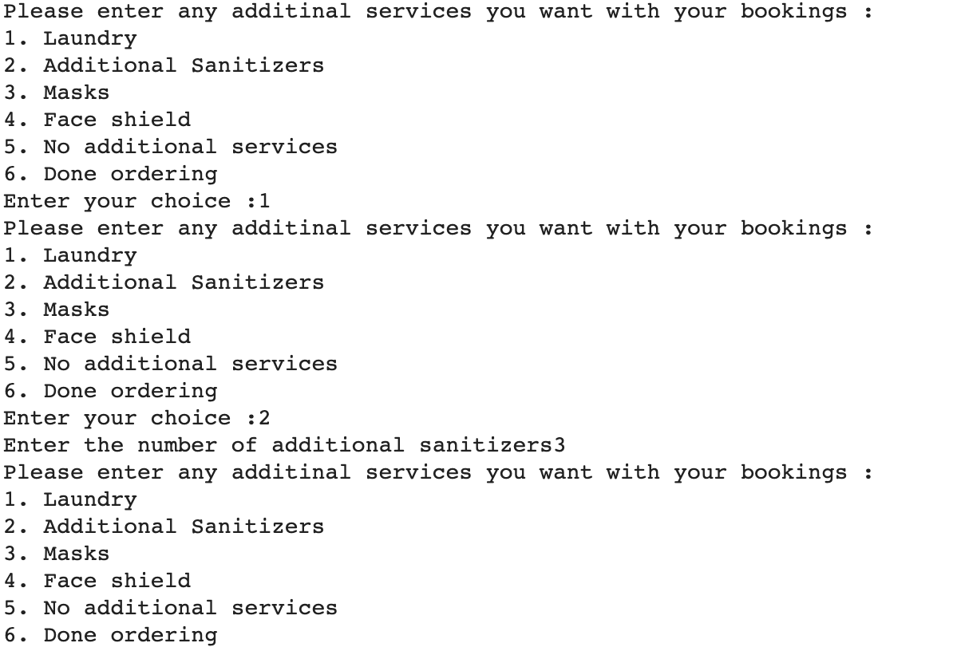
Choose Additional Facilities

Slide 36
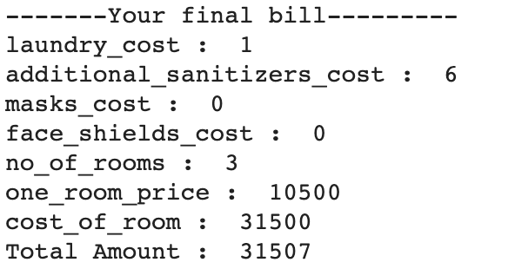
Displaying Final Bill

Slide 37
Booking Confirmation

Slide 38
Payment

Slide 39
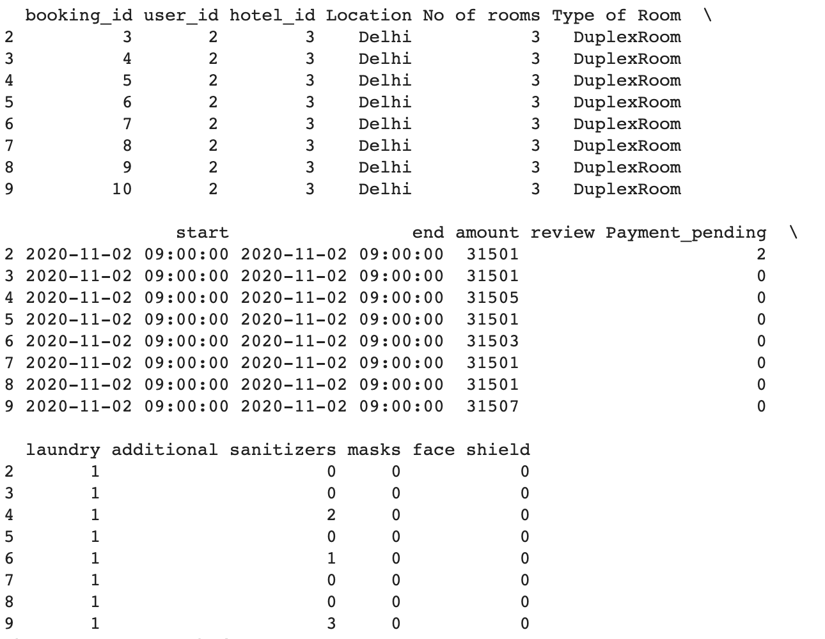
Displaying Pending Payment

Slide 40
Select Booking for Payment

Slide 41
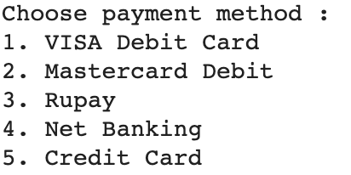
Make Payment

Slide 42
Payment Confirmation

Slide 43
Cancellation

Slide 44
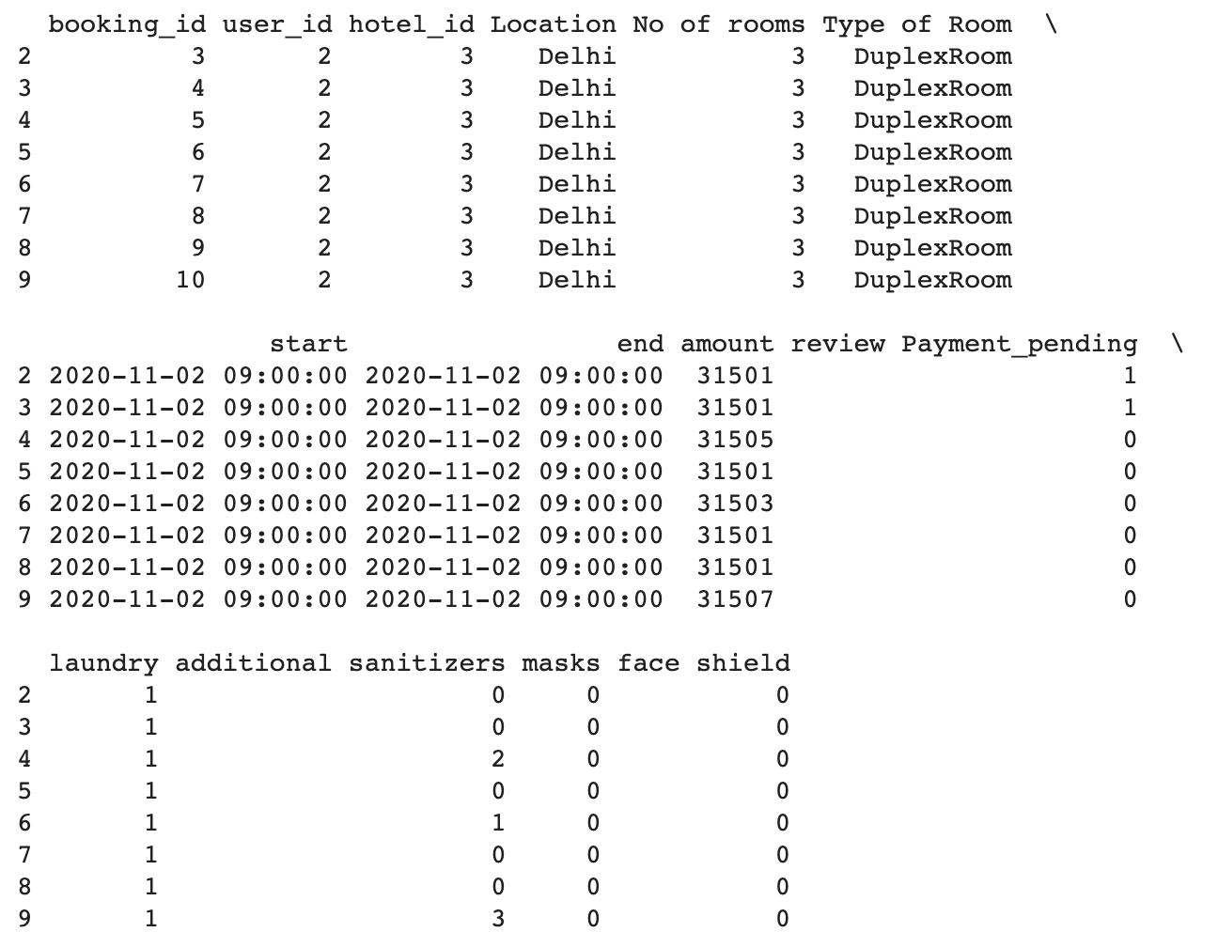
Displaying Current Bookings

Slide 45
Select Booking For Cancellation

Slide 46
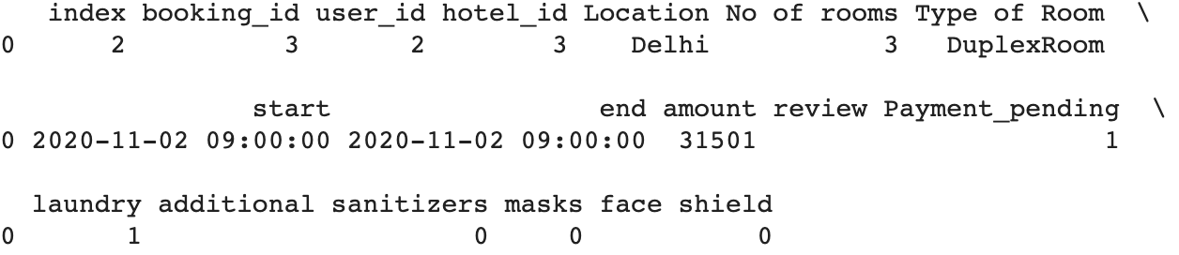
Cancellation and Refund

Slide 47
Cancellation Confirmation

Slide 48
CONTRIBUTION BY EVERY MEMBER

Slide 49
Akanksha Shrimal
Login
Searching Hotels
Select Hotel Room
Database schema
Ravi Rathee
Booking
Payment
Cancellation
Logout

Slide 50
THANKS

