Slide 1
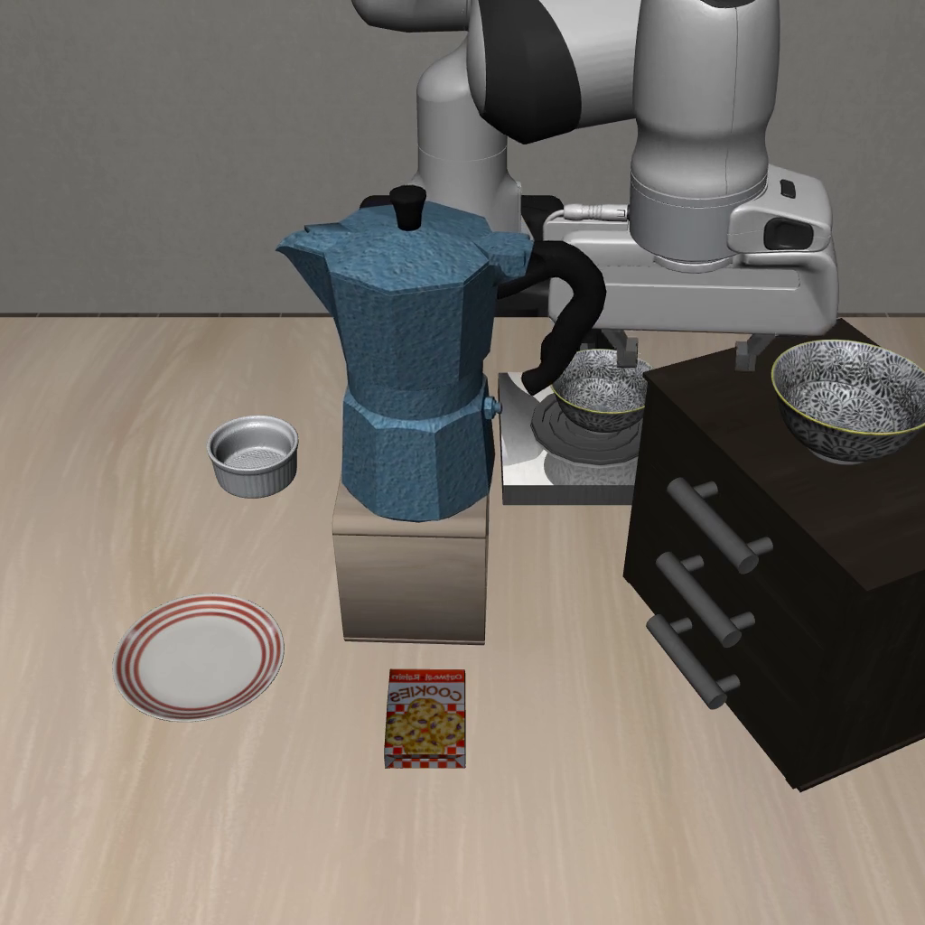
PROGRESS + METHODOLOGY
Situational safety for robot manipulation
Seeing a hazard.
Remembering what happened.
Akanksha Singal · October 2026
01
Notes:
Class presentation. The two completed studies ask what a robot can avoid from current visual observations and what changes when a safety-relevant fact persists across episodes. Results are simulation-only. Recommended speaking time: 15–20 minutes.

Slide 2
EXPERIMENTAL SETUP
What counts as a safe rollout?
Task success
Collision avoidance
Safe success
Did the robot finish?
Did it avoid contact?
Did it finish without
a violation?
4 task suites × 2 hazard levels × 200 episodes
Source: results/safelibero/policy_baselines/; results/README.md
02
Notes:
SafeLIBERO: spatial, object, goal and long suites, each at hazard levels I and II. The main baseline comparisons here use 50 episodes per task, four tasks, 200 episodes per condition. TSR and CAR are separate marginal rates; neither is the joint safe-success rate. Level I places hazards near the target; Level II places hazards along the movement path.

Slide 3
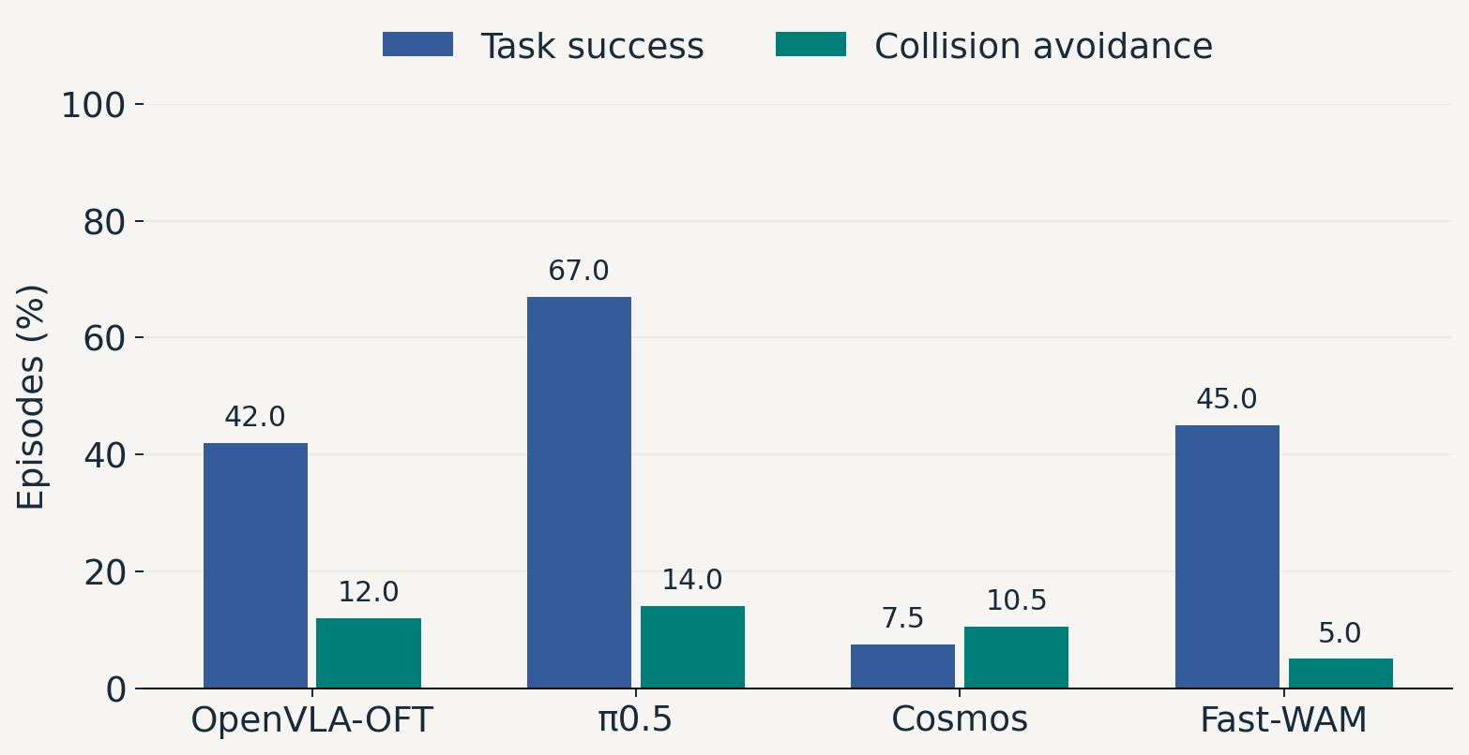
POLICY BASELINES
Task success leaves a safety gap
SafeLIBERO spatial · Level I · n = 200 per policy
03
Notes:
Completed spatial Level-I runs, 200 episodes per policy. Cosmos 7.5/10.5, Fast-WAM 45/5, OpenVLA-OFT 42/12, pi0.5 67/14 (TSR/CAR). These describe the evaluated checkpoints and settings, not universal model rankings. Fast-WAM uses the completed fastwam_50ep run. Full baseline board is in the appendix.

Slide 4
METHOD 1 · PERCEPTION
Use the images to locate the obstacle
Identify
Ground
Which object
is the obstacle?
Where is it
in 3D?
RGB views + task
3D estimate + uncertainty
Source: fol_safety_filter/filter.py; final campaign report
04
Notes:
Completed visual filter v19: vision-based obstacle selection and multi-view triangulation produce a 3D obstacle estimate; uncertainty determines ellipsoid geometry, refined using later views. No ground-truth obstacle positions are used in this control path. The diagram summarizes the evaluated obstacle-avoidance mechanism, not the aspirational six-level taxonomy.

Slide 5
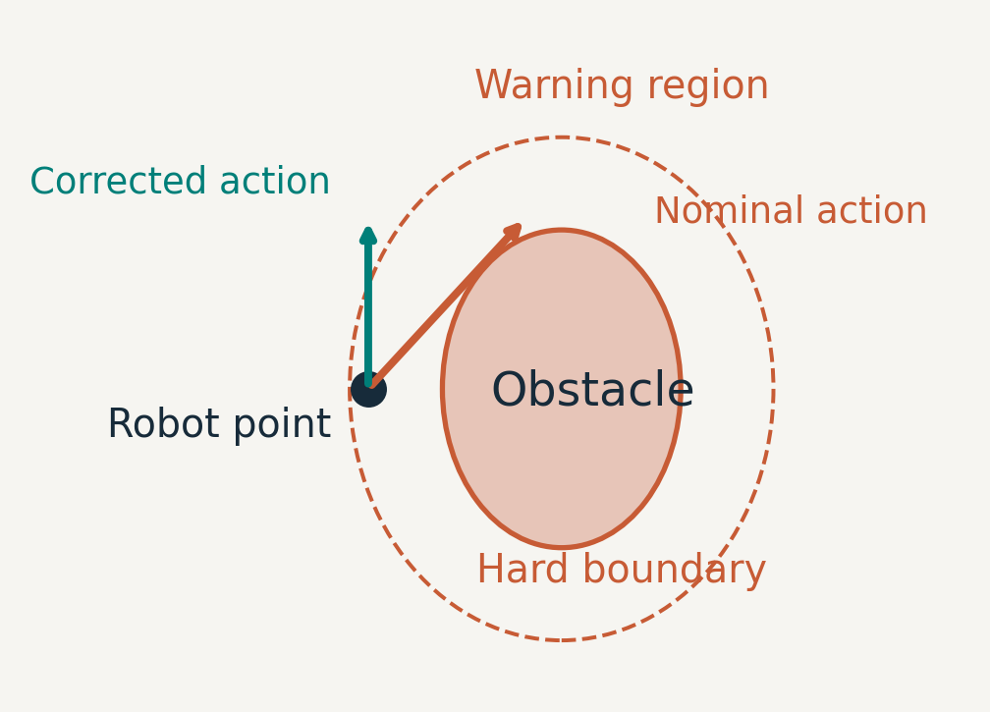
METHOD 1 · ACTION FILTERING
Adjust motion near the estimated hazard
Remove motion toward the obstacle.
Push outward inside the hard boundary.
Repeat for the gripper and arm checkpoints.
Schematic · geometric action correction · Source: fol_safety_filter/filter.py
05
Notes:
The implemented geometric filter removes the approaching component near the warning boundary and pushes outward inside the hard boundary. It monitors end-effector and arm checkpoints. v19 uses uncertainty-shaped ellipsoids and multi-frame refinement. This is a diagram of the implemented action correction, not a claim of a verified global safety guarantee or an exact QP solve.

Slide 6
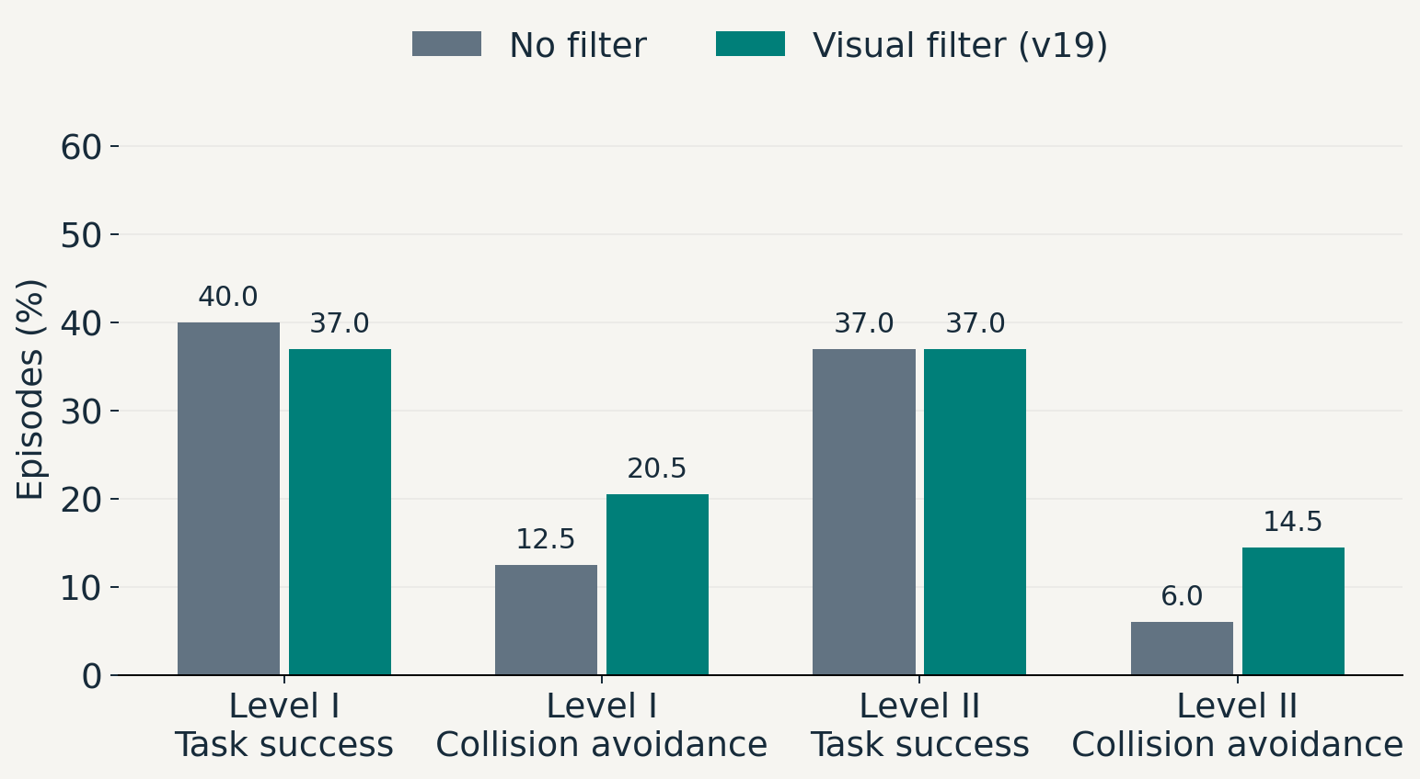
VISUAL FILTER RESULTS
Collision avoidance improves; failures remain
SafeLIBERO spatial · n = 200 per method and level · seed 7
06
Notes:
Matched final campaign, OpenVLA-OFT og10 checkpoint, seed 7. Each condition has 200 episodes. v19 Level I: TSR 40 to 37, CAR 12.5 to 20.5. Level II: TSR stays 37, CAR 6 to 14.5, a gain of 8.5 percentage points. No statistical significance claim. The run working tree was not fully committed; these are recorded experimental results, not a tagged reproducibility claim.

Slide 7
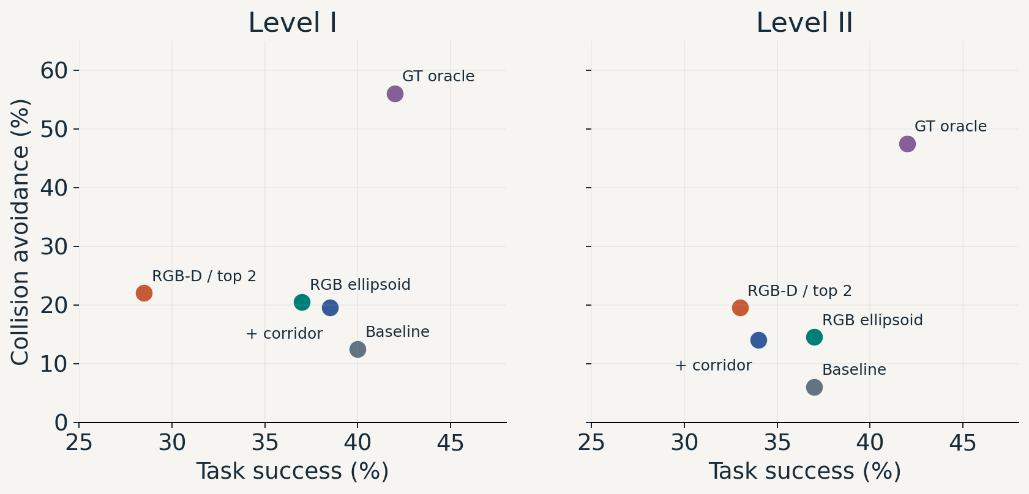
COMPLETED CAMPAIGN VARIANTS
More avoidance can cost task success
Source: results/safelibero/fol/{baseline_og10,v19,v20,v21d2,v172}/
07
Notes:
All points are completed 200-episode campaign conditions. v20 adds a target corridor mechanism; v21-D2 uses RGB-D and two obstacle candidates. GT oracle v17.2 uses simulator positions and differs in filter version, so the gap is diagnostic rather than a clean isolated perception ablation. Do not claim the full gap is caused solely by grounding. Unfinished variants are excluded.

Slide 8
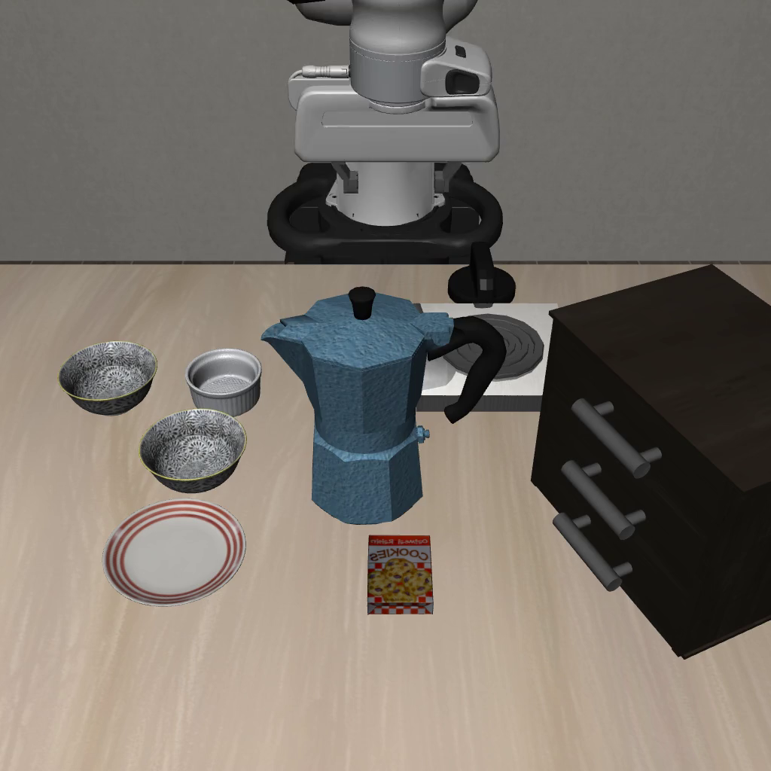

SafeLIBERO: without and with our method
Without our method
With our method
OpenVLA-OFT · spatial Level I · task 0, episode 0 · 10 seconds
08
Notes:
SafeLIBERO spatial Level I, task 0, episode 0. Both videos use OpenVLA-OFT og10. Left: baseline_og10_L1_video. Right: fol_v19_spatial_L1_n50_video. Full 10-second stored recordings, unchanged speed. Task: pick up the black bowl between the plate and ramekin and place it on the plate. The baseline topples the moka pot; it remains upright in this filtered recording. This illustrates obstacle avoidance, not proof of task completion or collision-free behavior for every robot link. v19 uses visual obstacle grounding and the geometric filter described earlier. Exact sources are in artifacts/class_progress_2026_10_08/comparison_demos/sources.json.

Slide 9
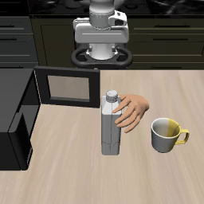
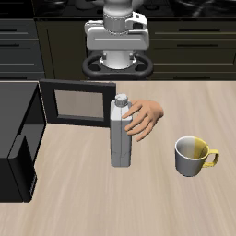
LIBERO-Safety: without and with our method
Without our method
With our method
Fine-tuned π0.5 · task 14, episode 1 · full recordings at 2× playback
09
Notes:
LIBERO-Safety obstacle_avoidance_human, level 2, task 14, episode 1. Task: put the white-yellow mug in the microwave and close it. Both arms use the LIBERO-Safety fine-tuned pi0.5 checkpoint (models--LIBERO-Safety--pi05_libero_safety), confirmed in .worktrees/flow-guidance-tier-gt/slurm/ls_teaser_render.slurm. Left disables guidance; right uses FOL obstacle selection and perceived entity positions with guided action generation (ramp schedule, 8 candidates, 0.09 m EEF radius, 0.30 m engagement radius, 60-degree cone). This is the guided pi0.5 variant, distinct from the OpenVLA-OFT v19 filter on the preceding slide. Result filenames and footage show baseline timeout (600 steps) and guided completion (510 steps). The full source recordings are shown at 2x stored playback speed: 10.0 s and 8.5 s. Original videos sample every five environment steps at 6 fps; playback is not wall-clock robot speed. Same task and episode index; do not claim pixel-identical starts or infer aggregate improvement from this selected example. Avoid interpreting the benchmark's defective robot-contact metric as proof of safety.

Slide 10

RECORDED SIMULATION · 10-SECOND CLIPS
Watch the remaining failure
No filter
Visual filter (v19)
Task: move the bowl from the cabinet to the plate · illustrative episode
10
Notes:
Same spatial Level-II task 3, episode 0, baseline og10 versus v19. Both recordings show the moka pot obstacle being toppled. These illustrate a failure case, not a successful intervention. The campaign rates on preceding slides summarize all 200 episodes. Playback is the stored 30 fps video, not a timing measurement.

Slide 11
EVALUATION AUDIT
Check what the benchmark actually measures
Robot contact
Affordance
Reported results
ID/name mismatch
misses collisions.
No constraints
means no safety score.
Do not treat those
100% rates as evidence.
Source: docs/code_review_findings.md · LIBERO-Safety audit
11
Notes:
Completed code audit of LIBERO-Safety, a different benchmark from SafeLIBERO. Robot-contact checks compare geometry integer IDs against string names, so that channel cannot fire. Affordance has no constraints. Duplicate predicate keys and success-step accounting also affect scoring. These findings prevent interpreting older 100% CAR values as safety evidence. No claim that the fixes or reruns are complete.

Slide 12
METHOD 2 · PERSISTENT FACTS
Some hazards outlast the image
Episode 1
Memory
Episode 2
Tool touches
a marked source.
Store MARKED(tool).
Keep the marked tool
away from food.
Fixed rule: marked tool + ready-to-eat food → keep apart
Scripted controller · fixed rules · persistent facts · marker-transfer analogue
12
Notes:
Separate proof of concept with a scripted waypoint controller, fixed human-written rules and a JSON fact store. A proximity event marks the tool in a marker-transfer analogue. The next episode resets and randomizes object poses while preserving identity. A hidden mark cannot be recovered from the current observation. No VLM, learned rule induction or physical contamination model is evaluated.

Slide 13
MEMORY EXPERIMENT DESIGN
Change the information; keep the controller fixed
Hidden
Clean / washed
Visible
Does memory
reduce violations?
Does the constraint
release?
Does memory become
redundant?
No memory Memory Memory deleted Oracle
Fixed rules · same policy and filter · four belief sources
13
Notes:
Four cells: hidden marked source, clean lookalike, marked then washed, visible mark. Four arms share the same scripted policy and barrier projection: memoryless, memory, deleted memory and oracle ledger. The memoryless arm has a perfect current-frame grounder. Observed state features of hidden marked/clean twins are identical in the documented leak check; this is not a claim about all raw camera pixels.

Slide 14
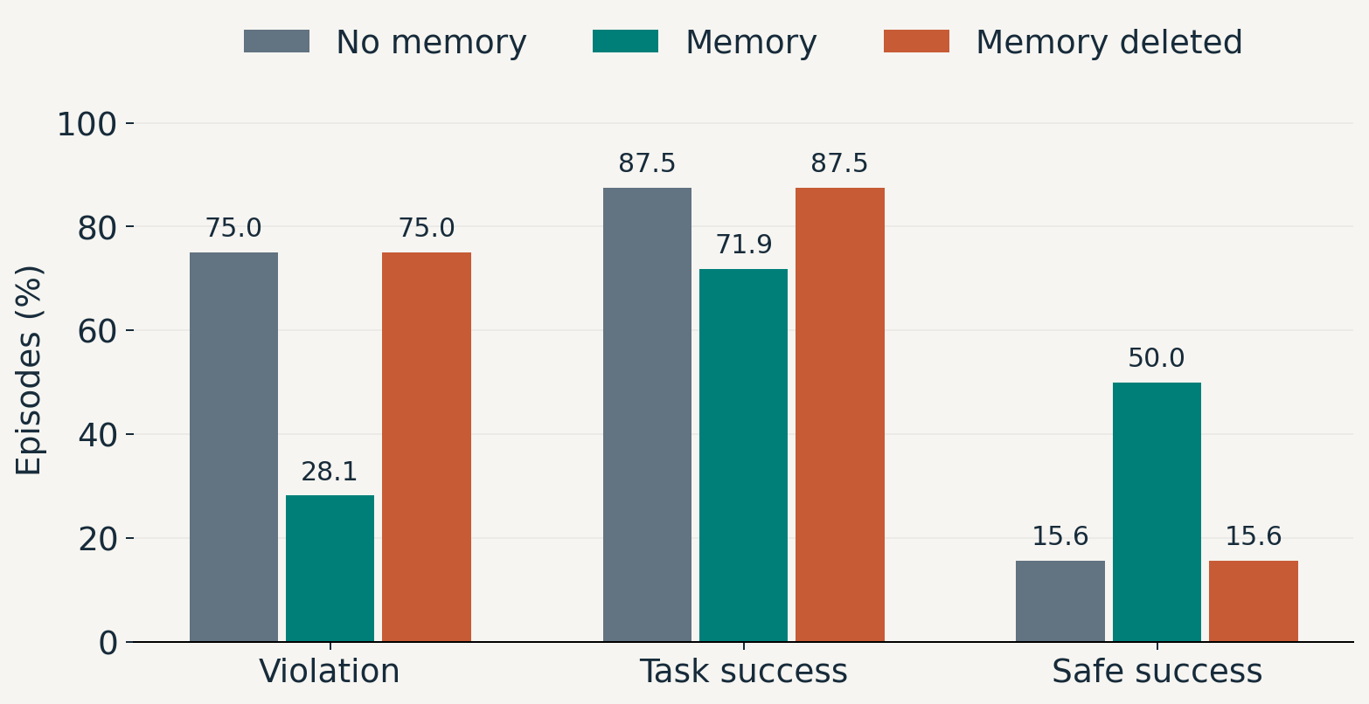
PHYSICS PROOF OF CONCEPT · BOARD B
Memory reduces hidden-hazard violations
Scripted controller · hidden hazard · n = 32 per arm · 512 scored / 640 run
14
Notes:
Full scored hidden-positive cell: 32 episodes per arm. Memoryless: violation 24/32, task 28/32, safe 5/32. Memory: violation 9/32, task 23/32, safe 16/32. Deleted memory matches memoryless. Entire board: 640 episodes run, 128 excluded by cell-aware settle criteria, 512 scored. The paired analysis uses a smaller matched subset of 20; do not mix its rates with these full-cell rates. Success is lower with memory; lack of significance does not establish no cost.

Slide 15
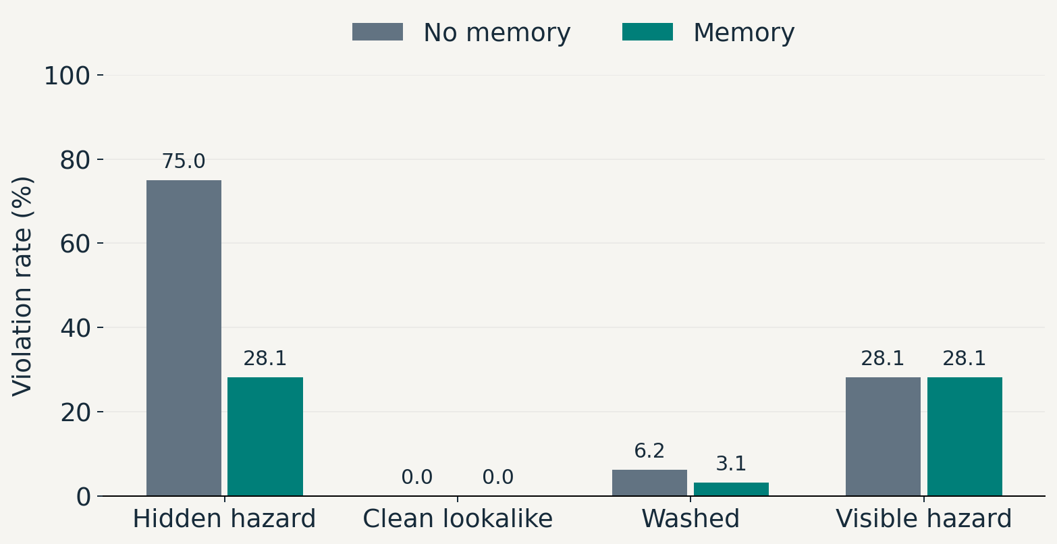
MEMORY CONTROLS
The effect depends on what can be observed
Full scored cells: n = 32 per arm · paired interaction: 45 pp, 95% CI [25, 65]
15
Notes:
Chart uses full scored cells, n=32 per arm. On the paired subset, hidden violation is 75% versus 30%; visible violation is 30% in both arms. The interaction is 45 percentage points, 95% CI [25,65], n=20 paired comparisons. Full-cell reset belief remains 6.2%, so do not claim perfect wash release. Memory and oracle match, but both derive their marking signal from the same proximity event.

Slide 16
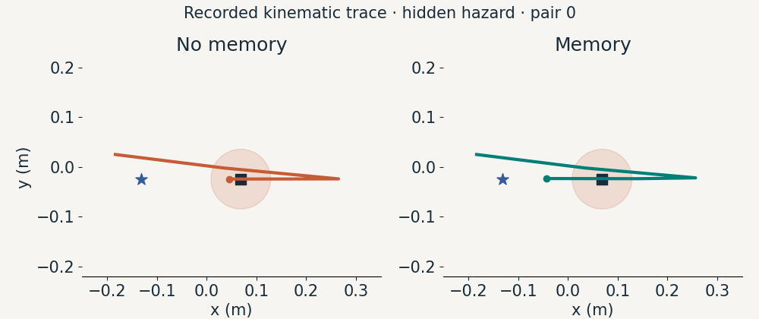
RECORDED KINEMATIC TRACE
Replay: the same task with and without memory
Kinematic testbed · recorded pair 0 · top view · no new rollout
16
Notes:
Animation replays the stored x/y end-effector trajectory for hidden-positive pair 0 in kin_final_v3. This is a projection of a 3D kinematic testbed trace, not MuJoCo video and not the physics board used in the preceding plots. Frame progression interpolates the display time over stored samples, not real-time simulation speed. Square: food location. Shaded disk: 6 cm proximity threshold in the top-down view. Star: goal. Exact 3D violation/success labels come from the recorded episode.

Slide 17
PROGRESS
What we have demonstrated
Visual filtering
Persistent facts
Remaining limits
Higher collision
avoidance in the campaign.
Higher safe success
in the hidden-hazard test.
Grounding errors.
Control failures.
Task-success cost.
Simulation results · visual filter and memory experiments evaluated separately
17
Notes:
Completed work: policy baseline evaluation, visual geometric safety filtering and its campaign, an audit of benchmark scoring, and persistent-fact enforcement in a controlled scripted-policy experiment. These are separate pieces, not an integrated learned memory/VLA system. Visual control still fails in many episodes. Memory improves safe success here but with reduced task success; external perception, learned policy integration and real robots are not established by these results.

Slide 18
APPENDIX · SAFELIBERO
Completed baseline board
Suite / level
OpenVLA-OFT
π0.5
Cosmos
Fast-WAM
Spatial / I
42.0 / 12.0
67.0 / 14.0
7.5 / 10.5
45.0 / 5.0
Spatial / II
35.0 / 11.5
55.5 / 12.0
2.5 / 3.5
52.0 / 12.0
Object / I
0.0 / 1.5
40.5 / 14.0
0.0 / 1.0
0.0 / 0.5
Object / II
42.5 / 26.0
74.0 / 25.0
9.0 / 36.5
53.5 / 16.0
Goal / I
18.0 / 15.5
51.0 / 23.0
5.0 / 22.5
23.0 / 2.0
Goal / II
21.0 / 6.0
66.5 / 35.0
0.0 / 27.5
30.0 / 3.0
Long / I
3.0 / 15.0
58.0 / 15.0
0.0 / 13.5
17.0 / 6.5
Long / II
16.0 / 8.0
36.5 / 62.5
0.0 / 13.5
15.0 / 9.0
Each cell: task success / collision avoidance (%) · n = 200
18
Notes:
Each entry is task success / collision avoidance (%), n=200. Values are read from completed JSONs. The pi0.5 Long-I stale markdown entry is replaced with its complete result (58 / 15). Fast-WAM Spatial-I uses the completed 50-episode-per-task run. Cross-policy comparisons are descriptive of these checkpoint configurations. All exact source paths are stored in sources.json.

