Slide 1


Major Project
Title:
CardioSense- A cloud-based Heart Disease Detection using Explainable AI
Presented by:
Aditya Kumar Tiwari, R2142201587
Ajay Saini, R2142211390
Akanksha Singh, R2142201586
Harshit Ojha, R2142211405
Guided by:
Dr. Roohi Sille

Slide 2
Content
Introduction
Problem Statement
Objectives
Tech Stack
Data Structures and Algorithms
Methodology
SWOT Analysis
Gantt Chart
References

Slide 3
1. Introduction
Cardiovascular diseases (CVDs) are the leading cause of death worldwide, responsible for approximately 17.9 million deaths annually. Early diagnosis is crucial to reduce the morbidity and mortality associated with heart diseases, but current methods often require sophisticated tools. CardioSense is a cloud-based platform that utilizes cloud computing and explainable AI to predict heart disease by analyzing patient history, lifestyle, and clinical data.
The platform aims to provide highly accurate predictions while offering transparent insights into how AI models make decisions, instilling confidence in both patients and healthcare professionals. Integration with cloud computing ensures real-time, accessible analysis and monitoring, enhancing the early detection and management of cardiac conditions.

Slide 4
2. Problem Statement
Heart disease is one of the leading causes of mortality among people of the world. Most of the available diagnostic methodologies lack accessibility, scalability, and transparency. The result requires a non-invasive data-based detection of heart diseases, with explainability in AI integrated into building trust for AI-driven healthcare toward efficient early diagnosis.

Slide 5
3. Objectives
To implement early detection of cardiovascular diseases by integrating advanced machine learning models
To critically explore the machine learning and apply an appropriate methodology to superscribe the identified problem
Improvement of diagnostic accuracy and clinical applicability
To deploy the application onto a cloud platform to ensure scalability, real-time processing and global accessibility

Slide 6
4. Technology Stack
Development
Frontend : Angular, CSS
Backend : Flask (Python)
APIs: RESTful APIs
SQL Databases: MySQL for structured data storage
Programming Languages: Python (with libraries like pandas, NumPy)
Cloud Platforms: AWS: For computing (EC2), storage (S3), and database services (RDS, DynamoDB).
Version Control
Git/GitHub
SDLC Model
Agile
IDE
VS Code

Slide 7
5. Data Structures and Algorithms
Hash Tables (Dictionaries/Maps):-
Application: To store and fetch patient data such as case history, lifestyle factors, and clinical parameters for a patient to perform fast query operations.
Possible Scenario: Real-time analytics, where particular patient data or health metrics are accessed fast.
Trees (Decision Trees):
Objective: Decision Trees would facilitate the depiction of the process of decision-making in explainable AI models.
Use Case: Decision trees can be used inside the AI part to model and explain the decision paths that lead to predictions related to the risk of heart diseases.
Graphs:
Objective: Model relationships between different health parameters or map connections in complex datasets.
Use Case: To denote the relationship that exists between different risk factors and various outcomes, or in the case of social network analysis, when there is involvement of social or environmental aspects in the patient lifestyle data.

Slide 8
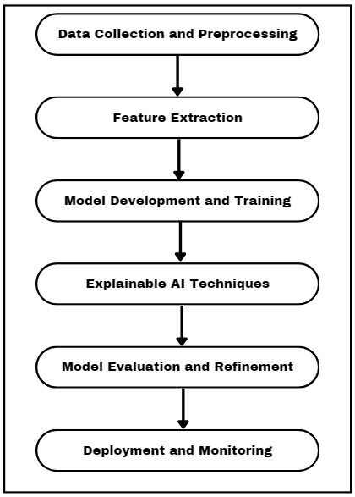
6. Methodology
Fig 1.1- Research Methodology

Slide 9
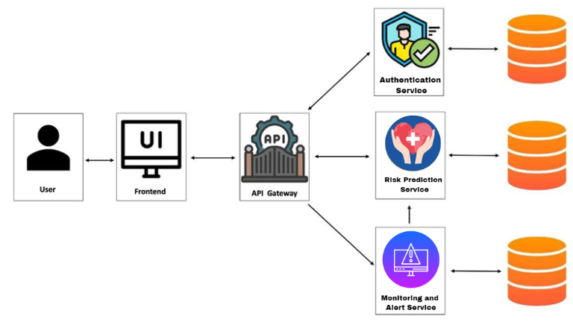
6. Methodology(cont.)
Fig 1.2- Architecture

Slide 10
7. SWOT Analysis
Strength:
Early detection by advanced AI may reduce mortality rates by heart disease through early detection with CardioSense, allowing timely interventions
Since it is cloud-based, CardioSense can easily be scaled up across multiple settings of healthcare
Minimizing discomfort for the patient and the need for extensive testing
Weakness:
Data quality and availability
Integration with Existing Systems
Technical Ability Requirement

Slide 11
7. SWOT Analysis (Cont.)
Opportunities:
Proliferation of AI in Healthcare
Expansion of Telemedicine:
Partnerships
Regulatory Support
Threats:
Data Privacy and Security
Competitive
Reliability and Liability

Slide 12
8. Gantt Chart
QuillPost | September |  |  |  | October |  |  |  | November
Gantt Chart | W1 | W2 | W3 | W4 | W1 | W2 | W3 | W4 | W1 | W2 | W3 | W4
Literature Study
Data Collection and Processing
Feature Extraction
Model Development and Training
Explainable AI Training
Model Evaluation and Refinement
Deployment and Monitoring
Whole Team
Whole Team
Ajay Saini
Akanksha Singh
Aditya
Harshit
Whole Team

Slide 13
9. References
[1] Angelov, P.P., Soares, E.A., Jiang, R., Arnold, N.I. and Atkinson, P.M., 2021. Explainable artificial intelligence: an analytical review. Wiley Interdisciplinary Reviews: Data Mining and Knowledge Discovery, 11(5), p.e1424.
[2] Mienye, I.D. and Jere, N., 2024. Optimized Ensemble Learning Approach with Explainable AI for Improved Heart Disease Prediction. Information, 15(7), p.394.
[3]Omar, S., Mohamed, N. and Elbendary, N., 2021, August. A Cardiovascular Disease Prediction Using Machine Learning Algorithms. In The International Undergraduate Research Conference (Vol. 5, No. 5, pp. 177-179). The Military Technical College.
[4]Hossain, M.M., Ali, M.S., Ahmed, M.M., Rakib, M.R.H., Kona, M.A., Afrin, S., Islam, M.K., Ahsan, M.M., Raj, S.M.R.H. and Rahman, M.H., 2023. Cardiovascular disease identification using a hybrid CNN-LSTM model with explainable AI. Informatics in Medicine Unlocked, 42, p.101370.

Slide 14
Thank You

