Slide 1
Jupyter Notebook Outputs
10 Charts from Python Statistical Analysis
UAE CPI • 2014–2025 • 14 Sectors • 8 Methods
01 CPI Overview & Annual Inflation
02 STL Decomposition
03 Structural Breaks & Volatility
04 CUSUM Change Points
05 Sector Cross-Correlation Matrix
06 UMAP + HDBSCAN Clusters
07 Sector Volatility Analysis
08 Cross-Correlation Lags
09 Sector Inflation Heatmap
10 Cumulative Price Evolution
1 / 11

Slide 2
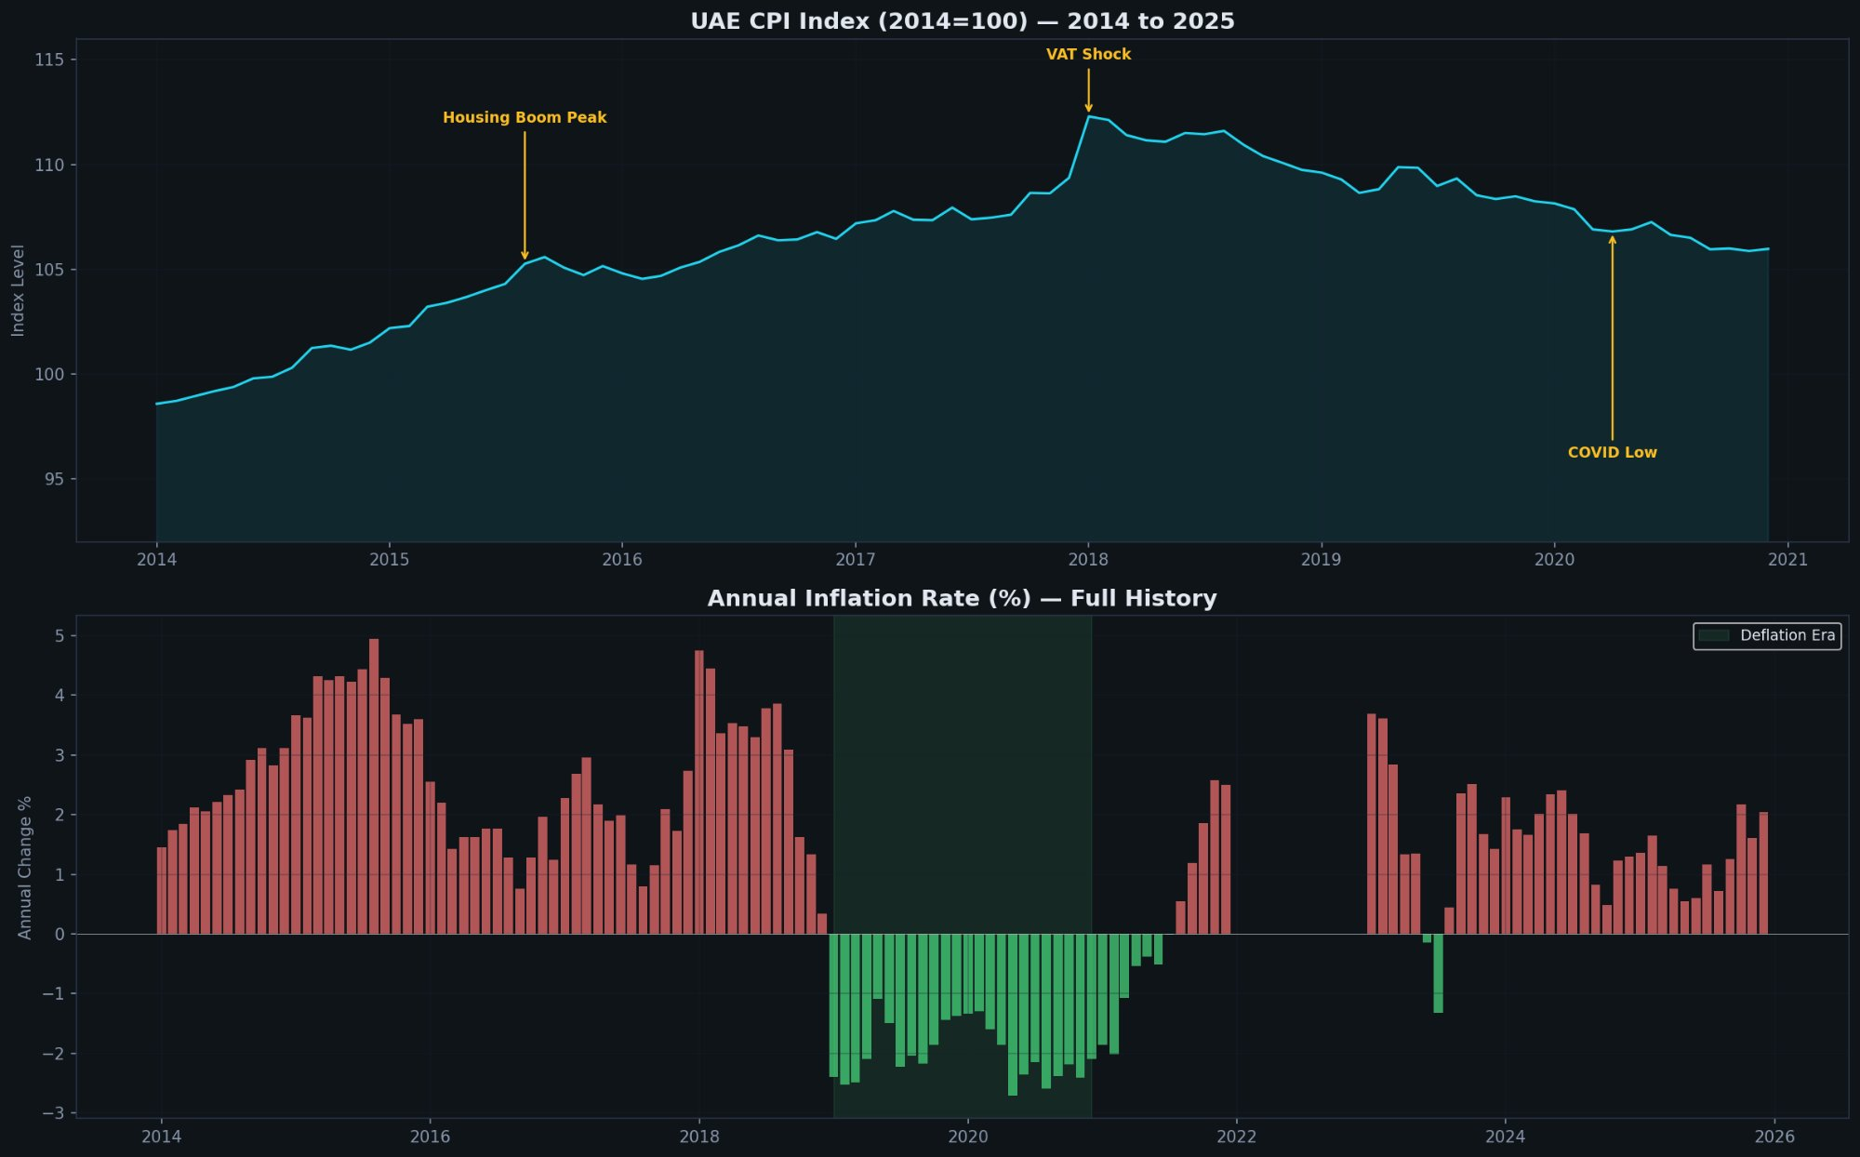
01 — CPI Overview & Annual Inflation Rate
Key Insights
Top chart: CPI Index (2014=100) Shows the price level trajectory. VAT shock in Jan 2018 is the sharpest jump. Post-2018 decline into deflation clearly visible. Bottom chart: Annual Inflation % Red = inflation, green = deflation. Four eras visible: 2015 boom (~5%), 2018 VAT spike (4.75%), 24-month deflation block (2019-20), and 2022 oil shock peak followed by normalisation. Green shaded area marks the 24-month deflation era — unprecedented in the GCC. Method: pandas pivot + matplotlib bar chart Data: 2014-base index (top), 2014+2021-base annual change (bottom), 2022 reconstructed from index levels
Used in: PPT Slide 2 (Problem), Dashboard Tab 1 (Overview)
2 / 11

Slide 3
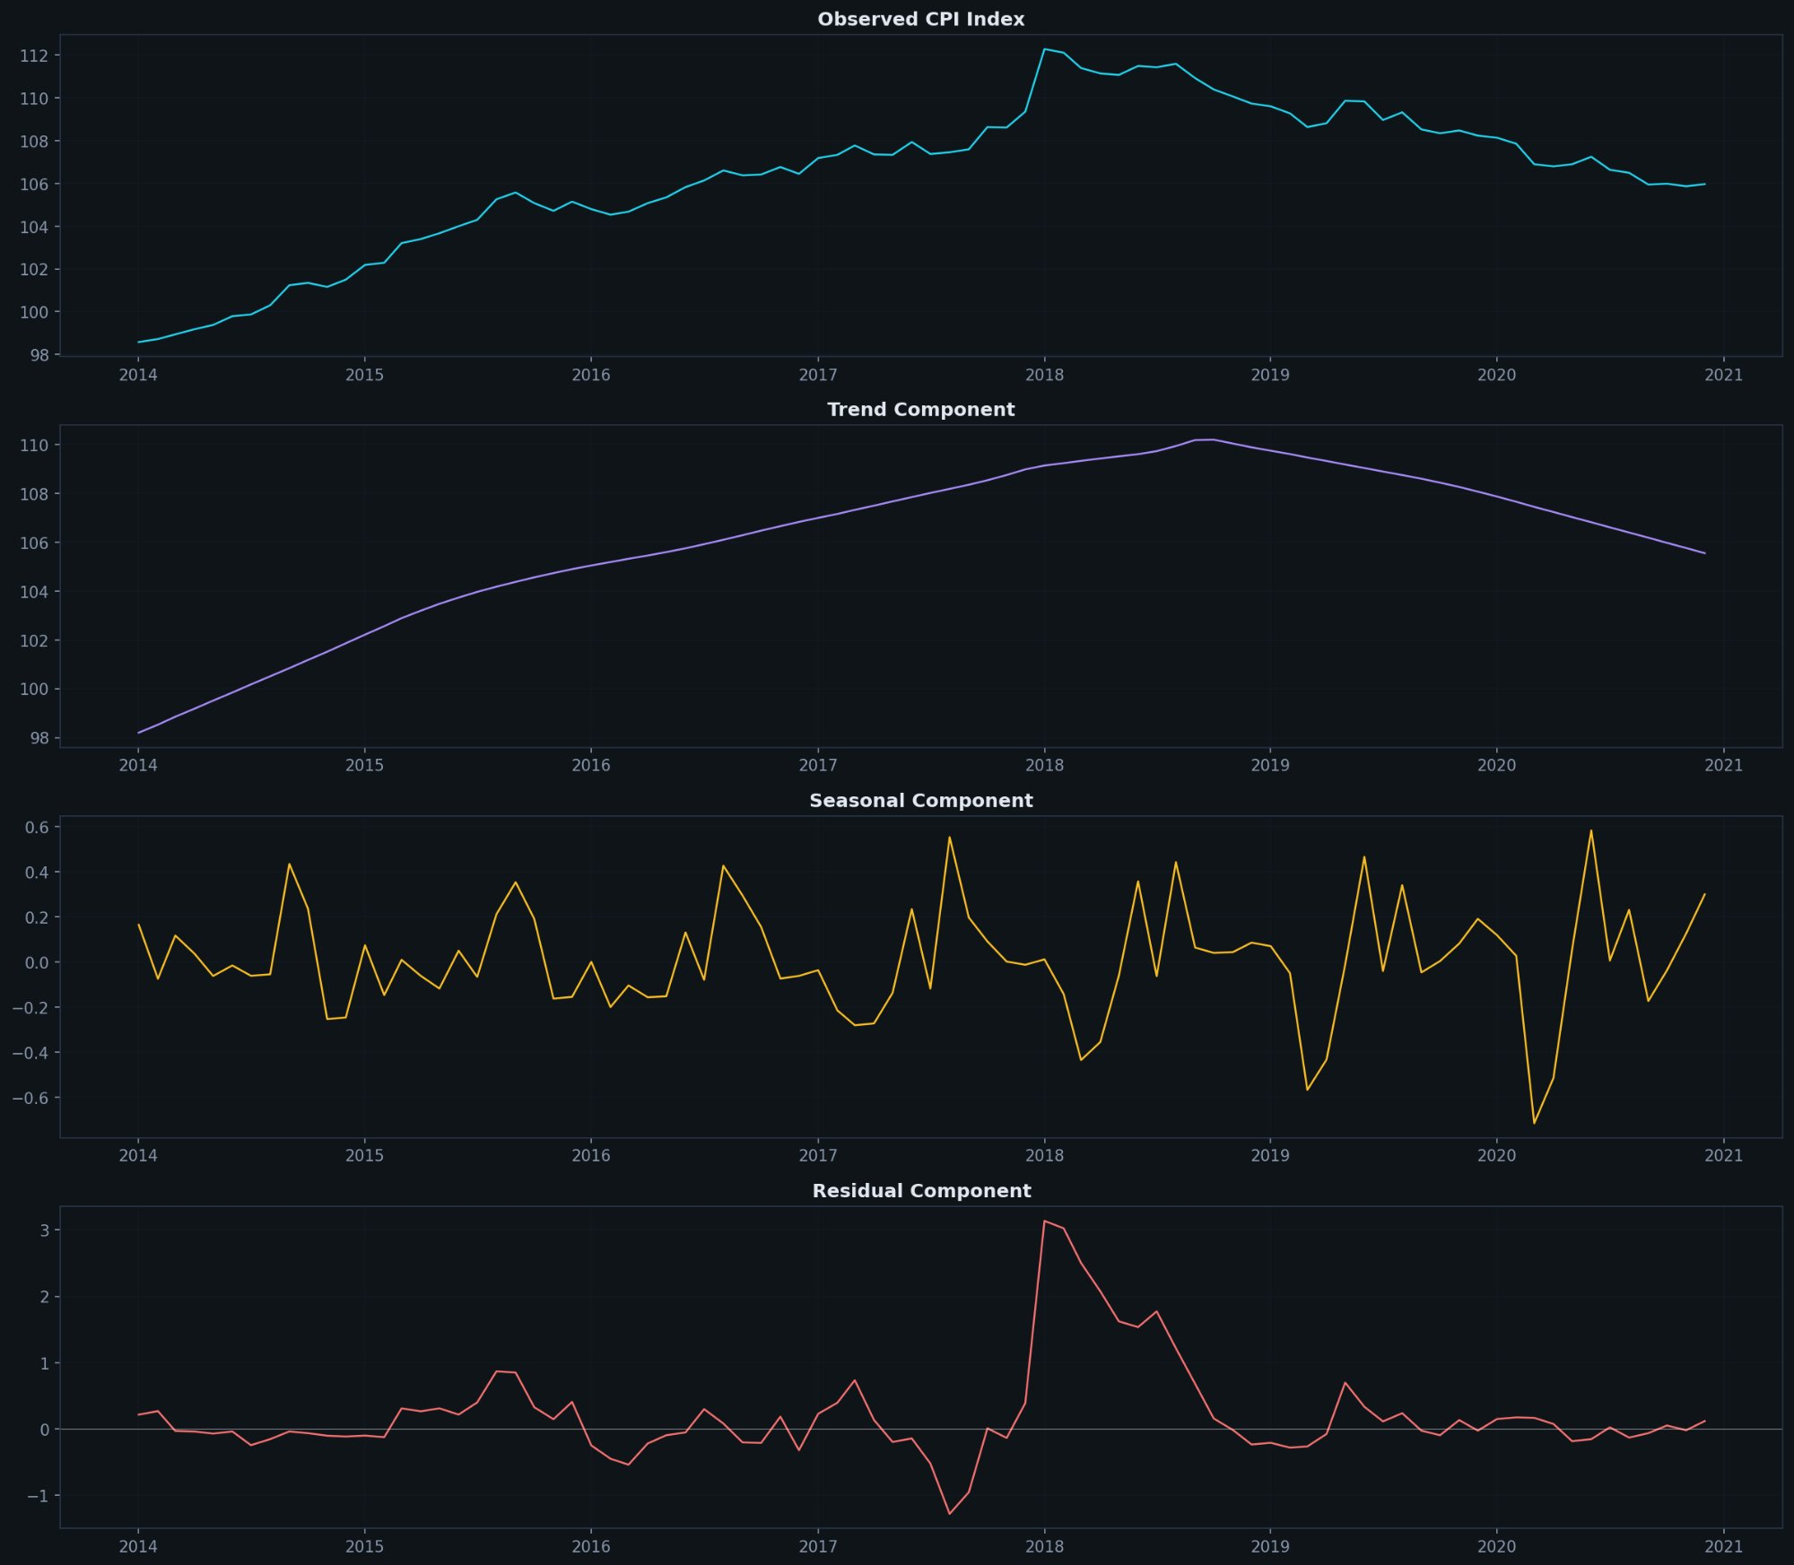
02 — STL Decomposition
Key Insights
4 panels (top to bottom): 1. Observed: Raw CPI index — same as Chart 01 top 2. Trend: Smooth underlying direction. Rise to 2018, then decline. Captures 85.8% of all variance. 3. Seasonal: Repeating annual pattern. Amplitude ±0.7 index pts — TINY. Only 0.5% of variance. Ramadan/summer barely matter. 4. Residual: Unexplained shocks. The Jan 2018 VAT spike (peak ~3.1) is the largest residual — a genuine one-off shock. Conclusion: UAE CPI is structurally driven, not seasonal. Focus on housing, oil, policy — not calendar.
3 / 11

Slide 4
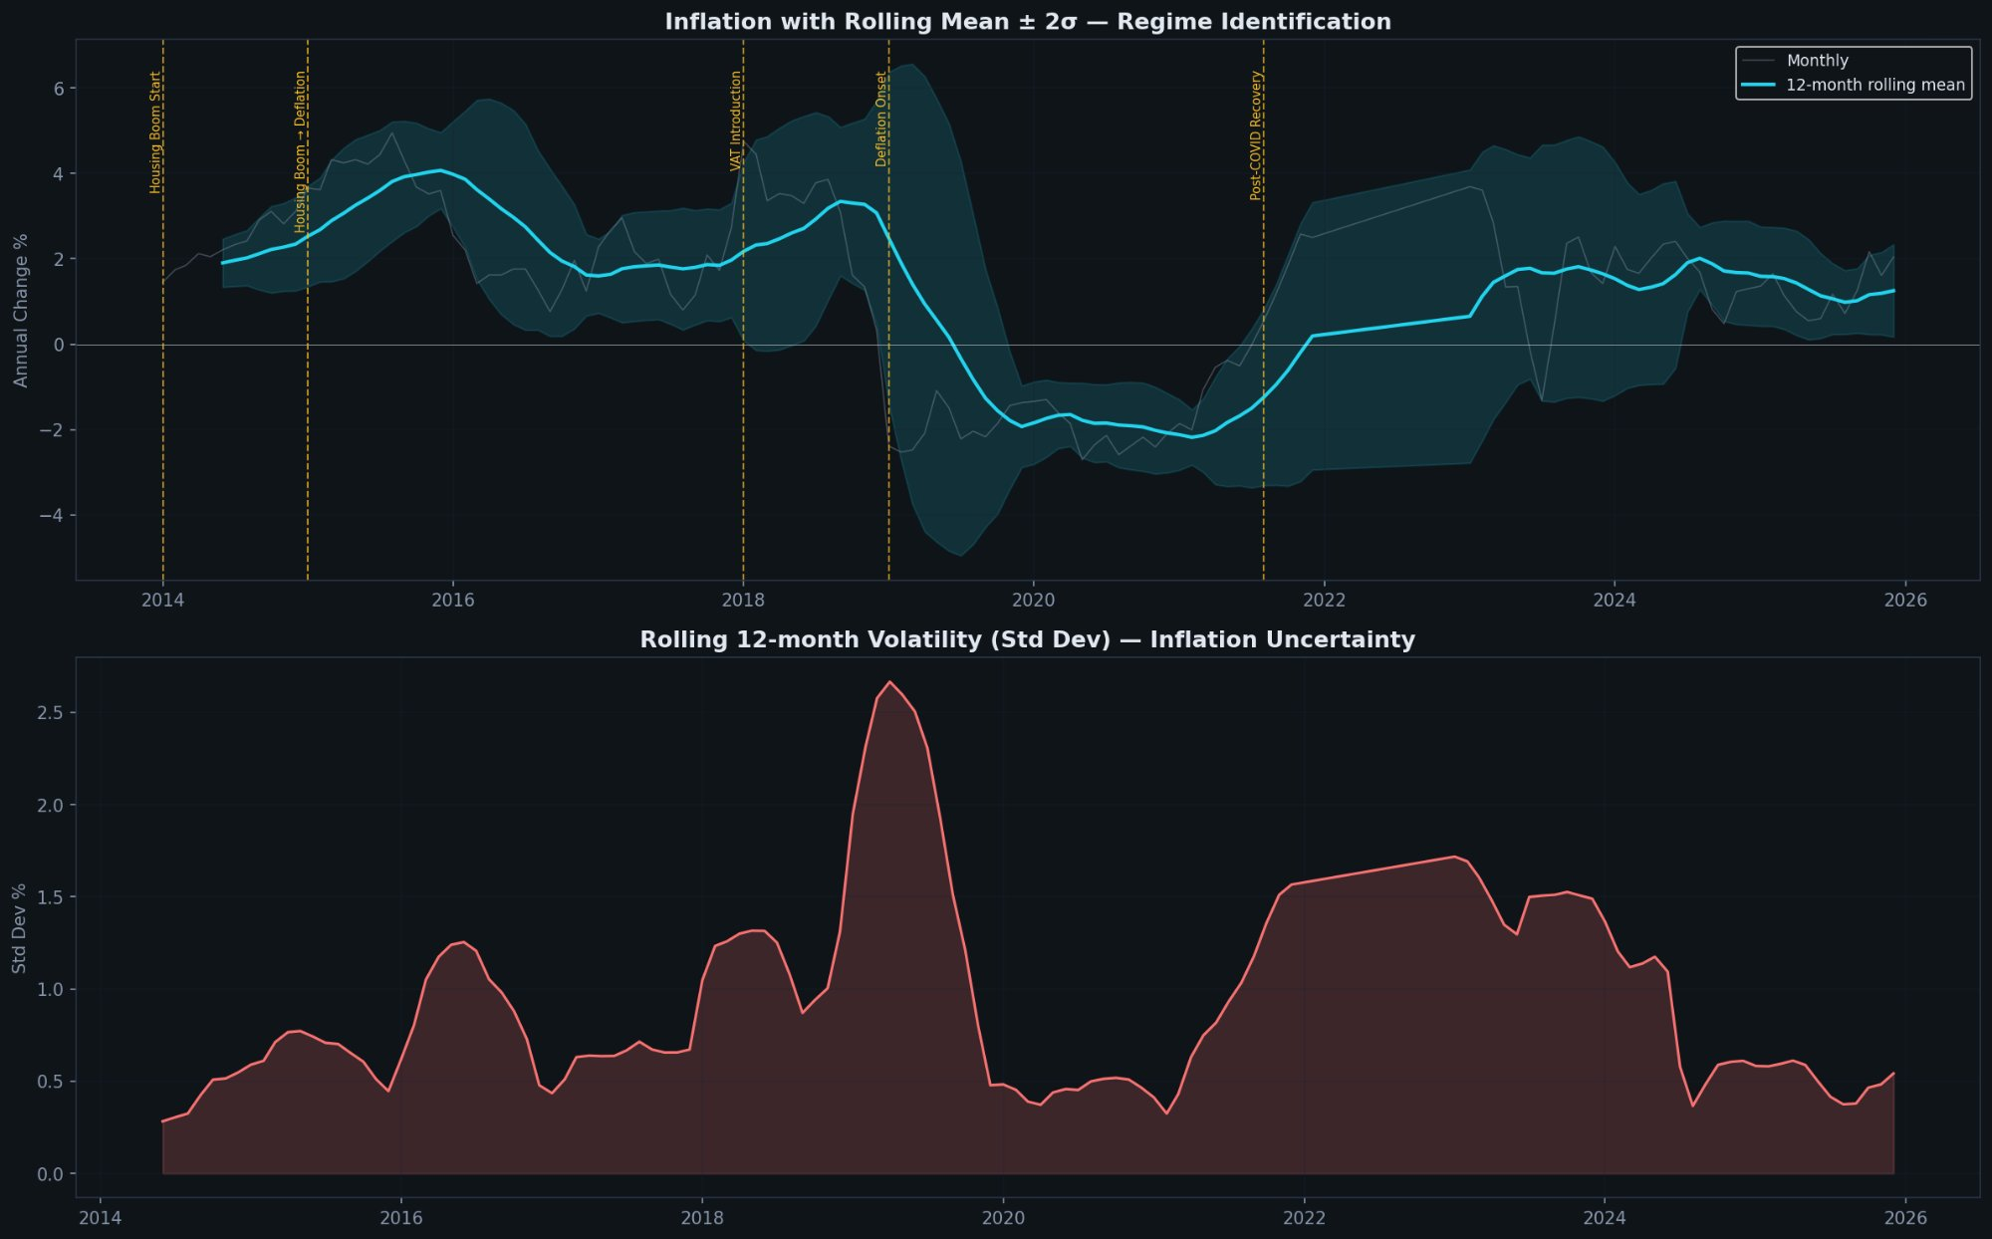
03 — Structural Breaks & Rolling Volatility
Key Insights
Top: Rolling mean ± 2σ bands Cyan line = 12-month rolling average. Teal band = ±2 standard deviations. Yellow dashed lines mark regime boundaries: Housing Boom, VAT, Deflation Onset, Post-COVID Recovery. When the line breaks outside the band = regime change. The 2018→2019 collapse is the most dramatic: from +4% to −2% in 12 months. Bottom: Rolling 12-month volatility The VAT period (2018) shows peak uncertainty at 2.6% std dev. The 2022 oil shock created a second volatility spike. Current 2025 volatility is LOW (~0.5%) = stable two-speed economy. Conclusion: Volatility spikes at regime transitions, then settles. 2025 is the most stable period since 2017.
4 / 11

Slide 5
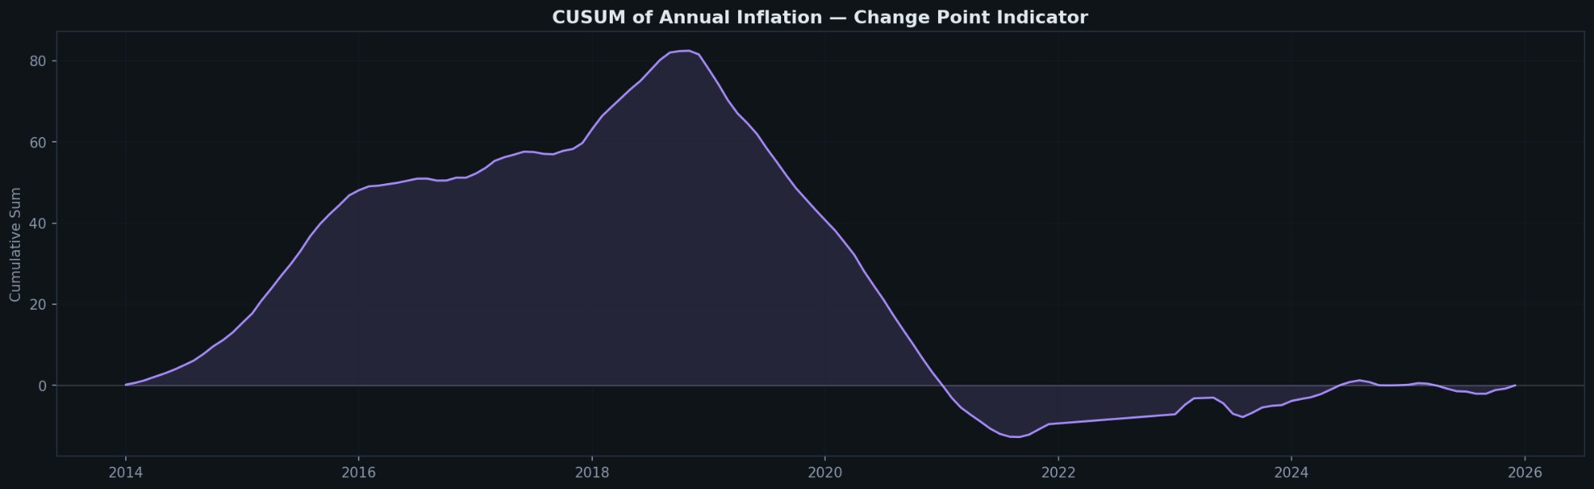
04 — CUSUM Change Point Detection
Key Insights
How to read CUSUM: Rising = sustained above-average inflation Falling = sustained below-average inflation Sharp kinks = regime change points The story in one curve: 2014→2018: Steep rise. UAE inflating above its long-run average for 4 years straight. 2018→2019: Sharp reversal. Peak at ~82, then plummets. The VAT shock followed by deflation onset. 2019→2021: Continued fall into negative territory. 24 months of below-average inflation. 2022→2025: Brief recovery (oil shock) then returns to ~0. The economy is now at its long-run average. Conclusion: CUSUM returning to zero in 2025 means the cumulative over/under-inflation has netted out over the decade.
5 / 11

Slide 6
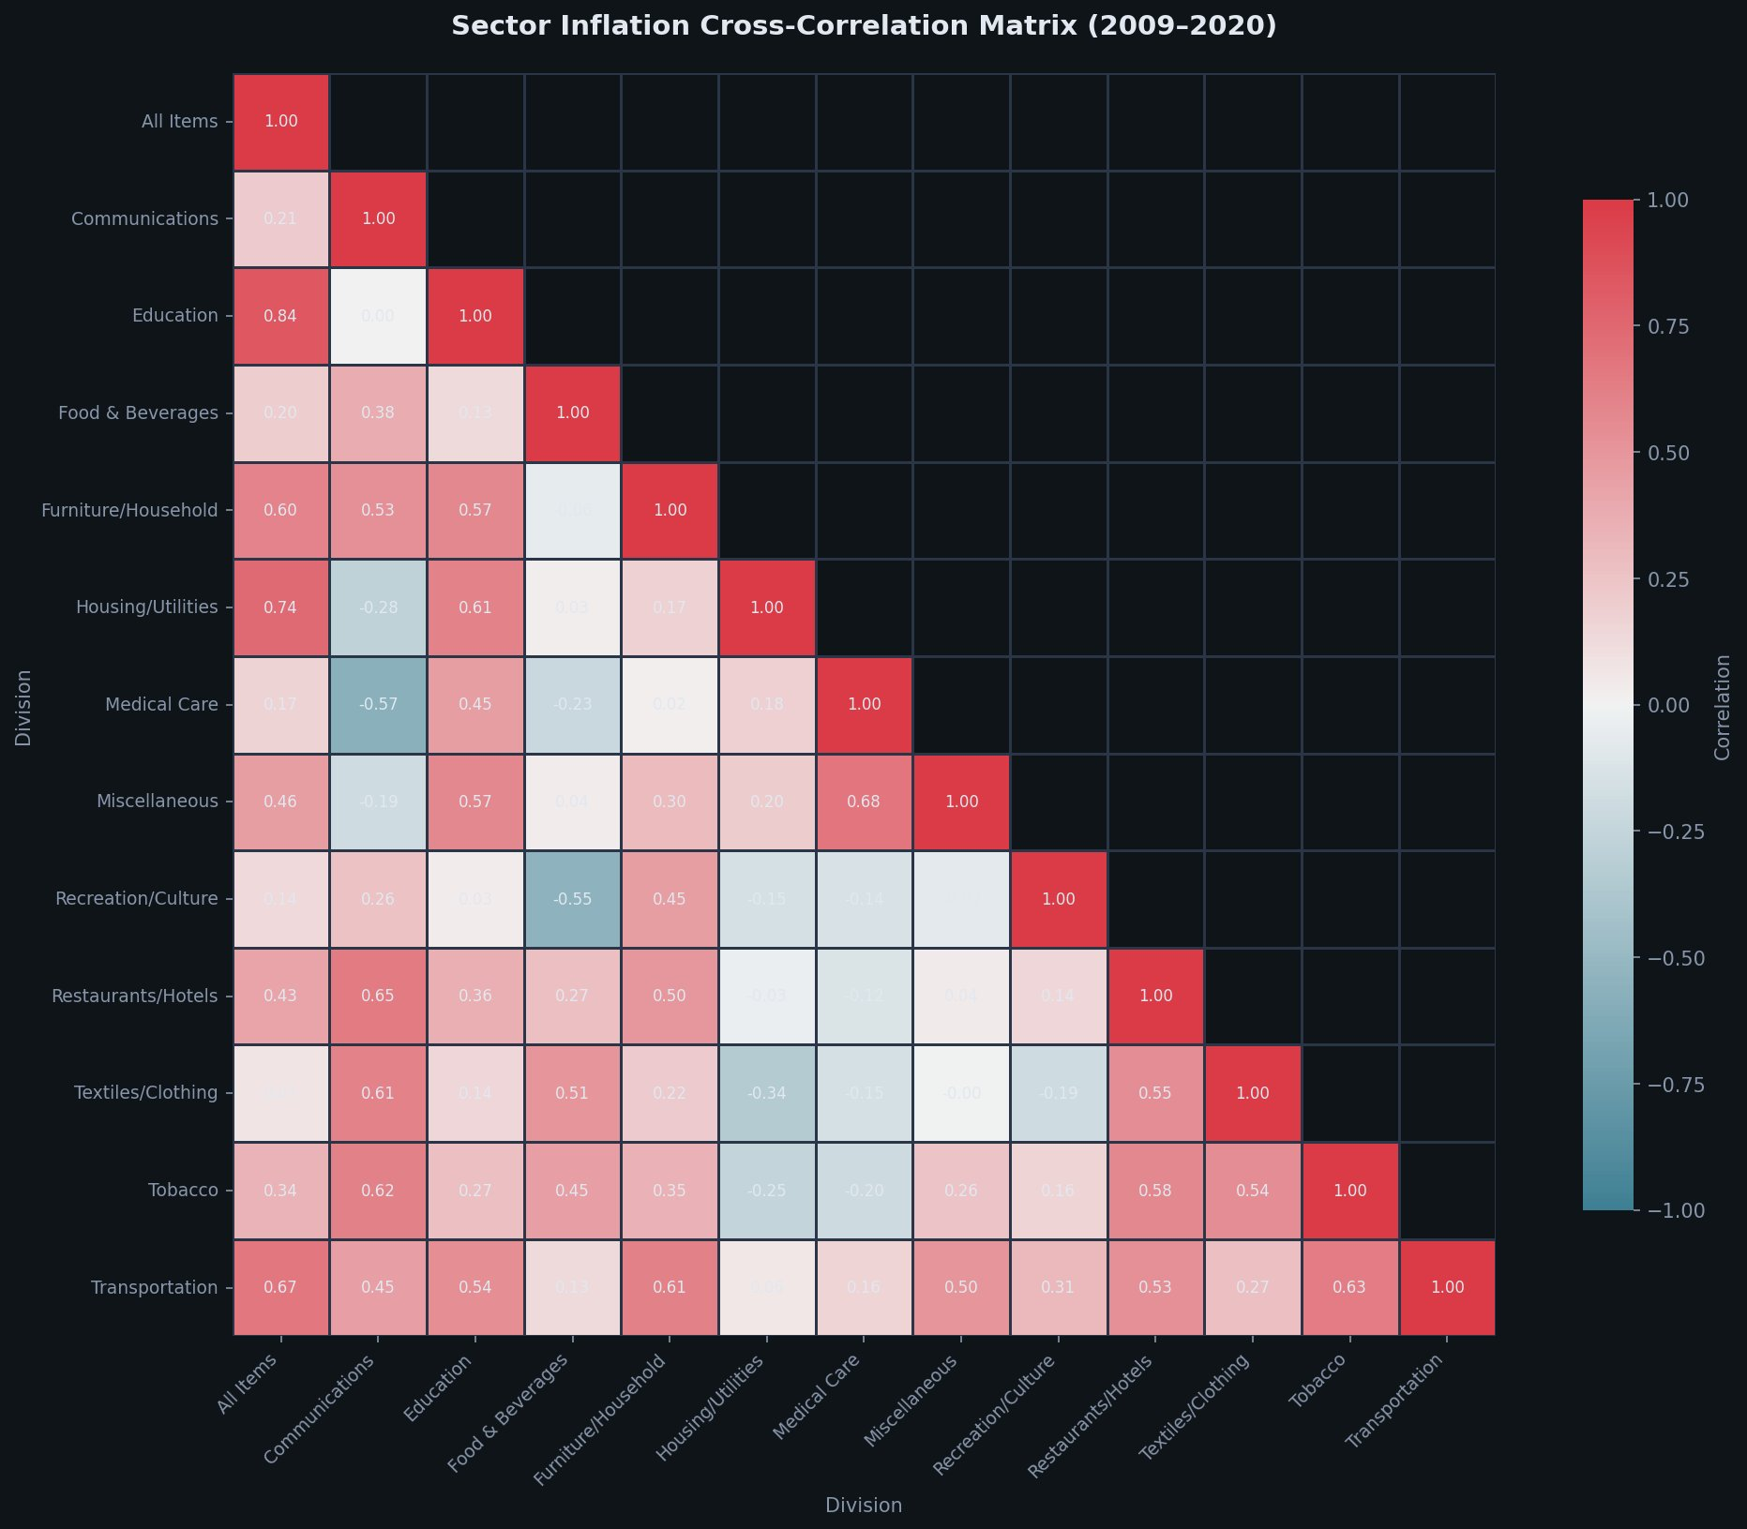
05 — Sector Cross-Correlation Matrix
Key Insights
What this shows: Pairwise Pearson correlation between every sector pair. Red = positive (move together), blue = negative (move opposite). Strongest correlations with All Items: • Education: 0.84 (school fees track overall CPI) • Housing: 0.74 (dominant weight) • Transport: 0.67 (oil channel) • Furniture: 0.60 (import-sensitive) Notable negative correlations: • Medical ↔ Communications: −0.57 (opposite dynamics) • Recreation ↔ Food: −0.55 (discretionary vs essential) Housing ↔ Communications: −0.28 These move in opposite directions — when housing inflates, communications deflates. The two-speed economy in one number. Method: seaborn heatmap on pandas .corr() matrix
6 / 11

Slide 7
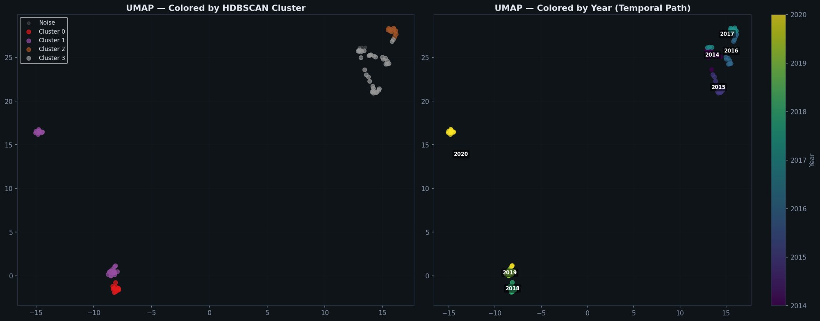
06 — UMAP Projection + HDBSCAN Clusters
Key Insights
Left panel: Coloured by HDBSCAN cluster. 4 distinct clusters + noise (grey). Each cluster = an economic regime discovered purely from 13 sector inflation profiles, with zero human guidance. Right panel: Same points coloured by year. You can see the economy travel through time: 2014-2017 (top right), 2018-2019 (bottom centre), 2020 (isolated left). The path through UMAP space IS the inflation story. Key finding: The 2020 deflation cluster (yellow, far left) is physically isolated from all other regimes — proving the deflation era was structurally unique, not just a mild slowdown.
7 / 11

Slide 8
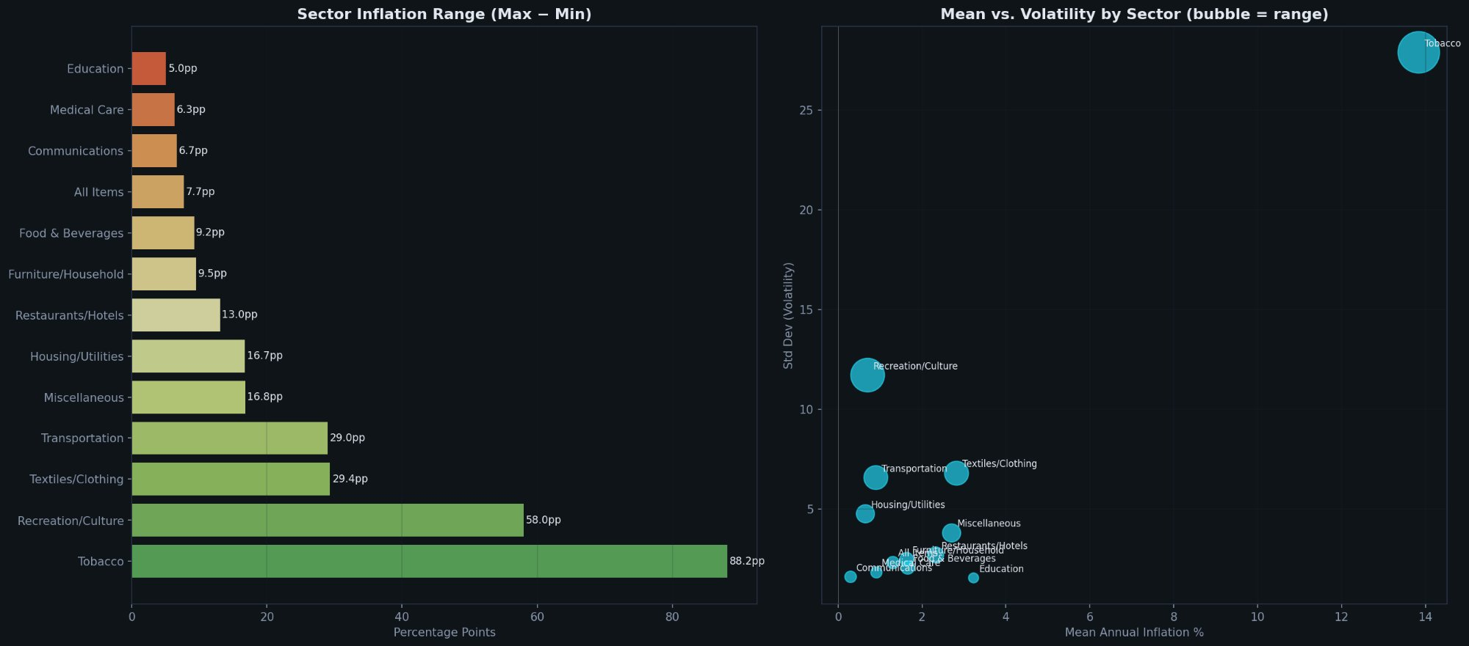
07 — Sector Volatility: Range & Mean vs Std Dev
Left: Inflation range (max minus min) per sector. Tobacco: 88pp range (excise tax). Recreation: 58pp (COVID swing). Transport: 29pp (oil). Education: just 5pp (regulated fees). Right: Mean inflation (x-axis) vs volatility/std (y-axis). Bubble size = range. Tobacco is the extreme outlier (high mean, high volatility, huge range). Housing sits at moderate mean with moderate volatility — but its 35% WEIGHT makes it the most impactful. Key insight: Impact = weight × volatility. Transport is volatile but only 13% weight. Housing is less volatile but 35% weight. Housing wins.
8 / 11

Slide 9
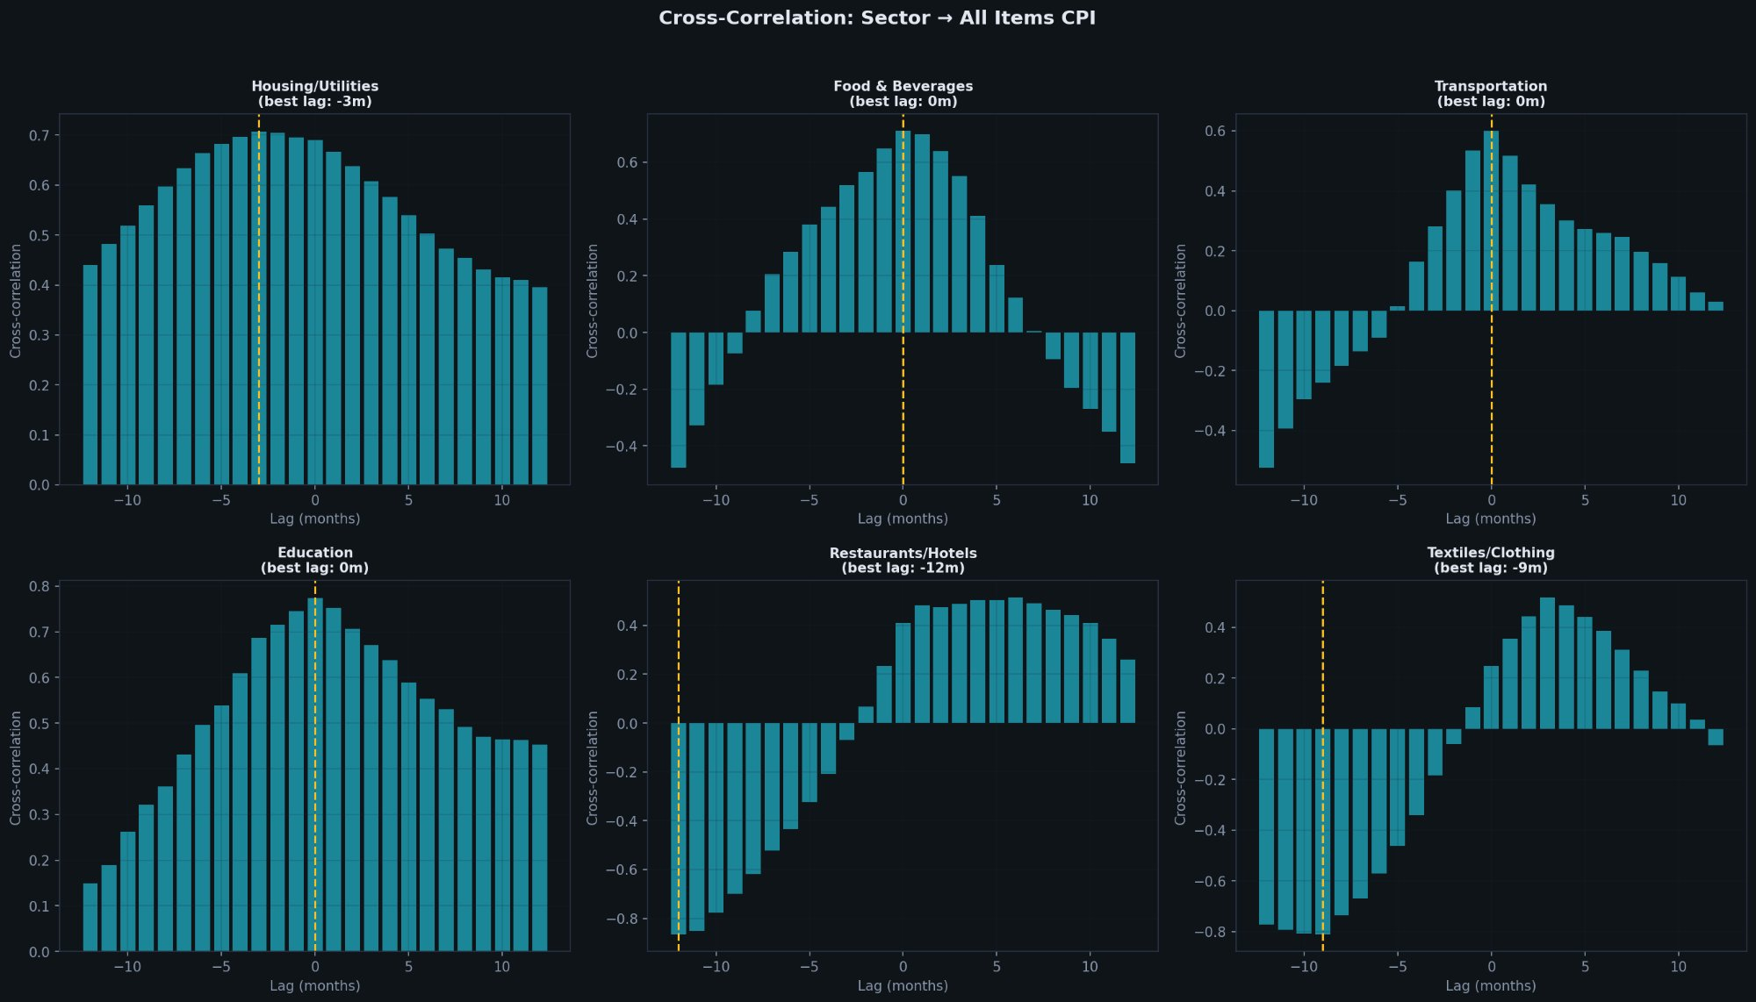
08 — Cross-Correlation Lag Analysis (6 Key Sectors)
How to read: Each subplot shows correlation between that sector and All Items at different monthly lags. Peak position = lead/lag timing. Yellow dashed = best lag. Housing (best lag: −3m): Strong positive correlation, peaks slightly before headline — a leading indicator. Food (0m) & Transport (0m): Coincident — they move simultaneously with headline CPI. Oil/food shocks transmit instantly. Restaurants (−12m) & Textiles (−9m): Long lagging sectors — they respond months after headline moves. Useful for confirming trends, not predicting them.
9 / 11

Slide 10
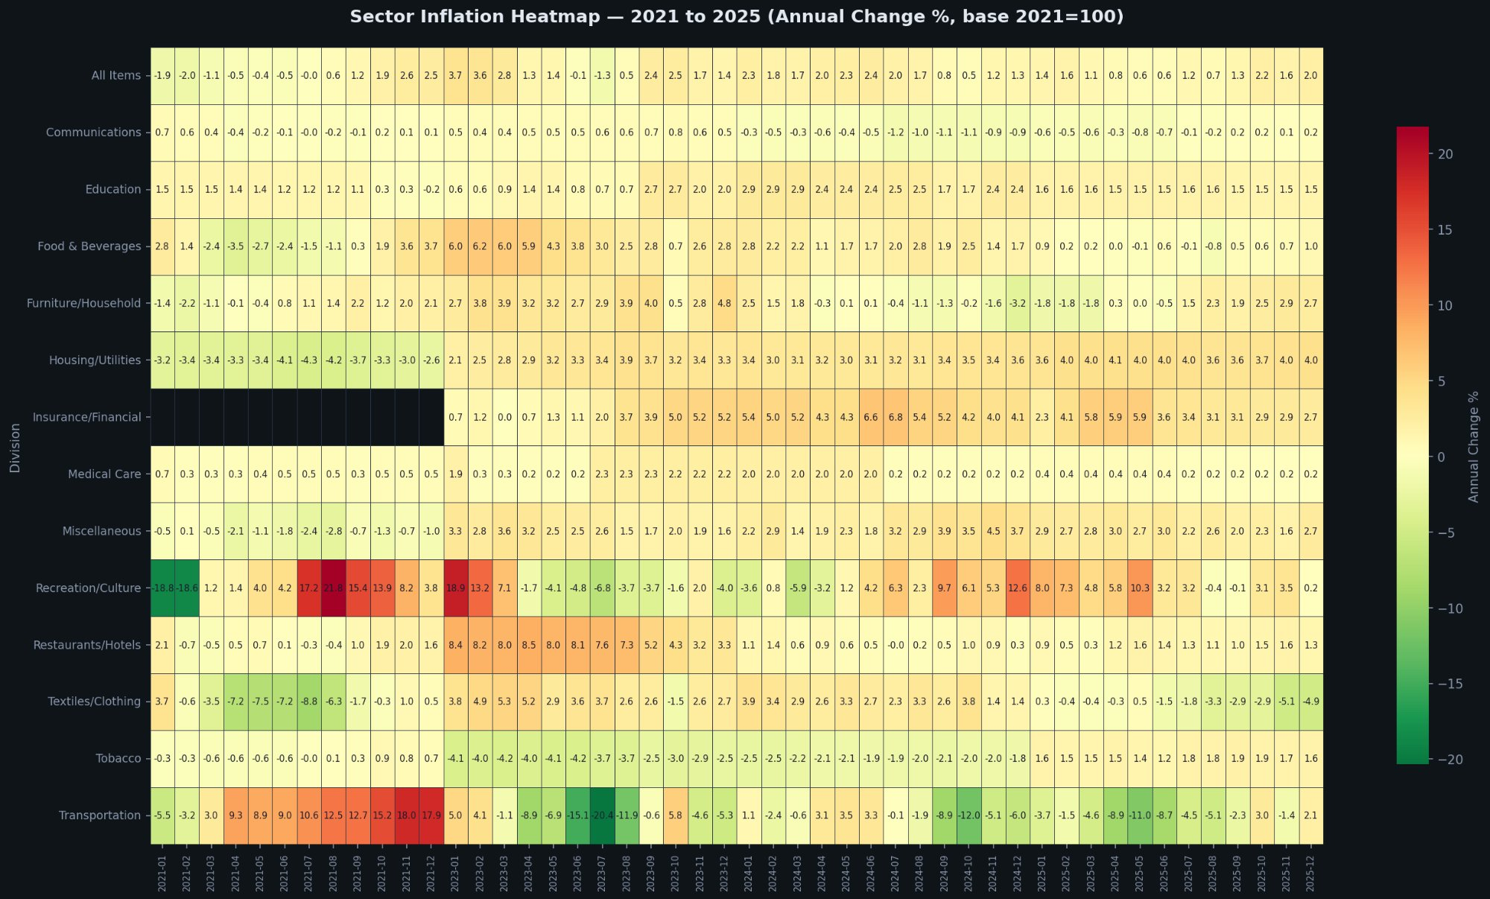
09 — Sector Inflation Heatmap (2021–2025)
Every cell = one sector, one month. Red = high inflation, green = deflation, yellow = moderate. Key patterns visible: (1) Transport's red band in mid-2022 (oil shock at +42%) then green band in 2023 (base effect collapse). (2) Housing turns from green (2021) to steady yellow-orange (2023-2025) — the slow structural shift. (3) Recreation's extreme red patch (2021-22) = Expo 2020 + COVID base effect. (4) Textiles going progressively greener through 2025 = strengthening dollar peg deflation. (5) Tobacco's white band (2021-base) = below 100 on the index, meaning prices FELL below 2021 levels despite excise tax.
10 / 11

Slide 11
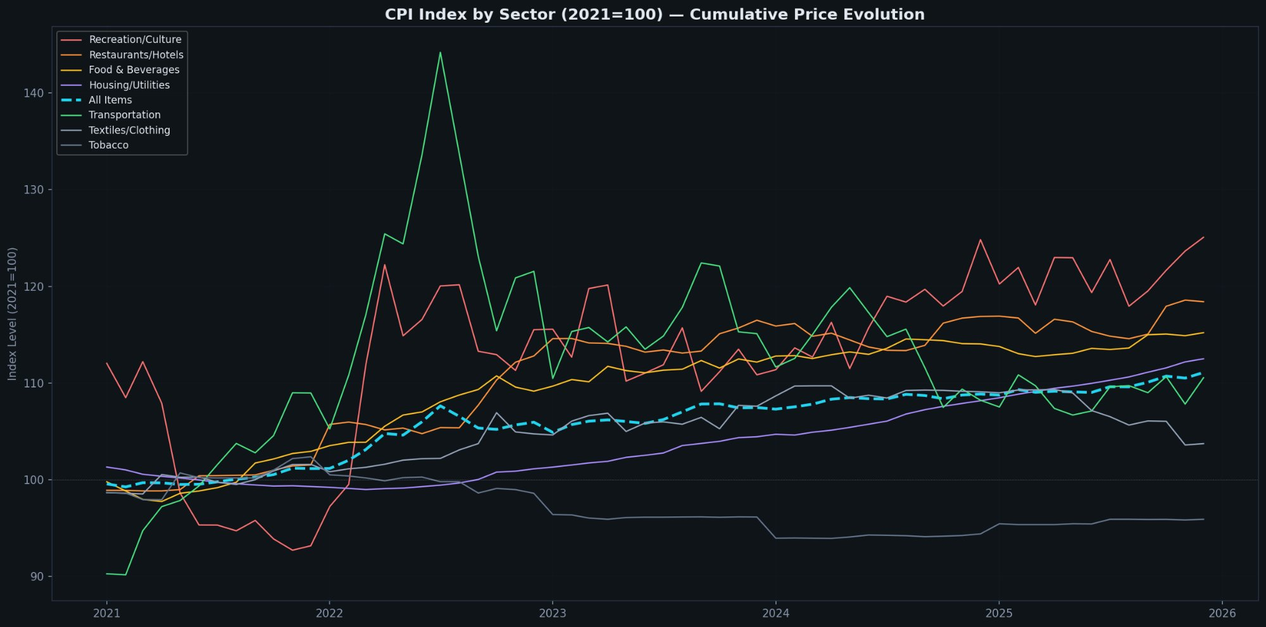
10 — Cumulative Price Evolution by Sector (2021=100)
Every line = one sector's price level since 2021. Dashed cyan = All Items. Winners since 2021: Recreation (+25%), Restaurants (+18%), Food (+15%), Housing (+12%). Losers: Tobacco (below 100 = cheaper than 2021), Textiles (barely above 100). Transport (green): The most volatile line — spiked to 145 in mid-2022 (oil at $122), then crashed back to 110. This single line explains the Jul 2023 “−20%” headline. The two-speed economy: Non-tradeables (red/orange lines, top half) diverging from tradeables (grey/green, bottom half). Gap widens through 2025.
11 / 11

