Slide 1
Q-Commerce Pricing &
Experimentation Engine
Price and promote with evidence, not guesswork
Data-science project · synthetic UAE q-commerce data · Akanksha Swarnim

Slide 2
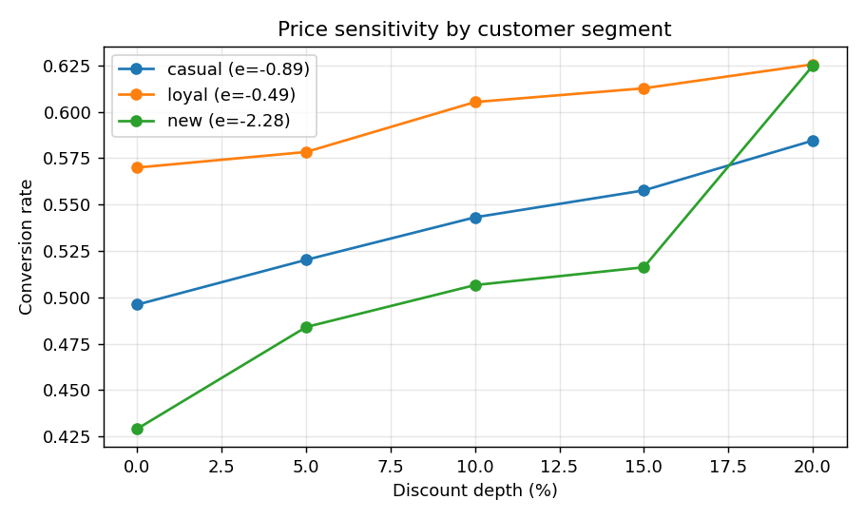
The problem
Why this matters to the business
Q-commerce wins orders with discounts and promos — but do they actually make money?
Thin margins every discount point hurts
Promos are costly spend must pay for itself
A/Bs mislead naive reads can flip the truth
Segments differ one price doesn't fit all
Demand does respond to price — the question is by how much, and for whom.

Slide 3
What we're building
Three questions, answered with data
Measure
Experiment
Optimise
true price elasticity
read A/Bs correctly
for margin, by segment
From “did the promo work?” to “what pricing makes the most margin?”

Slide 4
How it works
End-to-end pipeline
1
2
3
4
5
Synthetic orders
Price elasticity
Experiment (A/B)
Margin guardrail
Segment policy
price, segment, zone
how demand reacts
stratified + CUPED
is a discount worth it?
the optimal action
Synthetic orders → a pricing decision the business can act on

Slide 5
Approach, models & tools
Pricing science, end to end
1
2
3
4
Elasticity
Experiment
Optimisation
Data
Logit on log-price
A/B + stratification
Margin curves
Synthetic DGP
interpretable elasticity
Simpson-safe, CUPED
optimal discount / segment
known elasticity & zones
Tools
Python
pandas
NumPy
SciPy
statsmodels
Plotly

Slide 6
Key data-science decisions & why
Judgment, not just code
Demand as a logit on log-price
→
gives an elasticity leadership can act on, not a black box
Stratified the A/B by zone
→
allocation was imbalanced — the average lied (Simpson's paradox)
Applied CUPED
→
cuts variance ~5% so smaller true effects show up sooner
Optimised margin, not conversion
→
a conversion lift can still lose money; the P&L is what matters
Discount guardrail at break-even
→
never recommend a promo that gives away more than it earns

Slide 7
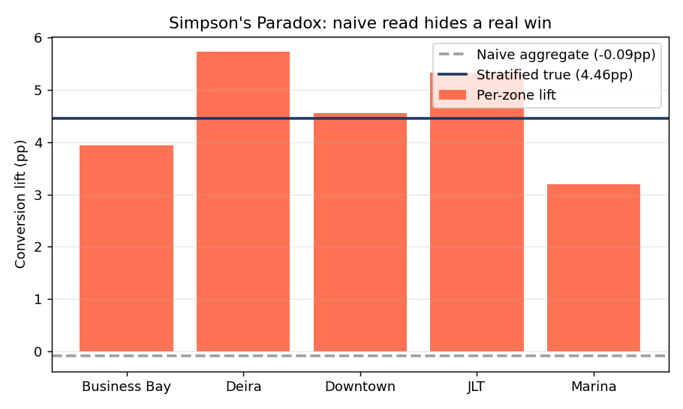
Reading experiments correctly
The trap that flips a result
Same data, opposite stories.
Naive read: -0.09pp “the promo did nothing”
Stratified by zone: +4.46pp it actually works

Slide 8
How it helps the business
From method to money
+AED 2.0M
8.85 → 10.87
+4.46pp
per month margin upside
margin per order (AED)
true promo lift, uncovered
Decisions it enables:
Stop blanket discounts that quietly erode margin
Trust experiments — stratified reads, not misleading averages
Set price/promo per segment and zone, where it pays

Slide 9
Results
What the engine found
-0.78
+4.46pp
5.1%
+AED 2.0M
price elasticity (inelastic)
true promo lift (stratified)
CUPED variance cut
monthly margin upside
Demand is fairly inelastic — so discounts mostly give away margin. The engine quantifies exactly when they don't.

Slide 10
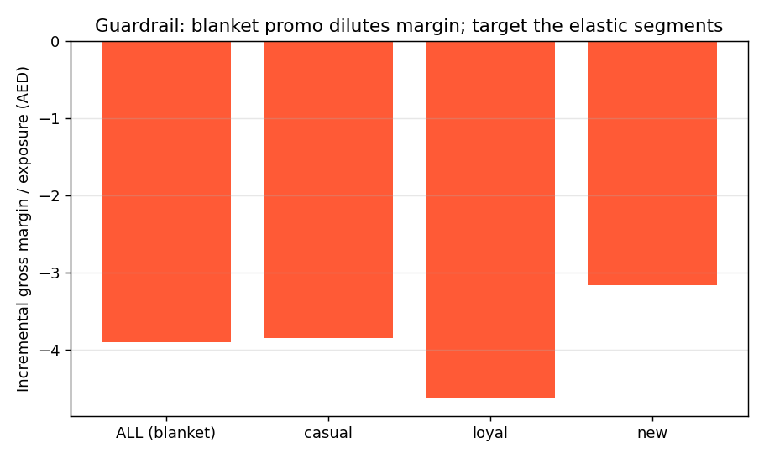
The key insight
Lift ≠ profit
Discounts lift orders — and still lose money.
Margin per order falls at every discount depth.
Optimal discount = 0% for every segment here — disciplined pricing beats blanket promos.

Slide 11
Edge cases & guardrails
Why the answer holds up
Simpson's paradox
CUPED variance cut
Margin guardrail
stratify by zone before reading any A/B
spot smaller true effects sooner
never recommend a money-losing discount
Segment & zone mix
Inelastic-demand check
Reproducible
uneven allocation handled explicitly
lift is weighed against margin given up
fixed seed → identical results

Slide 12
What it proves
Experimentation done right — A/B, CUPED, Simpson's-paradox detection
Pricing science tied to margin, not vanity metrics
Quantified business impact: ~AED 2.0M / month
Price and promote with evidence, not guesswork

