Slide 1
Shell Bootcamp 2024 3 Reflections for Week 2
Akanksha Goel
Date : 09-Sep-2024

Slide 2

About Me
Quiet persistence leads to unstoppable progress.
Please share an image / visual that best represents you

Slide 3

My learnings from this week!

Slide 4
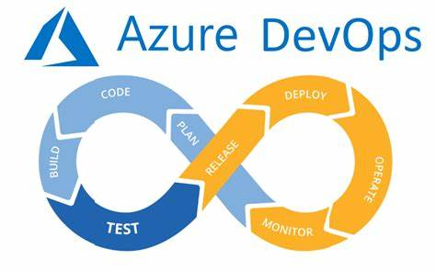
Learning 1 | My takeaways
Azure VM & Azure DevOps
Key takeaways:
User Story and tasks Creation
Sprint Backlog, Product Backlog
Sprint Board
Definition of Ready & Definition of Done(DOR & DOD)
Acceptance Criteria
Creation and configuration of Virtual Machine
Cloud(IaaS,PaaS,SaaS)
Implementation in the Energy sector:
Azure VMs can be used to create scalable and flexible infrastructure for energy management systems
Azure DevOps facilitates better collaboration among teams working on energy projects by providing tools for version control, continuous integration, and continuous deployment.
Utilizing cloud services like IaaS, PaaS, and SaaS can significantly reduce the costs associated with maintaining physical servers and infrastructure

Slide 5
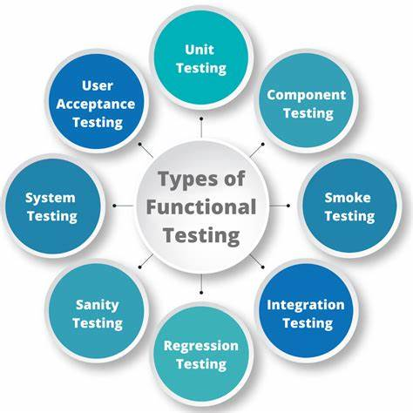
Learning 2 | My takeaways
Testing & STLC
Key takeaways:
Functional and Non-Functional Testing
System Testing Hierarchy
Testing Types(Smoke, Regression, Adhoc, Performance)
Test Plan Document and Test Case Development
Behavioral Driven Development using Gherkin
Bug Life Cycle & Defect Report
Test Driven Development
Implementation in the Energy sector:
By conducting thorough unit, integration, system, and acceptance testing, energy companies can ensure that their systems are robust and reliable, minimizing downtime and improving service continuity.
Gherkin facilitates clear communication between developers, testers, and business stakeholders, ensuring that the developed systems meet the actual needs of the energy sector.

Slide 6
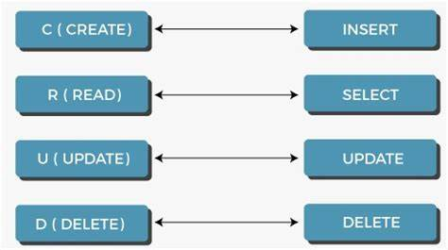
Learning 3 | My takeaways
PostgreSQL & CI/CD
Key takeaways:
CRUD operations
DDL,DML & DQL
Creation of Queries
Architecture & API protocols
Integration using Maven
GitHub Actions and yml file creation
Implementation in the Energy sector:
PostgreSQL: Used for storing and managing large volumes of energy consumption and production data.
Implementing CI/CD pipelines using GitHub Actions ensures that updates to energy management systems are tested and deployed automatically, reducing downtime and improving reliability.

Slide 7

Relevance of learnings for my organization

Slide 8
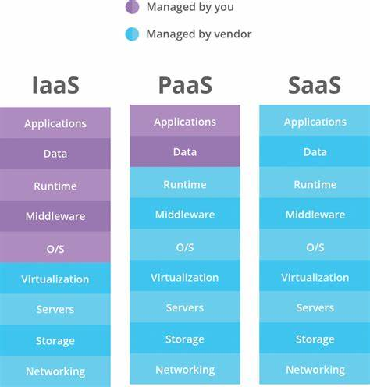
Learning 1 | Relevance for Shell
Azure VM & Azure DevOps
How I feel Shell implements this learning
Shell employs Azure DevOps to meticulously create and manage user stories and tasks, ensuring clear project requirements and responsibilities. Additionally, Shell uses Azure VMs to create scalable and flexible infrastructure, leveraging different cloud models (IaaS, PaaS, SaaS) to optimize its IT environment.
How I feel Shell benefits from this learning
Azure DevOps tools enhance collaboration among teams, improving project management, version control, and CI/CD processes, leading to faster development cycles and higher-quality outputs. Utilizing cloud services like IaaS, PaaS, and SaaS reduces costs associated with maintaining physical servers and infrastructure, allowing Shell to allocate resources more efficiently, invest in innovation, and enhance overall business performance. This comprehensive approach enables Shell to respond swiftly to market changes and operational needs, driving better performance and innovation in the energy sector.

Slide 9
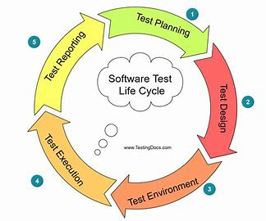
Learning 2 | Relevance for Shell
Testing & STLC
How I feel Shell implements this learning
Shell conducts thorough functional and non-functional testing to ensure robust systems. It follows a structured testing hierarchy and employs various testing types. Test plans and cases guide the process, while BDD with Gherkin ensures clear communication. The bug life cycle and TDD practices maintain high-quality code.
How I feel Shell benefits from this learning
Comprehensive testing ensures robust, reliable systems, minimizing downtime and improving service continuity. BDD with Gherkin facilitates clear communication, aligning developed systems with energy sector needs. These practices enhance Shell’s ability to deliver reliable energy solutions and maintain high service standards.

Slide 10
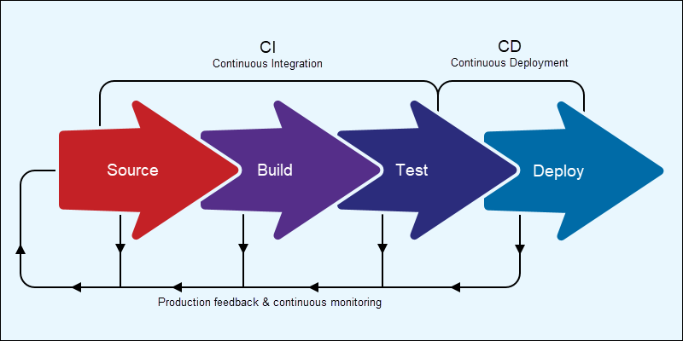
Learning 3 | Relevance for Shell
PostgreSQL & CI/CD
How I feel Shell implements this learning
CRUD operations, along with DDL, DML, and DQL, are employed to handle data effectively. Queries are created to retrieve and manipulate data as needed. Shell integrates PostgreSQL with other systems using API protocols and Maven for dependency management. GitHub Actions and YAML files are used to set up CI/CD pipelines, automating testing and deployment processes.
How I feel Shell benefits from this learning
By using PostgreSQL, Shell can efficiently store and manage vast amounts of energy data, enabling detailed analytics and reporting. Implementing CI/CD pipelines with GitHub Actions ensures that updates to energy management systems are automatically tested and deployed, reducing downtime and improving system reliability. This automation enhances operational efficiency and ensures continuous delivery of high-quality software solutions.

Slide 11

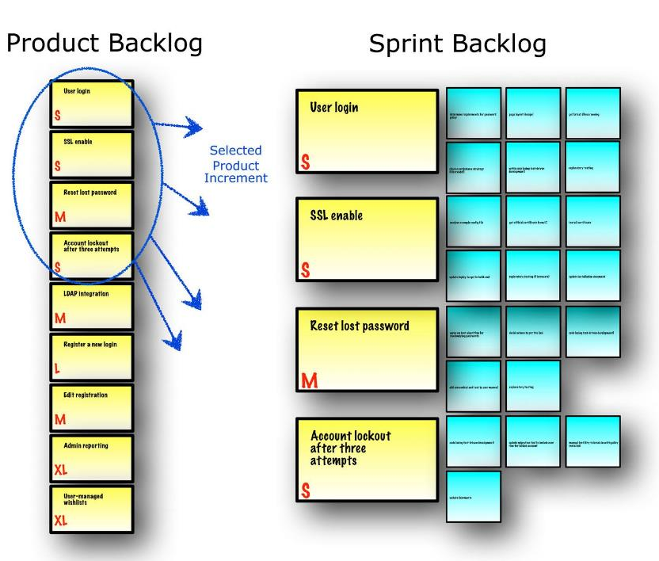
Challenge faced while implementing Learning 1
AzureVM &Azure DevOps
Challenges Faced:
Ensuring that user stories are well-defined, and tasks are clearly outlined
Deciding the Story Points & Priority
Configuring VMs to meet specific requirements and ensuring they are secure can be complex.
Plans to Overcome:
Practice Creation of Sprint Backlog
Develop a deeper understanding of functioning of VMs

Slide 12
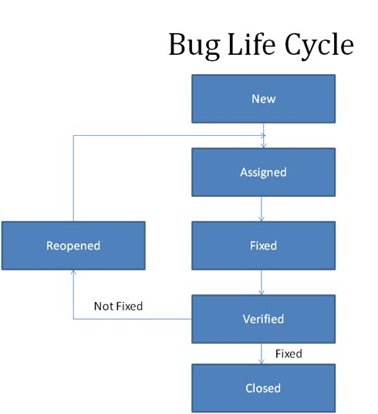
Challenge faced while implementing Learning 2
Testing & STLC
Challenges Faced:
Ensuring thorough testing at each level without redundancy.
Writing detailed & Specific Test Cases
Managing and tracking defects
Plans to Overcome:
Use RTM to ensure all use cases are covered by the test cases
Proper Documentation of bugs

Slide 13
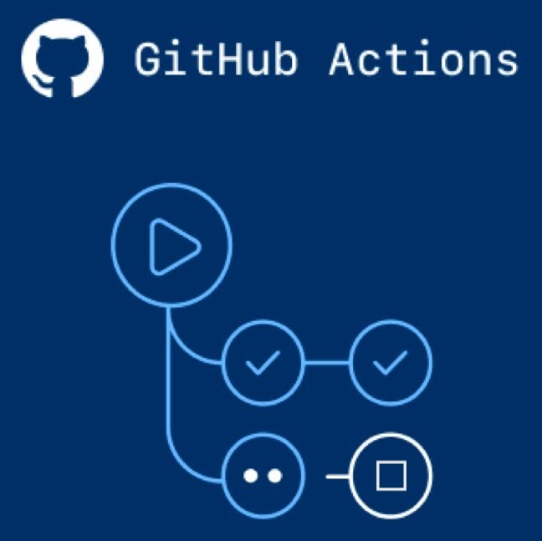
Challenge faced while implementing Learning 3
PostgreSQL& CI/CD
Challenges Faced:
Ensuring efficient CRUD operations
Setting up and maintaining CI/CD
Plans to Overcome:
Develop detailed understanding of yaml file and GitHub Actions.
Practice Query writing.

Slide 14

Action Plan

Slide 15
My Action Plan for this Week
Actions
Timeline
Status
Understanding the configuration of VMs
Practicing PostgreSQL queries
Practicing Azure DevOps
Test case development for sites to practice
Saturday- Learn more about VMs
Sunday- Practice DevOps and STLC
Will be completed

Slide 16

Learning is also Fun!

Slide 17
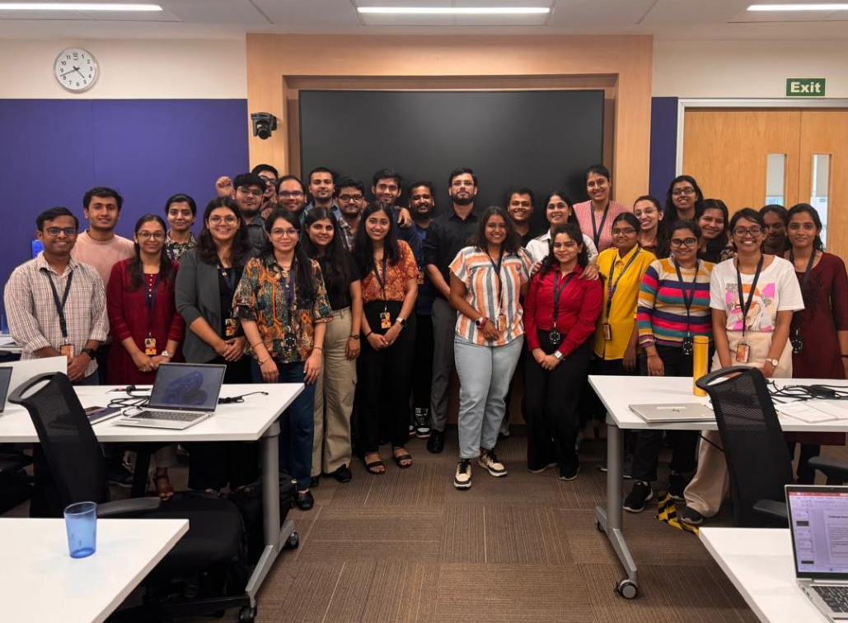
Learning is also Fun!
Sohel sir taught us all aspects of the technical training in a detailed manner and ensured that we got enough hands-on experience for creating VMs and using Azure DevOps.
He also made sure we engaged in multiple team activities. Finding bugs for multiple websites along with your teammates and then creating defect reports for the same was an interesting experience and a great learning opportunity.

Slide 18

Summary
The final study was stressful yet exhilarating. The experience will come in handy in our corporate career.
CI/CD Pipeline using GitHub Actions is crucial for deploying builds.
Azure DevOps is widely used for Agile framework using SCRUM methodology in the software industry.
PostgreSQL is a relational Database Management System with advanced features.

Slide 19
Thank You

