Slide 1
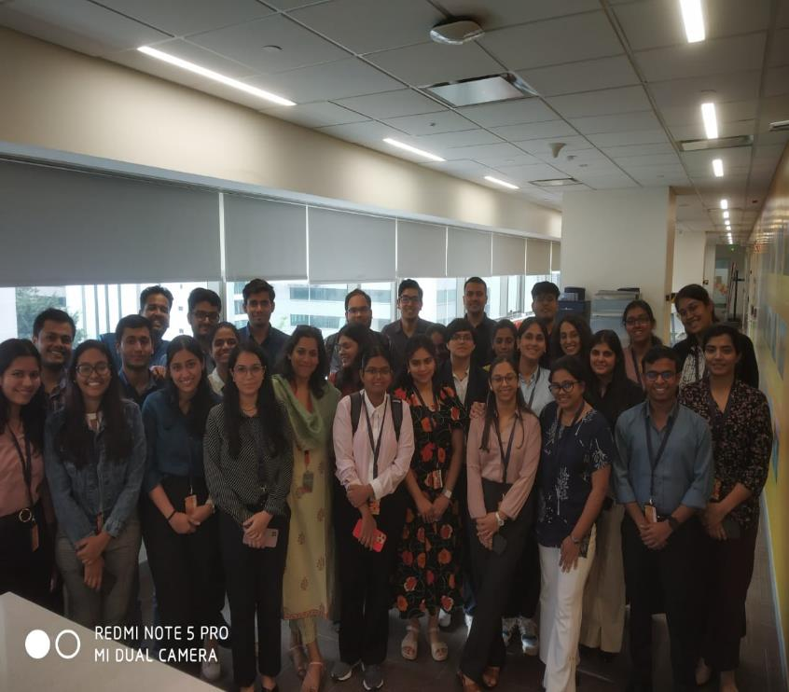
Shell Bootcamp 2024 3 Reflections for Week 1
Akanksha Goel
Date : 30-Aug-2024

Slide 2

About Me
Quiet persistence leads to unstoppable progress.
Please share an image / visual that best represents you

Slide 3

My learnings from this week!

Slide 4
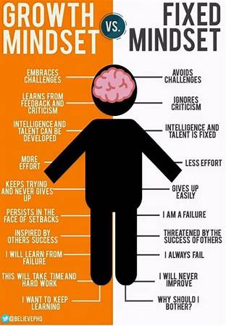
Learning 1 | My takeaways
Professionalism and Team Work
Key takeaways:
Do more by doing less
Thought Leadership
Managing Complexity
Growth Mindset
Email Etiquette
The Cart(Types of Team Members)
Team Development(Tuckman Model)
Implementation in the Energy sector:
Apply the Tuckman model (Forming, Storming, Norming, Performing) to guide team development and address challenges at each stage.
Encourage employees to share their expertise and insights through internal forums, industry conferences, and publications.
Recognize and leverage the diverse strengths of different team members to enhance collaboration and productivity.

Slide 5
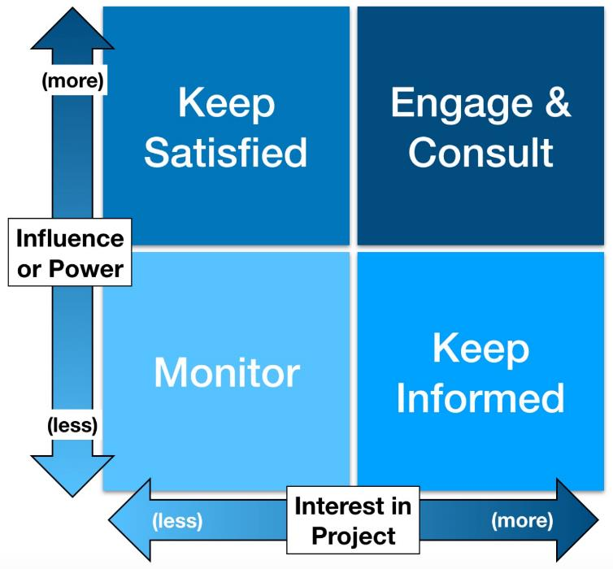
Learning 2 | My takeaways
Stakeholder Management
Key takeaways:
Identifying Stakeholders
Internal and External Stakeholders
Stakeholder Engagement
Power Interest Grid
Shell’s Trust Model
Implementation in the Energy sector:
Identifying stakeholders and ensuring stakeholder engagement is crucial for all projects in the energy sector
In the energy sector, it’s crucial to identify stakeholders.
Shell’s Trust Model emphasizes transparency, consistent communication, and long-term relationship building to gain stakeholder trust and support.
[Add a graphic that provides evidence of what you learned]

Slide 6
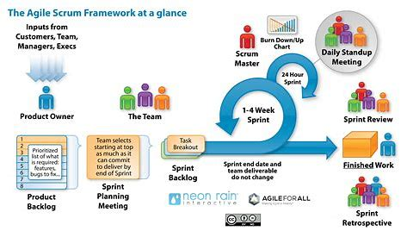
Learning 3 | My takeaways
Software Development Life Cycle
Key takeaways:
Role of Business Analyst
SRS and BRD documents
Software Project Management
Types of SDLC(Waterfall, Vmodel, Prototype)
Agile SCRUM Methodology
SCRUM ceremonies
Implementation in the Energy sector:
Creation of SRS and BRD are crucial to guide the development process
Agile SCRUM is particularly effective in the energy sector for managing complex and dynamic projects.
Key SCRUM ceremonies help in maintaining transparency, fostering collaboration, and ensuring that the project adapts to changing requirements.
[Add a graphic that provides evidence of what you learned]

Slide 7

Relevance of learnings for my organization

Slide 8
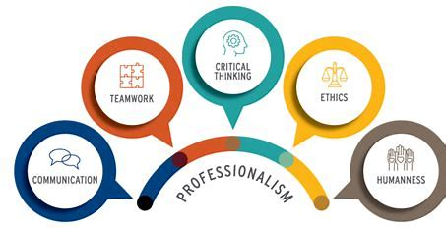
Learning 1 | Relevance for Shell
Professionalism and Team Work
How I feel Shell implements this learning
Shell effectively implements the principles of professionalism and teamwork by fostering a culture of continuous improvement and collaboration. Shell encourages thought leadership by providing platforms for employees to share their expertise through platforms like Yammer. Additionally, Shell recognizes and leverages the diverse strengths of its team members, promoting a growth mindset and managing complexity
How I feel Shell benefits from this learning
Shell benefits from enhanced team performance and innovation. The structured approach to team development ensures that teams are well-prepared to tackle complex projects, leading to higher productivity and better outcomes. Encouraging thought leadership and knowledge sharing helps Shell stay at the forefront of industry advancements.

Slide 9
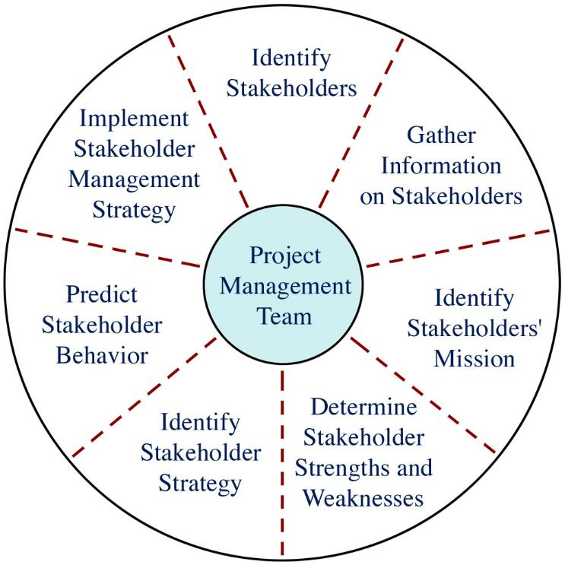
Learning 2 | Relevance for Shell
Stakeholder Management
How I feel Shell implements this learning
Shell implements stakeholder management principles by meticulously identifying and engaging both internal and external stakeholders. By using tools like the Power Interest Grid, Shell prioritizes stakeholder concerns and tailors its engagement strategies accordingly. Shell’s Trust Model is central to their approach.
How I feel Shell benefits from this learning
By adopting these stakeholder management practices, Shell benefits from stronger relationships with key stakeholders, which can lead to smoother project execution and fewer conflicts. Effective stakeholder engagement ensures that all voices are heard, leading to more comprehensive and sustainable decision-making. The emphasis on transparency and trust-building helps Shell maintain a positive reputation and secure long-term support from stakeholders.

Slide 10
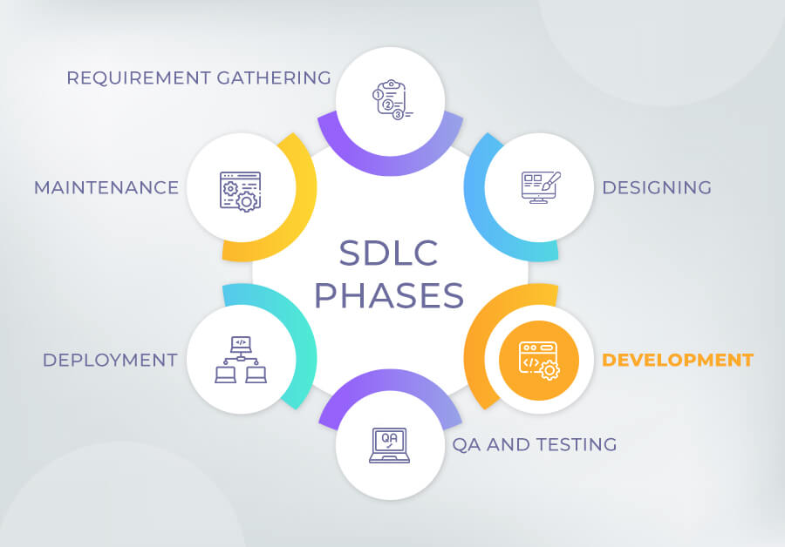
Learning 3 | Relevance for Shell
Software Development Life Cycle
How I feel Shell implements this learning
Shell implements the principles of the Software Development Life Cycle (SDLC) by ensuring thorough documentation and structured project management. Shell adopts Agile SCRUM methodology to manage complex and dynamic projects, which is particularly effective in the energy sector.
How I feel Shell benefits from this learning
By implementing these SDLC practices, Shell benefits from more efficient and effective software development processes. The detailed SRS and BRD documents provide a clear roadmap for development, reducing misunderstandings and ensuring that the final product meets business needs. The Agile SCRUM methodology allows Shell to manage complexity and adapt to changes quickly, leading to more responsive and resilient software solutions. The regular SCRUM ceremonies enhance team communication and collaboration, ensuring that all team members are aligned and working towards common goals.

Slide 11

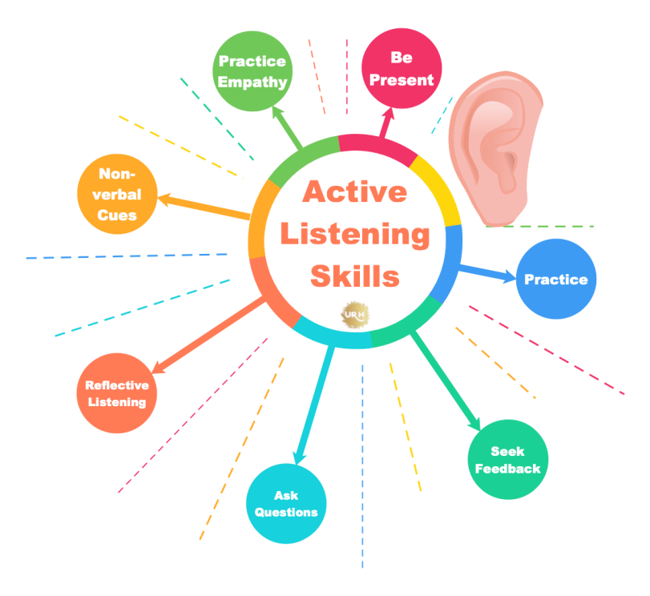
Challenge faced while implementing Learning 1
Professionalism & Teamwork
Challenges Faced:
Introversion and Interaction Difficulty
Implementing Growth Mindset
Transition from college to corporate
Plans to Overcome:
Active Listening and small group interactions
View challenges as opportunities to learn and grow rather than threats.
Observe the behavior and communication styles of colleagues and adapt accordingly.

Slide 12
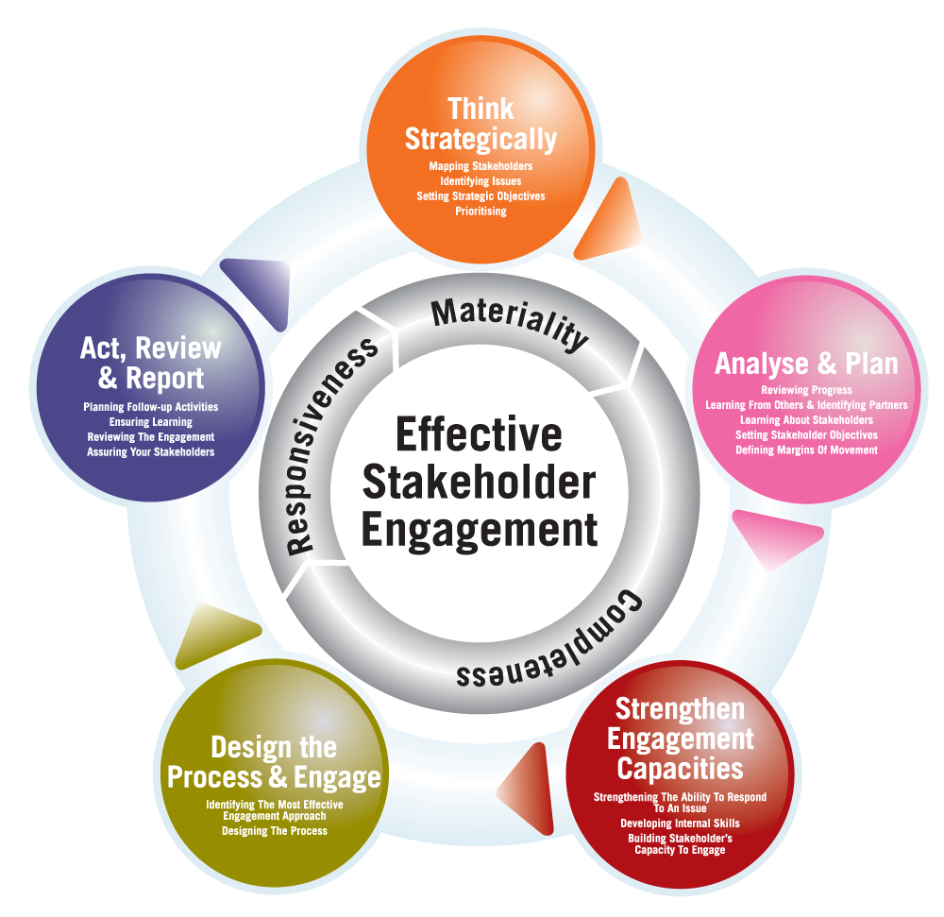
Challenge faced while implementing Learning 2
Stakeholder Management
Challenges Faced:
Identifying Internal & External Stakeholders
Ensuring Stakeholder engagement
Misjudging the power and interest of stakeholders
Plans to Overcome:
Use Stakeholder mapping to categorize
Develop customized communication strategies for different stakeholder groups.

Slide 13

Challenge faced while implementing Learning 3
Software Development Life Cycle
Challenges Faced:
Ensuring SRS and BRD are appropriate and complete
Efficiently allocating resources to meet project timelines
Plans to Overcome:
Use standardized templates and guidelines to clearly define the purpose and content of each document.
Plan accordingly and do not overcommit.

Slide 14

Action Plan

Slide 15
My Action Plan for this Week
Actions
Timeline
Status
Understanding the formation of SRS and BRD documents.
Reading up more about the Agile SCRUM methodology.
Interacting and Networking with my colleagues.
Saturday- Read up on SDLC concepts and documentation.
Sunday- Networking with other freshers.
Will be completed

Slide 16

Learning is also Fun!

Slide 17
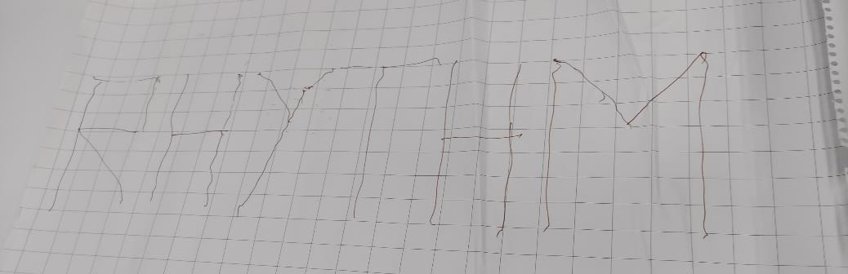
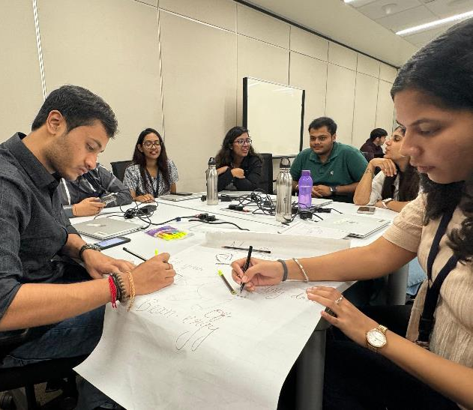
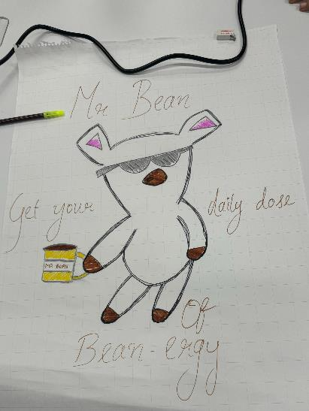
Learning is also Fun!
Nitya ma’am engaged us in an interesting activity to inculcate teamwork. Teams of four held a single pen using strings and wrote a word on a piece of paper using the same. Another activity involved producing a team name, logo and slogan.
MS Abbassi sir was extremely inspiring, he tried to include various real-life anecdotes of some interesting projects that he himself worked on, to help us develop a detailed understanding of the technical concepts.

Slide 18

Summary
Importance of Grooming, Professionalism, Email Etiquette, Thought Leadership and Teamwork.
Importance of Pacing yourself and doing more by doing less.
Waterfall Model, V Model, Prototype Model and Agile Model.
Scrum ceremonies and T-Shirt model for user story estimation.
The upcoming technical topics on Agile, DBMS, DevOps, Software Testing will prove to be beneficial for our corporate careers at Shell.
Topics covered this week- Soft Skills(Stakeholder management, Teamwork and communication, Professionalism, grooming, Shell Trust Model, Self awareness),Technical Skills(Business Analytics, SRS, BRD, Requirement Elicitation, SDLC Models, Agile SCRUM methodology)

Slide 19
Thank You

