Slide 1
ROS2 Jazzy CI/CD Pipeline Demo
Implementation of End-to-End Cloud Native DevOps for Robotics Applications
Project Github Link : Akankshakumbhare/ros2-jazzy-demo: ros2-jazzy-demo-application
Submitted by :
Akanksha Kumbhare
Kumbhare.akanksha12@gmail.com

Slide 2
Problem Statement
Solution Overview
Automate ROS2 builds and testing
Deploy containerized robotics applications
Provide monitoring and troubleshooting
Ensure secure-by-design architecture
Enable scalable Kubernetes deployments
Azure DevOps CI/CD Pipeline
Dockerized ROS2 Jazzy application
Azure Container Registry (ACR)
Azure Kubernetes Service (AKS)
Prometheus and Grafana monitoring
TLS-secured ingress deployment

Slide 3
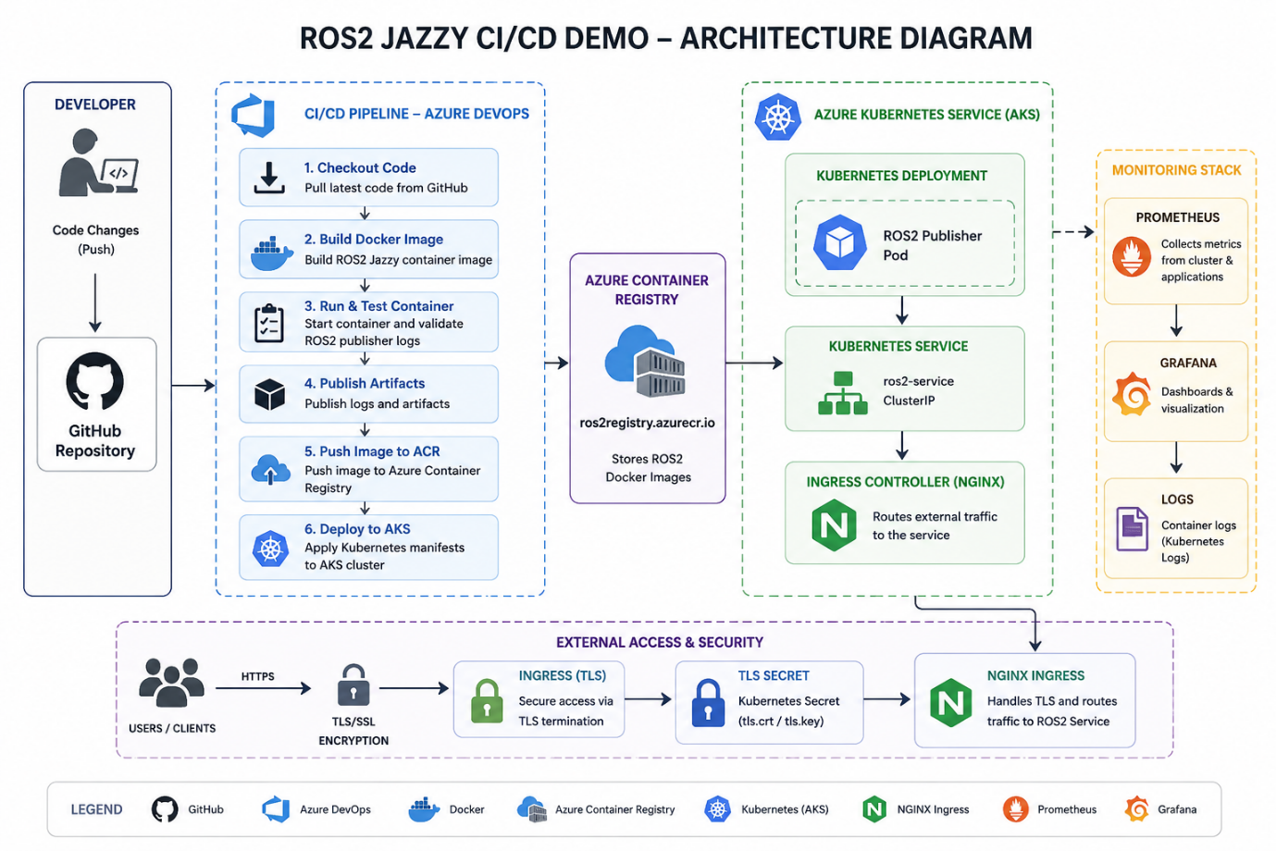
High-Level Architecture
Developer pushes code to GitHub.
Azure DevOps triggers pipeline.
Docker image build and validation.
Image pushed to Azure Container Registry.
Application deployed to AKS.
Prometheus and Grafana monitor workloads.

Slide 4
ROS2 Demo Application
ROS2 Jazzy minimal publisher/subscriber example.
Publishes 'Hello, world!' messages.
Lightweight and ideal for CI/CD demonstrations.
Used for runtime validation in pipeline.
Docker Containerization
Base image: ros:jazzy-ros-base
Containerized ROS2 runtime
Consistent deployment environment
Immutable and portable deployments

Slide 5
Azure DevOps Pipeline
Automatic trigger on every commit
Build and Push Docker image
Run ROS2 validation container
Publish logs and artifacts
Deploy automatically to AKS

Slide 6
Azure Container Registry
Stores versioned Docker images
Private and secure registry
Integrated with AKS
Supports automated deployments
AKS Deployment
Kubernetes Deployment and Service
Self-healing pods
Rolling updates
Scalable orchestration platform
Cloud-native deployment model

Slide 7
Security Implementation
TLS ingress configuration
Kubernetes TLS secrets
Private image pulls from ACR
Controlled CI/CD deployments
Secure-by-design infrastructure

Slide 8
Monitoring Architecture
Prometheus for metrics collection
Grafana dashboards
Kubernetes logs for troubleshooting
CPU, memory, network and pod monitoring
Grafana Dashboard
Real-time cluster monitoring
Memory and CPU visualization
Pod availability tracking
Useful for production diagnostics

Slide 9
Production Improvements
Helm-based deployments
Blue/Green deployment strategy
Automated vulnerability scanning
GitOps using ArgoCD
Horizontal pod autoscaling
Centralized log aggregation

Slide 10
Conclusion
Implemented complete ROS2 CI/CD workflow
Automated build, test, push and deployment
Secure and scalable AKS deployment
Production-grade monitoring solution
Cloud-native robotics DevOps architecture

Slide 11
Thank YoU

