Slide 1


Predicting Hotel Booking Cancellation cDAc noida
Group Members : Group Guide :
Akanksha Singh Mrs. Priti Bhardwaj
Shree Tiwari

Slide 2
content
Problem Statement
Introduction
The Data
Workflow
Exploratory Data Analysis (EDA)
Pre-processing
Machine Learning Model
Conclusion
References

Slide 3
Problem statement
When selecting a hotel, numerous factors come into play. The primary objective is to identify the most suitable prediction model for forecasting hotel booking cancellations, one that accurately identifies the key variables explaining customer cancellations. Such a Hotel Booking Cancellation model holds value not only for travelers seeking ideal accommodations but also for hotel owners aiming to optimize their operations and revenue management strategies.

Slide 4
introduction
In this presentation, we introduce a novel approach to predicting hotel booking cancellations using machine learning. Cancellations pose a significant challenge to the hospitality industry, impacting revenue and operations. Our objective is to develop a predictive model that can accurately forecast cancellations, enabling hotels to optimize inventory management and revenue forecasting. By leveraging historical booking data and advanced machine learning techniques, we aim to create a model that can provide valuable insights to hotels, allowing them to proactively manage cancellations and improve overall efficiency.

Slide 5
The data
The dataset comprises 119,390 observations.
It contains booking data for a city hotel and a resort hotel in Portugal, as well as other European countries from 2015 to 2017.
The dataset includes 32 variables, such as:
Reservation and arrival dates
Length of stay
Canceled status
Number of adults, children, and babies
Number of available parking spaces
Number of special guests
Number of bookings made by companies and agents

Slide 6
WORKFLOW
Data loading
Data Cleaning
EDA
Pre-processing
Building ML Model
Cross-validation

Slide 7
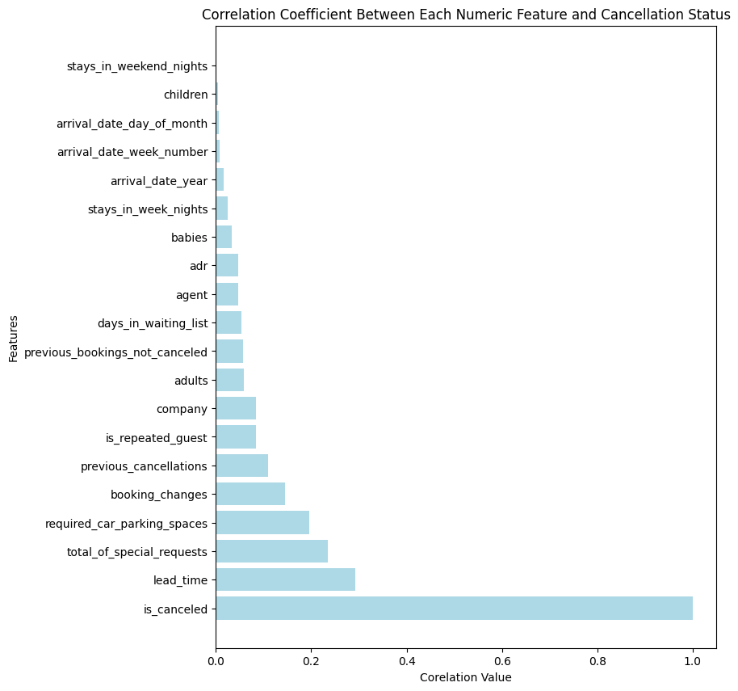
Exploratory Data Analysis (EDA)
The analysis reveals several key insights into the factors influencing hotel booking cancellations:
Lead Time: The number of days between booking and arrival is highly correlated with cancellations, with longer lead times increasing the likelihood of cancellation.
Special Requests: Bookings with more special requests are less likely to be canceled, suggesting that engagement and meeting customer needs may reduce cancellations.
Parking Spaces: The number of parking space requests is also negatively correlated with cancellations, indicating that customers requesting parking are less likely to cancel.
Customer History: Surprisingly, a customer's prior history with the hotel (excluding cancellations) does not strongly correlate with future cancellations. However, a history of cancellations does increase the likelihood of future cancellations.

Slide 8
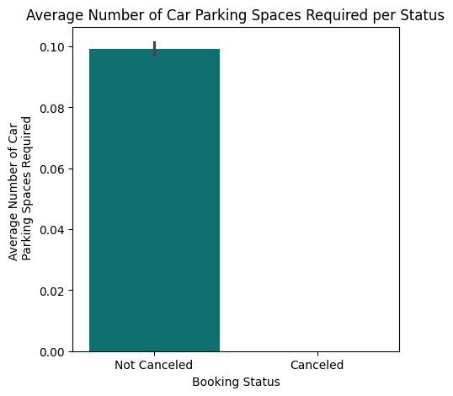
The analysis suggests that customers who do not cancel their bookings tend to request more parking spaces. This finding aligns with the idea that more engagement with the hotel, such as requesting a parking spot, reduces the likelihood of cancellation.
From the hotel's perspective, limited parking options in the area may make customers less likely to cancel their bookings, as the need for parking restricts their hotel choices.

Slide 9
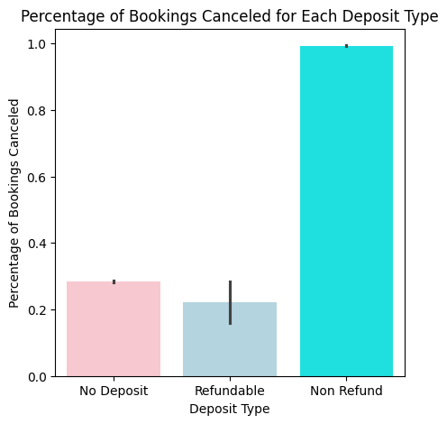
Surprisingly, customers who pay a non-refundable deposit have a much higher percentage of canceled reservations.

Slide 10
pre-processing
Imputing missing values
Encoding categorical variables
Handling outliers
defining dependent(y) variable and independent (x) variable

Slide 11
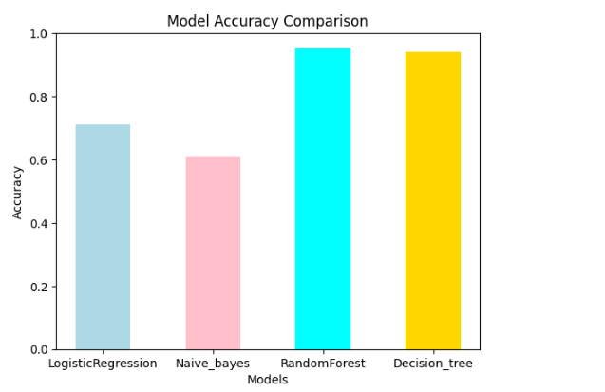
Machine LEARNING MODEL
This bar graph illustrates the performance of various machine learning models on a given task. The accuracy scores for four models—Logistic Regression, Naive Bayes, Random Forest, and Decision Tree—are presented. Each bar represents the accuracy achieved by a specific model, with values ranging from 0.61 to 0.95.
This graph serves as a quick visual comparison, allowing for an easy understanding of how these models perform in terms of accuracy. It can aid in making informed decisions about model selection based on their predictive capabilities.

Slide 12
Conclusion:
hotel_booking.csv dataset is a supervised classification dataset.
Among these four machine learning algorithms, Random forest and Decision trees perform well with respect to accuracy.
This models classifies whether or not a booking will be canceled with 95% and 94% accuracy.
Our EDA (Exploratory data analysis ) explain a non-refundable deposit and requiring parking spaces are the two features influencing cancellation prediction the most.
Our analysis also pointed at the importance of lead time, number of special requests, and room type.
we discovered that a deeper understanding of the situation may require additional hotel specific information (such as surrounding parking availability or deposit policies).

Slide 13
References
https://www.analyticsvidhya.com/blog/2022/03/end-to-end-hotel-booking-cancellation-machine-learning-model/
https://www.kaggle.com/datasets/hoyeonkangjoe/hotel-booking-cancellation-prediction
https://www.ijraset.com/research-paper/hotel-booking-prediction-using-ml
https://www.sciencedirect.com/science/article/abs/pii/S0167923623000349
https://medium.com/analytics-vidhya/predicting-hotel-booking-cancellations-3fe40d4522f8

Slide 14
THANK YOU!!

