Slide 1

Machine Learning Based Detection of Object Moving Away from FIUS Sensor
with Workspace Clearance Prediction
Ayush Parmar - 1565427
Akanksha Venkatesh Baitipuli - 1568316
Prof. Dr. Andreas Pech
Machine Learning
WiSe 2025/26

Slide 2

Introduction
Industrial robots stop when humans enter a safety zone — but have no idea when the zone will be clear
AWY-1 uses a single ultrasonic sensor + machine learning to classify motion and predict clearance time
Trained on real sensor data across 3 object types, 3 speeds, 2 lighting conditions
Random Forest achieved 85.93% accuracy — enabling smarter, proactive AGV decisions

Slide 3
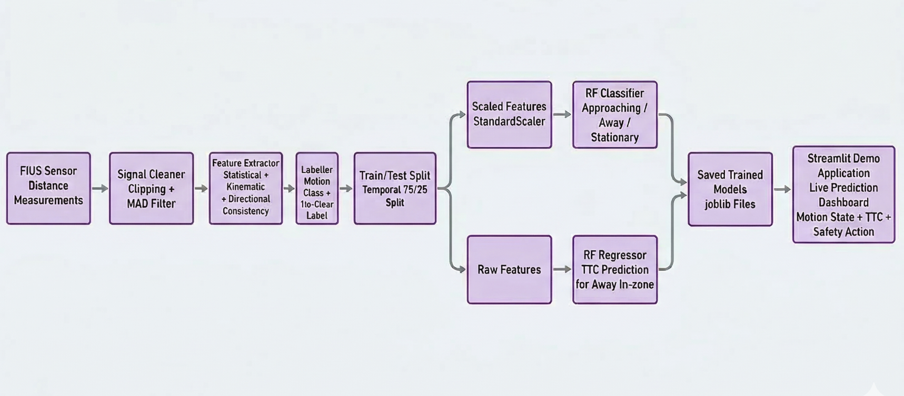
System Architecture

Slide 4
ML Pipeline - Key Design Decisions
Window-Based Analysis
300 readings = 7.9 seconds of sensor history
More robust than single-reading threshold detection
Signal Cleaning
Hard clip: removes physically impossible values
MAD Filter: removes spike artefacts from multipath reflections
16 Features — 3 Groups
Statistical: mean, std, min, max
Kinematic: velocity, acceleration, net displacement
Directional: frac_increasing + frac_decreasing → top predictors (24.7% importance)
Temporal Train/Test Split
75% train / 25% test — done per file
Prevents same trajectory leaking into both sets
Dual-Path Training
Classifier → StandardScaler + RF → Motion State
Regressor → Raw features + RF → Time-to-Clear (seconds)
Output
Two saved models loaded directly by the Streamlit dashboard

Slide 5
Project Simulation Demo

Slide 6
Challenges & Limitations
TtC Target
Target: MAE < 0.6 s → Achieved: MAE = 6.38 s
7.9 s window too short for accurate long-horizon prediction
Zone Threshold Revised
Original: 3.0 m → Revised to 0.90 m
Lab space physically limited the recording range
Class Imbalance
Away heavily overrepresented (49.9% vs 21.3% Approaching)
Led to lower recall on the Approaching class
Single Sensor Axis
Lateral motion produces no distance change → misclassified as Stationary

Slide 7
Conclusion
We started with a simple question — can a robot do better than just stop and wait?
Using nothing more than a single ultrasonic sensor, we built a system that understands motion and anticipates what comes next
85.93% accuracy, 49× improvement in clearance prediction — the numbers speak for themselves
But beyond the numbers, this project shows that intelligent, proactive safety systems don't need to be complex or expensive
One sensor. Real data. Machine learning. That's AWY-1.

Slide 8
References
T. Nesti, S. Boddana, and B. Yaman, "Ultra-sonic sensor based object detection for autonomous vehicles," in Proc. IEEE/CVF Conference on Computer Vision and Pattern Recognition Workshops (CVPRW), 2023, pp. 210–218.
D. Hunter, "Analysis of the measurement error from a low-cost ultrasonic sensor," Edward Waters University Undergraduate Research Journal, vol. 1, no. 1, 2023.
R. Tapu, B. Mocanu, E. Tapu, and T. Zaharia, "When ultrasonic sensors and computer vision join forces for efficient obstacle detection and recognition," Sensors, vol. 16, no. 11, p. 1807, 2016.

