Slide 1

PYTHON
Submitted by:-
Akankshi Priya
Roll-50(G:2)
Subasis Naik
Roll-51(G:2)
Prince Kumar
Roll-50(G:2)

Slide 2
Overview
Definition
Applications
How to do
Benefits
Drawbacks

Slide 3
Definition
CAPTCHA stands for Completely Automated Public Turing test to tell Computers and Humans Apart
A program that can tell whether its user is a human or a computer
Only human can pass this test but computers cannot
Types of CAPTCHA
Text based
Graphic based
Audio based

Slide 4
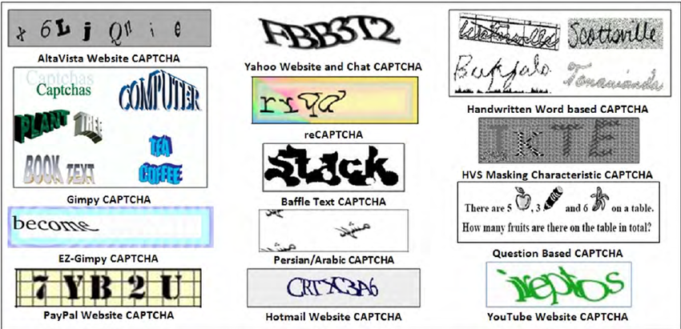
Example

Slide 5
How to do?
Task is to generate unique CAPTCHA every time and to tell whether the user is human or not by asking user to enter the same CAPTCHA as generated automatically and checking the user input with generated CAPTCHA
Set of characters to generate CAPTCHA are stored in a character array chrs() which contains(a-z, A-Z, 0-9) , there size of chrs() is 62

Slide 6
How to do?
To generate a unique CAPTCHA every time a random number is generated using rand() function
Randint(97 ,122) is used for small alphabets
Randint(65,90) is used for capital alphabet
Randint(48,57) is used for numerical
get() function is used to get the data
Message box is used to show the message
GUI is used to create window pages by importing tkinter.

Slide 7
How to do?
Reg. no. should always be integer and maximum of 8 digits
CAPTCHA is any random 6 digits that can be alphabets or numerical
If entered CAPTCHA is equal to shown CAPTCHA then proceed further
If not same not allowed to proceed
Submit button is used to submit the information

Slide 8
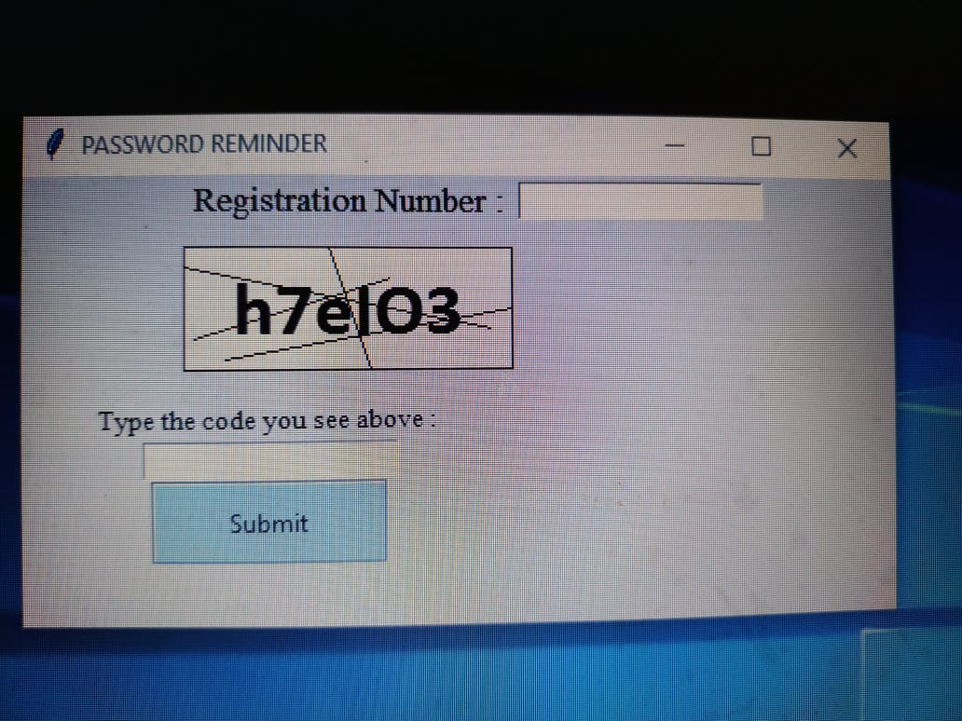

Slide 9
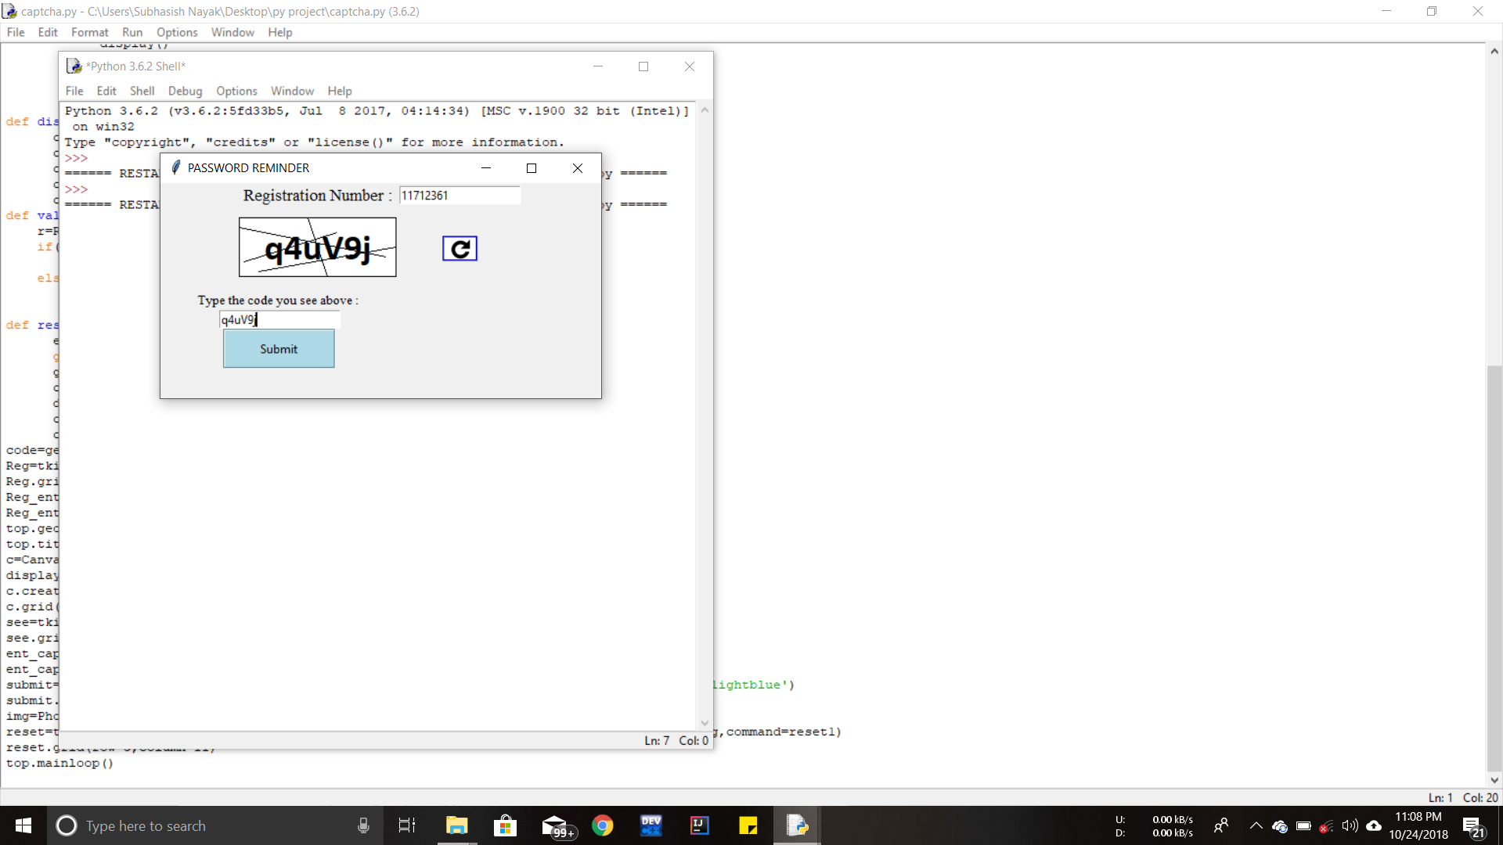

Slide 10
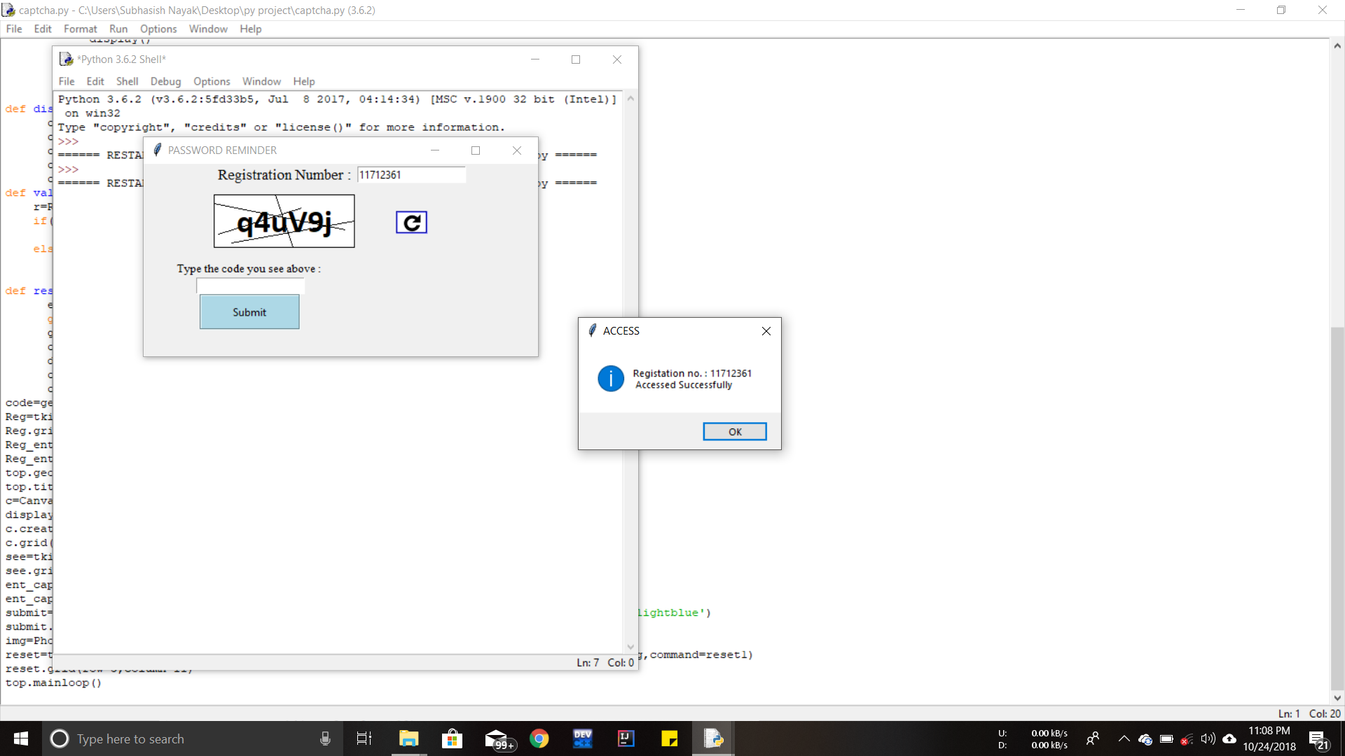

Slide 11


Slide 12
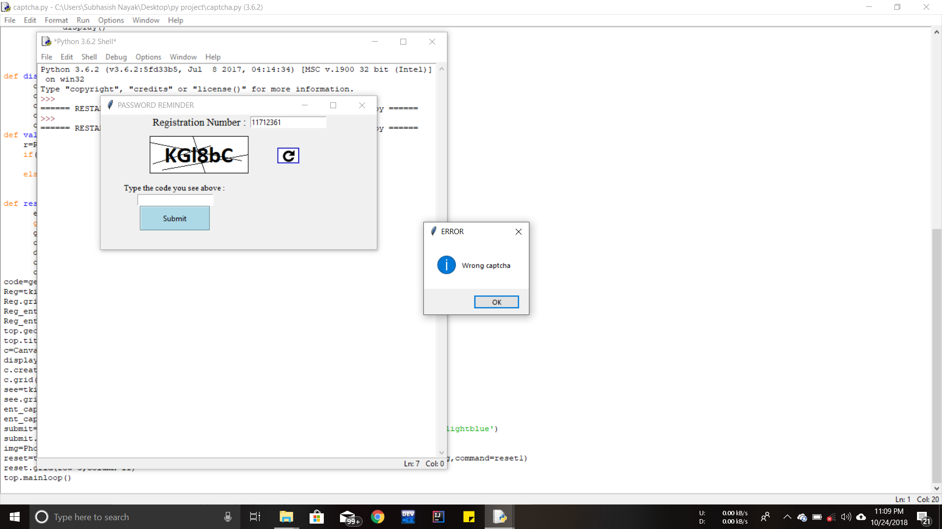

Slide 13
Benefits
Quick expiration limits streaming hacks
Protecting Registration Forms in Websites
Preventing Spam Comments
Making Online Shopping More Secure
Protecting Email Accounts
Distortion prevents caching hacks
Adding “concrete objects “ to the dictionary is virtually instantaneous

Slide 14
Queries??

Slide 15
Thank you

