Slide 1
RiskPulse AI
AI/NLP Financial Risk Intelligence Engine
Strategic Portfolio Stress Testing — Module B
Akankshya Dibyadarsinee Rout | VIT Bhopal University
S&P Global & CRISIL Campus Hackathon 2026

Slide 2
2. Problem & Approach
Financial risk can emerge first as unstructured language in news and social-media discussion.
RiskPulse AI converts this text into structured sentiment, event and impact signals.
The downstream Module B consumes high-impact events and runs a transparent portfolio stress scenario.
The design prioritizes reproducibility, traceability and an end-to-end working prototype.

Slide 3
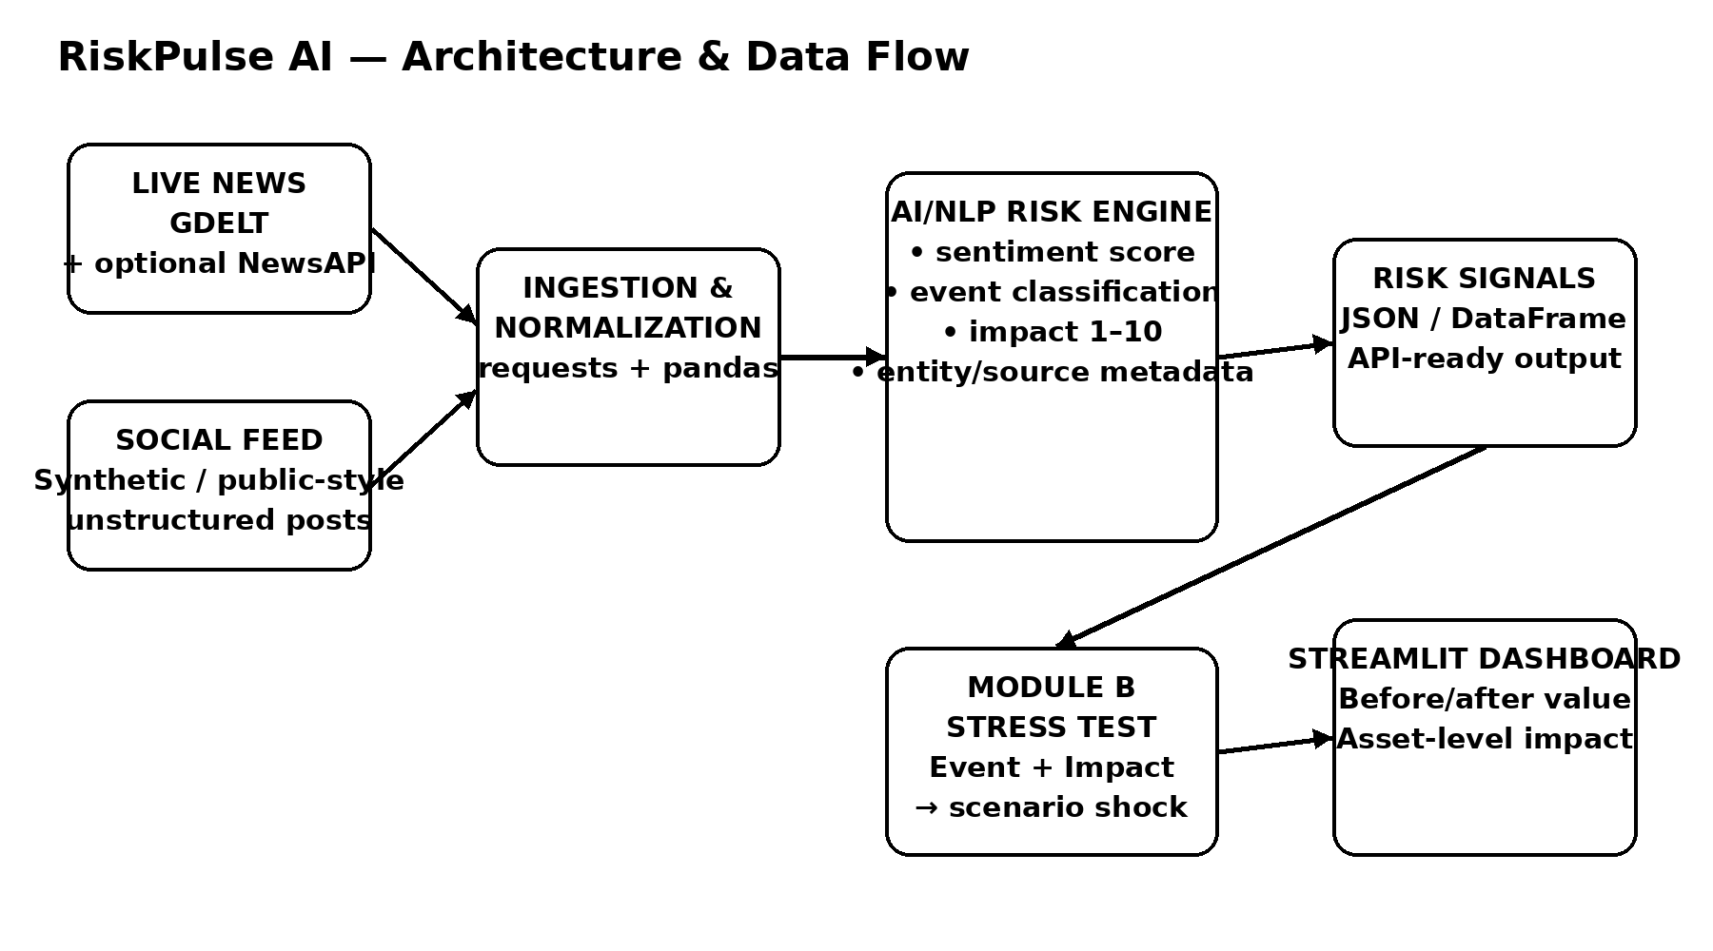
3. System Design
GDELT / optional NewsAPI → ingestion → hybrid NLP risk engine → structured risk signal → Module B stress test → Streamlit dashboard.

Slide 4
4. Implementation Highlights
Hybrid NLP: VADER sentiment + domain-specific event taxonomy + transparent impact scoring.
Event classes include Geopolitical, Macroeconomic, Credit Event, M&A, Regulatory, Product Launch and Earnings.
Synthetic portfolio covers equities, bonds, loans and derivatives.
FastAPI exposes the risk engine as a machine-readable endpoint.
Streamlit provides live ingestion, signal inspection and stress-test visualization.

Slide 5
5. Key Results
End-to-end pipeline converts unstructured text into structured risk signals.
Dashboard surfaces high-impact events and event distribution.
Stress test reports portfolio value before/after, simulated P&L and asset-level impact.
All synthetic demo data is included in the repository for reproducibility.
Scenario shocks are explicitly illustrative assumptions, not investment advice.

Slide 6
6. Domain Impact
Creates a standardized risk-intelligence layer between unstructured information and downstream risk workflows.
Provides traceability: source → text → classification → impact → portfolio effect.
Can support rapid scenario analysis when event severity crosses a configurable threshold.
Production path: financial event model, entity linking, streaming, confidence calibration, historical scenario calibration and monitoring.

Slide 7
7. Limitations & Next Steps
Current event/impact logic is a transparent hybrid MVP rather than a fully trained financial foundation model.
Synthetic social and portfolio data are used for reproducibility and confidentiality.
Production deployment would require authorized feeds, calibrated risk models, validation and governance.
Next: fine-tuned financial NLP, event deduplication, confidence scores, streaming infrastructure and model monitoring.

