Slide 1
RiskPulse AI
Financial Risk Intelligence Engine
+ Strategic Portfolio Stress Testing
(S&P Global & CRISIL Campus Hackathon 2026)
Akankshya Dibyadarsinee Rout(24BAI10724)
VIT Bhopal University

Slide 2
THE PROBLEM
Financial risk often appears first in unstructured information:
• Breaking news
• Market commentary
• Social-media signals
The challenge is converting this information into actionable, structured risk signals quickly.
OUR APPROACH
RiskPulse AI:
1. Ingests public/synthetic text data
2. Performs sentiment analysis
3. Classifies financial events
4. Calculates impact and risk scores
5. Triggers portfolio stress testing
6. Visualizes portfolio impact

Slide 3
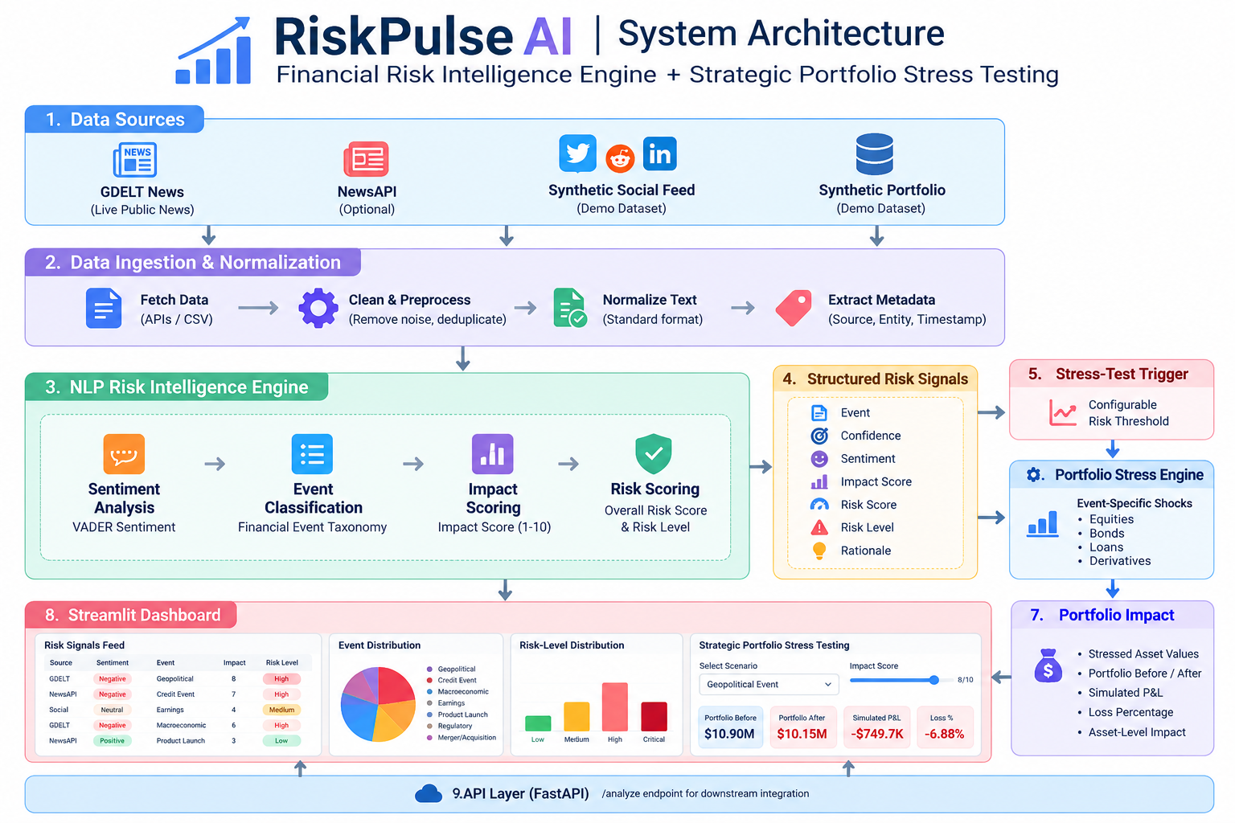
DATA SOURCES
GDELT News
NewsAPI (Optional)
Synthetic Social Feed
Synthetic Portfolio
↓
DATA NORMALIZATION
↓
NLP RISK ENGINE
• VADER Sentiment
• Event Classification
• Impact Scoring
• Risk Scoring
↓
RISK SIGNALS
↓
STRESS-TEST TRIGGER
↓
SCENARIO SHOCK ENGINE
↓
PORTFOLIO IMPACT
↓
STREAMLIT DASHBOARD
+
FASTAPI ENDPOINT

Slide 4
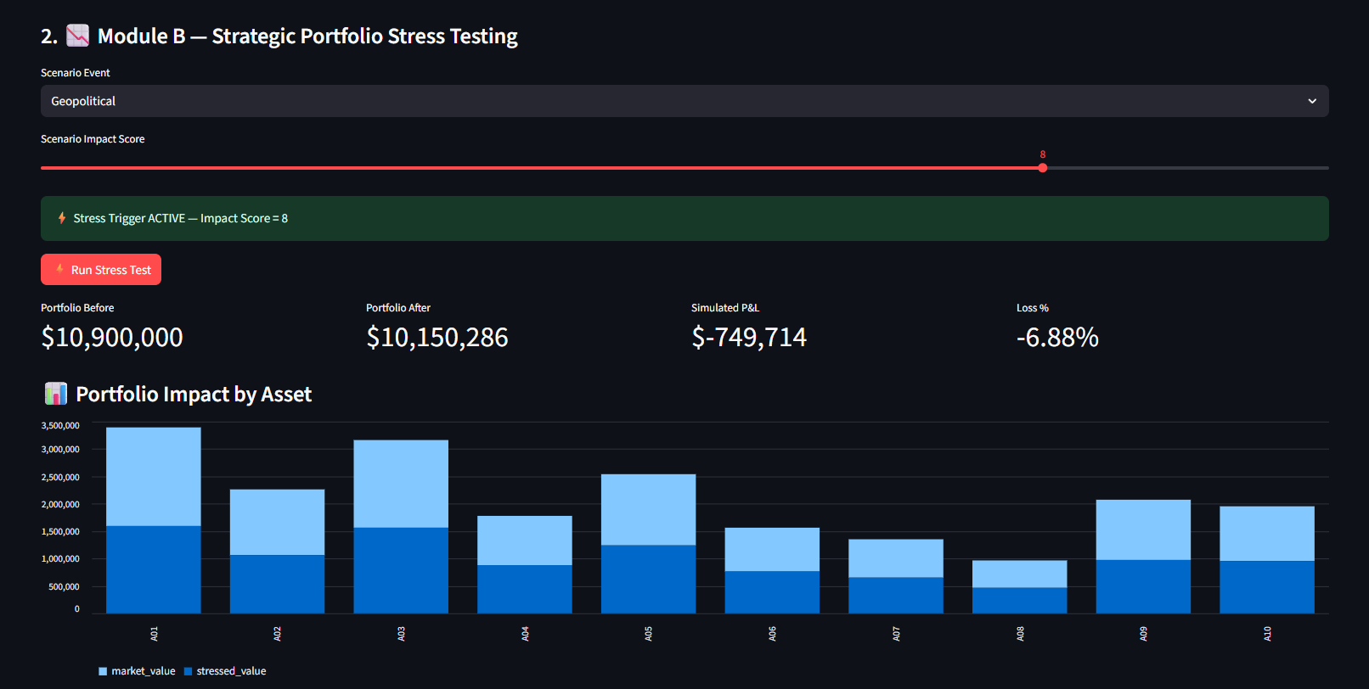
Key Results
Screenshot 1: the Strategic Portfolio Stress Testing screen

Slide 5
→ Shows the actual scenario execution:
Geopolitical scenario
Impact Score = 8
Portfolio Before = $10.9M
Portfolio After = $10.15M
Simulated P&L = -$749.7K
Loss = -6.88%
Portfolio impact chart
Screenshot 2: the Stress-Test Results table
→ Shows the detailed asset-level output:
A01–A10
Asset type
Market value
Shock %
Stressed value
Loss

Slide 6
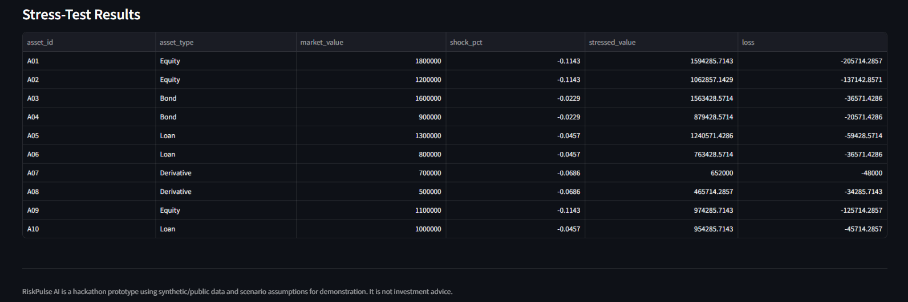

Slide 7
WHY IT MATTERS
RiskPulse AI demonstrates how unstructured information can be converted into structured risk intelligence for portfolio analysis.
Potential applications:
• Portfolio monitoring
• Early-warning systems
• Scenario analysis
• Credit-risk monitoring
• Market-event triage
• Risk analyst decision support
VALUE
Information → Risk Signal → Scenario → Portfolio Impact
The prototype emphasizes transparency so that each risk signal can be traced back to its detected event and impact drivers.

Slide 8
CURRENT LIMITATIONS
• Hybrid keyword-based event classification
• VADER is a general-purpose sentiment model
• Synthetic social and portfolio data
• Illustrative stress-shock assumptions
• No production-grade streaming infrastructure
NEXT STEPS
→ Fine-tuned financial NLP / FinBERT
→ Named-entity recognition
→ Event deduplication
→ Confidence calibration
→ Streaming ingestion
→ Model monitoring
→ Historical backtesting
→ More granular portfolio risk factors
RiskPulse AI is a hackathon prototype and not investment advice.

