Slide 1
DATA SCIENCE PROJECT- Clustering Global Development
Team Members:
Akankshya Sharma
Tharnika
Ranjit
Vishal Bhagat
Sujith Gujjar

Slide 2
EDA – Visual Insights
Visual Analysis
Numerical Feature Distribution: Most indicators show skewed distributions with extreme values (GDP, CO₂ Emissions, Energy Usage, Population), indicating real-world socio-economic variability.
Correlation Analysis: Strong positive correlations exist between GDP, Energy Usage, CO₂ Emissions, Internet Usage, and Life Expectancy, while Infant Mortality Rate shows strong negative correlation with development indicators.
GDP Category Distribution: Majority of countries fall into Lower-Middle and Upper-Middle income groups, highlighting global economic imbalance.
PCA Cluster Visualization (DBSCAN): PCA reveals multiple dense clusters and noise points, showing that countries naturally group based on development patterns rather than uniform separation.
Feature Engineering Impact: Derived features such as Health_GDP_Impact, CO₂_per_Energy, and Dependency_Ratio improved interpretability by combining economic, health, environmental, and demographic aspects.

Slide 3
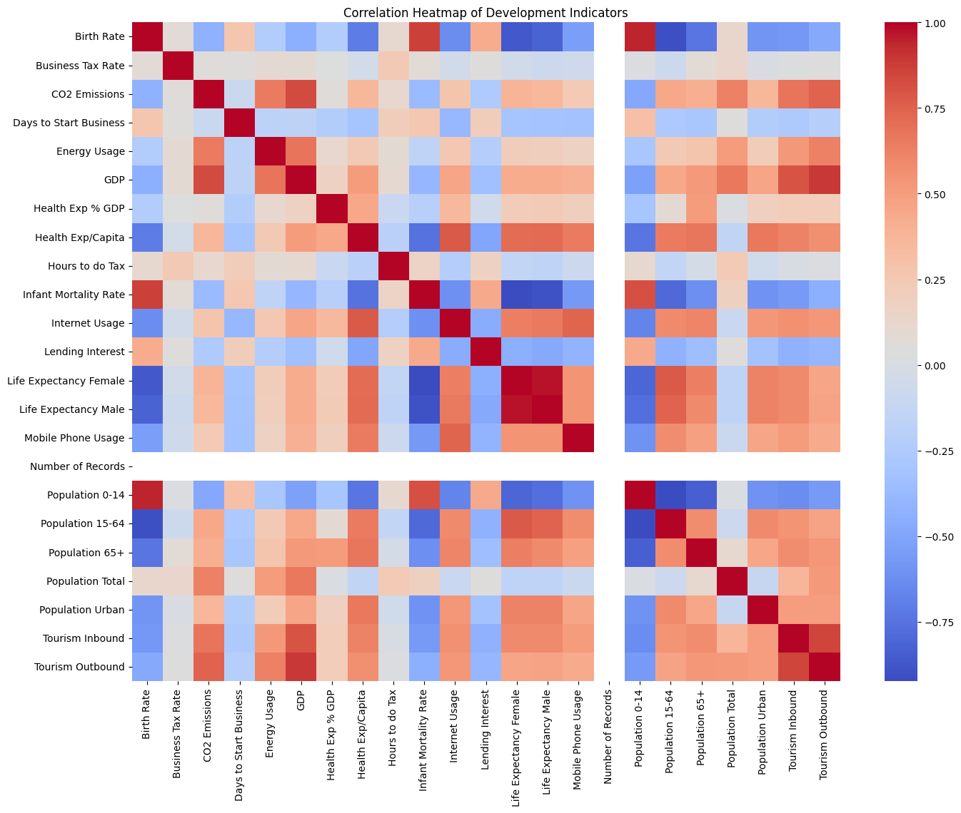
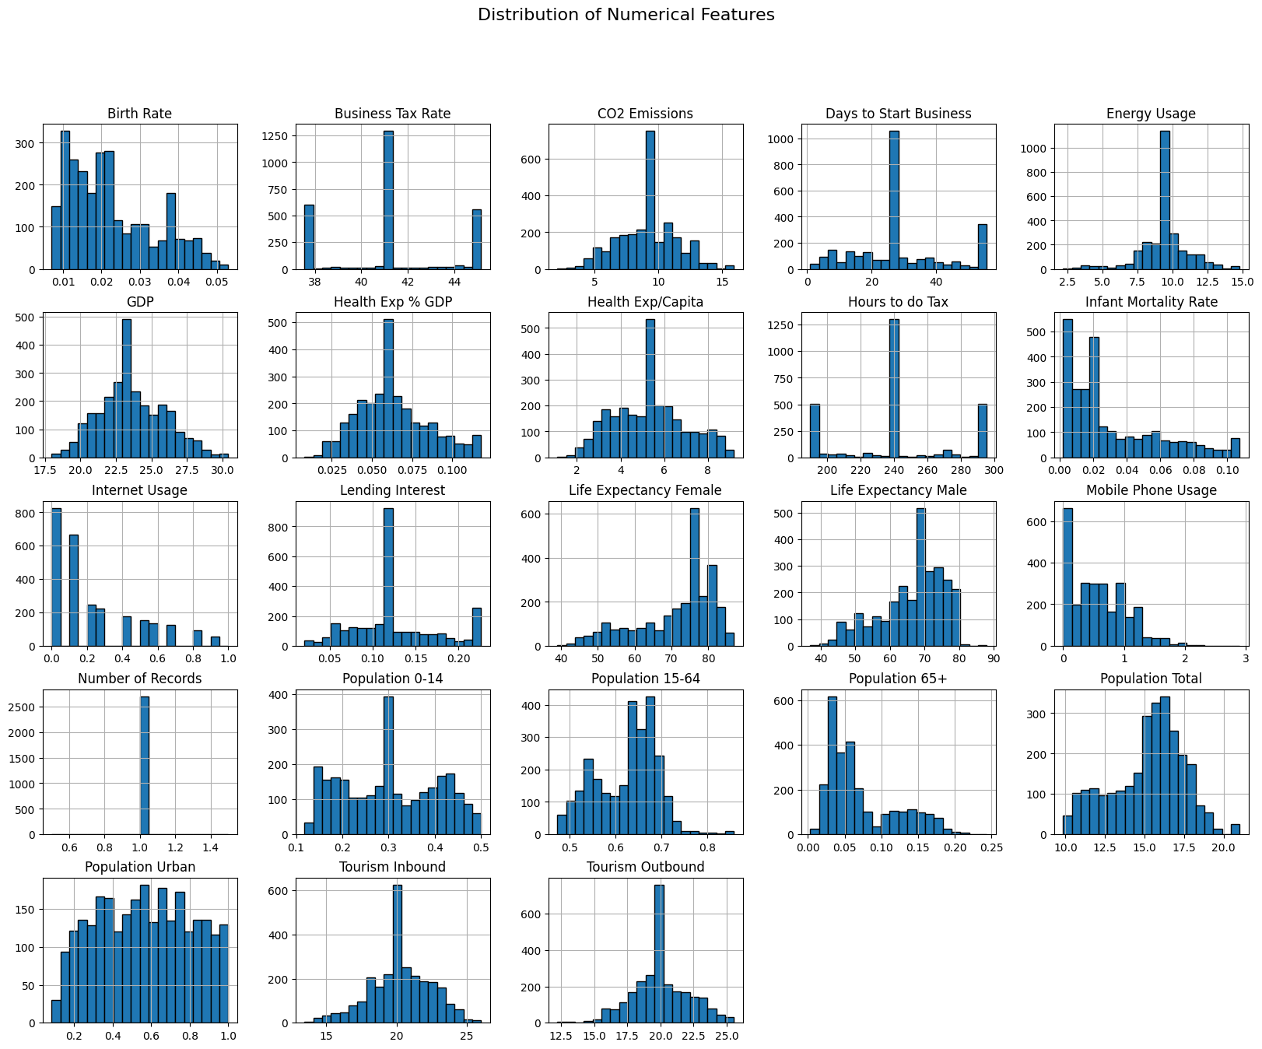
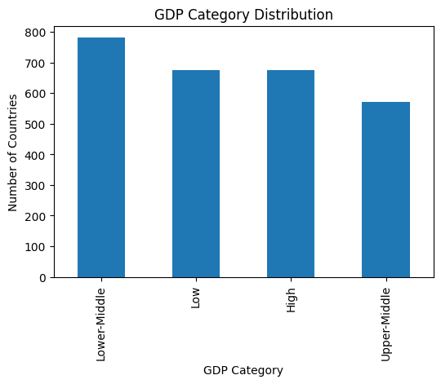
Bar-chart and Heatmap

Slide 4
Feature Selection and Preprocessing
Feature Selection: Selected only numerical development indicators, excluding categorical fields (e.g., country names, income groups) to ensure algorithm compatibility.
Missing Value Handling: Checked for null values and applied appropriate imputation to maintain data consistency.
Outlier Treatment: Identified extreme values using IQR-based analysis and handled them using capping and log transformations.
Feature Engineering: Created meaningful derived features such as Health_GDP_Impact, CO₂_per_Energy, and Dependency_Ratio to capture combined socio-economic effects.
Scaling & Normalization: Applied RobustScaler to reduce the influence of outliers and bring all features to a comparable scale.
Dimensionality Reduction (for Visualization): Used PCA to project high-dimensional data into two dimensions for cluster visualization.

Slide 5
Model Building
Algorithm Selection: Implemented five unsupervised clustering algorithms: K-Means, Hierarchical Clustering, DBSCAN, Gaussian Mixture Model (GMM), and Mean Shift.
Input Data Preparation: Used scaled numerical development indicators as input features for all clustering models.
Model Training: Applied each clustering algorithm independently to identify natural groupings among countries.
Parameter Tuning: Tuned key parameters such as number of clusters (K-Means), linkage methods (Hierarchical), EPS and MinSamples (DBSCAN), components (GMM), and bandwidth (Mean Shift).
Model Evaluation: Evaluated clustering performance using Silhouette Score to measure cluster quality and separation.
Final Model Selection: Selected DBSCAN as the final model due to its highest Silhouette Score, ability to detect outliers, and flexibility in identifying irregular cluster shapes.

Slide 6
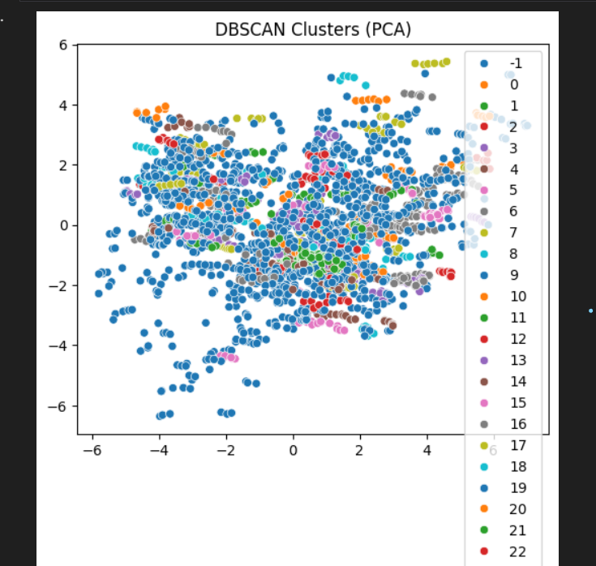
Model Evaluation – DBSCAN

Slide 7
Model Comparison
Compared five clustering algorithms: K-Means, Hierarchical Clustering, DBSCAN, Gaussian Mixture Model (GMM), and Mean Shift.
K-Means and Hierarchical Clustering produced lower Silhouette Scores (0.175 and 0.137 respectively), indicating weaker cluster separation.
Gaussian Mixture Model (GMM) showed the lowest clustering performance (Silhouette Score = 0.112), suggesting overlapping clusters.
Mean Shift performed better than K-Means and GMM (Silhouette Score = 0.289) but generated unstable cluster boundaries.
DBSCAN achieved the highest Silhouette Score (0.466), demonstrating the best-defined clusters and effective density-based separation.
DBSCAN uniquely identified noise and outliers, which other algorithms could not detect.
Best Overall Model: DBSCAN — selected for its superior cluster quality, robustness to outliers, and ability to discover irregular cluster shapes.

Slide 8
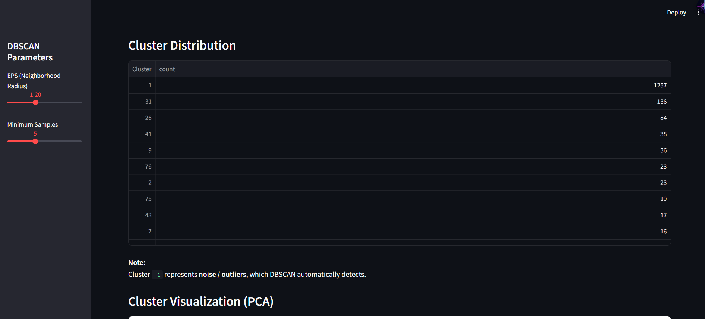
Deployment

Slide 9
1. The finalized DBSCAN clustering model is deployed using Streamlit.
2. The application provides an interactive dashboard for exploring global development clusters.
3. PCA-based visualizations are used to display cluster separation clearly.
4. Users can analyze cluster-wise country characteristics.
5. The model also identifies outlier countries using DBSCAN.
6. The deployment enables easy interpretation and real-time interaction with model results.

Slide 10
Challenges Faced
Highly Skewed and Heterogeneous Data: Development indicators showed extreme values and non-uniform distributions across countries.
Feature Correlation & Redundancy: Many socio-economic indicators were strongly correlated, requiring careful feature selection and engineering.
Cluster Selection Difficulty: Determining meaningful clusters without a target variable made evaluation and model selection challenging.
Parameter Sensitivity in DBSCAN: Clustering results were highly dependent on EPS and MinSamples, requiring extensive tuning.

Slide 11
Conclusion
Performed end-to-end analysis on global development indicators using unsupervised learning.
Compared five clustering algorithms using Silhouette Score for evaluation.
DBSCAN emerged as the best model due to superior cluster separation and effective outlier detection.
PCA-based visualization confirmed meaningful country groupings.
The deployed Streamlit application enables interactive exploration of global development patterns.

Slide 12
THANK YOU

