Slide 1
Seeing beyond the concrete A Visual journey into Rainfall and Air pollution
Group 5

Slide 2
Idea:
1. Visualise the geographical distribution of Rainfall and Air Quality
2. Visualise Air pollution trends, and predict future values for its various parameters
3. Visualise trends in Rainfall and create forecasts
4. Visualise relationship between Air pollution parameters and Rainfall
5. Make an interactive Visualisation Interface

Slide 3
DEMO!

Slide 4
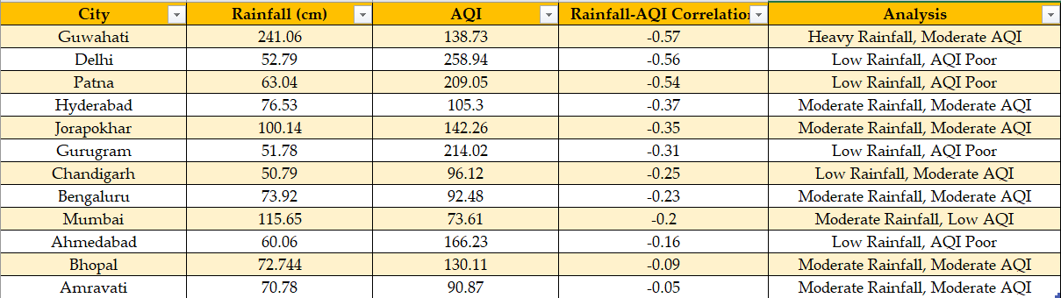
observationS:

Slide 5
THANK YOU!

Slide 6

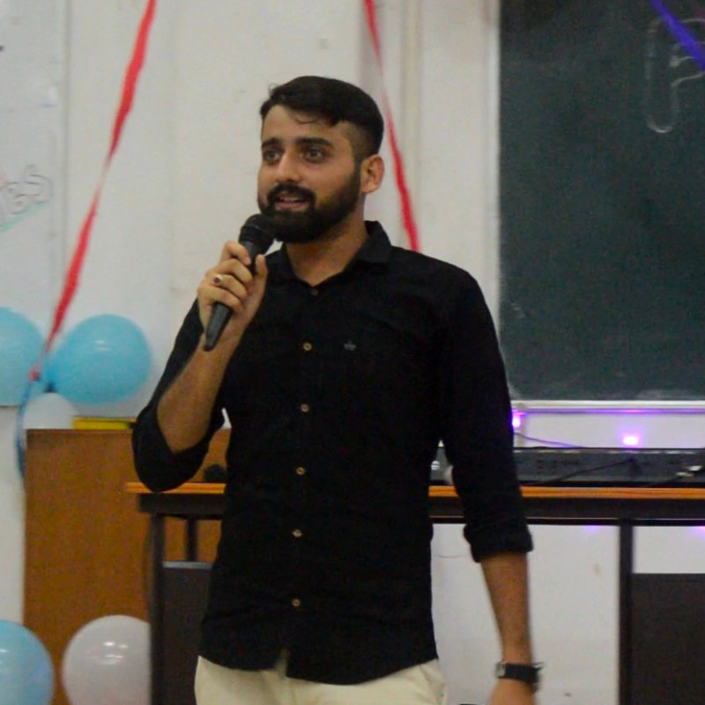



Group 5
Akansh Agrawal
(180050)
Abhinav Anand
(22111261)
Samanvay Lakhotia
(190747)
Anubhav Kalyani
(190164)
Our Mentor: Prof. Soumya Dutta

