Slide 1


SMART INDIA HACKATHON 2025
Problem Statement ID – 25074
Problem Statement Title -AI-Powered Personal Farming Assistant for Kerala Farmers
Theme - Agriculture, FoodTech & Rural Development
PS Category - Software
Team ID -
Team name - Sprout7

Slide 2
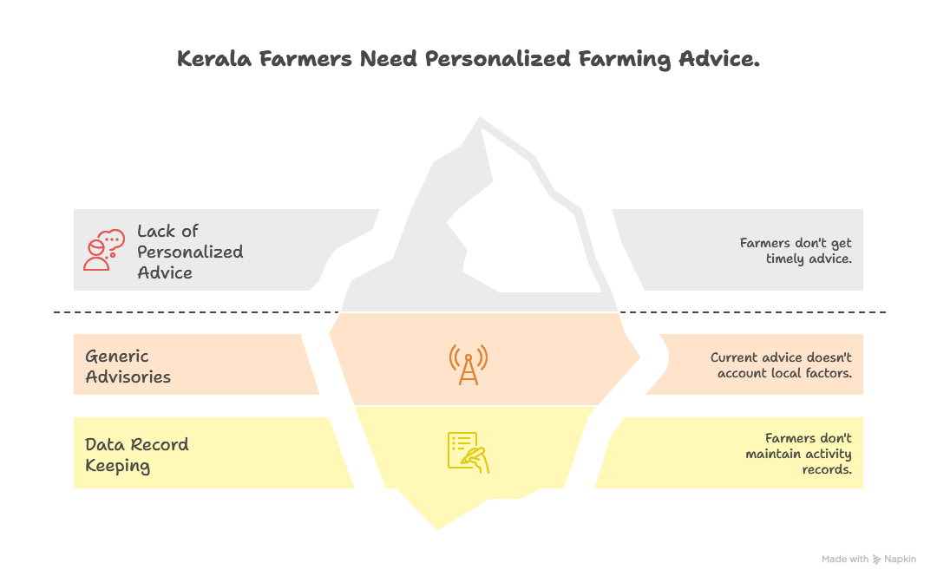
IDEA TITLE
Sprout7
Proposed solution :
The system will be built on a core platform with plug-in modules, allowing features to be added as development progresses
A simple, intuitive onboarding process within the Website.
Advanced AI & Personalization Engine, Knowledge Base Integration.
Proactive Alert System, Market & Scheme Integration.
Image Recognition for Pest/Disease Diagnosis.
How it addressess the problem :
Lack of Personalized, Timely Advice & Generic Advisories
Failure to Account for Local Conditions (Crop, Weather, Soil, Practices)
Farmers Not Maintaining Activity Records
Bridging the Knowledge Gap
Enhancing Productivity and Sustainability

Slide 3
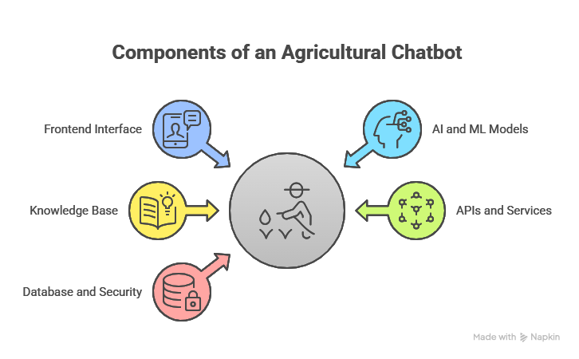
TECHNICAL APPROACH
Sprout7
Frontend
Chatbot interface (text + voice, local language).
Simple UI for crop, weather, market, and scheme queries.
Visual dashboards: crop calendar, price trends, weather alerts.
Backend
AI Engine: NLP for query understanding, recommendation system, predictive models.
Knowledge Base: Crops, soil, diseases, market.
APIs & Services: Real-time weather API, market data API, IoT integration.
Database & Security: Cloud storage for farmer profiles & logs, encrypted data handling.
Integration & Services
APIs & Cloud Storage → real-time weather, market data, and scalable backend.
AI/ML Models → NLP for chatbot queries, image recognition for disease detection.

Slide 4
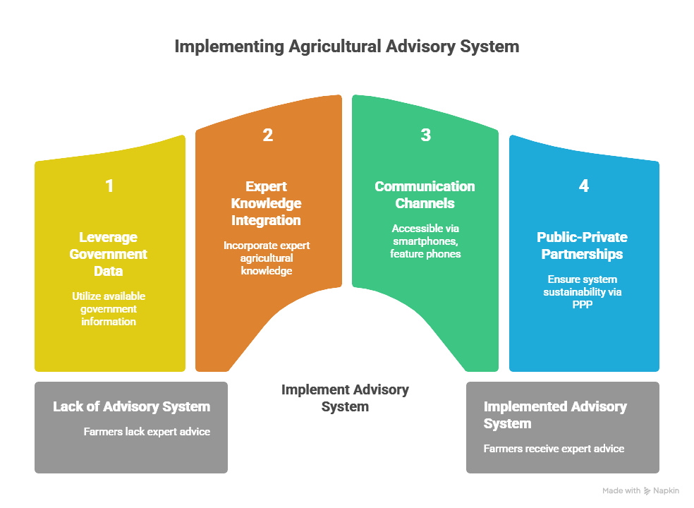
FEASIBILITY AND VIABILITY
Sprout7
Feasibility
Technical Feasibility
Govt. data available: IMD (weather), Soil Health Card (soil), Ag-market (prices).
KAU provides expert knowledge & crop calendars.
Accessible via WhatsApp & IVR for both smartphone & feature phone users.
Social Feasibility
Kerala: high mobile penetration & digital literacy.
Scope for PPP: ag-input firms fund targeted advisories to subsidize free farmer services.
Viability
The potential benefits—increased crop yields, reduced input costs, prevented crop losses, and more efficient subsidy distribution—can far outweigh the development and operational costs of the platform. This strong positive ROI makes it an attractive investment for a government ​
• The app can be designed to be lightweight, with offline capabilities for key features (e.g., logging
activities, accessing basic info) and data-sync when connected, making it viable in areas with poor
connectivity. ​
• Promoting timely and precise application of water, fertilizers, and pesticides directly contributes to
more sustainable and climate-resilient farming practices, a key goal for the state. ​
• The system becomes more valuable over time. The data collected on local conditions, farmer
practices, and outcomes creates a powerful, hyper-local knowledge repository that continuously
improves the AI's advice, creating a virtuous cycle.​

Slide 5
IMPACT AND BENEFITS
Sprout
7
IMPACT
Direct impacts : Early warnings for weather anomalies (heavy rain, drought), pest outbreaks, and disease spread allow farmers to take preventive measures, reducing crop losses and ensuring farm resilience.
Development impact : By maintaining a digital record of farming activities, the assistant can automatically alert farmers to government subsidies, insurance schemes, and loan programs they are eligible for, and even help compile the necessary documentation. This bridges a critical gap in last-mile delivery of benefits.
Sustainable impact :The knowledge engine can be programmed to promote integrated pest management (IPM), organic farming techniques, and crop diversification, aligning with Kerala's focus on sustainable agriculture.
Impact on Agricultural Ecosystem & Policy : By improving the profitability and sustainability of smallholder farms, the initiative helps preserve agriculture as a viable livelihood, preventing migration from rural areas and strengthening local economies.
BENEFITS
Hyper-Personalized Guidance: Moves beyond generic advice to receive recommendations tailored to their specific plot of land, crop variety, soil health, and local micro-climate.
Crisis Management: Allows for rapid, targeted dissemination of critical information during widespread pest attacks or extreme weather events across
specific regions and crops
Environmental Sustainability: Promotes the reduction of chemical inputs and optimal water use, leading to healthier soil and reduced pollution of
Kerala's b backwaters and rivers.
Attracting Youth to Agriculture: Modern, tech-enabled farming makes agriculture a more attractive and viable profession for the younger generation.
Rapid Feedback Loop: New recommendations or varieties can be tested and their adoption and effectiveness can be monitored in real-time, accelerating
agricultural R&D.

Slide 6
RESEARCH AND REFERENCES
Sprout7
Research :
Kerala Agricultural University (KAU) is a premier institution in Kerala dedicated to agricultural education, research, and extension.
* Kerala Agricultural University (KAU) → [https://kau.in/](https://kau.in/)
* National Centre of Organic Farming (NCOF) → [https://ncof.dacnet.nic.in/](https://ncof.dacnet.nic.in/)
OpenWeather → [https://openweathermap.org/api](https://openweathermap.org/api)
Agmarknet → [https://agmarknet.gov.in/](https://agmarknet.gov.in/)
Soil Health Card Portal → [https://soilhealth.dac.gov.in/](https://soilhealth.dac.gov.in/)
PlantVillage Dataset → [https://plantvillage.psu.edu/](https://plantvillage.psu.edu/)

