Slide 1
Learn data Analytics
Name:- Akansha
Title :- Data Analytics using Python

Slide 2
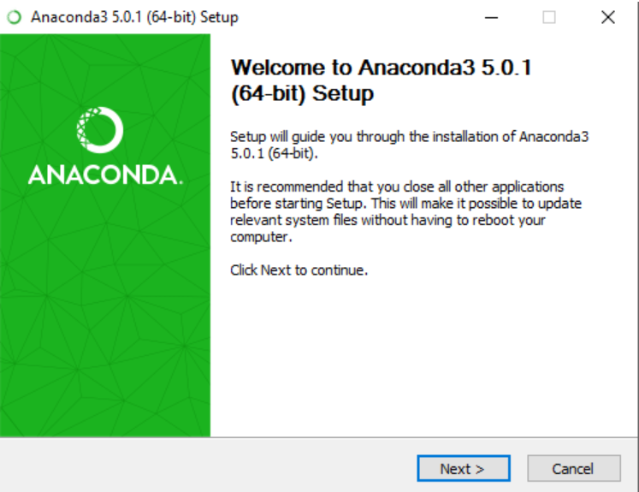
Downloading Anaconda
STEP :- 1 Downloading

Slide 3
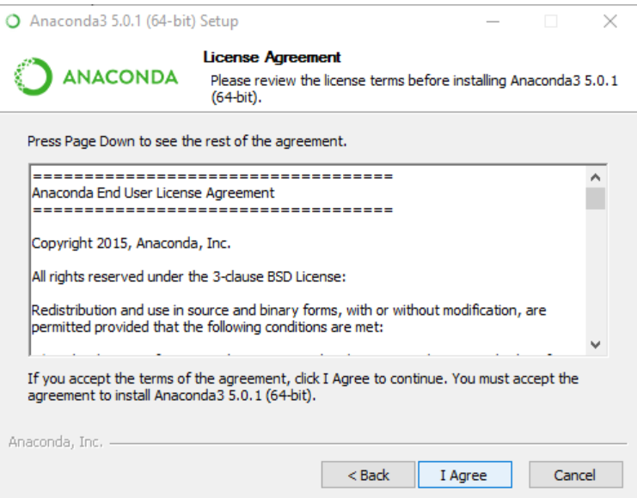
STEP :- 3 Installing

Slide 4
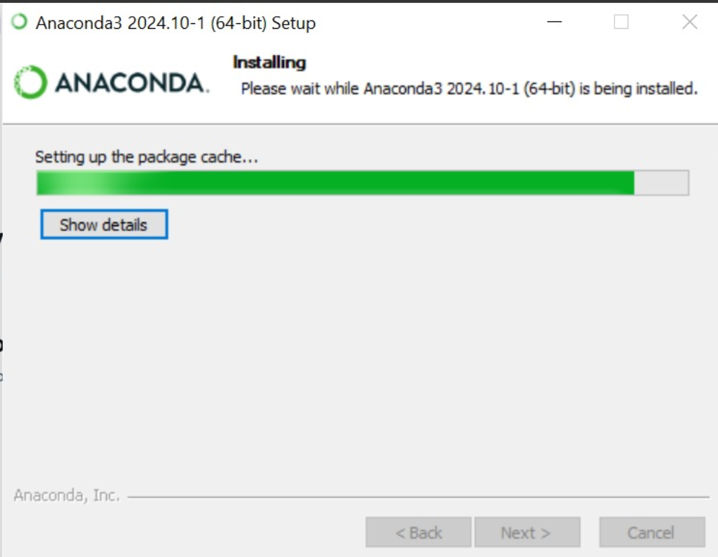
Installation Done.

Slide 5
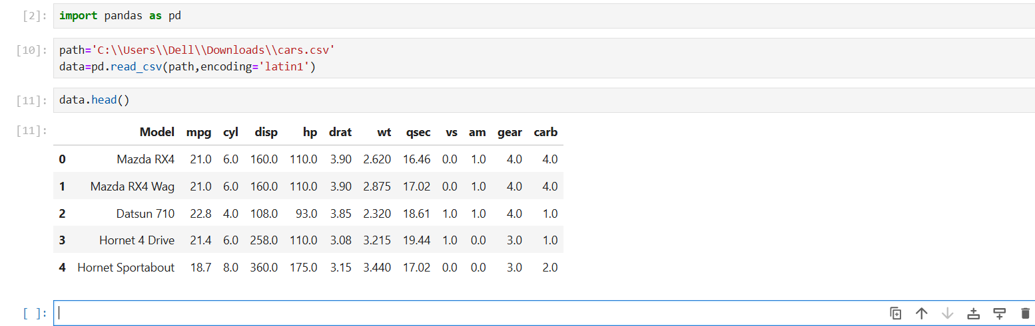
#installing pandas library on jupyter-notebook
!pip install pandas
Importing Pandas Library as pd and read the csv file by entering the path .

Slide 6
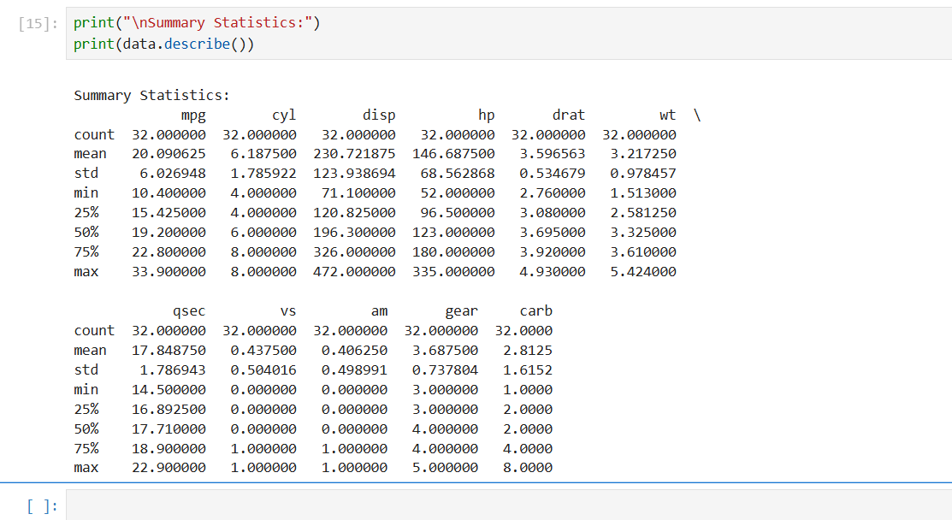
Describe method describes the statistical summary of the dataset by finding the mean, count, median ,std, max, min, 25%percentile, etc of each column.

Slide 7
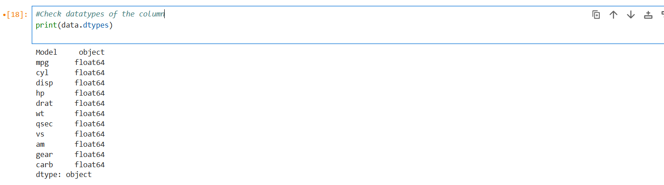
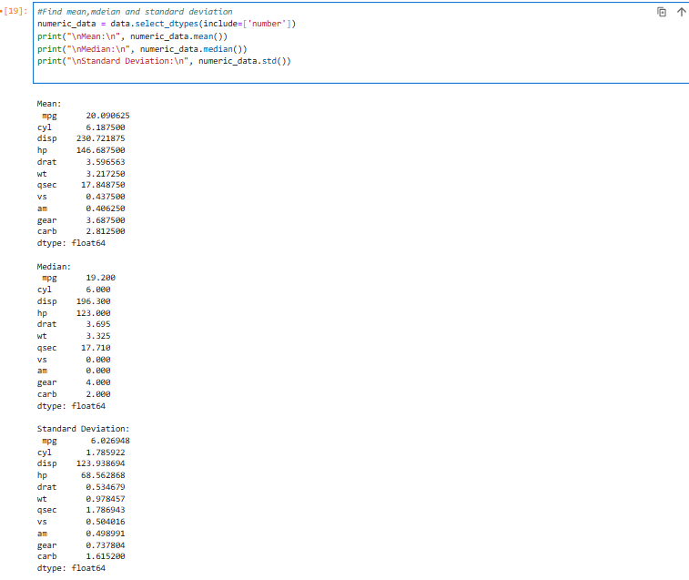
Check datatypes of column and then find the mean, median, std on numerical datatype col.

Slide 8
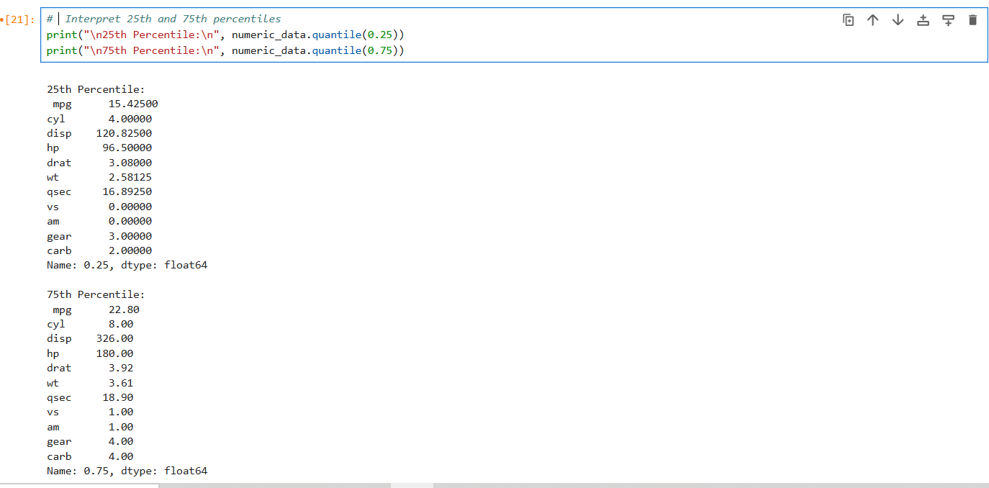
Quartile divides data into 3 parts:Q1 (25th Percentile): 25% of the data is below this value.
Q2 (Median): 50% of the data is below this value.
Q3 (75th Percentile): 75% of the data is below this value

Slide 9
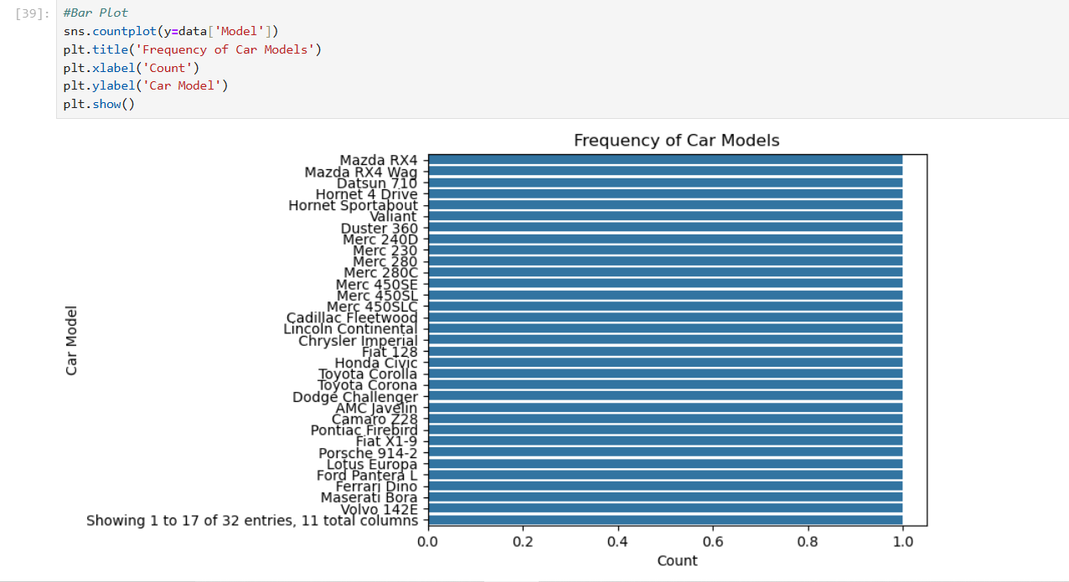
Visualize the data with graphs and descriptions to each
Bar Plot:
A bar plot uses rectangular bars to visually compare different categories, with bar length proportional to their values.
It indicates the frequency of each model, means how many times the model is decribed in the dataset.
Bar plot

Slide 10
Histogram
A histogram is a graphical representation of the distribution of a dataset, showing the frequency of data points within specific intervals or "bins". It is a common tool used to visualize the shape and spread of continuous data.
Key Features of a Histogram:
Bins: The data is divided into intervals or bins.
Frequency: The height of each bar represents the frequency or number of data points that fall within that bin.
No Gaps: The bars in a histogram are typically adjacent to each other, indicating that the data is continuous.
When to Use a Histogram:
To visualize the distribution of a single continuous variable.
To identify the shape of the distribution (e.g., normal, skewed, uniform).
To compare the distributions of different groups.
Example: A histogram can be used to visualize the distribution of student test scores, where the bins represent score ranges and the height of each bar represents the number of students who scored within that range.

Slide 11
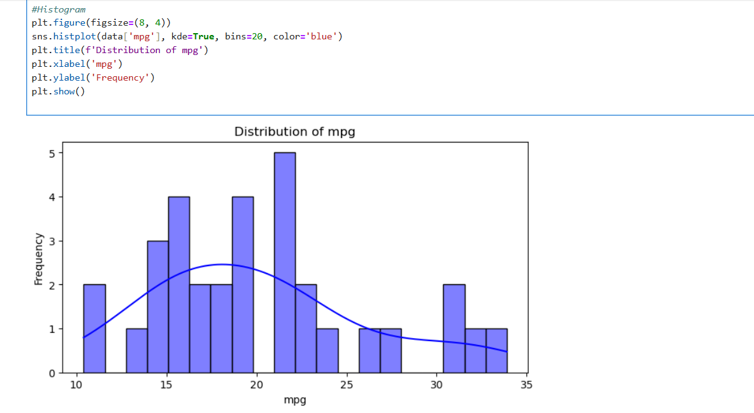
Histogram:
A histogram is a graphical representation of the distribution of a dataset, showing the frequency of data points within specific intervals
Its shows how the data is widely spread out for 'mpg' column.
This graph represents that data is spread high in range between 15-20.(Most cars have similar mpg)
Histogram

Slide 12
Scatter Plot:
A scatter plot is a graphical representation of the relationship between two numerical variables. Each data point is represented by a dot on the plot, where the x-coordinate represents the value of one variable and the y-coordinate represents the value of the other variable.
Key Features of a Scatter Plot:
Data Points: Each dot represents a pair of values for the two variables.
X-Axis and Y-Axis: The x-axis and y-axis represent the two variables being plotted.
Patterns: The pattern of the dots can reveal relationships between the variables, such as positive or negative correlation, or no correlation.
When to Use a Scatter Plot:
To visualize the relationship between two numerical variables.
To identify trends or patterns in the data.
To detect outliers or unusual data points.

Slide 13
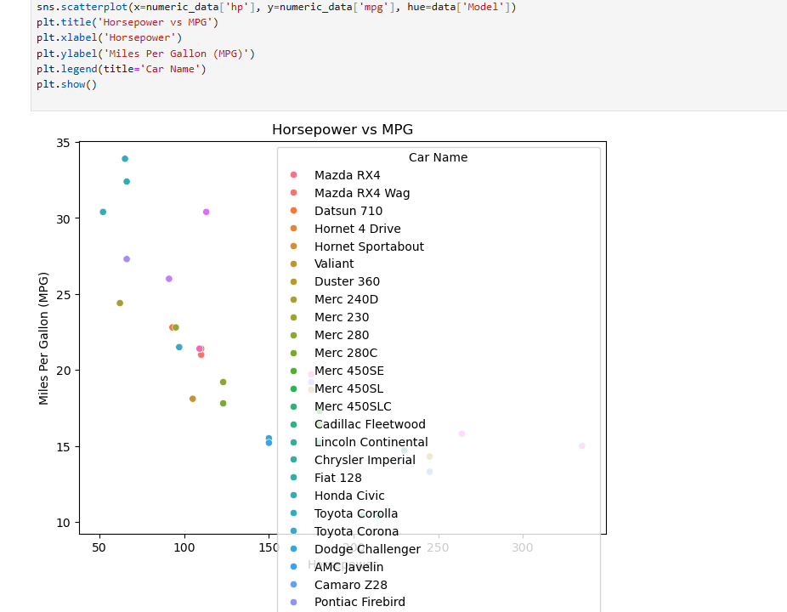
Scatter plot:
Used to visualize the relationship between two variables .
It helps to identify the correlation between variables like negative correlation and positive correlation.
It tells the negative correlation between hp and mpg are more powerful cars (with higher horsepower) usually consume more fuel, leading to lower mpg.
Scatter-plot

Slide 14
A box plot, also known as a box-and-whisker plot, is a standardized way of displaying the distribution of a data set based on its five-number summary: ¹ the "minimum," first quartile (Q1), median, third quartile (Q3), and "maximum." It provides a concise and visual representation of the spread and central tendency of the data.
Box: The box represents the interquartile range (IQR), which encompasses the middle 50% of the data. The bottom of the box marks Q1, the top marks Q3, and a line inside the box indicates the median (Q2).
Whiskers: The lines extending from the box are called whiskers. They typically represent the range of the data within 1.5 times the IQR from the box edges. Data points beyond this range are considered potential outliers.
Outliers: Individual data points that fall outside the whiskers are often plotted as individual dots or symbols.
How to Read a Box Plot:
Median: The line inside the box indicates the median, which divides the data into two equal halves.
Spread: The width of the box represents the IQR, giving you an idea of the data's spread. A wider box indicates greater variability.
Skewness: The position of the median within the box can suggest skewness. If the median is closer to the bottom of the box, the data is likely skewed to the right (positively skewed). If it's closer to the top, the data is skewed to the left (negatively skewed).
Outliers: Outliers are points that lie outside the whiskers, suggesting potential unusual observations.

Slide 15
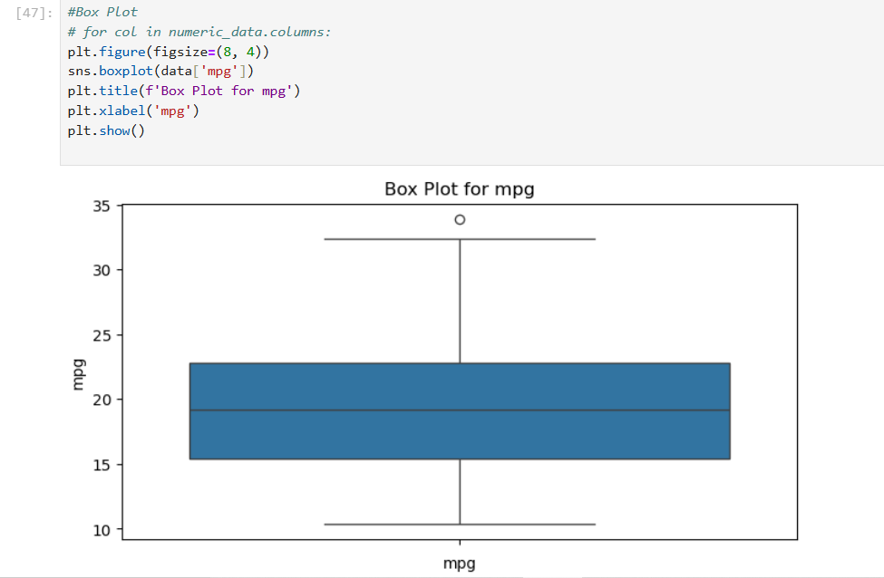
Box Plot:-
It tells the summary or statistics of the dataset. The line between the graph represents the median that lies near the 20(Median is nearly 19). And also shows the outlier point (one data point is outside the box near about 35(which is greatest)).
Range of the box Plot shows how spread out the middle 50% of mpg values are.
Box-Plot

