Slide 1

By Akansha Gupta

Slide 2
Framework for 2 Weeks
2 weeks plan
Every Day Discussion about topics / Technologies/ doubt clearance .
Every day with SME/Trainer discussion of Project progress & transformation based on design & Technologies.
Every Day Recap of previous day Topics

Slide 3
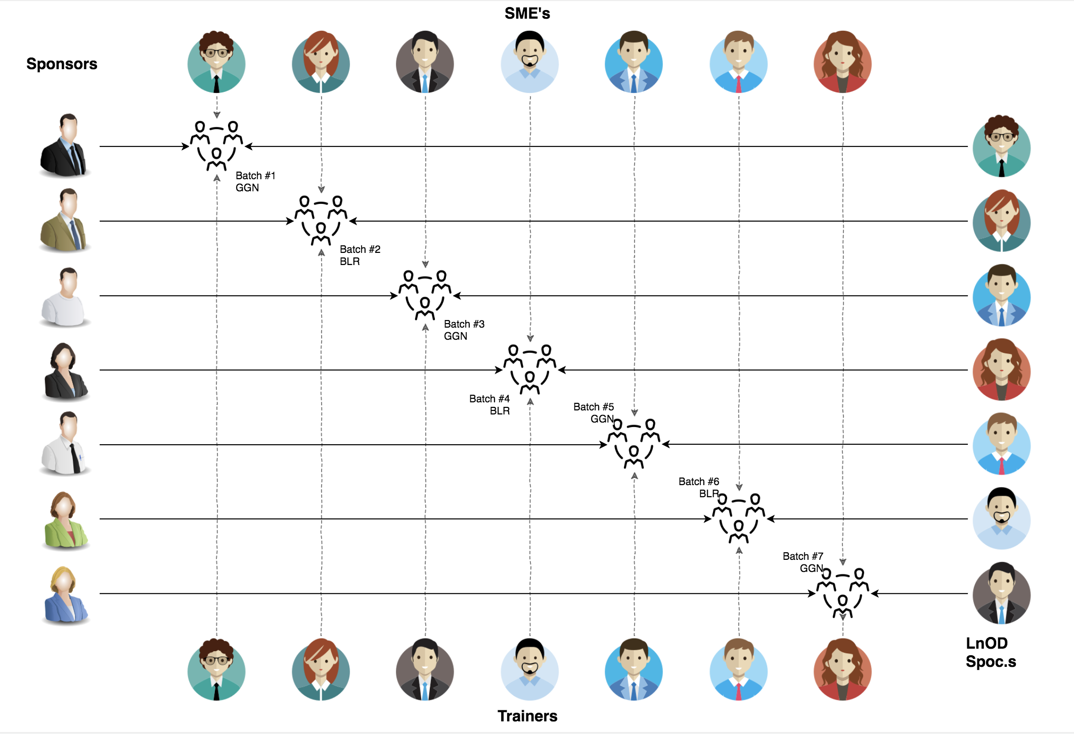
Stakeholders
Sponsors
Coforge
SME’s
1. Alin Bhattacharyya
2. Apoorva Kumar Saxena
3. Amit Balyan
4. Priyanka Singh
Trainers
Amit Balyan

Slide 4
Our Vision
Notes:
Time – 1 min
Swati

Slide 5
2 Weeks of Training + Project demo
Intro
Basics
HTML5
CSS3
ES6
Typescript
Angular 11
ReactJs
10 DAYS
80 HOURS
4800 MINUTES
288,000 SECONDS
Limitless knowledge

Slide 6

Our Journey
Notes:
Time - 2 mins

Slide 7
Demo
Mindset
Process
5
project Demo
Tools
4
Adapting to a developer
Mindset
Comprehend
3
Design Thinking
2
Decide the Technologies
1
Understanding Project Goals

Slide 8
AGENDA
Day 1: ES6
Day 2: HTML5 + Advanced API
Day 3: CSS3
Day 4: Typescript
Day 5-8: Angular11 (Lazy Loading, Jaon-server, Routing, Reactive Forms, Testing with Jasmine and Karma etc.)
Day 9-10: ReactJs + Redux

Slide 9
Learning
Start with the basics of HTML5 and CSS3 for making better UI/UX.
Learnt how to make the Application more accessible , interactive, and useful for the users.
Reusable components Creation.
Learn to write better quality code.
Learnt various features of Angular and ReactJs

Slide 10

Project Goals
Notes:
Time – 3 mins

Slide 11




Our Vision
To create an Flight Booking System using full stack development tools and technologies, where an agent as well as an customer can book and search flights from various airlines .
1
2
Quality
Security
3
4
Interactivity
Speed
Notes:
User satisfaction and brand value

Slide 12

Tech Stack
Notes:
Time – 2 mins

Slide 13


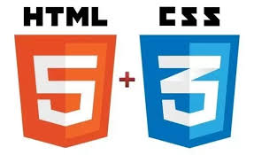




Frontend
Framework & Libraries
Testing
Notes:
Time – 1 min

Slide 14

Demo
Notes:
Time –
Architecture – 5 mins
NFR Dashboard – 3 mins
Demo – 10 mins
1. Show the Responsiveness and Wave tool first

Slide 15
Thank you
Notes:
Time – After this show the testimonial video. 1 min

