Slide 1
<Group by &
Having clause |
Akansha Shetty
Ai&De
14/05/2024
START

Slide 2

<
>
<
>
<
>
<
>
INTRODUCTION
GROUP BY
EXAMPLES
1
2
3
<
>
<
>
HAVING
EXAMPLES
4
5
<
>
RESOURCES
6

Slide 3

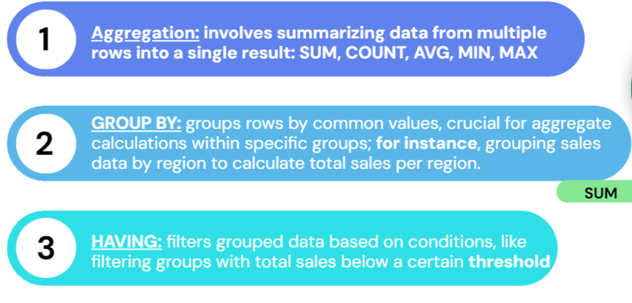


<
>
UNDERSTANDING SQL AGGREGATION:

Slide 4

<
>
groupby
START

Slide 5

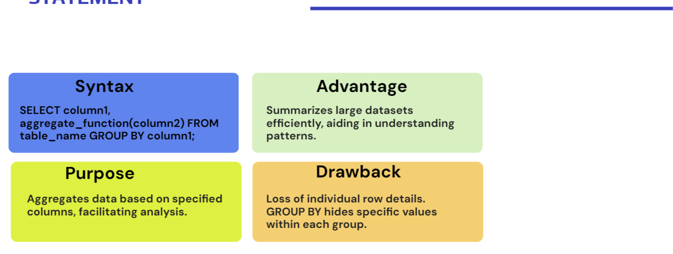
<
>

Slide 6
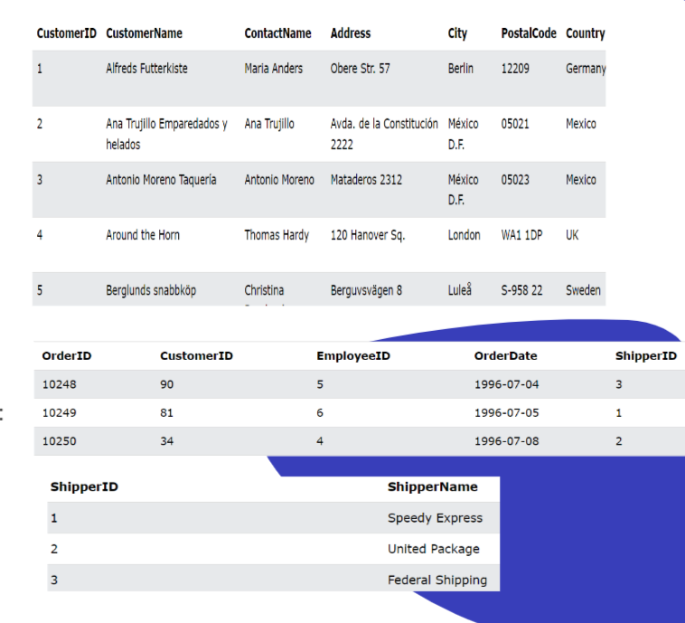
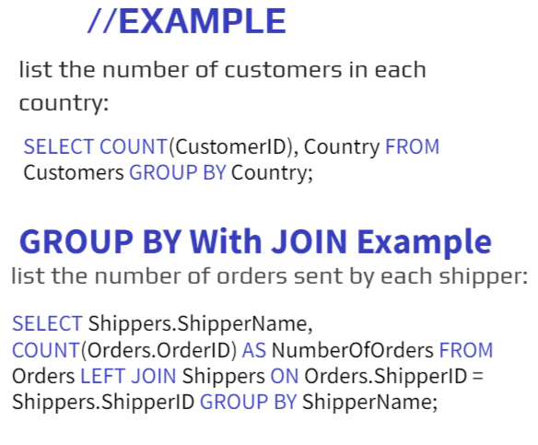
<
>

Slide 7



<
>
START

Slide 8

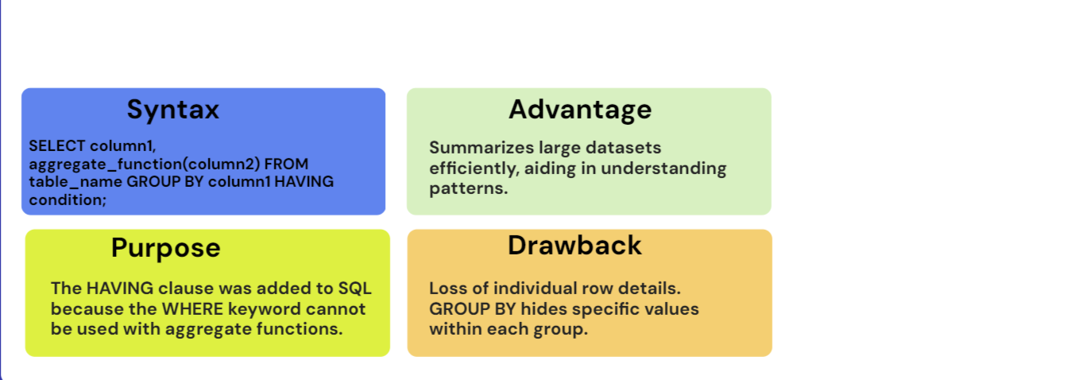
<
>
SELECT column1, aggregate_function(column2) FROM table_name GROUP BY column1
HAVING condition;
Filters groups based on aggregate functions, enabling powerful data analysis.
Limited granularity; filters entire groups, not individual rows.

Slide 9
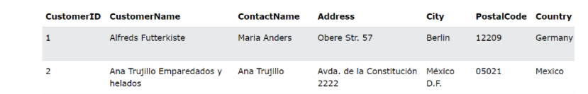
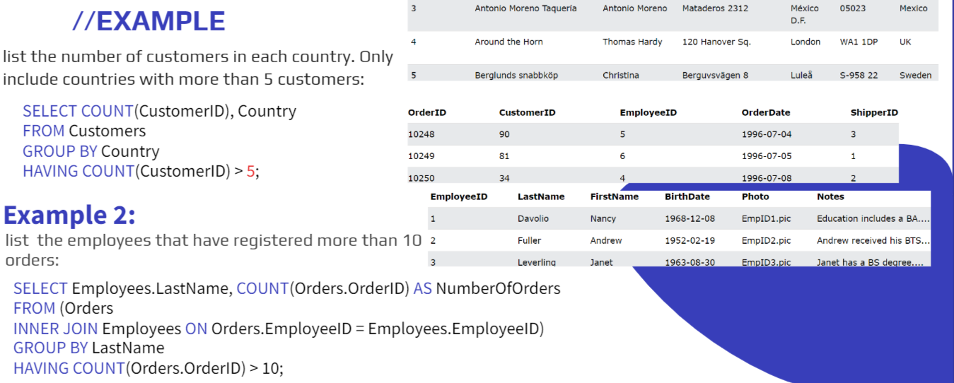
<
>

Slide 10


https://www.w3schools.com/mysql/mysql_groupby.asp
https://www.w3schools.com/mysql/trymysql.asp?filename=trysql_select_groupby
https://www.scholarhat.com/tutorial/sqlserver/definition-use-of-group-by-and-having-clause
https://www.geeksforgeeks.org/difference-between-having-clause-and-group-by-clause/
THANK
YOU

