Slide 1
Introduction to AI
Michael J. Watts
http://mike.watts.net.nz

Slide 2
Lecture Outline
  Artificial / Computational intelligence
  CI models

Slide 3
Computational Intelligence
  What’s it all about?
    The Turing test
    An alternative definition

Slide 4
The Turing Test
  Proposed by Alan Turing in 1950
  Deals with the question: “Can machines think?”
  Turing thought this question absurd
  How to define ‘think’?
  Dealt with it with a thought experiment

Slide 5
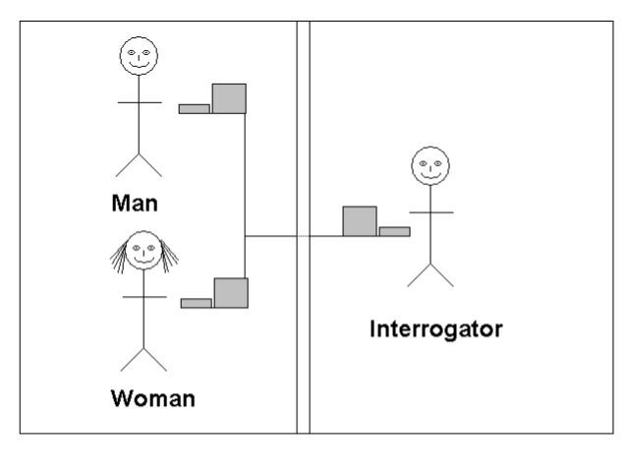
The Turing Test

Slide 6
The Turing Test
  Man’s objective is to convince interrogator that he is a woman
  Woman’s objective is to help the interrogator
  After a while, the interrogator must decide which is which
  Now, replace the man with a computer

Slide 7
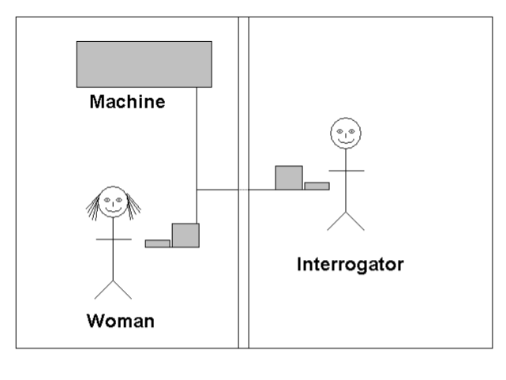
The Turing Test

Slide 8
The Turing Test
  Will the interrogator decide wrongly as often as before?
  In other words, can the machine convince the interrogator that it is human as often as a man can pass as a woman?

Slide 9
The Turing Test
  “The Turing Test is no more a test for intelligence than it is a test for femininity… A man doesn’t become a woman because he can fool you into thinking that he’s a woman. By the same token, a machine doesn’t become…an intelligent machine, just because it can fool you into thinking that it’s thinking”
    David B. Fogel, Blondie24: Playing at the Edge of AI pg 11

Slide 10
An Alternative Definition
  “Intelligence is the capability of a decision-making system to adapt its behavior to meet its goals in a range of environments”
    David B. Fogel, Blondie24: Playing at the Edge of AI pg 14

Slide 11
Computational Intelligence
  Artificial Intelligence is now called Computational Intelligence
  Why the change?
    Fashion?
    Politics?
    More accurate?

Slide 12
CI Models
  We will be studying three general paradigms of CI
    Rule based and fuzzy systems (FS)
    Artificial Neural Networks (ANN)
    Evolutionary Computation (EC)

Slide 13
CI Models
  Why cover different models?
  No Free Lunch Theorem
    If there is a problem A on which the algorithm performs well, there will be a problem B on which the algorithm performs poorly
    Nothing is good at everything

Slide 14
Rule-Based Systems
  Systems that make decisions based on rules
  Used when the rules can be stated
  Crisp rules
    When the numbers dealt with are always exact
    Can be a pain in the neck to program, though
  Fuzzy rules
    deals with inexact concepts – ‘bigger’, ‘smaller’, ‘faster’
    easier to state rules
    Optimisation can be difficult

Slide 15
Rule-Based Systems
  First, define the rules
  Easier said than done
  Are the rules consistent?
  Are the rules complete?
    Cover all possibilities
  Fuzzy systems
    define the fuzzy membership functions

Slide 16
Artificial Neural Networks
  Based on models of the brain
  Consist of network of interconnected subunits
    Neurons
  Used when the rules are not known
  ANN are learning structures
    Don’t need to be told the answer to the problem

Slide 17
Artificial Neural Networks
  Many kinds in existence
  We will be covering only three
    Perceptrons
    Multi-layer Perceptrons (MLP)
    Kohonen Self-Organising Maps (SOM)

Slide 18
Artificial Neural Networks
  Which networks are used depends on the application
  perceptrons useful for simple problems
    linear separability
  MLPs handle problems perceptrons cannot
    Non linearly separable

Slide 19
Artificial Neural Networks
  Perceptrons and MLPs both use supervised learning
    Must know the target values the network is learning
  SOMs are unsupervised
    capture clusters in the data
    vector quantisers

Slide 20
Artificial Neural Networks
  Care must be taken with the data used to train the network
    It is easy to badly train an ANN
  Other circumstances where ANN don’t function well

Slide 21
Evolutionary Algorithms
  Based on the mechanisms of natural selection and biological evolution
  Evaluates fitness of (initially) random solutions
  More fit individuals produce more offspring
  Search algorithms
  Used when brute-force (exhaustive) search is not feasible
  Useful for multi-parameter optimisation

Slide 22
Evolutionary Algorithms
  Several kinds exist
    Genetic Algorithms (GA)
    Evolution Strategies (ES)
    Evolutionary Programming (EP)
    Genetic Programming (GP)
  Require the following characteristics
    representable
    Fitness (objective) function

Slide 23
Representation
  Must be able to represent the problem in the algorithm
  some means of encoding candidate solutions

Slide 24
Evaluation
  some means of rating candidates must exist
    binary ratings are no good
      right/wrong
    fitness function must be objective
    fitness function must separate good candidates from bad candidates
    Most problem dependent component of EA

Slide 25
Conclusions
  Computational intelligence is hard to define
  Oldest attempt is the Turing Test, but not very accurate
  Many different kinds of CI about
  Deal with 3 in this course
    Rule based systems
    Neural Networks
    Evolutionary Algorithms

