Slide 1
Data statistics and transformation revision
Michael J. Watts
http://mike.watts.net.nz

Slide 2
Lecture Outline
  Statistical operations on Data
  Data transformations
    The objectives of a data transform
    Linear versus non-linear transformations
    Transformations for pre-processing of data
    DFT and FFT Transformations
    Wavelet Transformations

Slide 3
Why Analyse Data?
  Important part of problem solving process
  Can suggest method to use to solve problem
  Answers many important questions about the data set and the problem
  Improves understanding of the problem

Slide 4
Why Analyse Data?
  what are the statistical parameters of the data?
    mean, standard deviation, correlation
  what is the nature of the process?
    periodic, chaotic, random?
    a random process cannot be predicted at all
    periodic processes are more easily modelled
    chaotic processes are a bit harder to model

Slide 5
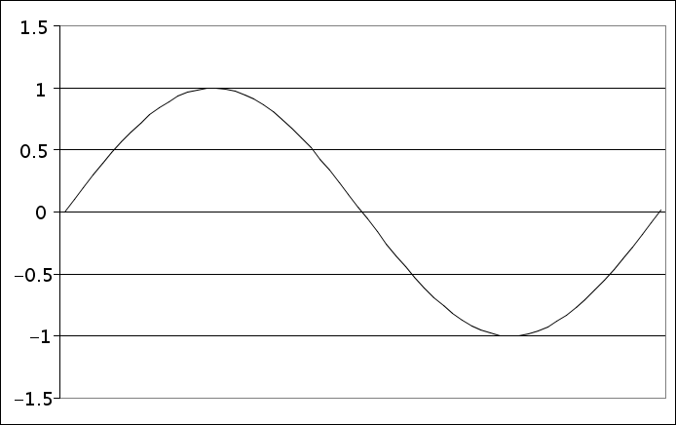
A Periodic Process

Slide 6
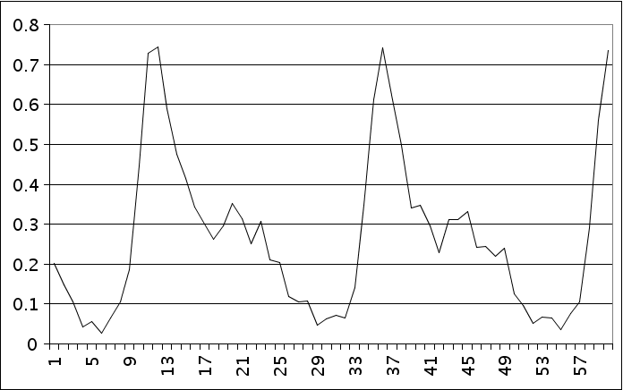
A Chaotic Process

Slide 7
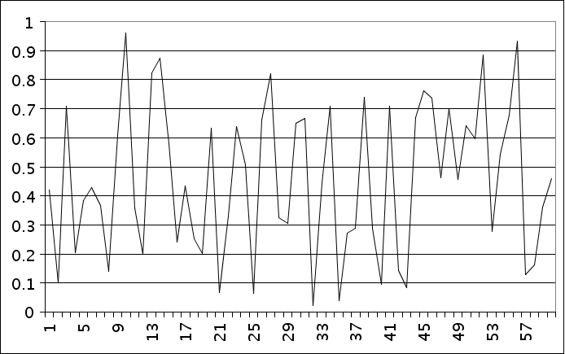
A Random Process

Slide 8
Why Analyse Data?…
  How is the available data distributed?
    does it naturally cluster together?
    is it uniformly distributed?
    does it cover enough of the problem space to be useful?

Slide 9
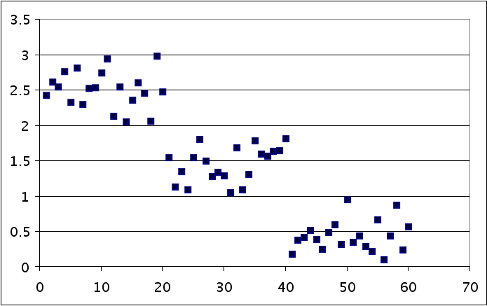
Clustered Data

Slide 10
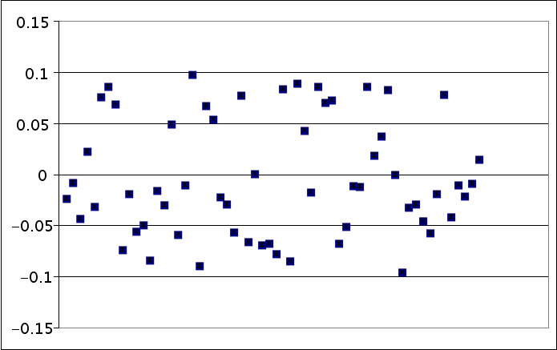
Uniform Distribution

Slide 11
Why Analyse Data?
  Is there missing data and how much?
    is missing data a critical obstacle?
    can other methods be used to compensate for the gaps?

Slide 12
Why Analyse Data?
  What features can be extracted from the data?
    reducing the number of variables in the data set
    can assist with modelling the problem
    can make correlations / relationships easier to see

Slide 13
Statistical Data Analysis
  Discover repetitiveness in data
  Simple functions
    mean
    standard deviation
    Histogram

Slide 14
Statistical Data Analysis
  Arithmetic mean
    A value that is representative of the population of values
  Standard deviation
    A measure of how far from the mean values deviate
  Analysis must be appropriate for the data
    Measurement theory

Slide 15
Correlation
  Correlation
    Finds linear dependencies between variables
    Correlation coefficients may change in time for time series data

Slide 16
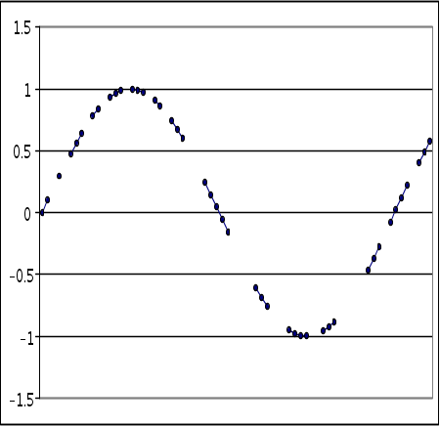
Regression and Interpolation
  Regression analysis:
    finds a formula which approximates data for a given output variable
  Interpolation:
    fills in gaps in data
    fit data into curves

Slide 17
PCA
  Principal component analysis (PCA)
    eliminates redundant variables
    reduces number of variables in data set
    makes it easier to model

Slide 18
ICA
  Independent component analysis
    separates components from a set of unknown independent components
    Example: the cocktail party problem - separating speakers from a signal taken from cocktail party speech - several people speaking simultaneously

Slide 19
Clustering Methods
  Assigns each datum into one and only one subset of the data set
  k-means clustering
    finds k centres in the data space
    sum of squares of distance between each data point and nearest centre is minimised
    Distance between cluster centres is maximised

Slide 20
Vector Quantisation
  represents a n dimensional space as a m dimensional one
  m < n
  Preserves distance between examples
    examples that are close in n dimensional space will be close in m dimensional space

Slide 21
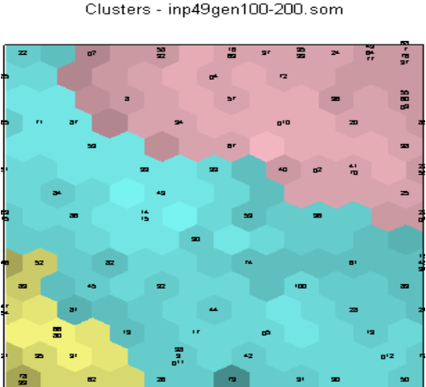
Example: SOM for vector quantisation of data in Bioinformatics
  SOM !! ---->
  A selected subset of genes expressed in 49 tissue samples (two types of Leukaemia - ALL and AML)

Slide 22
The objectives of a data transformation
  Data rate reduction – meaningful features are extracted from it
  Improving the quality of the information – via noise suppression or image enhancement
  Knowledge discovery and better understanding of the processes and events
  Finding similarities and analogies between processes and events

Slide 23
Linear versus non-linear transformations
  Linear transformation
    F(x) of a raw data vector x such that F is a linear function of x. E.g. F(x)=2x+1
  Non-linear transformations
    F(x) of a raw data vector x such that F is a non-linear function of x. E.g. F(x)=1(1+e^{-x.c})
  Other non-linear transformations
    The logarithmic function, F(x)=log₁₀x.

Slide 24
Transformations for pre-processing of data
  Sampling
    The process of selecting a subset of the available data. Can be applied to continuous time series data such as speech and music.
  Discretisation
    Representing continuous-valued data with the use of sub-intervals where the real values lie.
  Normalisation
    Moving the scale of the real data into a predefined scale e.g. [0,1]. Can be linear or non-linear.

Slide 25
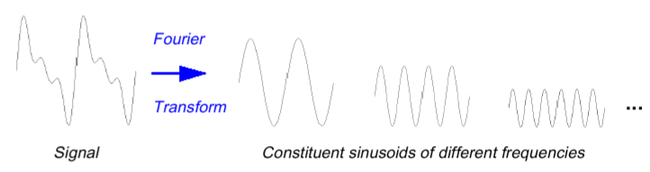
DFT and FFT Transformations
  Discrete Fourier Transforms (DFT)
    A non-linear transformation where the data is represented as a sum of harmonic Fourier series
  A periodic signal (e.g sin) is characterised by one frequency. Every signal can be represented as a sum of periodic signals with different frequencies.

Slide 26
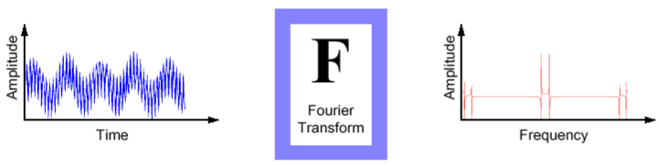
DFT and FFT Transformations
  Fast Fourier Transform (FFT)
    The fast implementation of a DFT when the number of periodic signals is a power of 2.
  Applications of FFT Transforms
    Speech and Image data.
    Sunspot activity analysis.

Slide 27
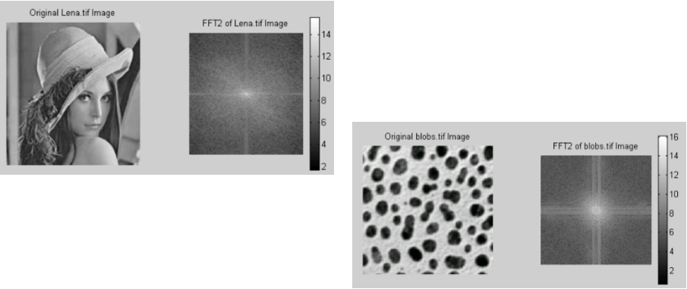
DFT and FFT Transformations
  Fast Fourier Transform (FFT) of Images
The FFT operator transforms the image from the spatial to the frequency domain
It allows us to analyse the information content of the image

Slide 28
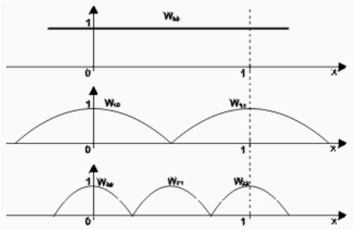
Wavelet Transformations
  Wavelet Transformation
    A non-linear transformation. Can represent sight changes of the signal within the chosen window from the time scale.
  W_{a,b}(x) = f(ax –b) ,
    f = non-linear function
    a = scaling parameter
    b = shifting parameter

Slide 29
Summary
  Data analysis is an integral part of the problem solving process
    can suggest means of solving problem
    assists in the modelling process
  Statistical techniques, clustering techniques, vector quantisation are all available methods

Slide 30
Summary
  There are many transforms available to apply to datasets, some more appropriate than others.
  Linear and non-linear transformations are simple but effective operations.
  DFT, FFT, and Wavelet transforms are powerful ways of analysing signals.

