Slide 1

Band Of Bandicoots
Problem Statement 1: Breakthroughs in Vehicle Safety and
Connectivity
(Innovations in Transportation to Enhance Safety and Efficiency)

Slide 2

Band Of Bandicoots
Starlink: The Cutting Edge of Communications Tech
Starlink is a project by SpaceX, an American aerospace company, to provide high-speed internet access to people around the world using a network of thousands of satellites in low Earth orbit. Starlink satellites use advanced technologies such as optical space lasers, ion propulsion systems, and self-orienting antennas to deliver fast and reliable internet service to even the most remote locations. Starlink is the first and largest satellite internet constellation in history, and it aims to make the internet more accessible and affordable for everyone.
Track 2: Optimizing Transportation Efficiency
(Innovations in Transportation to Enhance Safety and Efficiency)

Slide 3

Band Of Bandicoots
What Starlink Brings to the Table
Starlink offers truly global internet connection, so long as the dish is stationary while in operation. However, in many applications, this cannot be achieved, for example, on ships and airplanes. Therefore, we offer a solution which can get around this limitation. Introducing:
Track 2: Optimizing Transportation Efficiency
(Innovations in Transportation to Enhance Safety and Efficiency)

Slide 4
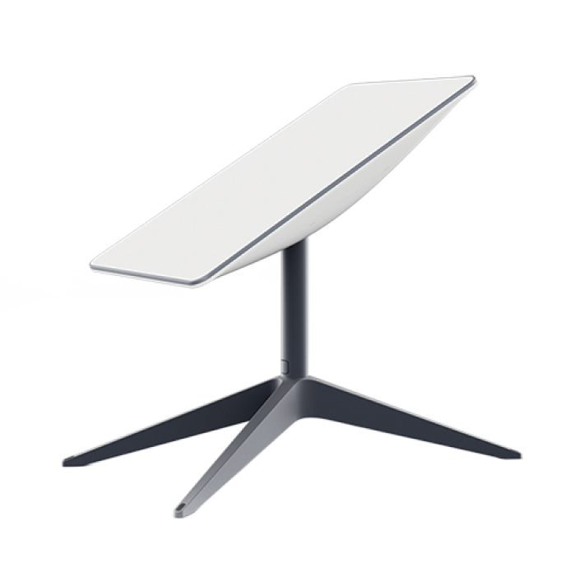
Band Of Bandicoots
Starlink: How it Works
A Starlink dish antenna is provided to the client, which combines the action of physical orientation, as well as phased array signal vectoring, to track one of thousands of satellites in the sky over a given location.
Track 2: Optimizing Transportation Efficiency
(Innovations in Transportation to Enhance Safety and Efficiency)

Slide 5
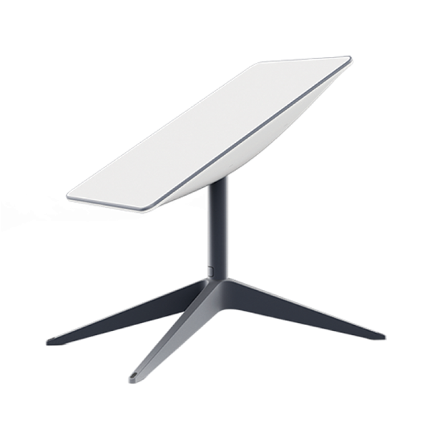
Band Of Bandicoots
Phased Array Signal Vectoring
Phased array antennas are a type of antenna that can electronically steer the direction of the radio waves without physically moving the dish. They consist of many small antenna elements that work together to form a beam that can be pointed at any angle. By changing the phase and amplitude of the signals from each element, the beam can be steered in different directions.
Track 2: Optimizing Transportation Efficiency
(Innovations in Transportation to Enhance Safety and Efficiency)

Slide 6
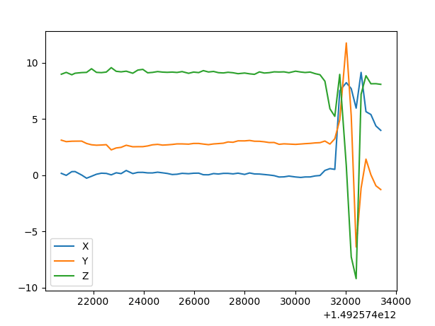
Band Of Bandicoots
Challenges while Moving
Movement on vessels like ships and airplanes is very turbulent. This causes unintentional deviation from the line of sight of the sensor with the satellite. To overcome this, we need high frequency accelerometer data, a high frequency correcting program and accurate quick-response servos.
Track 2: Optimizing Transportation Efficiency
(Innovations in Transportation to Enhance Safety and Efficiency)

Slide 7



Starlink Plus
Starlink Plus is an after-market solution to allow Starlink antennas to operate while in motion. The entire product will involve both hardware and software components, but we’re focusing on the software aspect of the product, the Starlink Plus software. This is a Windows™ based GUI application developed using Microsoft .Net Framework.

Slide 8
Starlink Plus
This software is designed to run on a low cost Embedded Windows™ machine, and communicate directly to the hardware sensors/servos though a serial port connection. It takes x-y-z data from the accelerometers, and controls the servos to correct the deviation, taking into account the distance of the dish from the satellite. Since we do not have the required hardware, we will be simulating it in software through direct data inputs.

Slide 9
Starlink Plus
This software is designed to run on a low cost Embedded Windows™ machine, and communicate directly to the hardware sensors/servos though a serial port connection. It takes x-y-z data from the accelerometers, and controls the servos to correct the deviation, taking into account the distance of the dish from the satellite. Since we do not have the required hardware, we will be simulating it in software through direct data inputs.

Slide 10
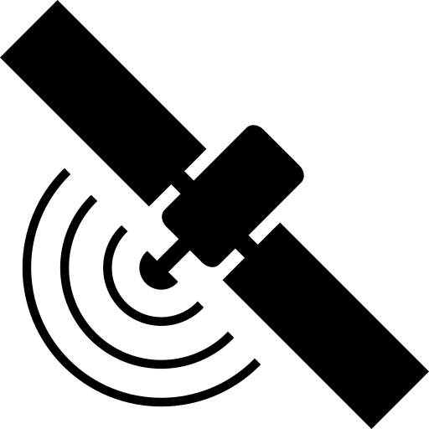
Starlink Plus
Distance from satellite can be calculated using signal ping. This is done at a hardware level, so in order to simulate that, we can implement that through user input.

Slide 11
Starlink Plus
#include <iostream>
#include <cmath>
using namespace std;
const double PI = 3.14159265358979323846;
const double C = 299792458; // Speed of light in m/s
const double RAD_TO_DEG = 180 / PI; // Conversion factor from radians to degrees
// Define a struct to represent a point in 3D space
struct Point {
double x; // x coordinate
double y; // y coordinate
double z; // z coordinate
};
// Define a function to calculate the distance between two points
double distance(Point p1, Point p2) {
return sqrt(pow(p1.x - p2.x, 2) + pow(p1.y - p2.y, 2) + pow(p1.z - p2.z, 2));
}
// Function to calculate the angle between two vectors
double angle(Point v1, Point v2) {
double dot = v1.x * v2.x + v1.y * v2.y + v1.z * v2.z; // Dot product of v1 and v2
double mag1 = sqrt(pow(v1.x, 2) + pow(v1.y, 2) + pow(v1.z, 2)); // Magnitude of v1
double mag2 = sqrt(pow(v2.x, 2) + pow(v2.y, 2) + pow(v2.z, 2)); // Magnitude of v2
return acos(dot / (mag1 * mag2)); // Angle in radians
}
// Function to calculate the degree change in angle of a light source
double degree_change(Point origin, Point target, Point acceleration, double distance) {
// Calculate the initial vector from the origin to the target
Point initial_vector;
initial_vector.x = target.x - origin.x;
initial_vector.y = target.y - origin.y;
initial_vector.z = target.z - origin.z;
// Calculate the time it takes for the light to reach the target
double time = distance * 1000 / C; // Convert distance from km to m and divide by speed of light
// Calculate the final position of the origin after accelerating for that time
Point final_position;
final_position.x = origin.x + acceleration.x * pow(time, 2) / 2;
final_position.y = origin.y + acceleration.y * pow(time, 2) / 2;
final_position.z = origin.z + acceleration.z * pow(time, 2) / 2;
// Calculate the final vector from the final position to the target
Point final_vector;
final_vector.x = target.x - final_position.x;
final_vector.y = target.y - final_position.y;
final_vector.z = target.z - final_position.z;
// Calculate the angle between the initial and final vectors
double theta = angle(initial_vector, final_vector);
// Convert the angle from radians to degrees and return it
return theta * RAD_TO_DEG; in m/s^2
}
int main() {
// Declare some variables to store the inputs from the sliders
double x_acc; // x axis acceleration
double y_acc; // y axis acceleration in m/s^2
double z_acc; // z axis acceleration in m/s^2
double dist; // distance to the target point in km
// Prompt the user to enter the inputs from the sliders
cout << "Enter the x axis acceleration in m/s^2: ";
cin >> x_acc;
cout << "Enter the y axis acceleration in m/s^2: ";
cin >> y_acc;
cout << "Enter the z axis acceleration in m/s^2: ";
cin >> z_acc;
cout << "Enter the distance to the target point in km: ";
cin >> dist;
// Create a point object for the origin with fixed coordinates (0, 0, 0)
Point origin;
origin.x = 0;
origin.y = 0;
origin.z = 0;
// Create a point object for the target with fixed coordinates (1000, 1000, 1000)
Point target;
target.x = 1000;
target.y = 1000;
target.z = 1000;
// Create a point object for the acceleration with the inputs from the sliders
Point acceleration;
acceleration.x = x_acc;
acceleration.y = y_acc;
acceleration.z = z_acc;
// Call the degree_change function and store the result
double result = degree_change(origin, target, acceleration, dist);
// Display the result to the user
cout << "The degree change in angle required to still point to the target point is: " << result << " degrees" << endl;
return 0;
}

Slide 12

Starlink Plus
Previous code contains the mathematical calculations required to get the angle which the servos have to rotate the antenna attitude in order to correct for a specificized amount of x-y-z jerk acceleration. It uses concepts of relativistic effects and vector calculus.

Slide 13
Starlink Plus
Previous code contains the mathematical calculations required to get the angle which the servos have to rotate the antenna attitude in order to correct for a specificized amount of x-y-z jerk acceleration. It uses concepts of relativistic effects and vector calculus.

Slide 14
THANK YOU!

