Slide 1
SE SW Competency Task Force(SSCTF)
Class - 2

Slide 2
Scope
Main objective is to focus on Key Algorithms/Methods that are frequently covered in Advance SW Competency Test.
Target is to get good understanding and Hands On Experience.
Tips - Dos and Don’t.
Test problems will be covered.
Out of Scope:
No intension to cover regular advance C programming training for various data structure and algorithms. That has to be covered through SRIB training.
PS: however invite the major concern that you feel to be addressed in this task force.

Slide 3
Recursion.. Continued -Binary tree traversal -Depth First Search(DFS) -Breadth First Search(BFS) Class-2
Anju Bala & Sasikumar

Slide 4
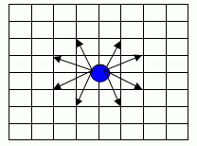
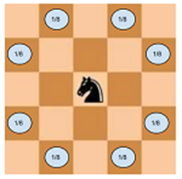
Chess Problem
There is a mobile piece and a stationary piece on the N×M chessboard. The available moves of the mobile piece are the same as set out in the image below. You need to capture the stationary piece by moving the mobile piece with the minimum amount of moves.
Write a program to find out the minimum number moves to catch a piece. Time limit:1 second (java: 2 seconds) [Input] Several test cases can be included in the inputs. T, the number of cases is given in the first row of the inputs. After that, the test cases as many as T (T ≤ 20) are given in a row. N, the numbers of the rows and M, the number of columns of the chessboard are given in the first row of each test case. R & C is the location information of the attacking piece and S & K is the location of the defending pieces and are given in the row at the second line. However, the location of the uppermost end of the left end is (1, 1) [Output] Output the minimum number of movements to catch a defending piece at the first line of each test case. If not moveable, output equals ‘-1’.
[I/O Example]
Input 2 9 9 3 5 2 8 20 20 2 3 7 9 Output 2
5
Practice

Slide 5
Chess Program in C
#include <stdio.h>
int map[100][100];
int n, m, r, c, s, k;
int result = 99999999;
void search(int x, int y, int count)
{
if ((x < 0) || (y < 0) || (x > n-1) || (y > m-1))
return;
if ((x == s-1) && (y == k-1))
{ if (result > count)
{map[x][y] = count;
result = count;
}
}
if ((map[x][y] == 0) || (map[x][y] > count))
{ map[x][y] = count;
search(x - 2, y - 1, count + 1);
search(x - 2, y + 1, count + 1);
search(x - 1, y - 2, count + 1);
search(x + 1, y - 2, count + 1);
search(x + 2, y - 1, count + 1);
search(x + 2, y + 1, count + 1);
search(x - 1, y + 2, count + 1);
search(x + 1, y + 2, count + 1);
}
}
int main(void)
{
int TC,i;
scanf("%d", &TC);
for(i = 1;i<= TC;i++
{
result = 99999999;
scanf("%d %d", &n, &m);
scanf("%d %d %d %d", &r, &c, &s, &k);
map[r-1][c-1] = 1;
search(r-1, c-1, 0);
printf("%d\n", result);
}
return 0;//Your program should return 0 on normal termination.
}

Slide 6
Chess Program in JAVA
import java.util.Scanner;
public class ChessProgram {
/**
* @param args
*/
static int n,m,r,c,s,k,result;
static int map[][];
public static void main(String[] args) {
int TC,i;
Scanner sc = new Scanner(System.in);
TC = sc.nextInt();
for(i = 1;i<= TC;i++)
{
result = 99999999;
n= sc.nextInt();
m = sc.nextInt();
r = sc.nextInt();
c = sc.nextInt();
s = sc.nextInt();
k = sc.nextInt();
map = new int[100][100];
map[r-1][c-1] = 1;
search(r-1, c-1, 0);
System.out.println(result);
}
}
static void search(int x, int y, int count)
{
if ((x < 0) || (y < 0) || (x > n-1) || (y > m-1))
return;
if ((x == s-1) && (y == k-1))
{
if (result > count)
{
map[x][y] = count;
result = count;
}
}
if ((map[x][y] == 0) || (map[x][y] > count))
{
map[x][y] = count;
search(x - 2, y - 1, count + 1);
search(x - 2, y + 1, count + 1);
search(x - 1, y - 2, count + 1);
search(x + 1, y - 2, count + 1);
search(x + 2, y - 1, count + 1);
search(x + 2, y + 1, count + 1);
search(x - 1, y + 2, count + 1);
search(x + 1, y + 2, count + 1);
}
}
}

Slide 7
Chess Problem in C/C++
int
main(int argc, char** argv)
{
int tc, T;
freopen(
"sample_input_8.txt", "r", stdin);
cin >> T;
for(tc = 0; tc < T; tc++)
{
/**********************************
* Implement your algorithm here. *
***********************************/
cin >> row >> col;
cin >> attacker_x >> attacker_y;
cin >> defender_x >> defender_y;
// grid_val[attacker_x][attacker_y] = result;
MovetoCatch(attacker_x, attacker_y, 0);
// Print the answer to standard output(screen).
cout <<
"\n Moves = " <<result;
//reset
for (int i = 1; i <= row ; i ++)
for (int j = 1; j <= col ; j++)
grid_val[i][j] = 0;
result = 999999999;
}
return 0;//Your program should return 0 on normal termination.
//getchar();
}
void
MovetoCatch(int x, int y, int num_of_moves) {
int u,v;
int temp = grid_val[x][y];
if (grid_val[x][y] > 0 && grid_val[x][y] <= num_of_moves )
return;
if (x == defender_x && y == defender_y) {
if (num_of_moves < result) {
result = num_of_moves;
grid_val[x][y] = num_of_moves;
}
//return;
}
else {
grid_val[x][y] = num_of_moves;
num_of_moves++;
}
for (int i = 0 ; i <= 7 ; i++ ) {
u = x + dx[i];
v = y + dy[i];
if ((u >= 1 && u <= row) && (v >= 1 && v <= col) && (!(u == attacker_x && v == attacker_y))) {
MovetoCatch(u, v, num_of_moves);
}
}
// grid_val[x][y] = temp;
// return;
}

Slide 8
Chess Program using BFS (lesser Time complexity)
#include <stdio.h>
#include <conio.h>
int map[100][100];
int vmat[100][100];
int n, m, r, c, s, k;
int Answer=0;
int front,rear,
int Qx[10000],Qy[10000],Ql[10000];
void Enqueue(int x, int y, int L)
{
Qx[rear]=x, Qy[rear]=y; Ql[rear]=L;
rear++;
vmat[x][y]=1;
}
void Dequeue(int *x, int *y, int *l)
{
*x=Qx[front]; *y=Qy[front]; *l = Ql[front];
front++;
}
bool QueueEmpty() { return front == rear; }
void chessbfs()
{
int R, C, L;
while (!QueueEmpty())
{
Dequeue(&R, &C, &L);
printf("R=%d, C=%d L=%d\n", R,C,L);
if ((R == s-1) && (C == k-1))
{
Answer = L;
break;
}
if ( (R-2>=0) && (C+1<m) && !vmat[R-2][C+1]) Enqueue(R-2, C+1, L+1);
if ( (R-1>=0) && (C+2<m) && !vmat[R-1][C+2]) Enqueue(R-1, C+2, L+1);
if ( (R+1<n) && (C+2<m) && !vmat[R+1][C+2]) Enqueue(R+1, C+2, L+1);
if ( (R+2<n) && (C+1<m) && !vmat[R+2][C+1]) Enqueue(R+2, C+1, L+1);
if ( (R-2>=0) && (C-1>=0) && !vmat[R-2][C-1]) Enqueue(R-2, C-1, L+1);
if ( (R-1>=0) && (C-2>=0) && !vmat[R-1][C-2]) Enqueue(R-1, C-2, L+1);
if ( (R+1<n) && (C-2>=0) && !vmat[R+1][C-1]) Enqueue(R+1, C-2, L+1);
if ( (R+2<n) && (C-1>=0) && !vmat[R+2][C-1]) Enqueue(R+2, C-1, L+1);
}
}
Continued in next page…

Slide 9
Chess Program using BFS (lesser Time complexity)
int main(void)
{
int TC,i,j,ct,x;
freopen("testip2.txt", "r", stdin);
scanf("%d", &TC);
for(ct=1;ct<=TC;ct++)
{
scanf("%d %d", &n, &m);
scanf("%d %d %d %d", &r, &c, &s, &k);
for (i=0; i<n; i++)
for (j=0; j<m; j++)
{ map[i][j]=0;
vmat[i][j]=0;
}
for (x=0;x<3000;x++) Qx[x]=Qy[x]=Ql[x]=0;
front=rear=Answer=0;
Enqueue(r-1, c-1, 0);
chessbfs();
printf("#%d %d\n", ct, Answer);
}
getch();
return 0;
}

Slide 10
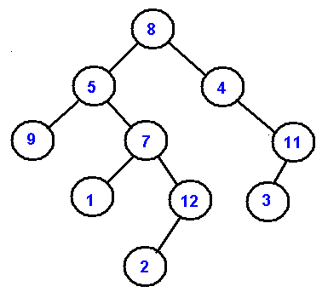
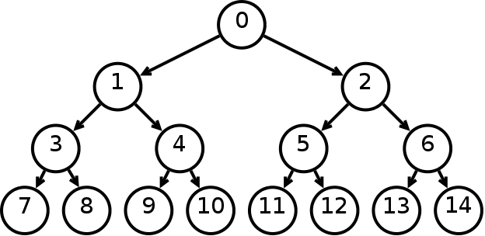
Binary Tree
A binary tree is a tree data structure in which each node has at most two children, which are referred to as the left child and the right child.
Advantages of trees
Trees are so useful and frequently used, because they have some very serious advantages:
Trees reflect structural relationships in the data
Trees are used to represent hierarchies
Trees provide an efficient insertion and searching
Trees are very flexible data, allowing to move subtrees around with minimum effort

Slide 11
Binary Trees
Traversals
A traversal is a process that visits all the nodes in the tree. Since a tree is a nonlinear data structure, there is no unique traversal. We will consider several traversal algorithms with we group in the following two kinds
depth-first traversal
breadth-first traversal
There are three different types of depth-first traversals, :
PreOrder traversal - visit the parent first and then left and right children;
InOrder traversal - visit the left child, then the parent and the right child;
PostOrder traversal - visit left child, then the right child and then the parent;

Slide 12
Binary Tree - traversals
As an example consider the following tree and its four traversals:
PreOrder - 8, 5, 9, 7, 1, 12, 2, 4, 11, 3 InOrder - 9, 5, 1, 7, 2, 12, 8, 4, 3, 11 PostOrder - 9, 1, 2, 12, 7, 5, 3, 11, 4, 8 LevelOrder - 8, 5, 4, 9, 7, 11, 1, 12, 3, 2

Slide 13
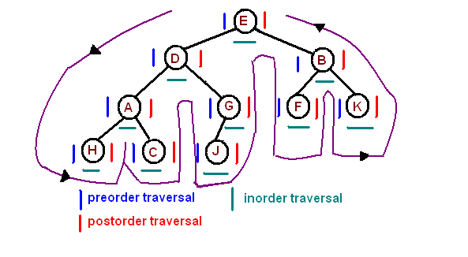
Binary Tree - Traversals
PreOrder - 8, 5, 9, 7, 1, 12, 2, 4, 11, 3 InOrder - 9, 5, 1, 7, 2, 12, 8, 4, 3, 11 PostOrder - 9, 1, 2, 12, 7, 5, 3, 11, 4, 8 LevelOrder - 8, 5, 4, 9, 7, 11, 1, 12, 3, 2

Slide 14
Binary Tree - Traversals
void printInorder(struct node* node)
{
if (node == NULL)
return;
/* first recur on left child */
printInorder(node->left);
/* then print the data of node */
printf("%d ", node->data);
/* now recur on right child */
printInorder(node->right);
}
struct node
{ int data;
struct node* left;
struct node* right;
};
Struct node *node, *root;
root = node
InOrder - 9, 5, 1, 7, 2, 12, 8, 4, 3, 11
void printPreorder(struct node* node)
{
if (node == NULL)
return;
/* first print data of node */
printf("%d ", node->data);
/* then recur on left sutree */
printPreorder(node->left);
/* now recur on right subtree */
printPreorder(node->right);
}
void printPostorder(struct node* node)
{
if (node == NULL)
return;
// first recur on left subtree
printPostorder(node->left);
// then recur on right subtree
printPostorder(node->right);
// now deal with the node
printf("%d ", node->data);
}
PreOrder - 8, 5, 9, 7, 1, 12, 2, 4, 11, 3
PostOrder - 9, 1, 2, 12, 7, 5, 3, 11, 4, 8

Slide 15
Recursion.. Continued - Depth First Search(DFS) -Breadth First Search(BFS) Class- 2
Sasikumar S

Slide 16
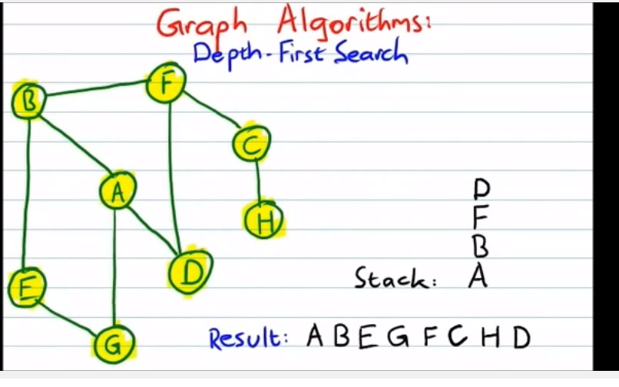
Depth First Search (DFS)
Depth First Search is an algorithm used to search the Tree or Graph. DFS search starts from root node then traversal into left child node and continues, if item found it stops other wise it continues. The advantage of DFS is it requires less memory compare to Breadth First Search(BFS).
Works for cyclic graphs, weighted or non weighted(weight=1), however not for computing minimum cost etc.
DFS cannot be used for short path.

Slide 17
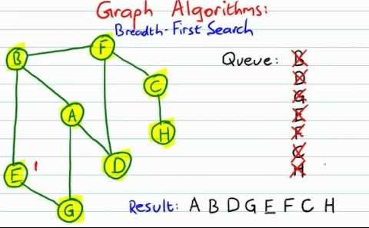
Breath First Search(BFS)
Breadth First Search is an algorithm used to search the Tree or Graph. BFS search starts from root node then traversal into next level of graph or tree and continues, if item found it stops other wise it continues. The disadvantage of BFS is it requires more memory compare to Depth First Search(DFS).
Works for cyclic graphs, weighted or non weighted(1), however not for computing minimum cost etc.
Shortest path will work only with non weighted graph in BFS

Slide 18
DFS and BFS video
http://107.108.206.159/Adv_Test_Video/Graph Traversals - Breadth First and Depth First.mp4
OR
https://www.youtube.com/watch?v=bIA8HEEUxZI
C:\Users\sasikumar\Documents\Temp\SE\SE-SW COMPETENCY TASK FORCE\Classes
\\sasikumar\SW Comp -Algo Videos
Video name: Graph Traversals - Breadth First and Depth First

Slide 19
DFS program
#include<stdio.h>
#include<conio.h>
int a[20][20],reach[20],n;
void dfs(int v)
{
int i;
reach[v]=1;
for(i=1;i<=n;i++)
if(a[v][i] && !reach[i])
{
printf("\n %d->%d",v,i);
dfs(i);
}
}
void main()
{
int i,j,count=0;
clrscr();
printf("\n Enter number of vertices:");
scanf("%d",&n);
for(i=1;i<=n;i++)
{
reach[i]=0;
for(j=1;j<=n;j++)
a[i][j]=0;
}
printf("\n Enter the adjacency matrix:\n");
for(i=1;i<=n;i++)
for(j=1;j<=n;j++)
scanf("%d",&a[i][j]);
dfs(1);
printf("\n");
for(i=1;i<=n;i++)
{
if(reach[i])
count++;
}
if(count==n)
printf("\n Graph is connected");
else
printf("\n Graph is not connected");
getch();
}
Practice

Slide 20
BFS program
#include<stdio.h>
#include<conio.h>
int a[20][20],q[20],visited[20];
Int n,i,j,f=0,r=-1;
void bfs(int v)
{
for(i=1;i<=n;i++)
if(a[v][i] && !visited[i])
q[++r]=i;
if(f<=r)
{
visited[q[f]]=1;
bfs(q[f++]);
}
}
void main()
{
int v;
clrscr();
printf("\n Enter the number of vertices:");
scanf("%d",&n);
for(i=1;i<=n;i++)
{
q[i]=0;
visited[i]=0;
}
printf("\n Enter graph data in matrix form:\n");
for(i=1;i<=n;i++)
for(j=1;j<=n;j++)
scanf("%d",&a[i][j]);
printf("\n Enter the starting vertex:");
scanf("%d",&v);
bfs(v);
printf("\n The node which are reachable are:\n");
for(i=1;i<=n;i++)
if(visited[i])
printf("%d\t",i);
else
printf("\n Bfs is not possible");
getch();
}
Practice

Slide 21
Endoscope – Feb’16 Advance Test
Company S has developed an industrial endoscope availbale to explore inner part of decrepit water pipes.
It is possible to explore the inner part of the pipes putting endoscope into a certain part of the pipe. The endoscope can be moved in the pipes only. Mean while, when the pipes are connected to each other, if the length of the endoscope is long enough to explore, it is able to inspect the connected pipes. However, we cannot observer every pipe because the lenght of endoscope is limited. when the map of the ground water pipes, the location where the endoscope to put in, and the length of the endoscope are given, calcuate the number of pipes which are avilable to explore.
There are 7 kinds of pipes, and description for each pipe are shown below.
1 - LRUD (left, right, Up, Down openings. It can be connected to up-down-left-right pipes))
2 - UD (it can be connected to up-down)
3 - LR
4 - UR
5 - DR
6 - LD
7 - LU
When the map of ground water pipes, the certain point where the endoscope is inserted, and the length of the endoscope were given, write a program to calculate the number of pipes are available to explore.
N - height of the map of ground water piper M, the width are grater then or equal to 5 and less than or equal to 50 respectively. (5<=N<=50, 5<=M<=50)
R the vertical location of the water piper where to put the endoscope is greater than or equal to 0 and less than or equal to N-1, C the horizontal location of the water piper where to put the endoscope is greater than or equal to 0 and less than or equal to M-1 (0<=R<=N-1, 0<=C<=M-1)
- The length of endoscope L is greater than or equal to 1 and less than or equal to 20(1<=L<=20)
- The endoscope is always inserted where the pipe exist.
First line T the number of test cases
Second line N, M, R, C, L
Following N line NxM matrix with information about the ground water pipe is given. Each number 1 to 7 means the type of water piper for the point. 0 means there is no water piper buried in that place.
Input:
5,6,2,1,3
0 0 5 3 6 0
0 0 2 0 2 0
3 3 1 3 7 0
0 0 0 0 0 0
0 0 0 0 0 0
Answer = 5

Slide 22
Advance Test - Endoscope
In given NxM matrix(Human Body) , we need to inject endoscope of length L and find out what are the cells can be reached. Injection point is R, C
where 0<=R<-N-1 and 0<=C<=M-1
Left Right Up Down |  | L | R | U | D
1 | LRUD | 1 | 1 | 1 | 1
2 | UD |  |  | 1 | 1
3 | LR | 1 | 1
4 | UR |  | 1 | 1
5 | DR |  | 1 |  | 1
6 | LD | 1 |  |  | 1
7 | LU | 1 |  | 1
 | CurrentPipe | 1,3,6,7 | 1,3,4,5 | 1,2,4,7 | 1,2,5,6
 | Next Possible Pipe | 1,3,4,5 | 1,3,6,7 | 1,2,5,6 | 1,2,4,7
N | M | R | C | L
5 | 6 | 2 | 1 | 3
NxM - matrix, validate N x M to be 5 to 50
RXC - injecting place where pipe is a must. Validate(R,C) is zero to N-1xM-1
L - is length of the endoscope
Practice
0 | 0 | 5 | 3 | 6 | 0
0 | 0 | 2 | 0 | 2 | 0
3 | 3 | 1 | 3 | 7 | 0
0 | 0 | 0 | 0 | 0 | 0
0 | 0 | 0 | 0 | 0 | 0

Slide 23
Advance Test - Endoscope
Practice
Recursive
Iterative
Recursive
Iterative

Slide 24
Practice: Advance Test –Sales Booth – Jan’16
Samsung wants to introduce the promotions in mobile sale. They want to setup a booth to sell mobile phones. They will club all areas of same mobile model with 1 single booth. In areas(marked zero), where samsung mobile is not established , they will consider selling the mobiles that are famous in adjacent areas of higher configuration.
Input
5 | 5 | 1 | 4 | 4
4 | 0 | 2 | 4 | 2
5 | 0 | 0 | 2 | 0
5 | 4 | 3 | 0 | 1
1 | 3 | 3 | 2 | 1
Output
5 | 5 | 1 | 4 | 4
4 | 5 | 2 | 4 | 2
5 | 5 | 5 | 2 | 2
5 | 4 | 3 | 3 | 1
1 | 3 | 3 | 2 | 1
11 booths
Traversal allowed in TOP,BOTTOM, LEFT or RIGHT
 | 5
5 | 0 | 3
 | 4
Here zero is covered by S5 maximum no.of times and hence the new area zero will be addressed by S5 booth
Practice

Slide 25
NEXT SESSION
Next Session
Program for Jan Adv Test
Minimum Spanning Tree Algo – Krushal & Prims

