Slide 1
SE SW Competency Task Force(SSCTF)
SSC Task Force
Anju Bala
Arabinda Verma
Chetan Sai Kumar T
Prathap HS
Vikas Agrawal
Veeraj S Khokale
Sasikumar Sathasivam
Class - 8

Slide 2
Robot Problem - (Similar to April’16 Adv Test) - Brainstorming session and approach to resolve Class-8
Compiled by Sasikumar

Slide 3
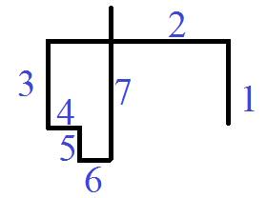
Practice: Advance Test –Robot April’16
There is a Robot which can move in four directions North, South, East and West. Robot can travel x distance on each direction. Provided with a set of steps print the following:
“-1” if there is no intersecting/overlapping paths
“n” if the nth path intersects with any of the earlier paths. Print first intersection only.
“m” if the mth path overlaps with any of the earlier paths. Print first overlapping only.
if for any set of data both intersection and overlapping is present. Print the smallest of the two.
2<x<100000
Max steps is 100
Direction North =1 , South =2, East =3, West = 4
Sample Input:
7 // number of steps
1 2 // 1 – denotes direction North 2 – denotes distance in that direction
4 2
2 2
3 1
2 1
3 1
1 4
Answer is 7

Slide 4
Robot- Approach
East , 4
Storing the coordinates
Finding intersections
y11 = y12
x21 =x22
x11<x22<x12
y22<y11<y21
Finding Overlapping
y11 = y12 = y21 = y22
x11<x21<x12
(0,0)
(4,0)
South , 4
(x21,y21)
(4,-4)
(2,2)
(0,0)
(4,0)
(x11,y11)
(x12,y12)
(2,-2)
(x22,y22)
(x11,y11)
(x12,y12)
(0,0)
(5,0)
(1,0)
(6,0)
(x21,y21)
(x22,y22)

Slide 5
Robot- Problem solving approach
#define MAX 101
int line[MAX][5];
enum direction
{
NORTH = 1,
SOUTH,
EAST,
WEST
};
int nb_lines = 0;
int i, j;
scanf("%d", &nb_lines);
for (i = 1; i <= nb_lines; i++)
{
line[i][0] = line[i - 1][2];
line[i][1] = line[i - 1][3];
int dir, length;
scanf("%d %d", &dir, &length);
if (dir == EAST)
{ line[i][2] = line[i][0] + length;
line[i][3] = line[i][1] ;
line[i][4] = 0;
}
else if (dir == NORTH)
{ line[i][2] = line[i][0] ;
line[i][3] = line[i][1] + length;
line[i][4] = 1;
}
else if (dir == WEST)
{ line[i][2] = line[i][0] - length;
line[i][3] = line[i][1];
line[i][4] = 0;
}
else if (dir == SOUTH)
{ line[i][2] = line[i][0] ;
line[i][3] = line[i][1] - length;
line[i][4] = 1;
}
}
Storing the input in coordinate format.
The 5th index stores whether horizontal or vertical line

Slide 6
Robot - Problem solving approach
Logic to find if there is any intersection and storing the min value in minIntersect
if (dir1 != dir2) // find intersection
{
if (dir2) //line1 horizontal
{
if ((x11 < x21 && x21 < x12) && (y22 < y12 && y12 < y21)
|| (x12 < x21 && x21 < x11) && (y22 < y12 && y12 < y21)
|| (x11 < x21 && x21 < x12) && (y21 < y12 && y12 < y22)
|| (x12 < x21 && x21 < x11) && (y21 < y12 && y12 < y22))
{
if (j < minIntersect)
{
minIntersect = j;
}
}
}
else // line1 vertical
{
if ((x21 < x11 && x11 < x22) && (y12 < y22 && y22 < y11)
|| (x22 < x11 && x11 < x21) && (y12 < y22 && y22 < y11)
|| (x21 <x11 && x11 < x22) && (y11 < y22 && y22 < y12)
|| (x22 < x11 && x11 < x21) && (y11 < y22 && y22 < y12))
{
if (j < minIntersect)
{
minIntersect = j;
}
}
}
}

Slide 7
Robot - Problem solving approach
Logic to find if there is any overlapping and storing the min value in minOverlapping
else // find overlapping
{
if (!dir1) //line1 horizontal
{
if (y11 == y21 && ((x21 < x11 && x11 < x22)
|| (x21 < x12 && x12 < x22)
|| (x11 < x21 && x21 < x12)
|| (x12 < x22 && x22 < x11)
|| (x22 < x11 && x11 < x21)
|| (x22 < x12 && x12 < x21)
|| (x12 <x21 && x21 < x11)
|| (x11 < x22 && x22 < x12)
))
if (j < minOverlapping)
minOverlapping = j;
}
else // line1 vertical
{
if (x11 == x21 && ((y21 < y11 && y11 < y22)
|| (y21 < y12 && y12 < y22)
|| (y11 < y21 && y21 < y12)
|| (y12 < y22 && y22 < y11)
|| (y22 < y11 && y11 < y21)
|| (y22 < y12 && y12 < y21)
|| (y12 < y21 && y21 < y11)
|| (y11 < y22 && y22 < y12)
))
if (j < minOverlapping)
minOverlapping = j;
}
}

Slide 8
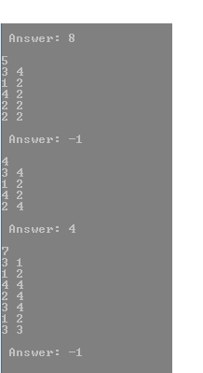
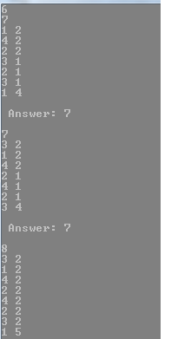
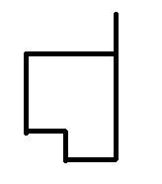
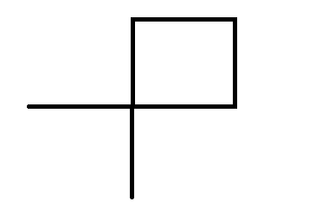
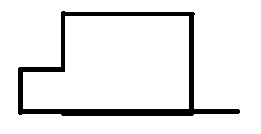
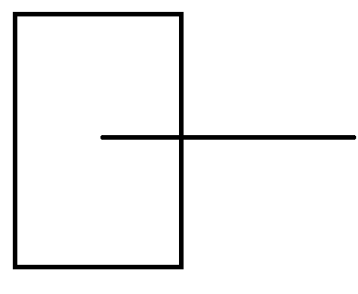
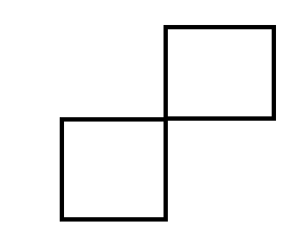
Robot– Output

Slide 9
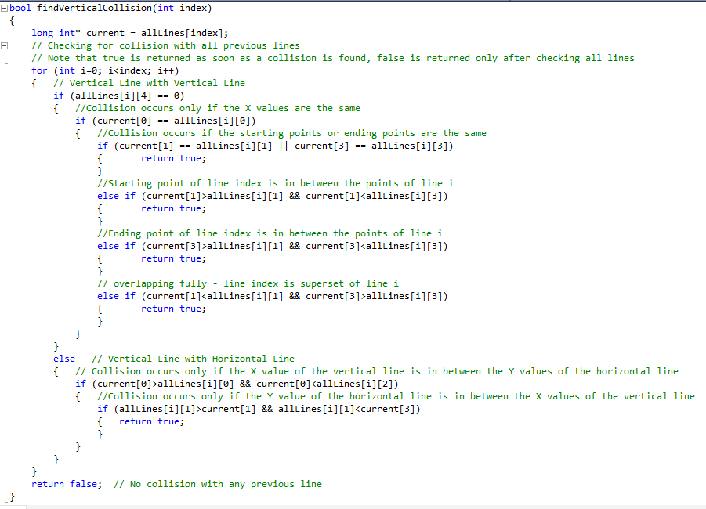
Robot Path Crossing - Solution-2
#include <stdio.h>
#include <conio.h>
// allLines is to be used to mark the starting point, ending point and the orientation of the line
// Vertical - 0; Horizontal - 1
long int allLines[100][5];
long int currentX;
long int currentY;
bool foundCollision;
int firstCollision;

Slide 10
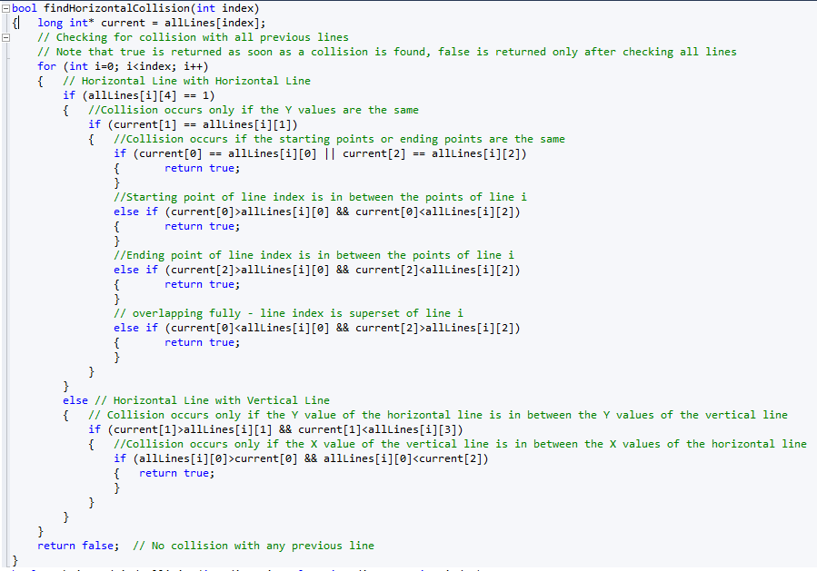
Robot Path Crossing - Solution-2

Slide 11
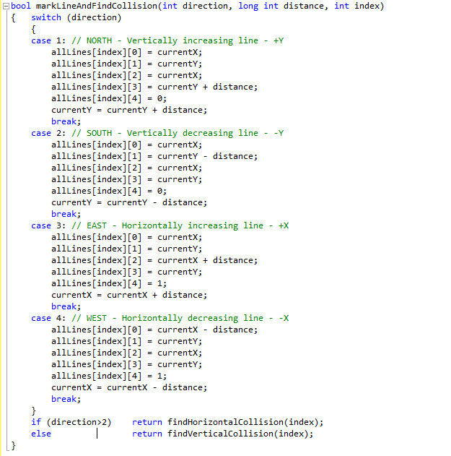
Robot Path Crossing - Solution-2
Note: in South and West case, we update starting coordinate in order to keep starting lesser than ending coordinate. This helps to reduce no,of. Conditions.
/* NOTE: The two functions can be combined but it is kept separate to make it easier to understand and reduce the number of conditions to be checked in each. The total number of comparisons will be similar in both cases. */

Slide 12
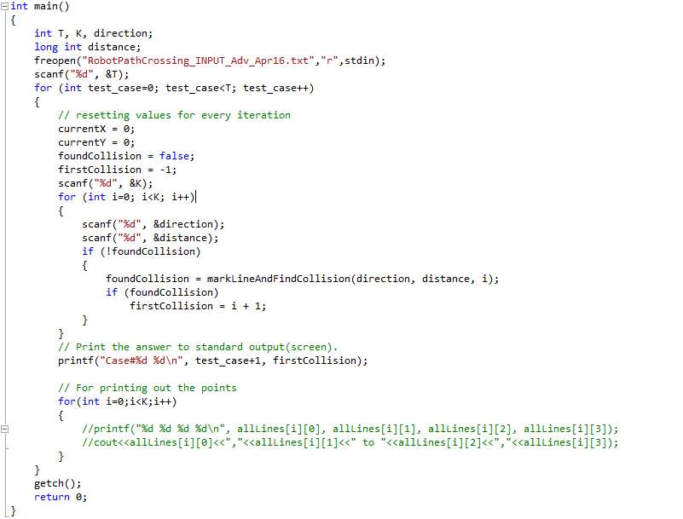
Robot Path Crossing - Solution-2

Slide 13
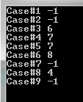
Robot Path Crossing - Solution-2 (i/p & O/p)
9
8
1 1
4 1
2 1
3 1
3 1
2 1
4 1
1 1
6
2 2
3 2
1 1
4 1
2 1
2 1
6
3 10000
1 2
4 2
2 1
3 2
1 5
7
1 2
4 2
2 2
3 1
2 1
3 1
1 4
7
3 2
1 2
4 2
2 1
4 1
2 1
3 4
8
3 2
1 2
4 2
2 2
4 2
2 2
3 2
1 5
5
3 4
1 2
4 2
2 2
2 2
4
3 4
1 2
4 2
2 4
7
3 1
1 2
4 4
2 4
3 4
1 2
3 3

Slide 14
Thank You

