Slide 1

Movie Rating

Slide 2
A simple web application based on ReactJS with IMDB APIs linked.
The deployed prototype shows the list of movies available on IMDB along with the functionality to see the top review.
Future Implementation Idea :
Top 10 movies sorted based on current year and top rating.
Also, to display the OTT platform on which the movie or series is available.

Slide 3
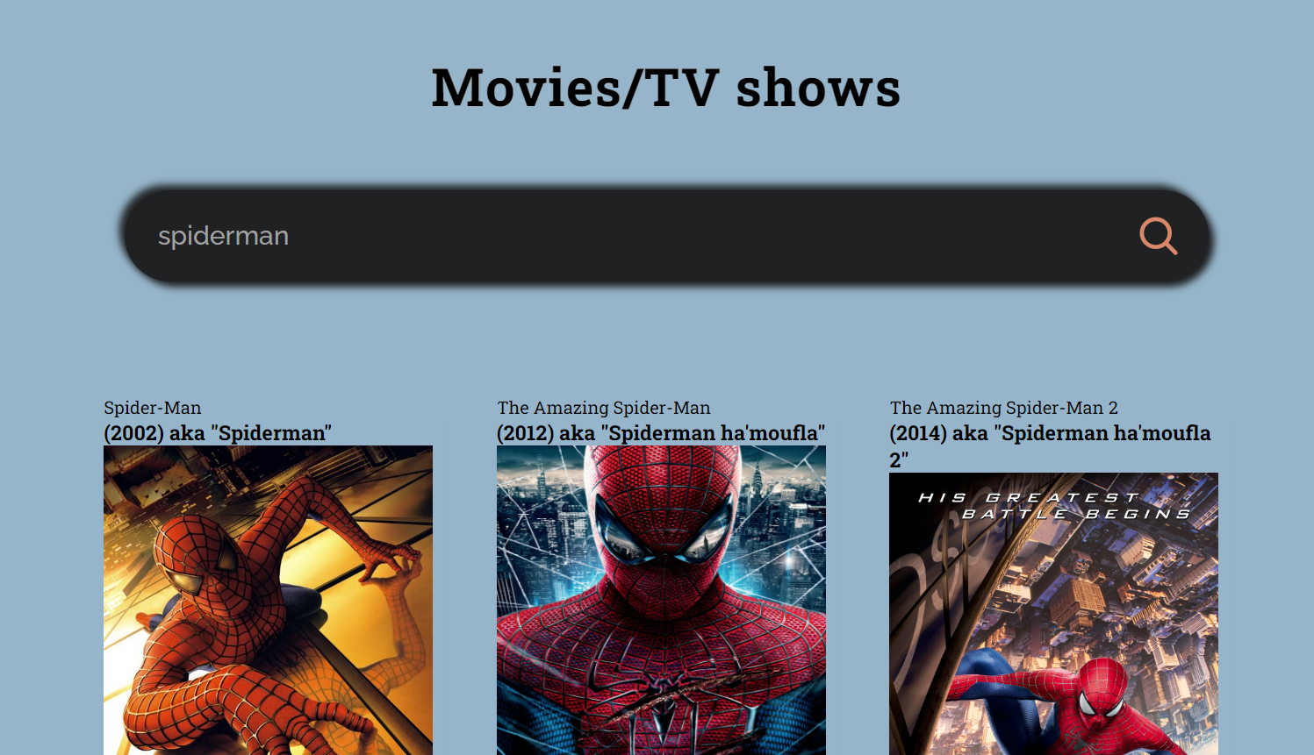

Slide 4
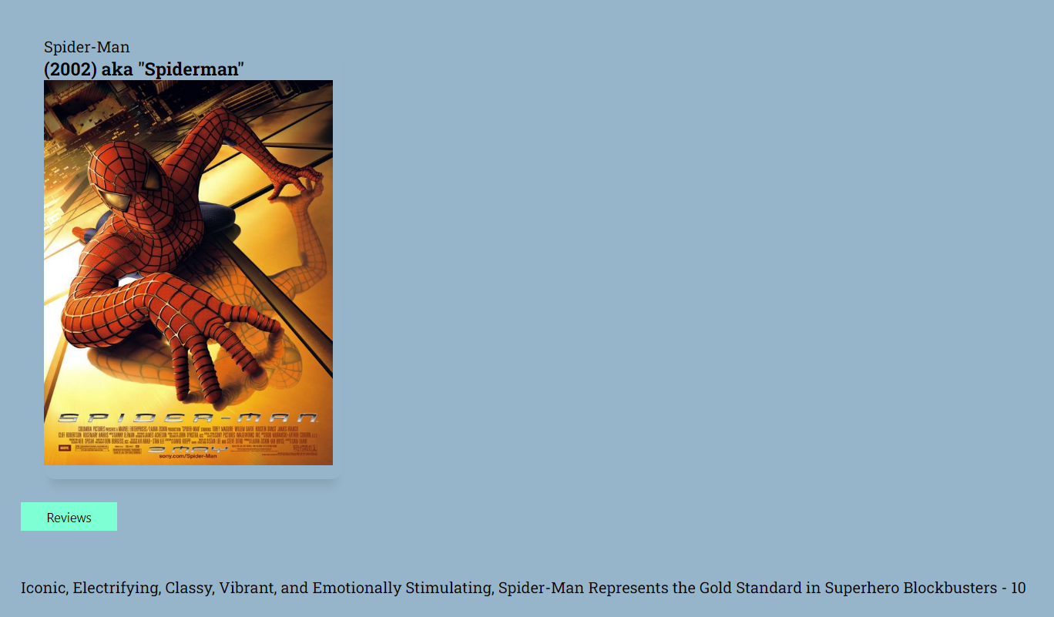

Slide 5
Thankyou

