Slide 1
FINANCIAL RISK MANAGEMENT
Geopolitical Risk and the Pharmaceutical Industry
A case study of the Red Sea shipping disruption and its impact on Indian pharmaceutical companies
Group Assignment

Slide 2
THE GEOPOLITICAL EVENT
Red Sea Shipping Disruption
Asia → Suez Canal → Europe
Original route
Asia → Cape of Good Hope → Europe
Rerouted, longer and slower
What Happened
Why It Matters for Pharma
• The Red Sea links Asia and Europe via the Suez Canal, a major global shipping route.
• Higher freight and marine insurance costs on affected shipments.
• Longer delivery times and greater supply-chain uncertainty.
• Attacks on commercial vessels in November 2023 raised serious security concerns.
• Pharma firms depend on steady raw-material imports and timely global delivery.
• Shipping lines began avoiding the Red Sea and Suez Canal route.
• A shipping and security issue becomes a real business and financial risk.
• Vessels were rerouted via the Cape of Good Hope, adding distance and transit time.
2

Slide 3
METHODOLOGY
Our Approach: From Event to Mitigation
→
→
→
→
→
Geopolitical Event
Industry Impact
Company Analysis
Risk Measurement
Stress Test
Mitigation
1. Identify the Event
2. Industry Impact
3. Company Analysis
Selected the Red Sea disruption and studied the supply-chain risks it created.
Analysed the effect on Indian pharma and shortlisted six companies.
Studied stock price, volatility, beta and event study for each company.
4. Risk Measurement
5. Stress Test
6. Mitigation
Used these metrics to quantify the market impact of the disruption.
Assessed how higher freight and input costs affect financial performance.
Identified major risks and suggested risk mitigation strategies.
3

Slide 4
Indian Pharma Industry—Red Sea Disruption
Overall industry effect, risk-factor matrix & relative company exposure
GEOPOLITICAL → FINANCIAL TRANSMISSION
RISK-FACTOR MATRIX
Red Sea attacks
Relative exposure of the Indian pharma industry
Commercial shipping risk
↓
Risk factor
Impact
Transmission
Suez disruption
Vessels rerouted via Cape of Good Hope
↓
Freight cost
HIGH
Rerouting → distance & shipping cost ↑
Economic shock
Transit time ↑ | Freight cost↑
Transit time
HIGH
Cape route → longer delivery cycle
↓
Inventory / working capital
Longer transit → buffer stock / cash tied up
Pharma impact
Inventory / working capital pressure → margins & cash flow
MED-HIGH
Profit margins
MED-HIGH
Logistics cost ↑ → EBITDA pressure
Export revenue
MEDIUM
Delivery delays / logistics constraints
CRISIL INDUSTRY EVIDENCE
Supply chain
MEDIUM
Movement of inputs & finished goods delayed
~50% of industry revenue is export-linked | ~2/3 of pharma exports move by sea | Impact assessed: MEDIUM
Domestic Demand
LOW
Less directly exposed to maritime disruption
COMPANY-WISE RELATIVE EXPOSURE
Cipla
Relatively Lower
Sun Pharma
Relatively Lower
Zydus Lifesciences
Mixed
Dr. Reddy’s
Mixed
Lupin
Relatively Higher
Aurobindo Pharma
Relatively Higher
KEY TAKEAWAY | Medium industry impact, but sensitivity is uneven across companies.

Slide 5
DR. REDDY’S — STOCK RISK & MITIGATION SNAPSHOT
EXPOSURE: MODERATE
Red Sea shipping disruption | Company-level financial risk
1 BUSINESS MODEL & EVENT IMPACT
2 FY2024 REVENUE MIX
3 STOCK RISK METRICS
BUSINESS MODEL
• Global Generics ≈ 88% — finished medicines sold globally
• PSAI (Pharmaceutical Services and Active Ingredients )≈ 11% — APIs (Active Pharmaceutical Ingredients ), intermediates & pharmaceutical services
RED SEA IMPACT
• Rerouting → longer transit + higher freight/insurance costs
• Working capital / COGS ↑ → margin & FCF pressure
North America 46.5% | India 16.6%
Beta — pre-event
0.254
Russia 11.1% | Europe 7.3%
Beta — post-event
0.355
PSAI 10.7% |
Historical volatility (ann.)
19.3%
Event-window volatility (ann.)
12.7%
4 PRE-EVENT → EVENT → POST-EVENT PERFORMANCE
5 STRESS TEST—FREIGHT COST SHOCK
Pre-event
20-Nov-23
1 Month
3 Months
6 Months
1 Year
Metric
Base
+30%
+100%
₹1,120.83
₹1,129.29
₹1,110.90
₹1,269.83
₹1,155.96
₹1,199.90
EBITDA margin
28.41%
28.25%
27.89%
—
+0.75%
−1.63%
+12.44%
+2.36%
+6.25%
PAT margin
19.98%
19.86%
19.59%
CFO (₹ cr)
4,543
4,500
4,398
Assumptions: 26% exposed revenue; freight = 2% of exposed revenue; tax = 25%.
6 RISK MITIGATION
RECOMMENDED NEXT
• Backup suppliers
• Strategic safety stock
• Longer-tenure freight contracts
• FX forwards + route review
RISK-O-METER
CURRENT / EVIDENCED
• Diversified markets & product base
• Supply-chain monitoring / continuity focus
LOW
MODERATE
HIGH
BEFORE: 0.254
AFTER: 0.355
Sources: Dr. Reddy’s FY2024 filing (SEC); CRISIL, Sectoral impact of Red Sea trade disruptions (Feb 2024); project workbook. Stress-test figures are analytical assumptions, not company guidance.
Both remain in LOW band; beta increased after the event.

Slide 6
CIPLA — IMPACT OF THE RED SEA GEOPOLITICAL CRISIS
1
PRE-EVENT
2
DURING CRISIS
3
POST-EVENT
Before Nov 2023 · Market-risk baseline
November 2023
After Nov 2023 · Recovery
STOCK RISK (VS NIFTY)
WHAT HAPPENED
STOCK RETURN SINCE EVENT
Shipment delay
Freight cost
Daily volatility
22–25 days
Rising ↑
1 Month
3 Months
Beta
EVENT STUDY — CAR AT T0
−0.86%
+16.12%
~0.31
1.50%
Full window
Excl. FDA day
6 Months
1 Year
−5.13%
+2.80%
+15.56%
+19.77%
Annualised volatility
Alpha
23-Nov's −7.74% move was confounded by separate USFDA news, not Red Sea exposure.
EBITDA margin
23.80%
~0.048%
24.4%
Estimation period: 10-Nov-2022 to 10-Nov-2023 • Exposure proxy: ~26% of FY24 revenue treated as directly exposed to the Africa / Europe corridor.
STRESS TEST — FREIGHT COST SHOCK
RISK MITIGATION & RECOMMENDATIONS
Scenario: freight/logistics cost shock applied only to the ~26% exposed revenue.
Metric | Base | Moderate | Severe
Freight increase | 0% | +30% | +100%
Incremental freight | — | ₹40.2 Cr | ₹134.0 Cr
EBITDA | ₹6,291 Cr | ₹6,250.8 Cr | ₹6,157.0 Cr
EBITDA Margin | 24.40% | 24.25% | 23.89%
PAT | ₹4,122 Cr | ₹4,091.8 Cr | ₹4,021.5 Cr
PAT Margin | 16.00% | 15.88% | 15.60%
CIPLA ALREADY DOES
OUR RECOMMENDATIONS
Alternate sourcing
Long-term freight contracts
Advance purchases
Higher Africa/Europe safety stock
Inventory & logistics buffers
Further API diversification
₹1,428 Cr revenue de-risked
FX & working-capital protection
18 new vendors in FY25
Alternate routes / air freight
KEY TAKEAWAY
Real logistics pressure, but Cipla's diversified revenue base and mitigation measures contained the overall impact.
OVERALL RISK — POST-MITIGATION
LOW
Diversified revenue base absorbs the shock
LOW
HIGH

Slide 7
ZYDUS LIFESCIENCES — RED SEA CRISIS IMPACT
A supply chain shock, a short-term market reaction, but resilient fundamentals.
1
PRE-EVENT
2
DURING CRISIS
3
POST-EVENT
Before Nov 2023
Nov 2023
After Nov 2023
Strong fundamentals, diversified sourcing, low leverage.
Logistics costs and investor uncertainty triggered a temporary stock reaction.
Stock recovered; fundamentals strengthened.
Beta
0.55
22–25 days
Freight ↑
STOCK PERFORMANCE
β
+40.7%
+49.4%
Shipment Delay
Costs Increased
3 Months
1 Year
%
Annualised Volatility
24.76%
EVENT STUDY (CAR)
Event Period
-2.56%
EBITDA Margin
PAT Margin
30.4%
20.4%
Mitigation: domestic sourcing & safety stock
✓ RISK MITIGATION
STRESS TEST — FREIGHT COST SHOCK
ALREADY IN PLACE
RECOMMENDED
Even in the Severe scenario (+150% freight cost), EBITDA margin slips only to 26.6% and PAT margin to 19.1% — under 1 point of impact. Zydus's scale and balance sheet absorb even a worst-case shock.
✓
Diversified & domestic sourcing
+
Increase strategic inventory
✓
Strong balance sheet (net cash)
+
Diversify suppliers further
✓
Multiple suppliers
+
Strengthen risk monitoring
!
KEY TAKEAWAY
Short-term pressure, but diversified sourcing and a strong balance sheet contained the impact.
COMPANY RISKOMETER
MODERATE

Slide 8
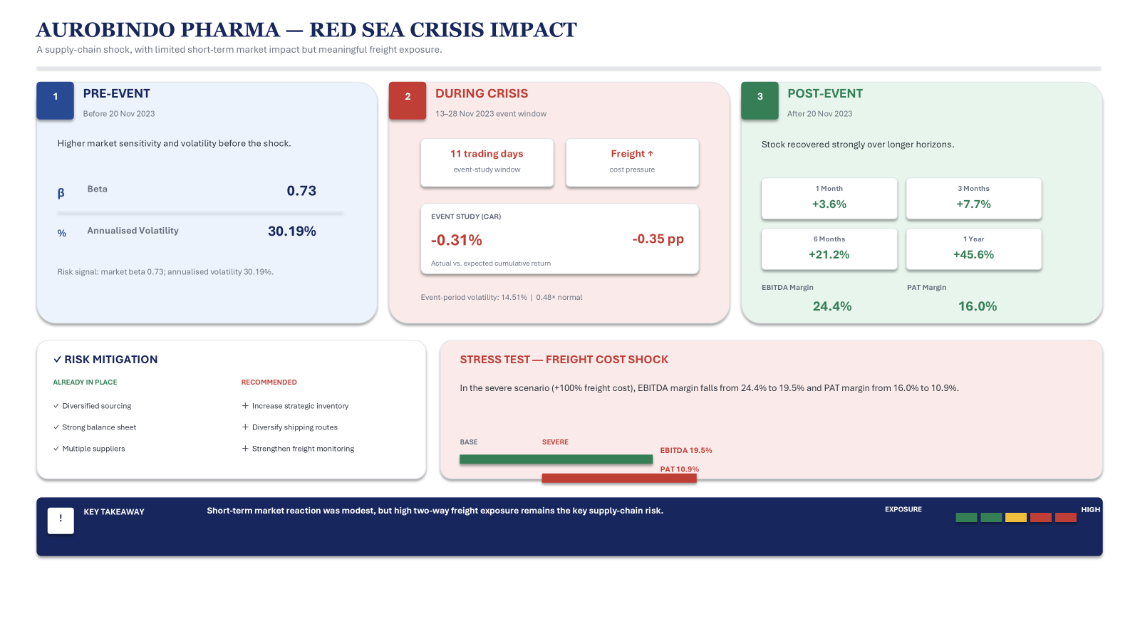

Slide 9
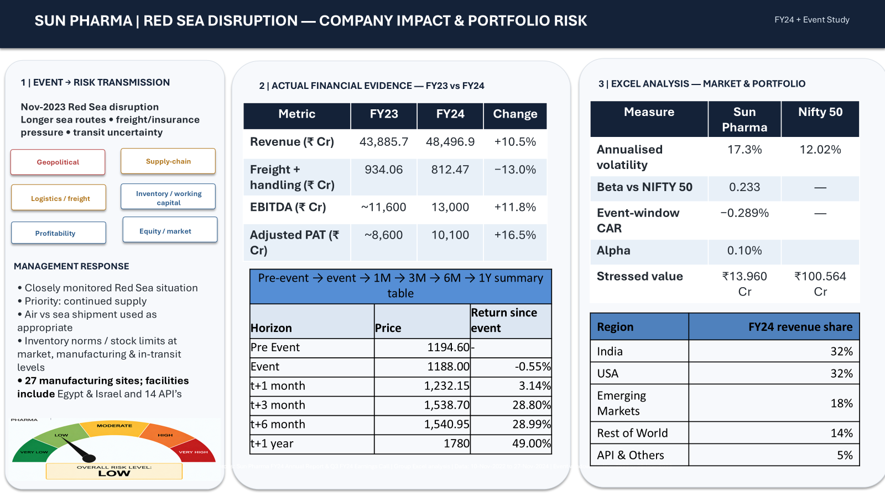

Slide 10
LUPIN — STOCK RISK & MITIGATION SNAPSHOT
Classification: LOSER
Red Sea shipping disruption
STOCK RISK METRICS
PRICE PERFORMANCE SINCE EVENT
Beta (vs Nifty 50)
0.44
Pre-Event
Event Date
+1 Month
+3 Months
+6 Months
+1 Year
Current Price
₹2,006
₹1,199
₹1,222
₹1,257
₹1,599
₹1,684
₹2,006
Historical Volatility (ann.)
25.5%
+2.9%
+30.9%
+37.8%
+64.2%
Event-Window Volatility (ann.)
23.6%
Volatility ratio 0.93x — event window was slightly calmer than normal. Event-day (T0) abnormal return: +1.8%
Return measured from event date (20-Nov-2023). Stock recovered and outperformed within a year.
STRESS TEST — CRUDE / FREIGHT COST SHOCK
RISK MITIGATION
Metric | Base | Moderate (+30%) | Severe (+100%)
EBITDA Margin | 20.0% | 19.5% | 18.3%
PAT Margin | 9.8% | 9.5% | 8.5%
Implied Stock Price | ₹2,006 | ₹1,926 (−4.0%) | ₹1,737 (−13.4%)
CURRENT
RECOMMENDED NEXT
Natural hedges + FX derivatives
ERM: Board Risk Committee oversight
Import-substitution strategy
Air freight cut 34% → 10%
Fixed-price contracts for crude-linked inputs
Increase % of USD revenue hedged
Accelerate import substitution
Build strategic buffer inventory
Exposed revenue 66% • Baseline freight cost 2.5% of exposed revenue • Tax rate 20%
RISK-O-METER
BEFORE: 3.25 (High)
LOW
MODERATE
HIGH
SEVERE
AFTER: 2.25 (Moderate)

Slide 11
BOARDROOM CRISIS — THE SURPRISE ELEMENT
News: crude oil +25% • INR depreciates 3% • 10-yr G-Sec yield +40 bps
Company | Class | Beta | EBITDA Margin Now → After | PAT Margin Now → After | Price Impact | Why | Decision
Sun Pharma | Winner | 0.03 | 26.8% → 26.3% | 20.8% → 20.5% | −1.8% | Dollar revenue tailwind; low cost exposure | Hold/Buy
Cipla | Winner | 0.31 | 24.4% → 24.3% | 16.0% → 15.9% | −0.7% | Low import dependency; muted FX impact | Hold
Zydus | Neutral | 0.55 | 27.5% → 27.4% | 19.8% → 19.6% | −0.6% | Diversified business cushions cost hit | Hold
Dr. Reddy | Neutral | 0.56 | 28.4% → 28.3% | 20.0% → 19.9% | −0.6% | Natural hedge — imports & exports offset | Hold
Lupin | Loser | 0.44 | 20.0% → 19.5% | 9.8% → 9.5% | −4.0% | Tender pricing blocks cost pass-through | Reduce/Hedge
Aurobindo | Loser | 0.73 | 20.1% → 19.9% | 10.9% → 10.8% | −1.1% | Two-way exposure + highest beta in group | Reduce
OTHER PORTFOLIO MOVES
FX Hedge
Rate Hedge
Lock forward cover for importers (Lupin, Aurobindo, Dr. Reddy)
Interest-rate swap for any floating-rate debt

Slide 12




