Slide 1

Capital Structure and Firm Performance
A Comparative Study of Indian Automobile and IT Industries
Course: Corporate Finance
PRESENTED BY: GROUP – 2
AKANSHA SAINI (25PGDMFM006)

Slide 2
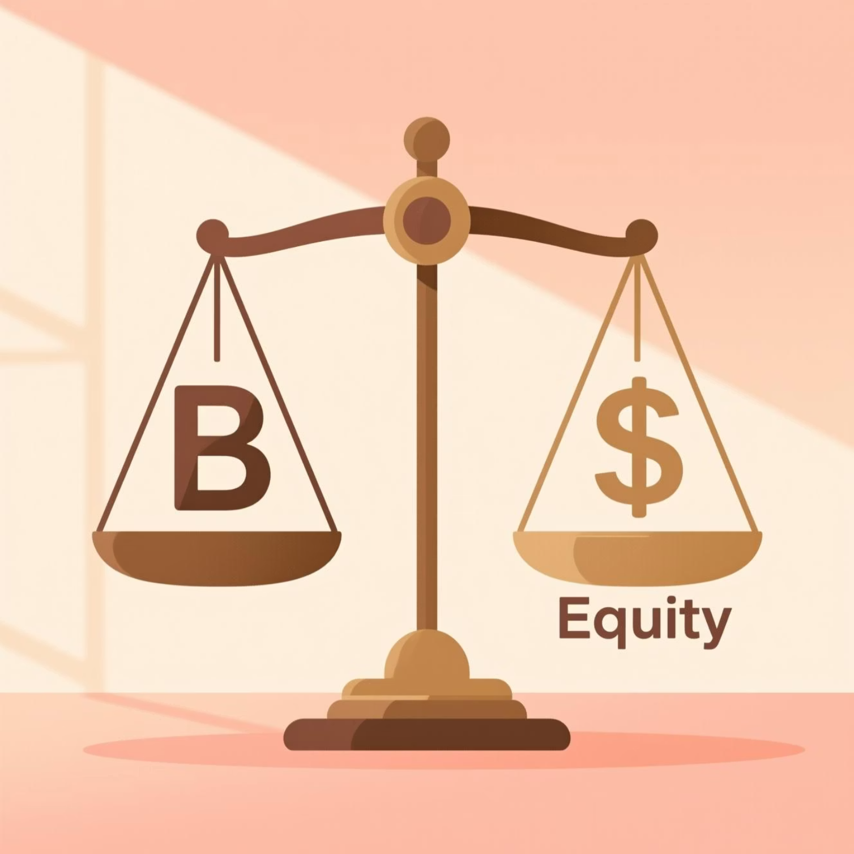
Introduction
Capital structure refers to how firms use a mix of debt and equity to finance their operations. These decisions directly influence a company’s risk level, profitability, and ability to grow.
The automobile industry, being capital-intensive, requires heavy investment in plants, machinery, and inventory. As a result, automobile companies generally rely more on debt financing to support their large asset base.
In contrast, the IT industry follows an asset-light model, depending mainly on intellectual capital with minimal physical infrastructure. These firms typically maintain low debt levels and prefer internal financing. This study compares how these different leverage patterns impact financial performance in both industries.
This comparative study examines how leverage decisions influence performance outcomes across these two fundamentally different industrial sectors.

Slide 3
Objectives of the Study
Capital Structure Analysis
Calculate Key Ratios
Leverage Classification
Examine and compare capital structure patterns between the Automobile and IT sectors
Debt-Equity Ratio
Categorise firms as under-leveraged or over-leveraged based on optimal capital structure benchmarks
Interest Coverage Ratio
Return on Assets (ROA)
Return on Equity (ROE)
Performance Evaluation
Strategic Recommendations
Assess the impact of leverage on firm performance across both industries
Provide industry-specific guidance for optimal capital structure decisions

Slide 4
Conceptual Background
Capital Structure Theories
Modigliani–Miller Theorem
Trade-Off Theory
Capital structure is irrelevant to firm value in perfect markets with no taxes, bankruptcy costs, or information asymmetry. This foundational theory establishes the baseline for understanding real-world deviations.
Firms balance the tax benefits of debt against potential bankruptcy costs and financial distress. Optimal leverage occurs where marginal benefits equal marginal costs.
Pecking Order Theory
Agency Cost Theory
Firms follow a financing hierarchy: internal funds → debt → equity, based on information asymmetry and the costs associated with external financing.
Debt serves as a disciplining mechanism for managers, reducing free cash flow problems. However, excessive debt increases risk and potential conflicts between stakeholders.
Debt-Equity Ratio
Measures financial leverage
Interest Coverage
Debt servicing capacity
ROA
Asset utilization efficiency
ROE
Shareholder value creation

Slide 5


Data & Methodology
01
Industry Selection
Automobile and Information Technology sectors chosen for their contrasting capital structures and operational characteristics
02
Data Collection
Secondary data spanning the last five years, sourced from Screener.in, Moneycontrol, and published annual reports
03
Sample Selection
3–5 representative companies from each industry, selected based on market capitalisation and data availability
04
Analytical Tools
Microsoft Excel employed for ratio calculations, trend analysis, and visualisation through charts and comparative tables
Research Period: Five-year longitudinal analysis enables identification of trends whilst minimising the impact of short-term market volatility.
05
Analytical Framework
Compare leverage and profitability trends, classify firms by leverage position, and evaluate performance implications

Slide 6
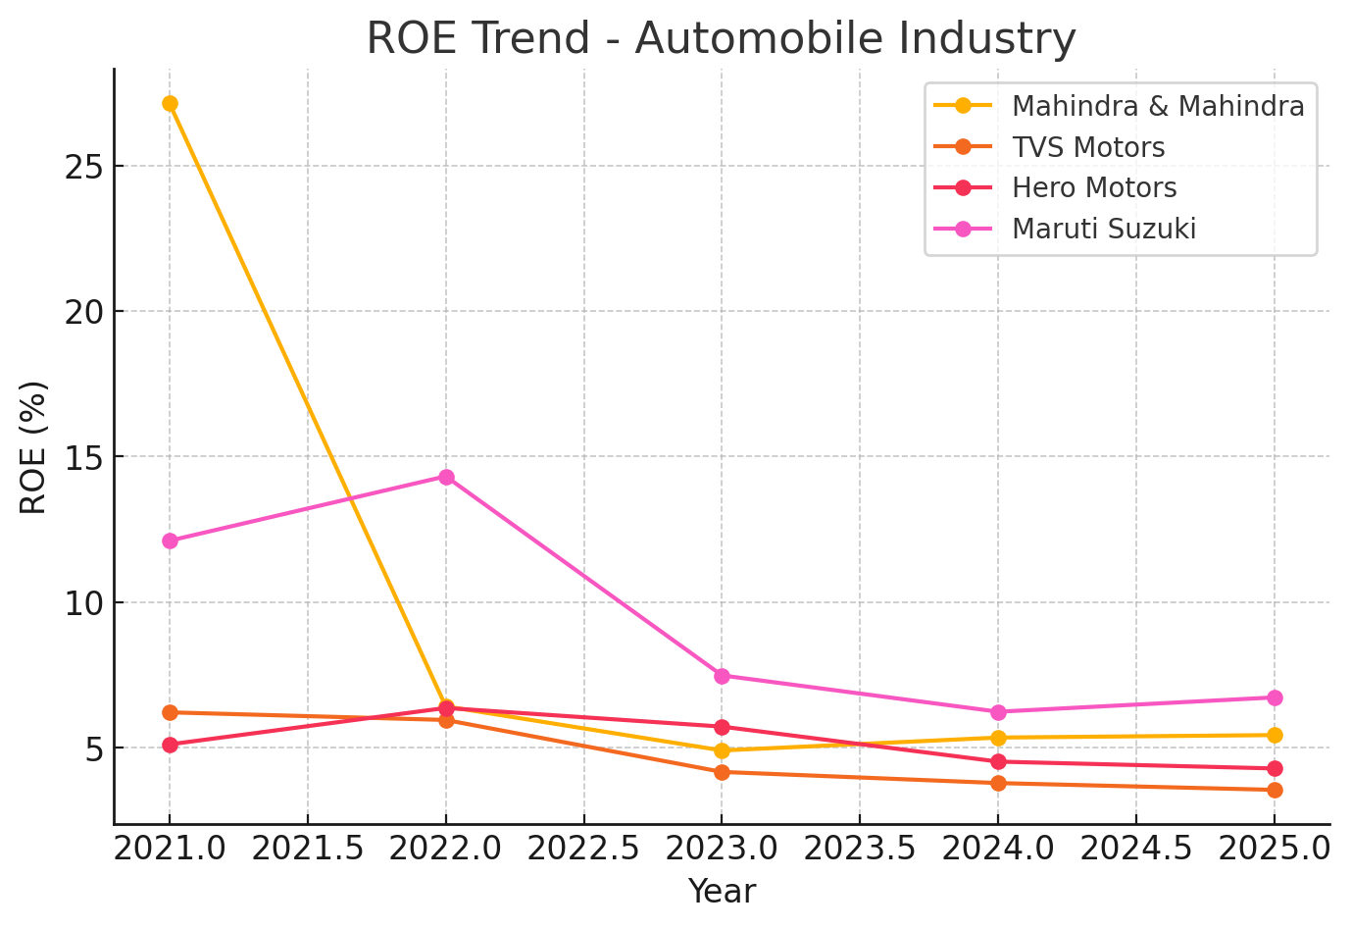
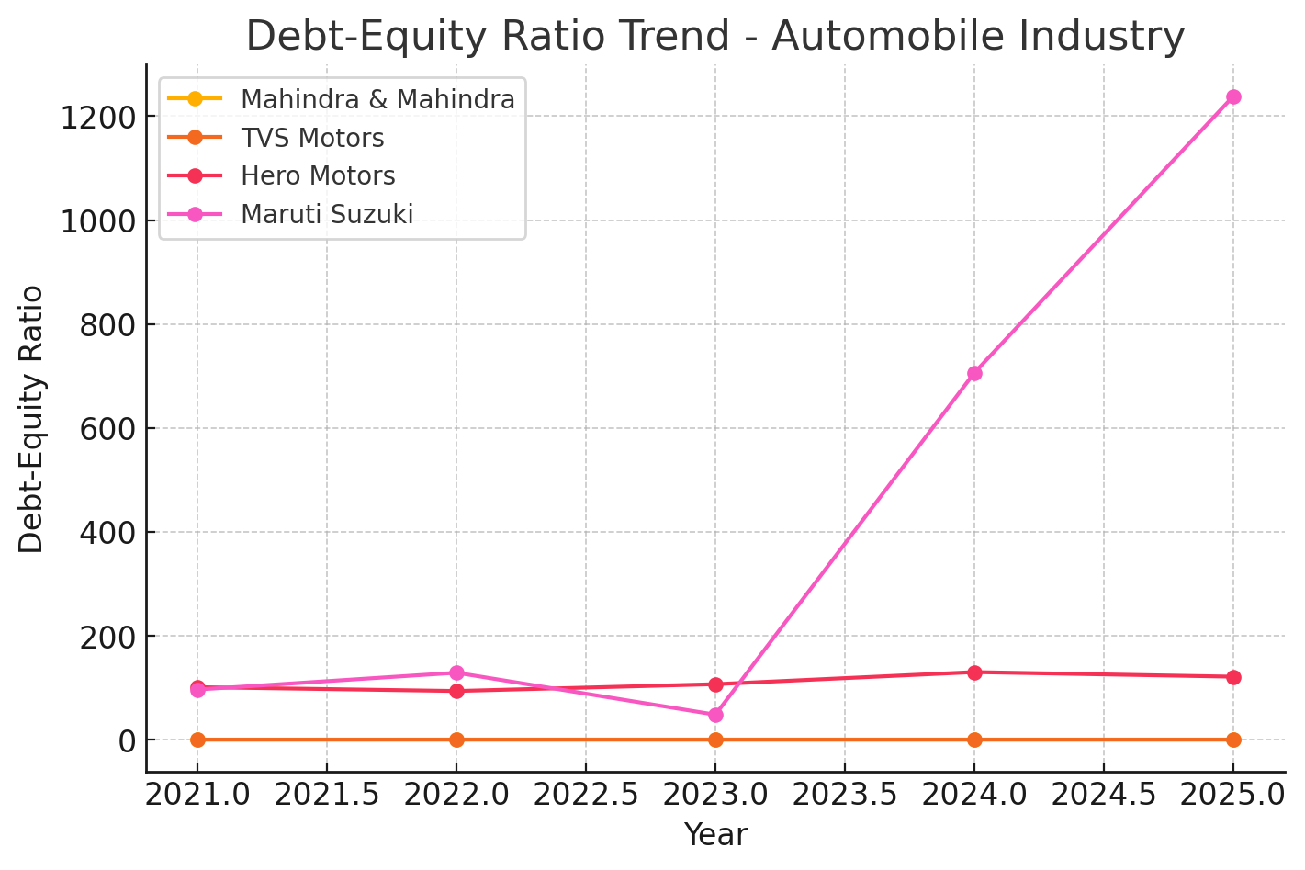
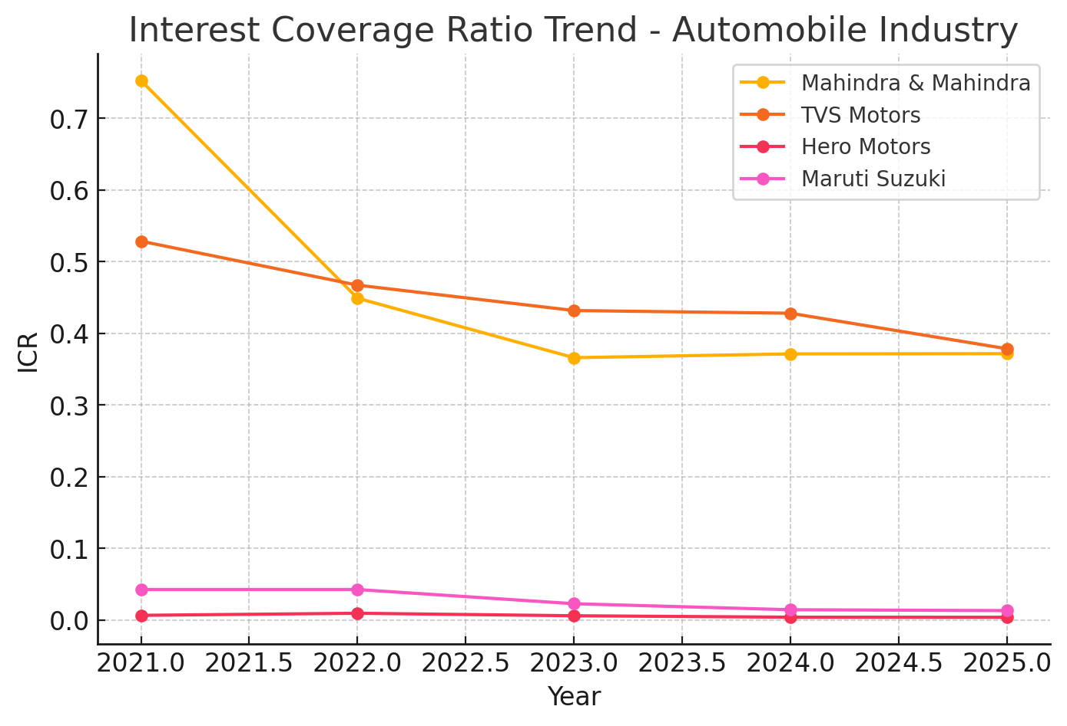
Analysis – Automobile Industry
Key Insights and Financial Characteristics
Higher Debt Usage
Automobile firms consistently demonstrate substantially higher debt utilisation compared to IT firms, reflecting the capital-intensive nature of manufacturing operations, extensive distribution networks, and inventory requirements.
Volatile ROE Performance
Over-Leveraged Firms
Mixed Interest Coverage
Return on equity tends to be volatile due to the cyclical demand patterns inherent to the automobile sector, influenced by economic conditions, consumer sentiment, and regulatory changes.
Several firms appear over-leveraged, facing challenges in maintaining financial stability during downturns. High fixed costs combined with substantial debt servicing obligations create vulnerability to market fluctuations.
Interest coverage ratios exhibit considerable variability across firms, with some companies struggling under the burden of capital structure obligations, particularly during periods of declining sales or margin compression.

Slide 7
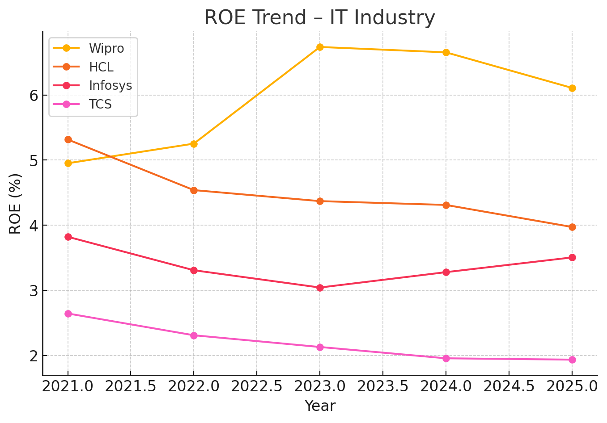
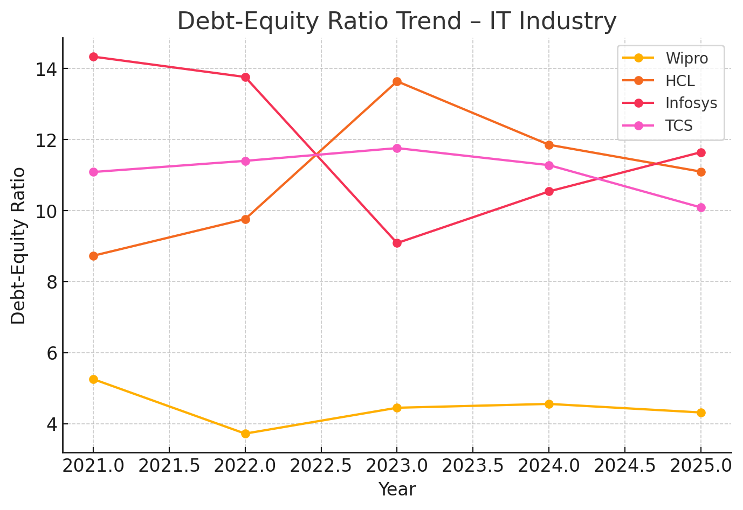
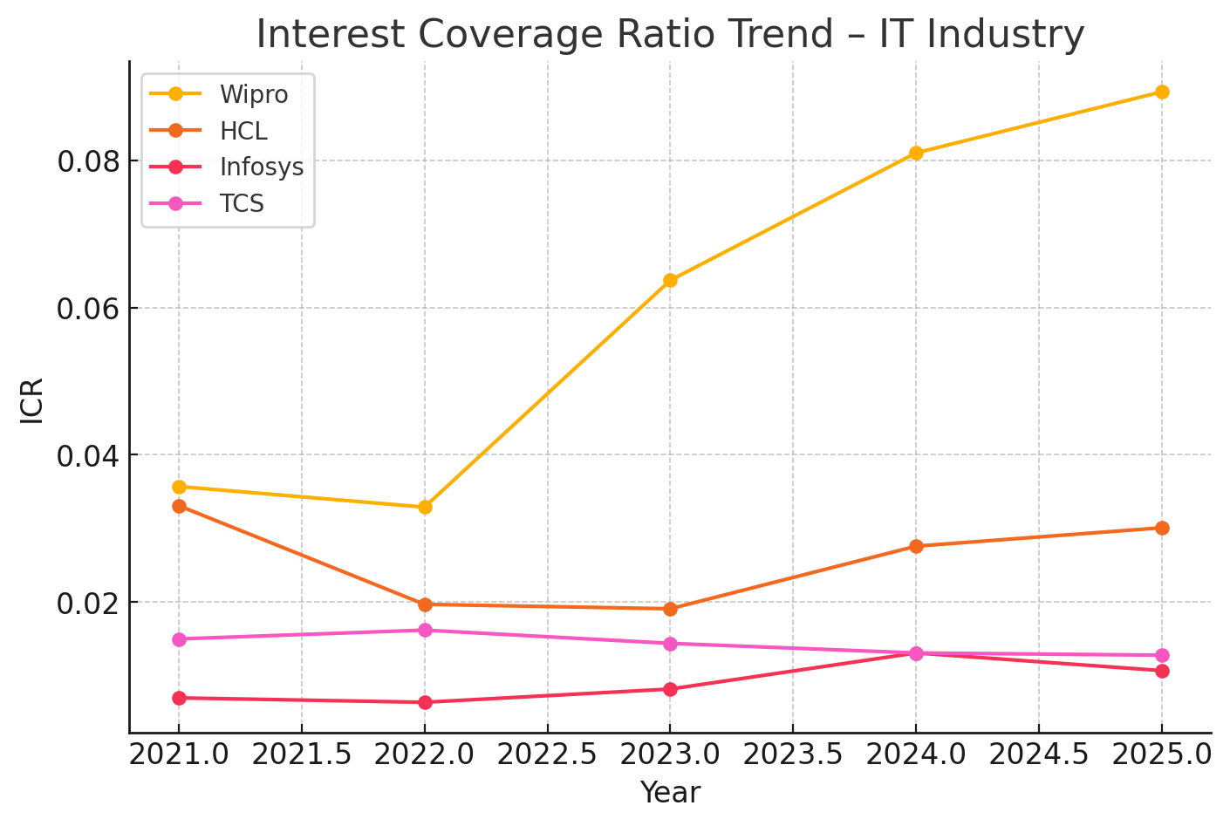
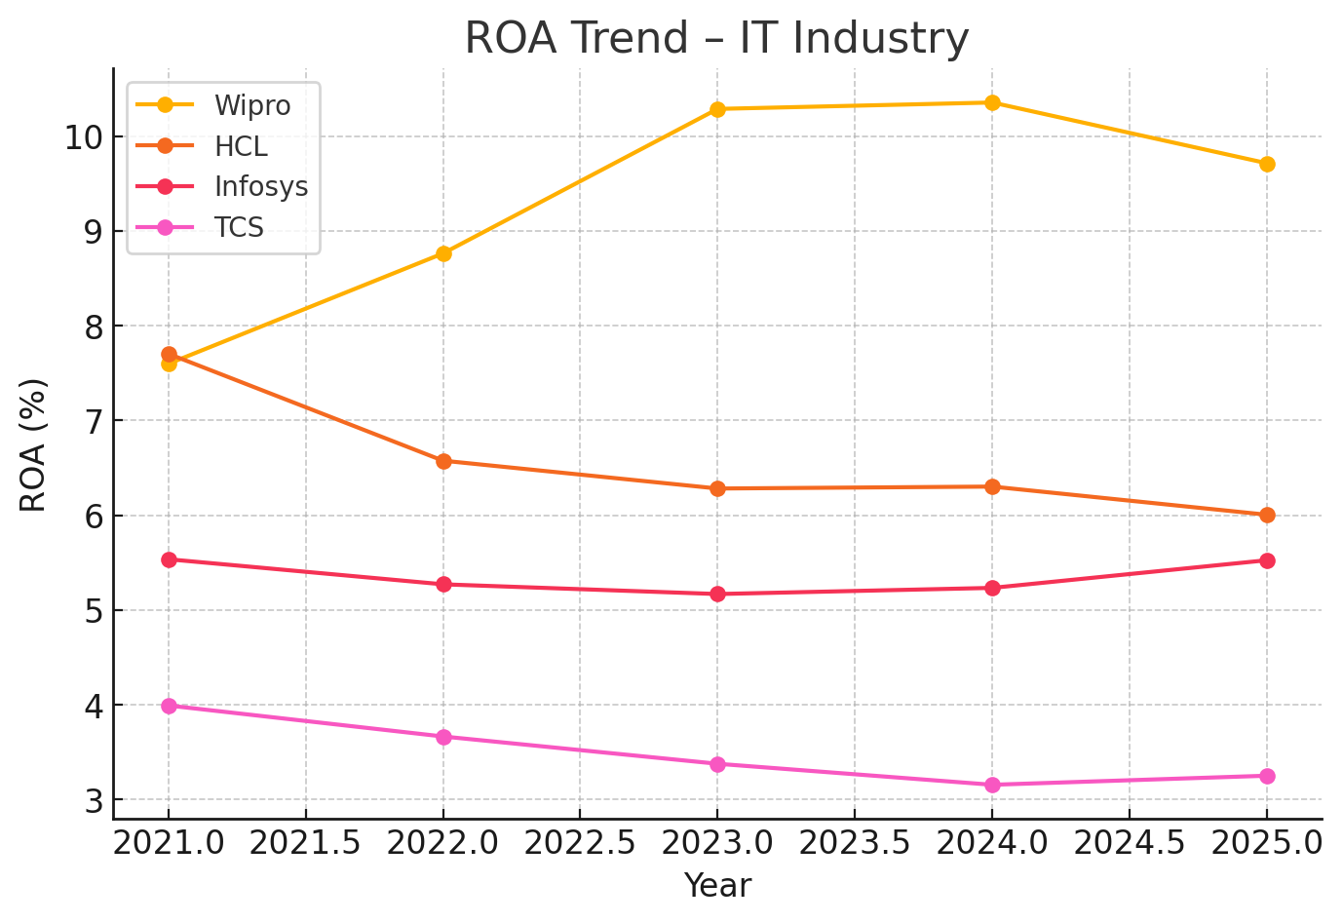
Analysis – IT Industry
Key Insights and Financial Characteristics
Minimal Debt Levels
Strong Interest Coverage
IT firms maintain very low or zero debt on their balance sheets, reflecting their asset-light business model and strong internal cash generation capabilities. This conservative approach reduces financial risk whilst maintaining strategic flexibility.
With minimal borrowing requirements, IT firms exhibit exceptionally strong interest coverage ratios, indicating robust debt servicing capacity and low financial distress risk even during challenging market conditions.
Superior Profitability
Under-Leveraged Position
The sector demonstrates high ROA and ROE metrics, attributed to asset-light operations, high-margin services, scalable business models, and the ability to generate substantial returns without significant capital investment.
Most firms are under-leveraged, maintaining comfortable liquidity positions and favourable risk profiles. Whilst this conservatism ensures stability, it may represent foregone opportunities to enhance ROE through judicious use of financial leverage.

Slide 8
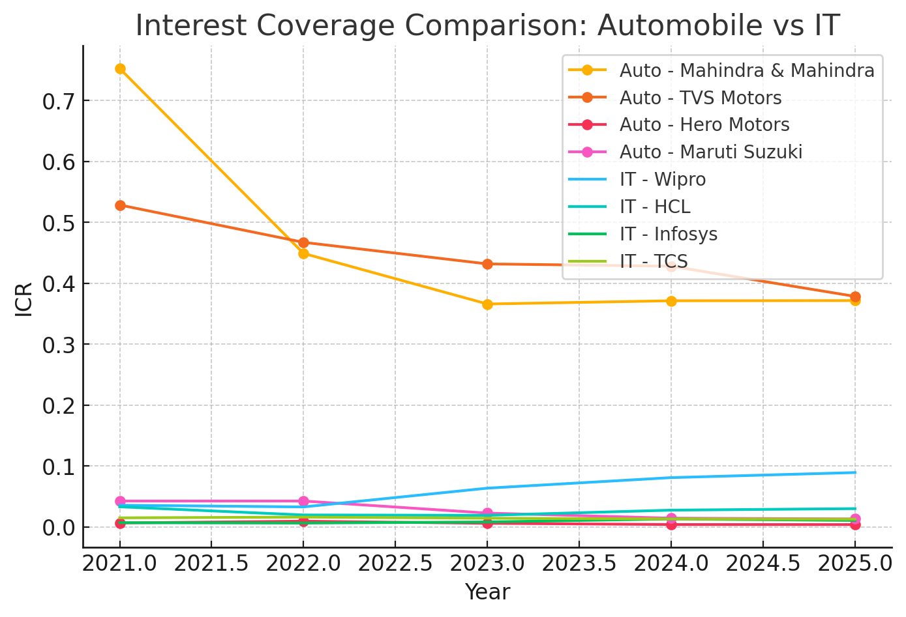
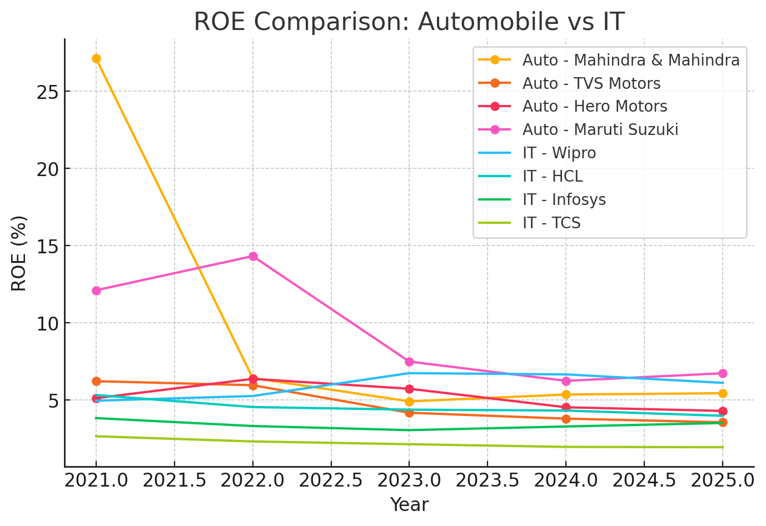
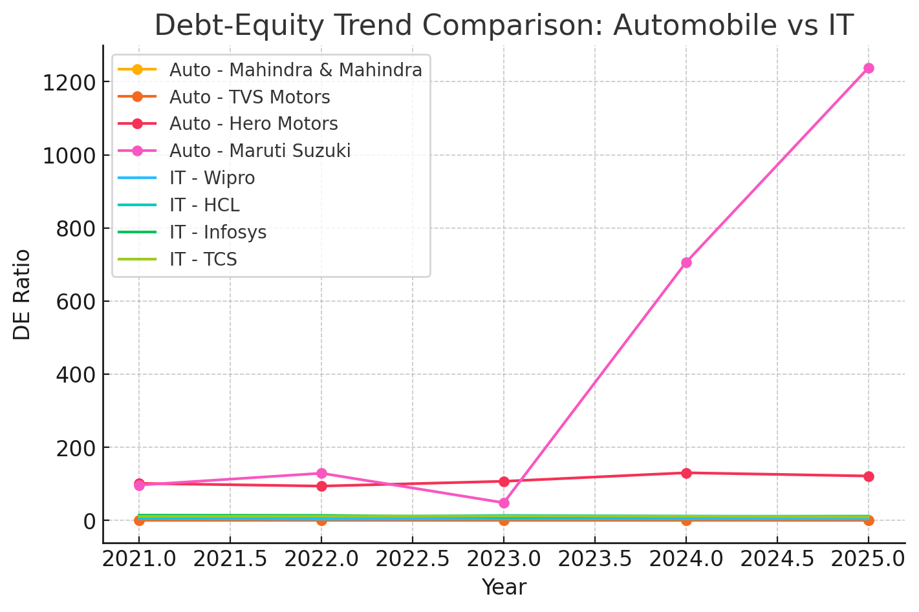
Cross-Industry Comparison
Automobile Industry Profile
IT Industry Profile
HIGH
MOD
LOW
HIGH
Debt-Equity Ratio
ROA / ROE
Debt-Equity Ratio
ROA / ROE
Substantial leverage reflects capital
intensity
Moderate returns on assets and
equity
Minimal leverage in asset-light model
Superior returns across both metrics
LOW
HIGH
Interest Coverage
Interest Coverage
Lower ICR indicates debt burden
Exceptionally strong debt capacity
Critical Performance Distinctions
Leverage Impact
Over-leveraged automobile firms face persistent pressure on profitability due to high interest obligations and fixed costs, particularly during cyclical downturns.
Industry Dynamics
Stability Patterns
IT firms demonstrate stable returns even without leverage benefits, relying on operational excellence rather than financial engineering.
Performance outcomes are fundamentally industry-driven: capital-intensive manufacturing versus knowledge-driven services.

Slide 9

Findings & Recommendations
Key Findings
Strategic Recommendations
Leverage-Performance Paradox
High leverage does not correlate with superior performance in the automobile industry, challenging traditional assumptions about debt benefits.
Automobile Industry
Reduce debt; improve ICR.
Adopt asset-light models.
Improve working capital.
Invest in EV and digitalization.
Use hybrid financing to reduce risk.
IT Sector Resilience
IT firms achieve strong returns despite minimal debt, demonstrating that operational efficiency can surpass leverage benefits.
Over-Leverage Consequences
Firms with excessive debt suffer from interest burden pressures and low interest coverage ratios, constraining strategic flexibility.
IT Industry
Use moderate debt to enhance ROE.
Invest in cloud, AI, and cybersecurity.
Optimize cash utilization and payouts.
Strengthen talent retention and delivery capabilities.
Manage global currency exposure.
Optimal Structure Matters
Firms maintaining optimal leverage consistently outperform both under-leveraged and over-leveraged peers across both sectors.
Automobile Sector
Reduce excessive debt levels, improve interest coverage ratios, and prioritise operational efficiency over financial leverage.
IT Sector
Consider moderate, strategic debt deployment to enhance ROE whilst maintaining the sector's characteristic financial stability.
Investor Guidance
Monitor DE ratio, ICR, and ROA/ROE trends comprehensively before making investment decisions.

Slide 10

Conclusion
1
2
Industry-Specific Impact
Contrasting Risk Profiles
Capital structure significantly affects firm performance, with effects varying substantially by industry characteristics and operational requirements.
The automobile industry's high debt levels elevate financial risk and vulnerability to cyclical downturns, whilst the IT industry's low leverage results in strong liquidity and consistent profitability.
3
4
Optimal Leverage Principle
Strategic Insight
Optimal leverage, not maximum leverage, enhances shareholder value. The key lies in balancing tax benefits, financial flexibility, and risk exposure.
This study demonstrates conclusively that industry characteristics fundamentally shape capital structure decisions, and that universal prescriptions are inappropriate for capital structure optimisation.
Final Thought: Successful capital structure management requires deep understanding of industry dynamics, operational requirements, and market conditions rather than adherence to generic financial ratios.

