Slide 1
IOT-PROJECT
SMART GARAGE SYSTEM
PRESENTED BY:
SAMHITA BHARADWAJ- RA1911029010015
S.AKANSHA- RA1911029010060

Slide 2
1.
INTRODUCTION

Slide 3
Smart garage is one such device that helps ease the access of the garage doors in domestic use. Smart garage system controls its objects such as windows, doors, lights, and also few gas detectors, alarm using micro-controller or computer technology.
Smart garage help you to access your doors with the help of a computable device such as smart phones or tablets connected to a network, and access by means of secured pins to authorize the access.
In this project we will be implementing Smart garage system with IOT and we will be showing the implementation of Smart garage system using Cisco Packet Tracer.

Slide 4
2.
MOTIVATION

Slide 5
This automation helps us to reduce the temperature in the garage by opening the doors and windows when the CO2 emissions reaches greater than the threshold.
As all are IoT devices, they can interact with one another based on the conditions defined by the owner. We can view the garage using the IP camera that is installed in the garage which reduces human effort of constant checking in the garage.
Scheduling the lights to turn on/off reduces the human effort as well as reduces the power consumption.

Slide 6
3.
METHODOLOGY

Slide 7
To Implement Smart garage system, we will be using Cisco Packet Tracer, which includes different smart objects used for garage automation such as smart door, smart window, smart light, smart sensors, fire sprinkler, etc.
To control these smart objects and sensors, microcontroller (MCU) and IoT server are used.
Different types of conditions are written on to the smart objects based on the user requirement to control the garage and security is assured to user by implementing the pin lock system in the mobile for automating uses.

Slide 8
4.
CONNECTIONS

Slide 9
Home gateway is connected to every smart device.
Different IP address is given to smart devices.
Programming of different smart devices is done according to the requirement of application.
Change the configuration of every smart device to home gateway(IOT SERVER).
Click the I/O Config tab and change the Network Adapter type to the PT-IOT-NM-1W wireless adapter.
For the fire sprinkler and fire detector part, we connect the fire detector to the home gateway.
We use custom cables for connecting MCU and fire sprinkler.

Slide 10
5.
SENSORS USED

Slide 11
Conditions are given in the home gateway which is connected to smart phone and it can be made manually or automatically based on the situation.
We have put a threshold value for the CO2 emmission based on which the automation of smart window and smart door are done.
We used Fire detecting sensor to detect fire in the garage. If it detects fire, it will turn on the sprinkler and the siren alarm.
We also used Temperature sensor and Humidity sensor to switch on/off the fan based on humidity value.
And finally we used Motion detecting sensor, to check for any thefts that happen in the garage. When it detects any motion, it will switch on the motion detector, smart light and CCTV camera.

Slide 12
7.
ACTUATORS USED

Slide 13
We used Mechanical actuators for both Fire detection and Motion detection. After detecting motion or smoke, Mechanical actuators will be used to operate the garage doors.
Electrical actuators will be used for turning on the web camera, smart lights and fan as and when required.

Slide 14
MICRO CONTROLLER UNIT CODE
from gpio import *
from time import *
def handleSensorData():
value = digitalRead(0)
if value == 0:
customWrite(1, '0')
else:
customWrite(1, '1')
def main():
add_event_detect(0, handleSensorData)
while True:
delay(1000)
if __name__ == "__main__":
main()

Slide 15
8.
SCREENSHOTS

Slide 16

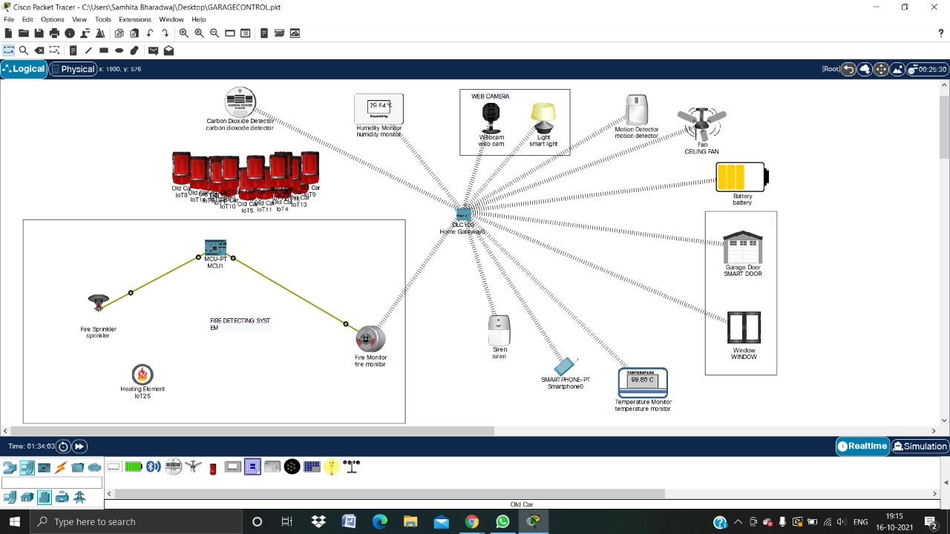
SMART GARAGE SIMULATION

Slide 17
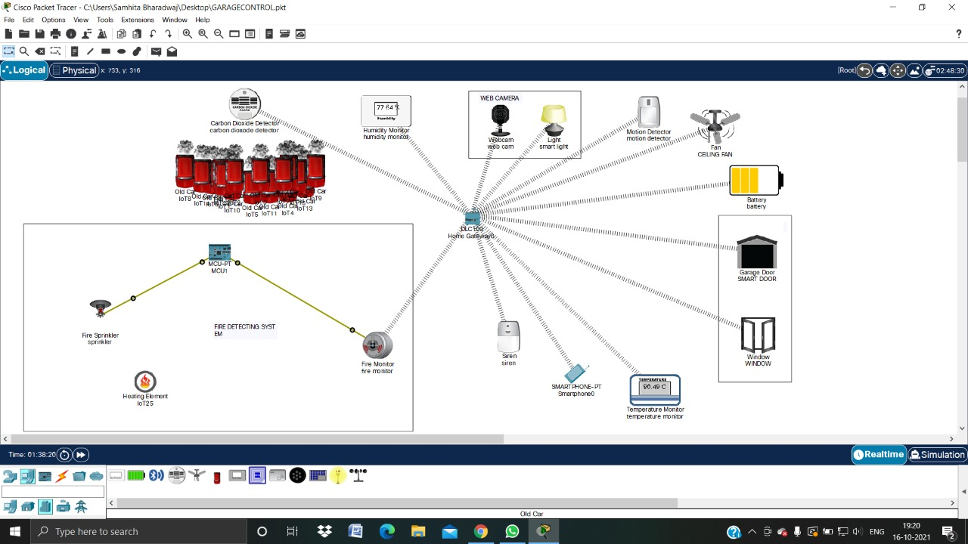
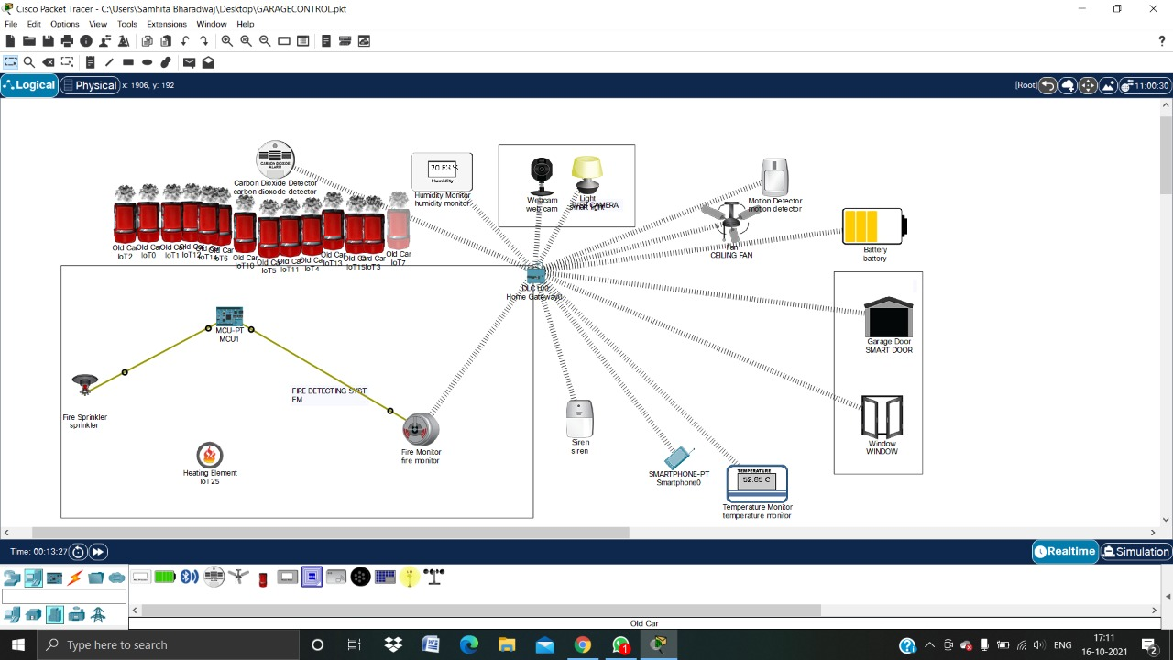
CO2 DETECTION
BEFORE
AFTER

Slide 18
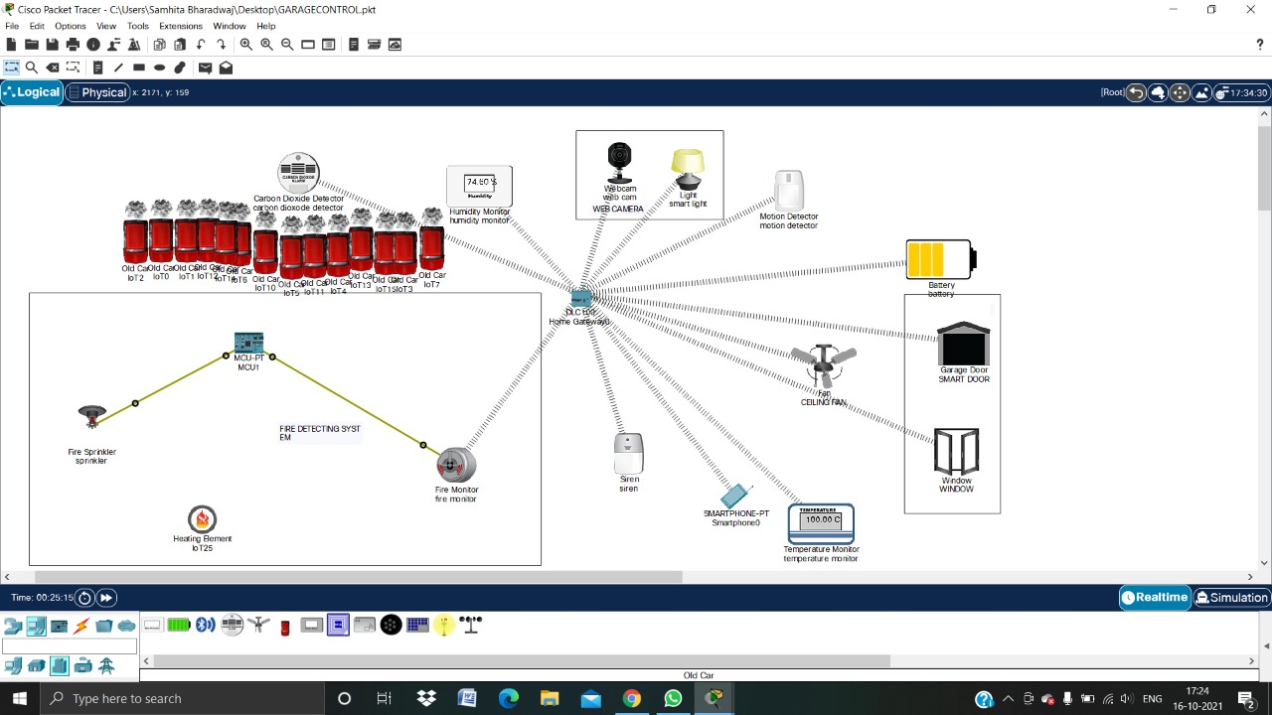
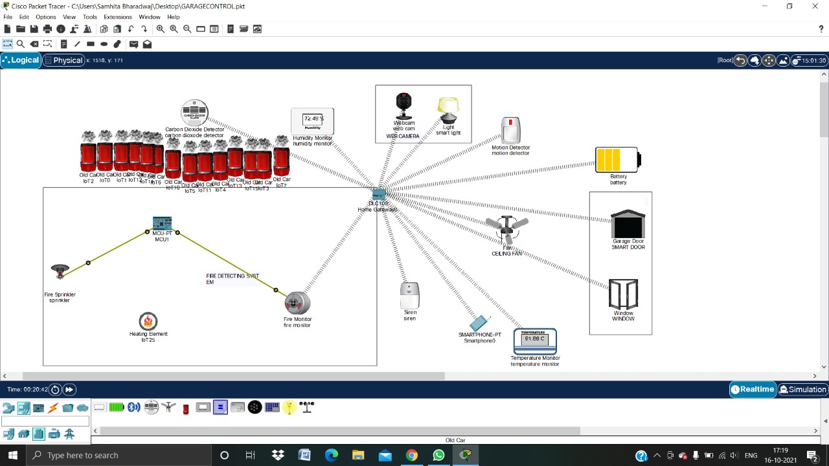
MOTION DETECTION
BEFORE
AFTER

Slide 19
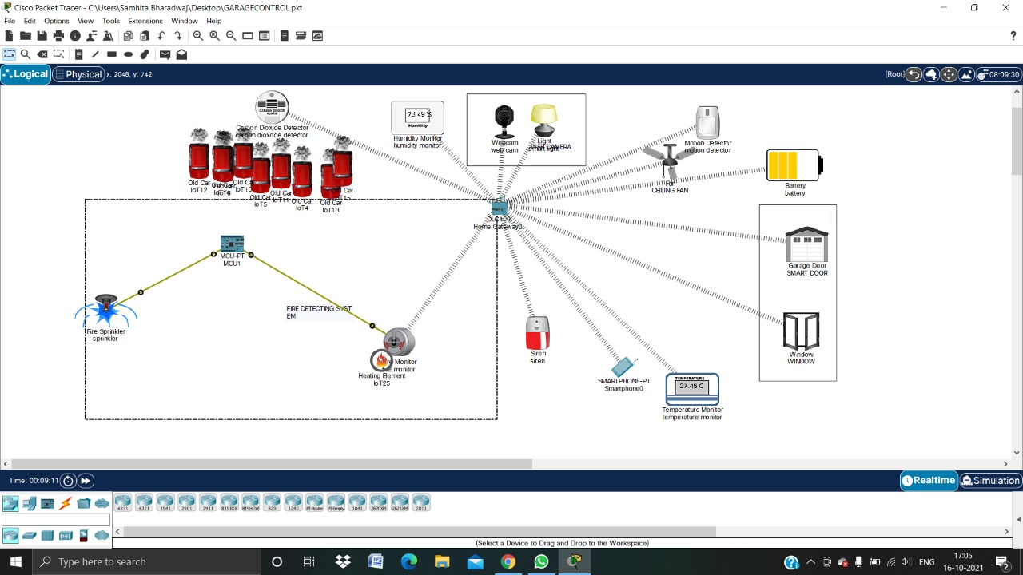
FIRE DETECTION
BEFORE
AFTER

Slide 20
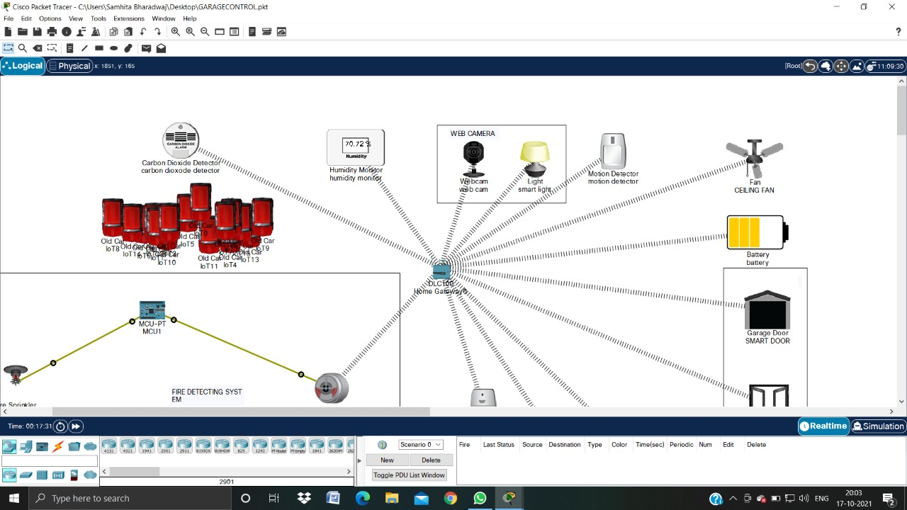

HUMIDITY AND TEMPERATURE DETECTION
BEFORE
AFTER

Slide 21
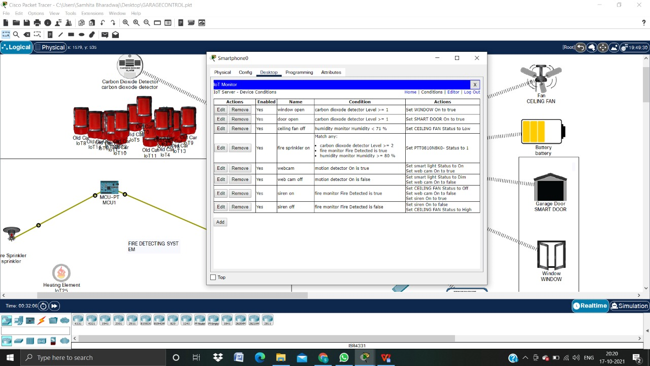
CONDITIONS

Slide 22
9.
OUTCOME

Slide 23
Opening of window and door when CO2 detector detects smoke which is greater than the threshold value which is set by the user.
Activates the fire sprinkler and the fire siren when the fire is detected.
If any motion is detected, then the motion detector, smart light and web camera turns on.
If the humidity increases beyond the threshold value and the temperature increases, then the ceiling fan turns on.

Slide 24
THANK YOU

