Slide 1
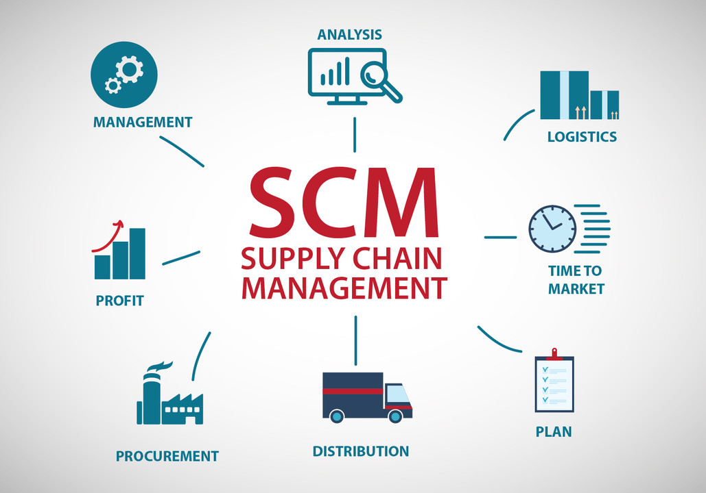

Slide 2
Project no – 169
SUPPLY CHAIN MANAGEMENT
GROUP 6 MEMBERS
Ms. Akansha Shaw
Mr. Devalapally Harish Kumar
Mr. Mahesh Kumar
Ms. Spoorti M Gouli
Mr. Onkar Bobade

Slide 3
PROJECT OVERVIEW
PROJECT INTRODUCTION
DATA DESCRIPTIONS
OBJECTIVES
EXCEL MAIN DASHBOARD
TABLEAU MAIN DASHBOARD
POWER BI MAIN DASHBOARD
KPI 1 SUB DASHBOARD
KPI 2 SUB DASHBOARD
KPI 3 SUB DASHBOARD
KPI 4 SUB DASHBOARD
KPI 5 SUB DASHBOARD
KPI 6 SUB DASHBOARD
KPI 7 SUB DASHBOARD
KPI 8 SUB DASHBOARD
KPI 9 SUB DASHBOARD
KPI 10 SUB DASHBOARD

Slide 4
PROJECT INTRODUCTION
Supply chain management (SCM) is management of the flow of goods, data, and finances related to a product or service, from the procurement of raw materials to the delivery of the product at its final destination.
Although many people equate the supply chain with logistics, logistics is actually just one component of the supply chain. Today’s digitally based SCM systems include material handling and software for all parties involved in product or service creation, order fulfilment, and information tracking―such as suppliers, manufacturers, wholesalers, transportation and logistics providers, and retailers.
Though SCM has always been an enterprise fundamental, the supply chain today is more vital than ever as a marker for business success. Companies that can effectively manage their supply chain to adapt to today’s volatile and ever-changing, technology-driven business environment are the ones that will survive and thrive.
SCM has advantages too. For instance, it can free up supply chain employees to contribute to the business in ways that add more value. Better SCM systems that automate mundane tasks can equip supply chain professionals with the tools they need to successfully deliver the products and services the supply chain is designed around.
SCM has historically been about increasing efficiency and reducing costs. Although those needs haven’t changed, what has changed is that the customer is now playing a front-and-centre role in setting SCM priorities. It’s been said that “customer experiences live and die in the supply chain.”

Slide 5
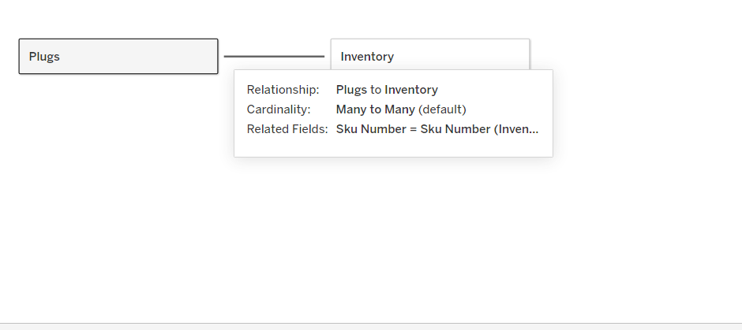
DATA DESCRIPTIONS
PLUGS_ELECTRONICS_HANDS_ON_LAB_DATA: This table is connected to F_Inventory_adjusted to create a relationship between the products. This table contains details of customers and stores.
F_INVENTORY_ADJUSTED DATASET: It contains the details of products such as sku number product type , product key, price and so on.

Slide 6
OBJECTIVES
Cost – Effective Production
On Time Delivery
Boosting Customer Utlity
Improving Distribution
Effective Inventory Management

Slide 7
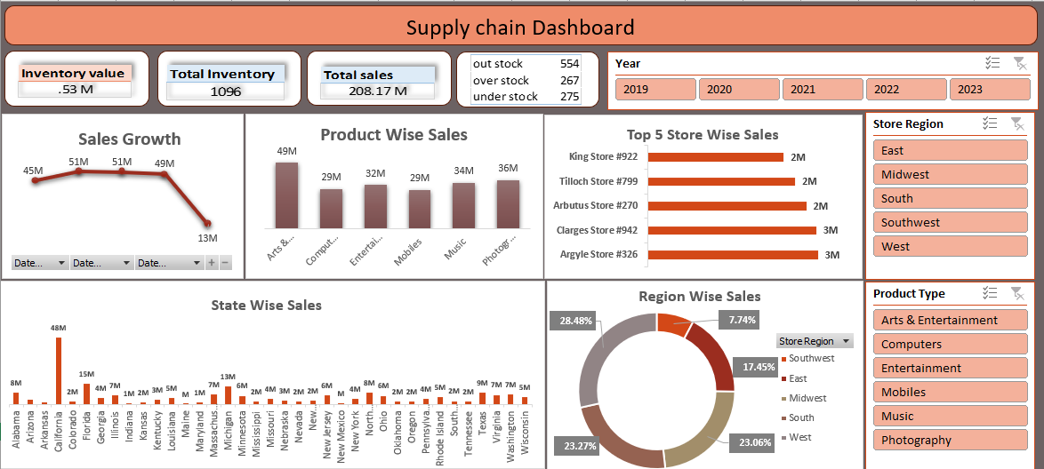
EXCEL DASHBOARD

Slide 8
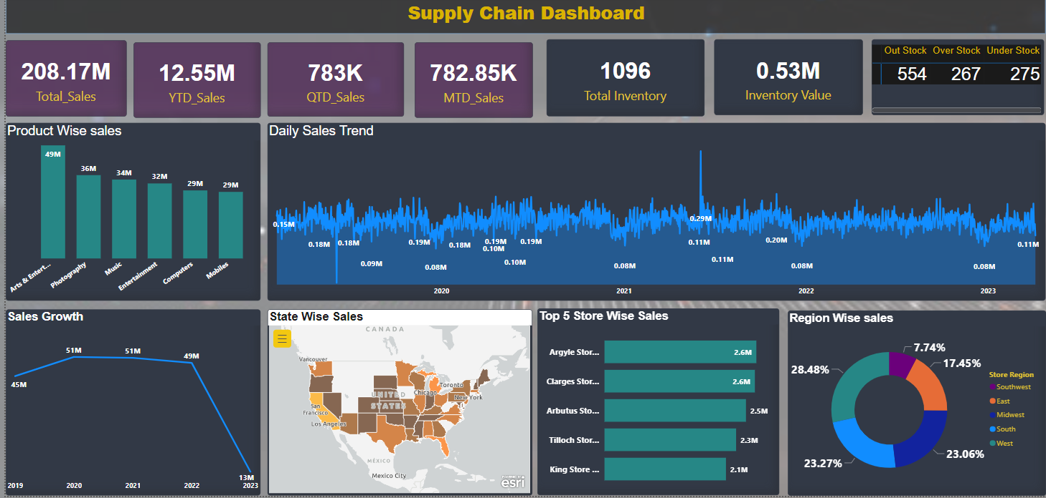
POWER BI DASHBOARD

Slide 9
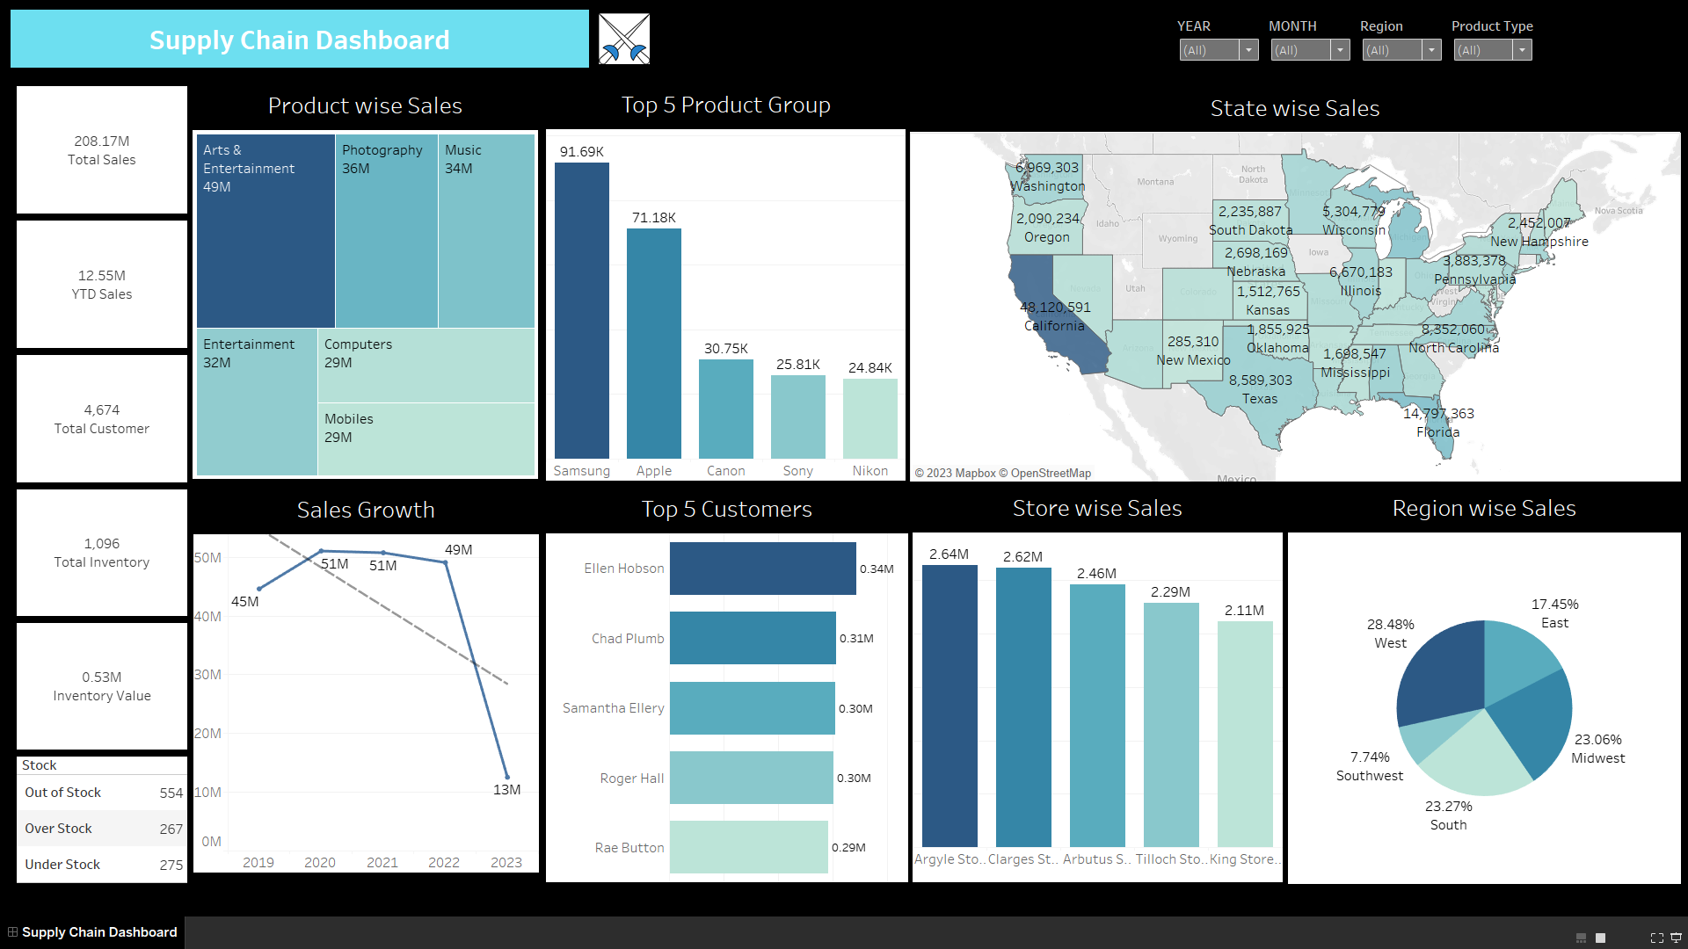
TABLEAU DASHBOARD

Slide 10
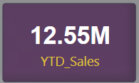
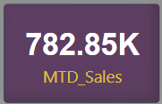
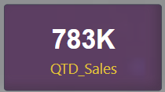
KPI 1 SUB DASHBOARD
Total Sales (MTD, QTD, YTD):
YTD (Year-to-date) refers to the total sales value recorded within the current year.
MTD (Month-to-date) refers to the total sales value recorded within the current month.
QTD (Quarter-to-date) represents the total sales value recorded within the current quarter.

Slide 11
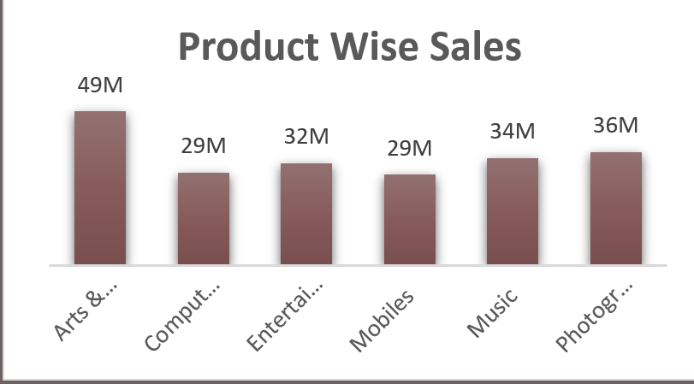
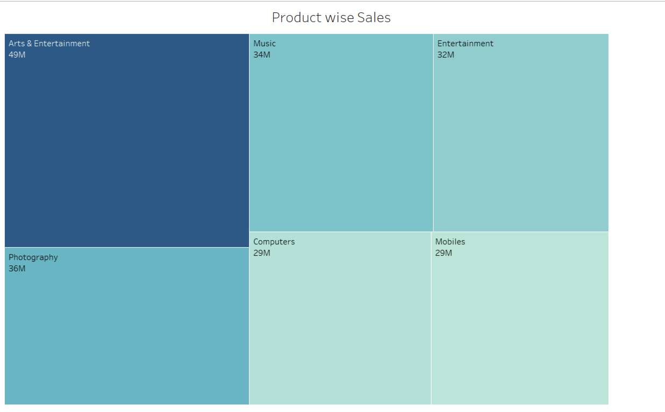
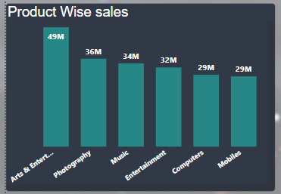
KPI 2 SUB DASHBOARD
We also found that the top 5 Products on the basis of sales are Arts& Entertainment, Photography, Music, Entertainment, Computers and Mobiles.
EXCEL
TABLEAU
Arts & Entertainment – 49M
Photography – 36M
Music – 34M
Entertainment – 32M
Computers – 29M
Mobiles – 29M
POWER BI

Slide 12
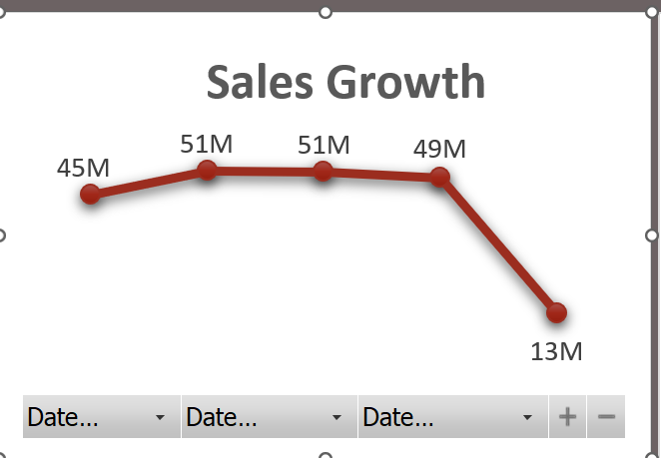
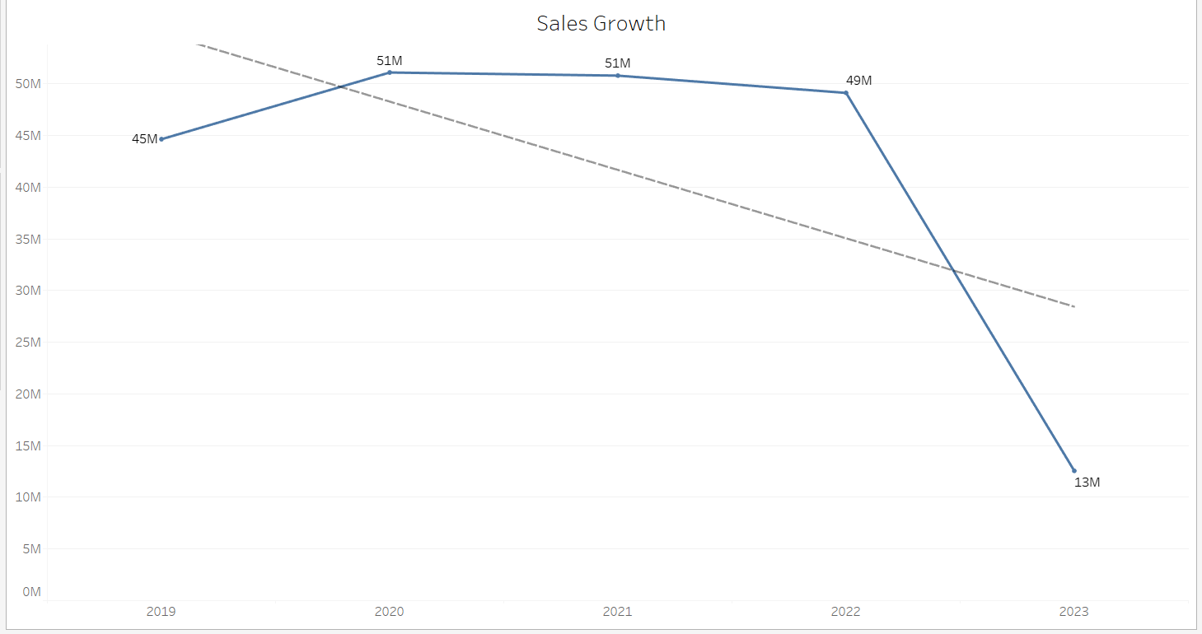
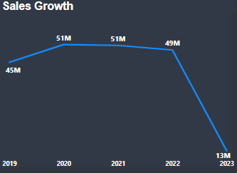
KPI 3 SUB DASHBOARD
We also found that the Sales growth is decreasing in further years as indicated by trendline.
Maximum sales is in the year 2020 and 2021.
EXCEL
TABLEAU
2019 – 45M
2020 – 51M
2021 – 51M
2022 – 49M
2023 – 13M
POWER BI

Slide 13
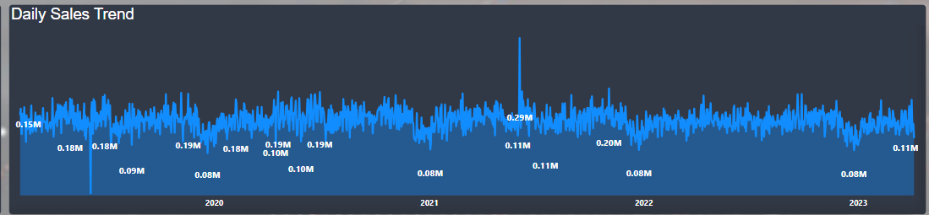
KPI 4 SUB DASHBOARD
POWER BI
Daily sales trend shows the pattern or trend in sales over a period of days. It helps identify any fluctuations or patterns in sales on a daily basis, which can be useful for demand forecasting and planning.

Slide 14
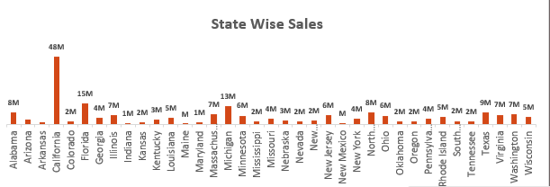
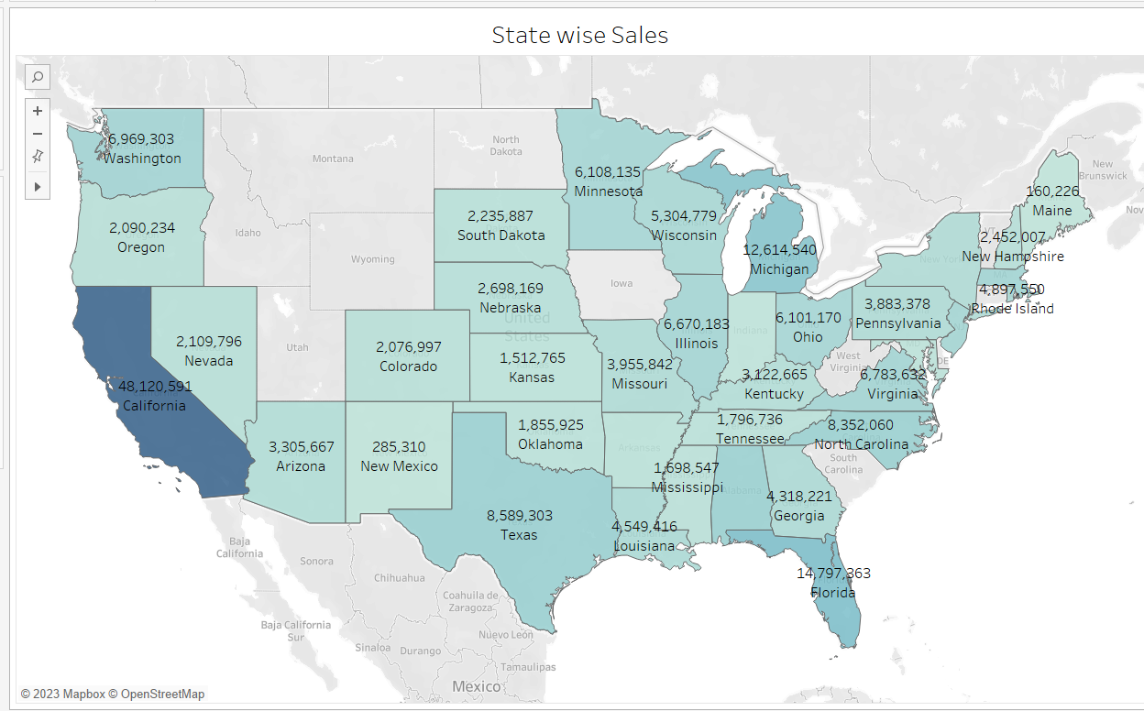
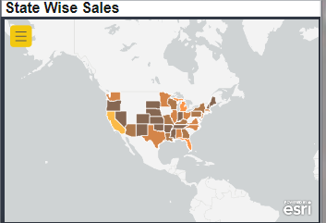
KPI 5 SUB DASHBOARD
EXCEL
State-wise sales analysis involves calculating the total sales value associated with each state or region in a country. California has maximum sales.
TABLEAU
POWER BI

Slide 15
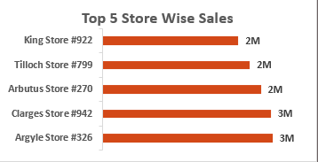
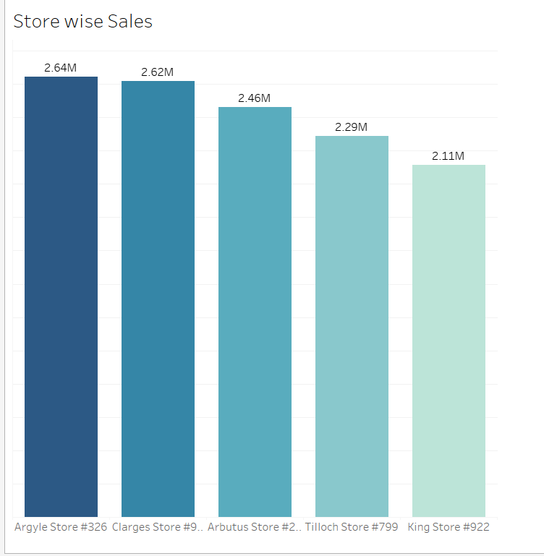
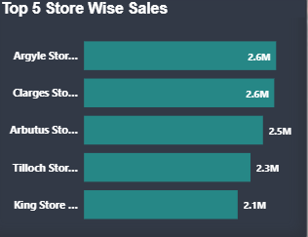
KPI 6 SUB DASHBOARD
This refers to the top 5 stores or retail outlets that have achieved the highest sales figures. It helps Identify the most successful stores or locations within the supply chain.
EXCEL
TABLEAU
Argyle Store #326 - 3M
Clarges Store #942 - 3M
ArbutusStore#270 - 2M
TillochStore#799 - 2M
King Store #922 - 2M
POWER BI

Slide 16
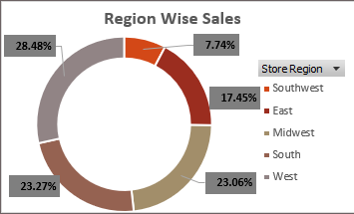
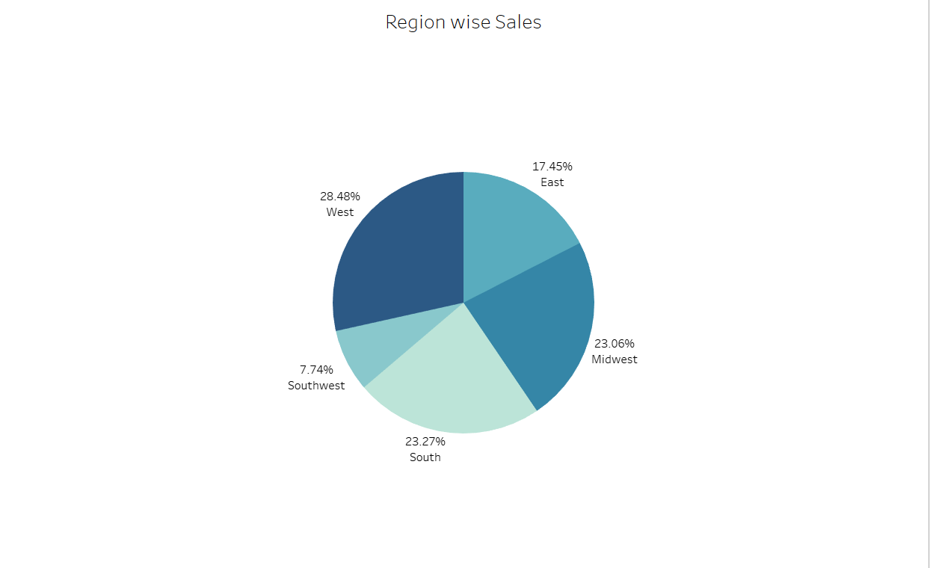
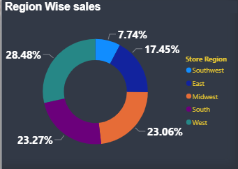
KPI 7 SUB DASHBOARD
Region-wise sales indicate the cumulative sales worth associated with individual regions or areas within a broader geographic domain, such as a country or continent. This analysis offers valuable information regarding sales achievements in various regions.
EXCEL
TABLEAU
West - 59M
Midwest - 48M
South – 48M
East – 36M
Southwest – 16M
POWER BI

Slide 17



KPI 8 SUB DASHBOARD
The total inventory encompasses all the goods or products present in the supply chain, consisting of finished products available for sale and raw materials or components utilized in the production process.
EXCEL
POWER BI
TABLEAU

Slide 18
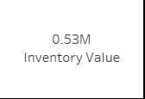


KPI 9 SUB DASHBOARD
The value of inventory signifies the overall financial worth of the inventory present in the supply chain. This is determined by multiplying the quantity of each item held in inventory by its corresponding unit cost or market value.
EXCEL
POWER BI
TABLEAU

Slide 19

KPI 10 SUB DASHBOARD
When there is an excess of inventory beyond the demand, resulting in a surplus, it is referred to as overstock in the supply chain.
On the other hand, when the supply chain does not possess sufficient inventory to fulfill the current demand, it is known as out of stock.
Understock denotes a situation where the inventory level falls below the desired or optimal level required to meet demand.

Slide 20


