Slide 1
Customer Churn Analysis - Telecom
Rows: 1000 | Columns: 10
Target Column: Churn

Slide 2
Customer Segments Summary
Other: 883 customers
Loyal: 117 customers

Slide 3
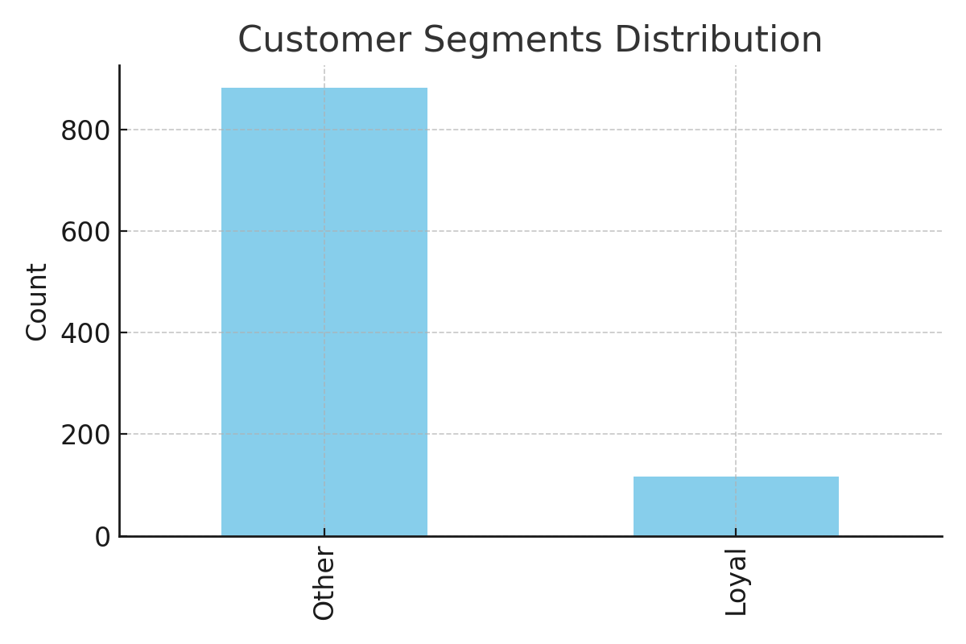
Customer Segment Distribution

Slide 4
Final Recommendations
1. **At Risk**: Personalized retention offers, 20% discount, VIP outreach.
2. **Loyal**: Upsell to premium plans, loyalty rewards.
3. **Dormant**: Reactivate via SMS/push with 7-day free data.
4. Reduce complaint resolution time, track satisfaction KPIs.
5. A/B test offers and measure uplift.

