Slide 1
ERPNext + Keycloak SSO – Implementation Progress
Azure VM deployment, ERPNext setup, Keycloak integration and end-to-end SSO validation
Objective: centralize authentication for ERPNext using Keycloak (OpenID Connect / OIDC).
Environment: Azure Ubuntu VM, ERPNext v15, Keycloak 26.7.4, MariaDB and Docker.
Current status: ERPNext login → Keycloak authentication → ERPNext Dashboard is working successfully.
Scope covered in this update: infrastructure, ERPNext deployment, Keycloak setup, OIDC configuration, user mapping and testing.
ERPNext + Keycloak SSO POC | Akansha Vishwakarma | Slide 1

Slide 2
Project Architecture – Current POC
Azure VM: VM-av | Ubuntu Server 24.04 LTS | Central India | 2 vCPU / 4 GiB RAM.
ERPNext/Frappe runs directly on the VM with Nginx + Supervisor + MariaDB + Redis.
Keycloak runs in Docker with a MySQL 8.0 database.
Keycloak is exposed on TCP 8080 for POC testing; ERPNext is served through Nginx on HTTP 80.
Authentication protocol: OpenID Connect (OIDC) Authorization Code flow.
User
ERPNext
Nginx :80
Keycloak
:8080
OIDC
Token
ERPNext
Dashboard
ERPNext + Keycloak SSO POC | Akansha Vishwakarma | Slide 2

Slide 3
Azure Infrastructure Provisioning
Resource Group: rg-av | Region: Central India.
VNet: vnet-av | Address space: 10.0.0.0/16 | Subnet: subnet-av (10.0.0.0/24).
VM: VM-av | Ubuntu 24.04 LTS | Standard D2ls_v6 | 2 vCPU / 4 GiB RAM.
Authentication: local VM username `akansha` with SSH access.
Public IP used during POC: 40.80.93.70.
NSG access: HTTP 80 and SSH 22; TCP 8080 temporarily allowed for Keycloak POC.
MariaDB/Redis ports were not exposed publicly.
ERPNext + Keycloak SSO POC | Akansha Vishwakarma | Slide 3

Slide 4
ERPNext Deployment
Clean ERPNext deployment was performed from the official Frappe/ERPNext repositories.
Frappe: 15.121.3 | ERPNext: 15.121.6.
Created site: `erp.av.local`.
MariaDB 10.11 configured with utf8mb4 and secure root authentication.
Redis cache/queue services configured and validated.
Production setup completed using Bench + Supervisor + Nginx.
Supervisor services verified RUNNING: Redis cache/queue, web, Socket.IO, long worker, short worker and scheduler.
ERPNext + Keycloak SSO POC | Akansha Vishwakarma | Slide 4

Slide 5
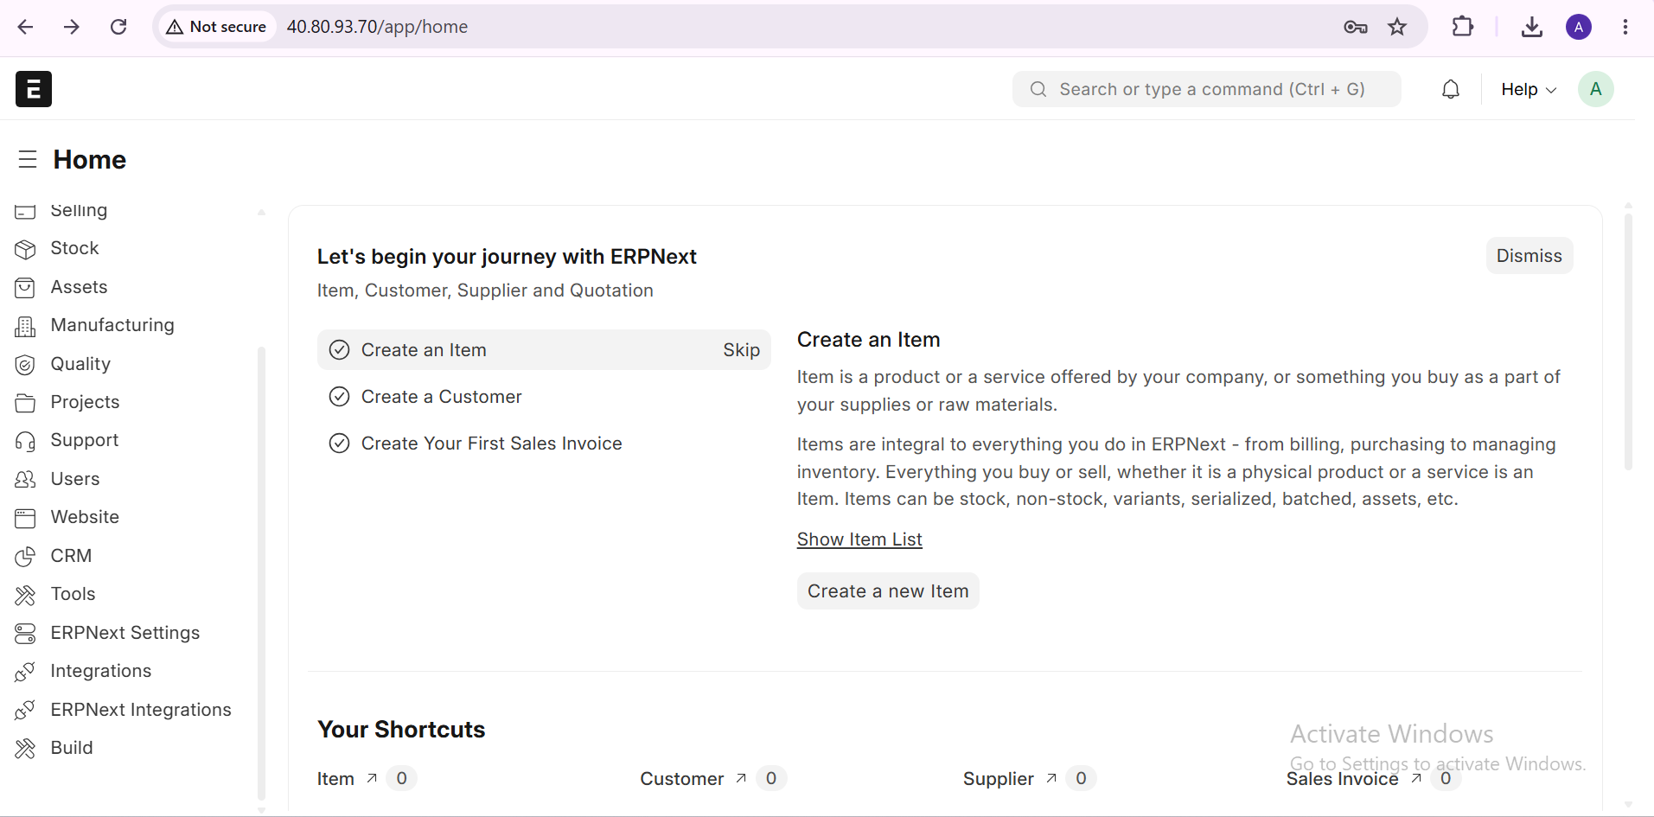
ERPNext Deployment

Slide 6
ERPNext Asset / Nginx Issue and Resolution
Initial browser login page loaded without proper styling because static assets returned HTTP 404.
Root cause: Nginx worker user could not traverse `/home/akansha` directory.
Actual assets existed under `frappe-bench/sites/assets`.
Permission was corrected by allowing directory traversal on `/home/akansha`.
Nginx configuration was tested and reloaded successfully.
Asset request then returned HTTP 200 and the ERPNext login page rendered correctly.
ERPNext + Keycloak SSO POC | Akansha Vishwakarma | Slide 5

Slide 7
Keycloak Deployment
Installed Docker Engine and Docker Compose v2 on the Azure VM.
Keycloak image: `quay.io/keycloak/keycloak:26.7.4`.
Database: MySQL 8.0 in a separate Docker container.
Persistent Docker volume configured for Keycloak database data.
Containers: `keycloak` and `keycloak-db`.
Keycloak health check and startup logs validated successfully.
Keycloak internal endpoint returned HTTP 302 to `/admin/`, confirming service availability.
ERPNext + Keycloak SSO POC | Akansha Vishwakarma | Slide 6

Slide 8
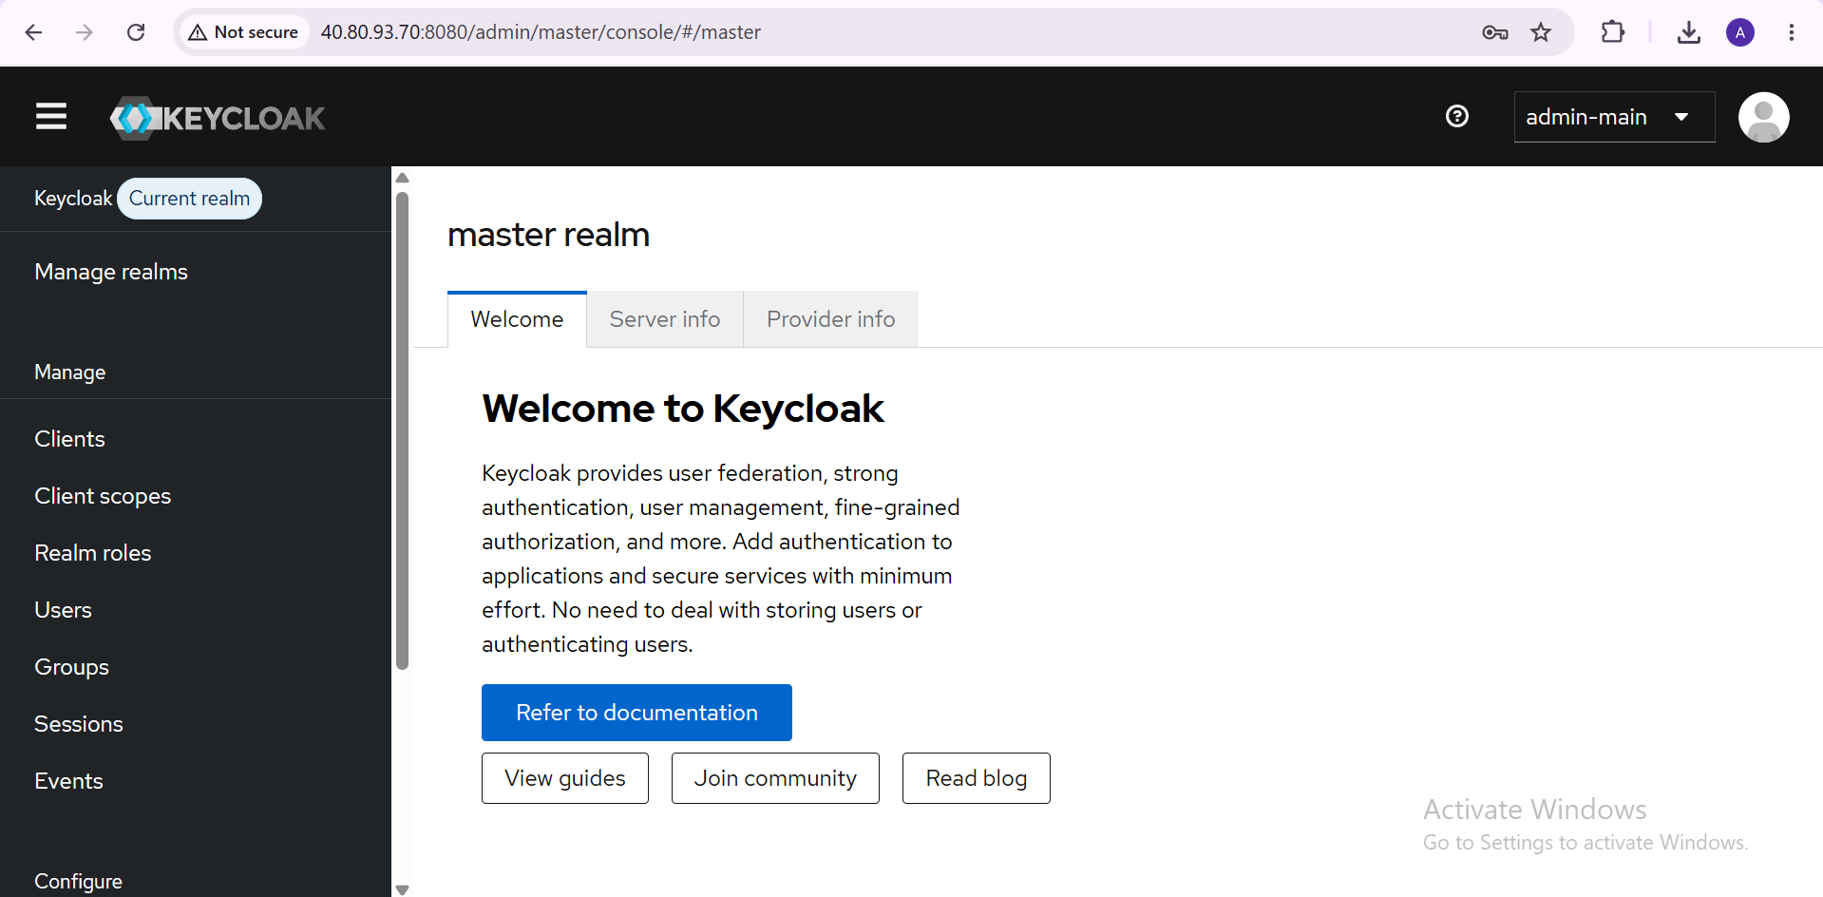
Keycloak Deployment

Slide 9
Keycloak Realm and Security Configuration – POC
Created realm: `erpnext`.
Master realm remains the Keycloak administration realm.
POC realm SSL requirement was set to NONE because the current test endpoint uses HTTP.
OIDC discovery endpoint was validated successfully.
Discovery metadata confirmed authorization, token, userinfo, logout and JWKS endpoints.
Important: SSL NONE + HTTP + public 8080 are temporary POC settings and must be replaced with HTTPS in production.
ERPNext + Keycloak SSO POC | Akansha Vishwakarma | Slide 7

Slide 10
Keycloak Client – ERPNext
Client ID: `erpnext`.
Client type: OpenID Connect.
Client authentication: ON (confidential client).
Standard Authorization Code flow: ON.
Direct Access Grants / Implicit Flow: OFF.
Root/Home URL: `http://40.80.93.70`.
Web Origin: `http://40.80.93.70`.
Callback route configured for Frappe: `/api/method/frappe.integrations.oauth2_logins.login_via_keycloak`.
Client Secret was generated and kept confidential.
ERPNext + Keycloak SSO POC | Akansha Vishwakarma | Slide 8

Slide 11
ERPNext Social Login Configuration
ERPNext: Settings → Integrations → Social Login Key → Provider: Keycloak.
Base URL: `http://40.80.93.70:8080/realms/erpnext`.
Authorize URL: `/protocol/openid-connect/auth`.
Access Token URL: `/protocol/openid-connect/token`.
API Endpoint: `/protocol/openid-connect/userinfo`.
User ID Property: `preferred_username`.
Auth URL Data: `response_type=code`, `scope=openid`.
Social Login was explicitly enabled after identifying that `enable_social_login` was initially set to 0.
ERPNext + Keycloak SSO POC | Akansha Vishwakarma | Slide 9

Slide 12
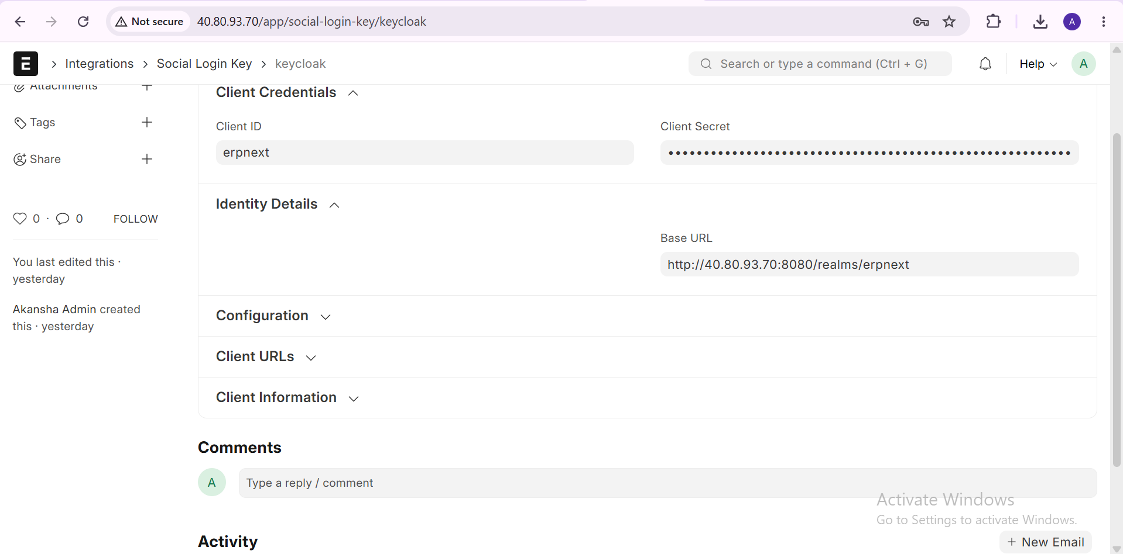
ERPNext Social Login

Slide 13
Issue Found During SSO Test – Signup Disabled
Keycloak login button appeared successfully after enabling the Social Login Key.
User was authenticated by Keycloak, but ERPNext returned HTTP 403: `Signup is Disabled`.
Investigation showed the Keycloak user did not yet have a matching ERPNext user account.
Created ERPNext user: `testuser@av.local`.
Initially the ERPNext record was created as Website User; this was corrected to System User.
After correction, the same Keycloak user successfully entered ERPNext.
ERPNext + Keycloak SSO POC | Akansha Vishwakarma | Slide 10

Slide 14
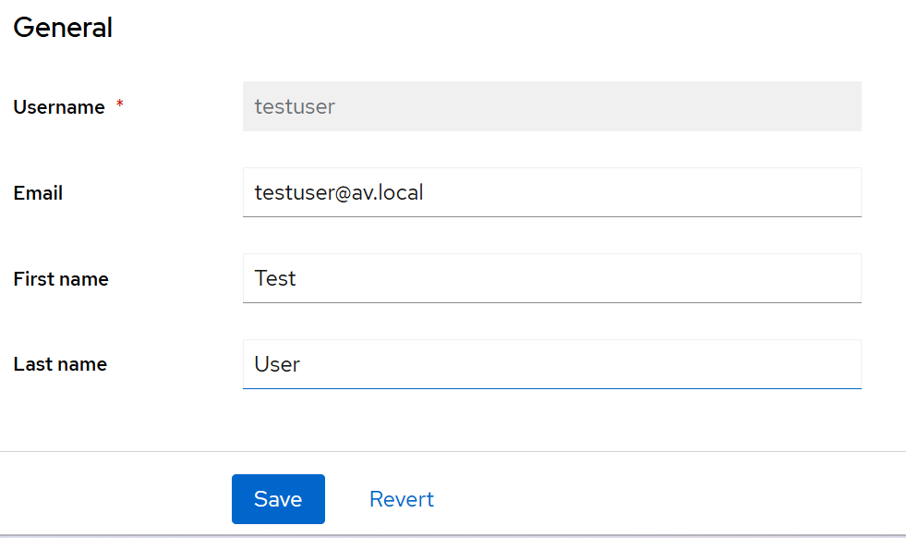
Test User Mapping
Keycloak realm: `erpnext`.
Keycloak username: `testuser`.
Keycloak email: `testuser@av.local`.
ERPNext email/user: `testuser@av.local`.
ERPNext account status: Enabled.
ERPNext User Type: System User.
Result: Keycloak identity successfully mapped to an ERPNext application user.
ERPNext + Keycloak SSO POC | Akansha Vishwakarma | Slide 11

Slide 15
End-to-End SSO Validation – SUCCESS
Step 1: User opens ERPNext login page.
Step 2: User selects `Login with Keycloak`.
Step 3: ERPNext redirects to Keycloak in the `erpnext` realm.
Step 4: User authenticates with Keycloak credentials.
Step 5: Keycloak returns the OIDC authorization response.
Step 6: Frappe processes the callback and identifies the matching ERPNext user.
Step 7: User is redirected into the ERPNext Dashboard.
Final status: END-TO-END ERPNext + Keycloak SSO POC SUCCESSFUL.
ERPNext + Keycloak SSO POC | Akansha Vishwakarma | Slide 12

Slide 16
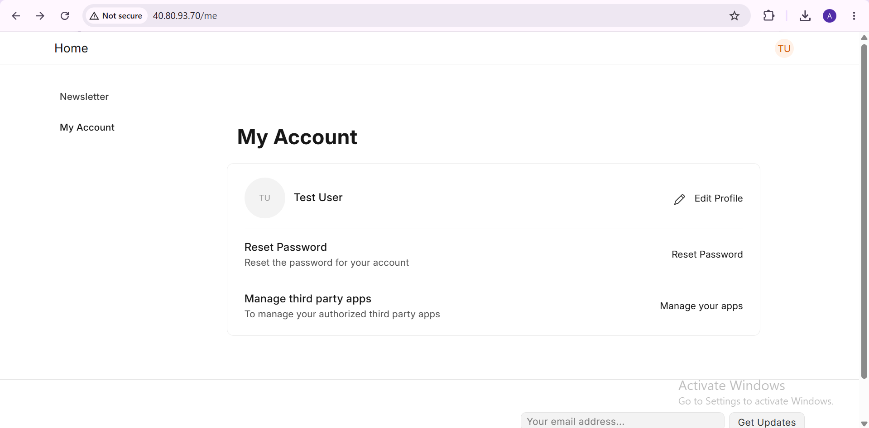
End-to-End SSO Validation – SUCCESS

Slide 17
Current Status – Completed vs Pending
COMPLETED
  Azure VM and network baseline
  ERPNext v15 deployment and production services
  Keycloak + MySQL Docker deployment
  Keycloak `erpnext` realm and OIDC client
  ERPNext Social Login Key configuration
  Keycloak authentication + ERPNext dashboard SSO test
PENDING / NEXT
  Production HTTPS + domain + reverse proxy
  Remove public Keycloak port 8080
  Keycloak production mode and hardened configuration
  Central user provisioning/synchronization
  BiBo SSO activation using the same Keycloak identity
  CI/CD pipeline, security gates, health checks and rollback
ERPNext + Keycloak SSO POC | Akansha Vishwakarma | Slide 13

Slide 18
Production Hardening Recommendations
Use a proper DNS name for ERPNext and Keycloak instead of public IP URLs.
Terminate TLS with Nginx / reverse proxy and enforce HTTPS.
Remove the Azure NSG rule allowing public TCP 8080 after reverse proxy setup.
Run Keycloak in production mode instead of `start-dev`.
Move database/admin credentials out of compose YAML into protected secrets or environment management.
Rotate POC credentials before production.
Keep MariaDB and Redis private; do not expose database ports.
Consider resizing to 8 GiB+ RAM or separating Keycloak from ERPNext as the user base grows.
Retain ERPNext Administrator as a controlled break-glass account until SSO is fully production-hardened.
ERPNext + Keycloak SSO POC | Akansha Vishwakarma | Slide 14

Slide 19
Next Phase – Central Identity + BiBo Integration
1. Harden Keycloak and ERPNext with domain + HTTPS.
2. Define employee identity attributes/groups in Keycloak.
3. Implement controlled ERPNext user provisioning and role mapping.
4. Integrate BiBo so the same Keycloak authentication activates the employee tracker without a second login.
5. Add application roles/groups for ERPNext and future applications.
6. Implement CI/CD separately: PR validation → security checks → approval → deployment → health check → rollback.
7. Document operations, backup/restore and access-control procedures.
ERPNext + Keycloak SSO POC | Akansha Vishwakarma | Slide 15

Slide 20
Management Summary
ERPNext has been successfully deployed on Azure and stabilized with production-style Nginx/Supervisor services.
Keycloak has been deployed as the centralized Identity Provider and connected to ERPNext using OIDC.
The end-to-end login flow has been tested with a real Keycloak test identity and reaches the ERPNext Dashboard.
The current implementation is a working POC; production security hardening is the next priority.
The architecture is ready to be extended toward centralized employee identity, BiBo integration and CI/CD.
ERPNext + Keycloak SSO POC | Akansha Vishwakarma | Slide 16

