Slide 1
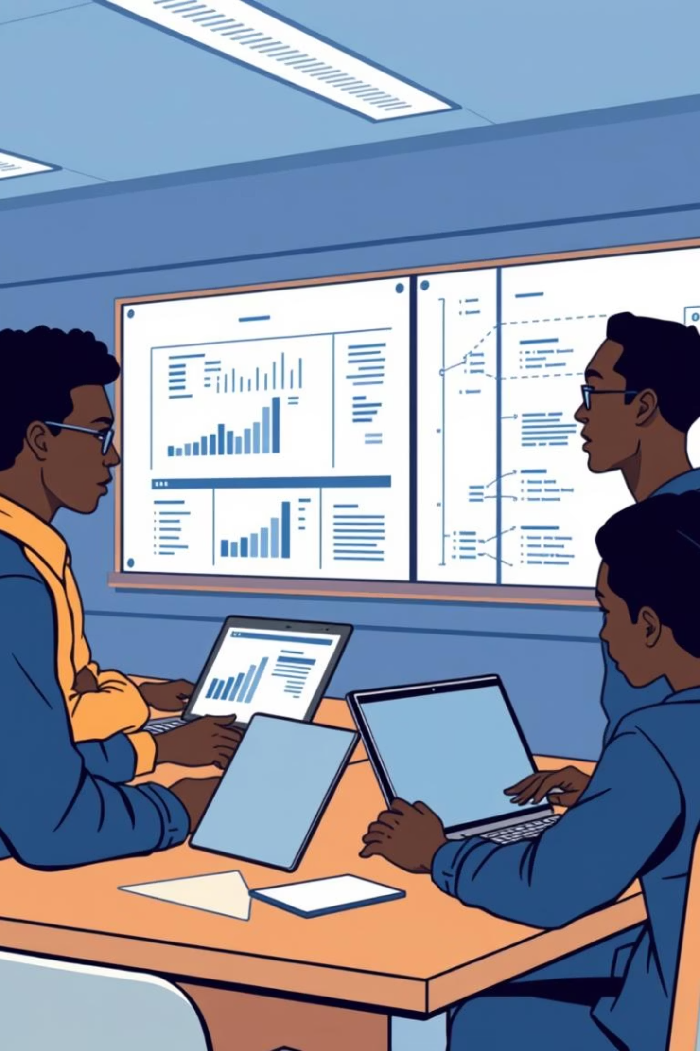
Student Performance Analysis & Prediction
Presented by Lesly Akanyana | INSY 8413 – Introduction to Big Data Analytics
Adventist University of Central Africa (AUCA), 2025

Slide 2




Project Overview
Sector: Education
Goal: Predictive Analytics
Focusing on higher education to improve student success and retention rates.
To analyze and predict student performance (Pass/Fail/Distinction) using robust big data methodologies.
Tools: Python & Power BI
Dataset: OULAD
Leveraging Python for advanced statistical analysis and Power BI for interactive data visualization.
Utilizing the Open University Learning Analytics Dataset (OULAD) for real-world insights.

Slide 3





Problem Statement
Can we accurately predict student academic outcomes (Pass, Fail, Withdrawn, Distinction, etc.) using readily available demographic and academic engagement data?
Understanding the influencing factors: How do variables such as gender, age group, geographical region, and prior educational attainment impact student performance? This project aims to identify these critical correlations to inform targeted interventions.
Demographics
Performance Outcomes
Academic History
Engagement Data

Slide 4
Dataset Description
Source & Scope
Key Features Analyzed
Sourced from the UCI Machine Learning Repository, ensuring data integrity and academic relevance.
gender: Student's gender.
age_band: Categorized age groups.
Specifically utilizing studentInfo.csv, a crucial component of the larger OULAD dataset.
highest_education: Prior educational qualifications.
region: Geographical location of the student.
Structure & Preparation
disability: Indication of student disability status.
A structured CSV file, requiring extensive preprocessing for optimal model performance.
final_result: The student's ultimate course outcome.
Involves data cleaning, handling missing values, and feature engineering.

Slide 5




Technologies & Tools Used
A comprehensive tech stack was employed to ensure robust analysis, effective modeling, and insightful visualization.
Python Ecosystem
Machine Learning
Utilized for data manipulation (pandas), statistical plotting (seaborn, matplotlib), and machine learning (scikit-learn).
The RandomForestClassifier was chosen for its predictive power and ability to handle complex datasets for outcome prediction.
Data Visualization
Development Workflow
Power BI was instrumental in creating interactive dashboards for exploratory data analysis and presenting key insights.
Jupyter Notebook facilitated iterative development, while Git + GitHub ensured version control and collaborative practices.

Slide 6
Python Workflow
Our analytical process followed a structured workflow:
1
Data Cleaning
2
Exploratory Data Analysis (EDA)
Addressed null values and inconsistencies. Implemented label encoding for categorical variables to prepare for modeling.
Generated distribution plots for individual features and a correlation heatmap to identify relationships between variables.
3
Machine Learning Modeling
4
Model Evaluation
Applied a Random Forest Classifier to predict student final_result, leveraging its ensemble learning capabilities.
Assessed model performance using accuracy scores, confusion matrices, and detailed classification reports to gauge precision and recall.

Slide 7
Power BI Dashboard
Interactive Visualizations
Key Insights & Relationships
The Power BI dashboard provides dynamic visuals to explore student performance trends across various demographic and academic factors.
The dashboard highlights critical relationships and trends, such as:
The impact of socio-economic status on student outcomes.
Visuals categorized by gender, age_band, region, education level, and disability status.
Performance disparities across different age groups.
Interactive slicers enable users to filter data and perform drill-down analysis, uncovering specific segments and patterns.
Correlation between prior education and final grades.
How specific demographic features link to overall academic success or struggle.

Slide 8
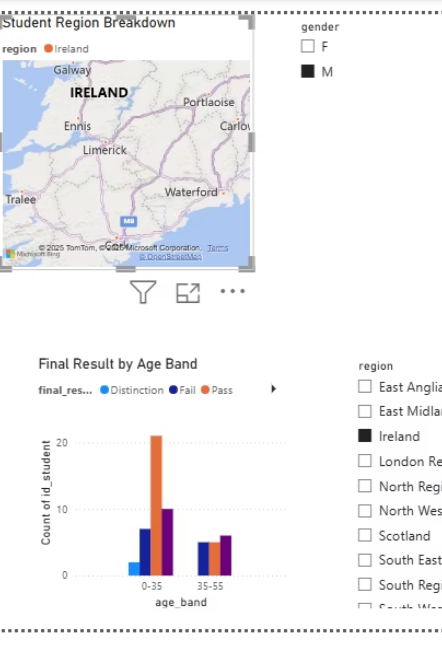
This Power BI dashboard offers a comprehensive, interactive view of student performance data, making complex insights accessible for educators and administrators. It visually highlights the distribution of student results across various demographic and academic attributes, enabling data-driven decision-making.

Slide 9
Key Insights
Education & Performance
Vulnerable Demographics
Students with higher initial education levels demonstrate a stronger correlation with positive academic outcomes.
Lower IMD (Index of Multiple Deprivation) bands and recorded disability status are significantly linked to student failure or withdrawal.
Demographic Influence
Early Intervention
Gender and age group, while not definitive predictors, show discernible patterns affecting overall academic success.
The developed Machine Learning model provides a valuable tool for early identification of at-risk students, enabling proactive support.

Slide 10



Recommendations
Based on our findings, we propose the following actionable recommendations for educators and institutions:
Tailored Support Programs
Implement targeted academic and emotional support for students identified as at-risk by the predictive model, focusing on their unique challenges.
Integrate Model into Advising
Incorporate predictive insights directly into academic advising workflows to provide timely, data-driven guidance and interventions.
Promote Inclusive Policies
Develop and strengthen policies that ensure equitable educational opportunities, particularly for students from disadvantaged backgrounds or with disabilities.

