Slide 1
Movie Rental Analytics Dashboard
Power BI Business Performance Analysis
Prepared by: AKARSH DWIVEDI

Slide 2
Introduction
The dashboard provides insights into customer behavior, film inventory, staff efficiency, and store performance.
It uses the MECE framework to structure the analysis and ensure comprehensive coverage of business questions.

Slide 3
Data Model
Fact Tables:
- fact_rentals (rental transactions)
- fact_sales (payment transactions)
Dimension Tables:
- dim_customer (customer demographics)
- dim_staff (staff details)
- dim_store (store details)
- dim_film (film details)
- dim_date (calendar)
Built as a star schema for optimized querying.

Slide 4
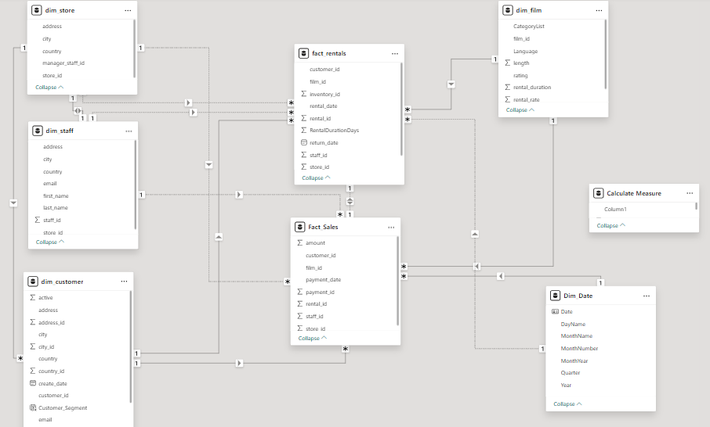

Slide 5
Sales Analysis Dashboard
1. Shows Total Sales (67.41K) with monthly filter.
2. Line chart – Sales trend by month.
3. Bar chart – Sales by customer segment.
4. Pie chart – Sales distribution by payment method.

Slide 6
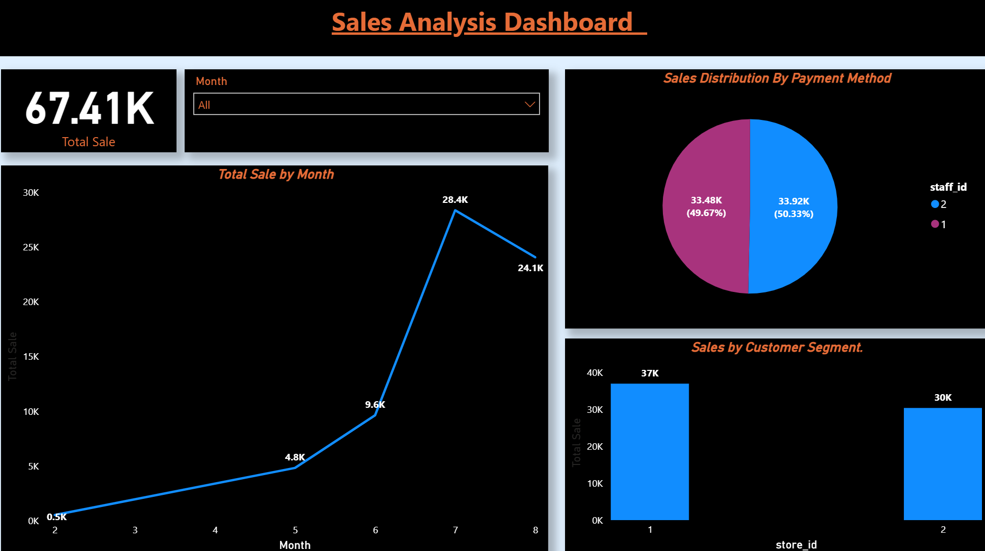

Slide 7
Film Analysis Dashboard
1. PG-13 films have the highest inventory count.
2. Sports & Animation are the top film categories.
3. Film library is primarily English, avg. length 115 min.
4. Sales performance tracked by store, staff, and customer.

Slide 8
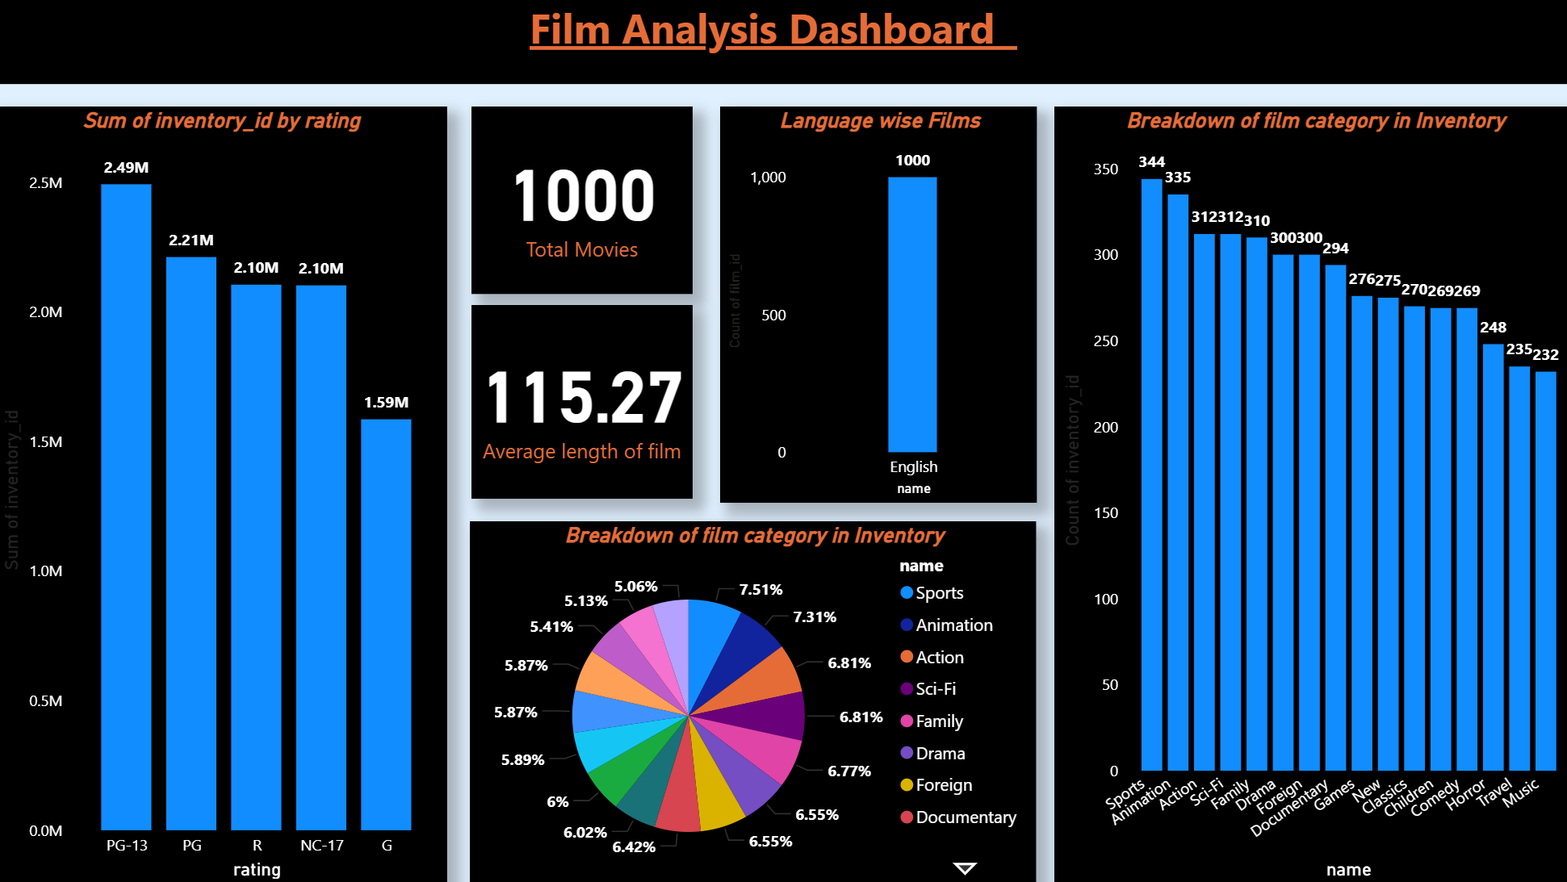

Slide 9
Rental Analysis Dashboard
1. 2005-2006 rental data analyzed by film title and duration.
2. Country-wise revenue shows top-performing regions (e.g., 4.1K).
3. Average rental duration varies by film category (5.20 - 4.86 days).
4. Sports & Sci-Fi categories have the highest rental rates.

Slide 10
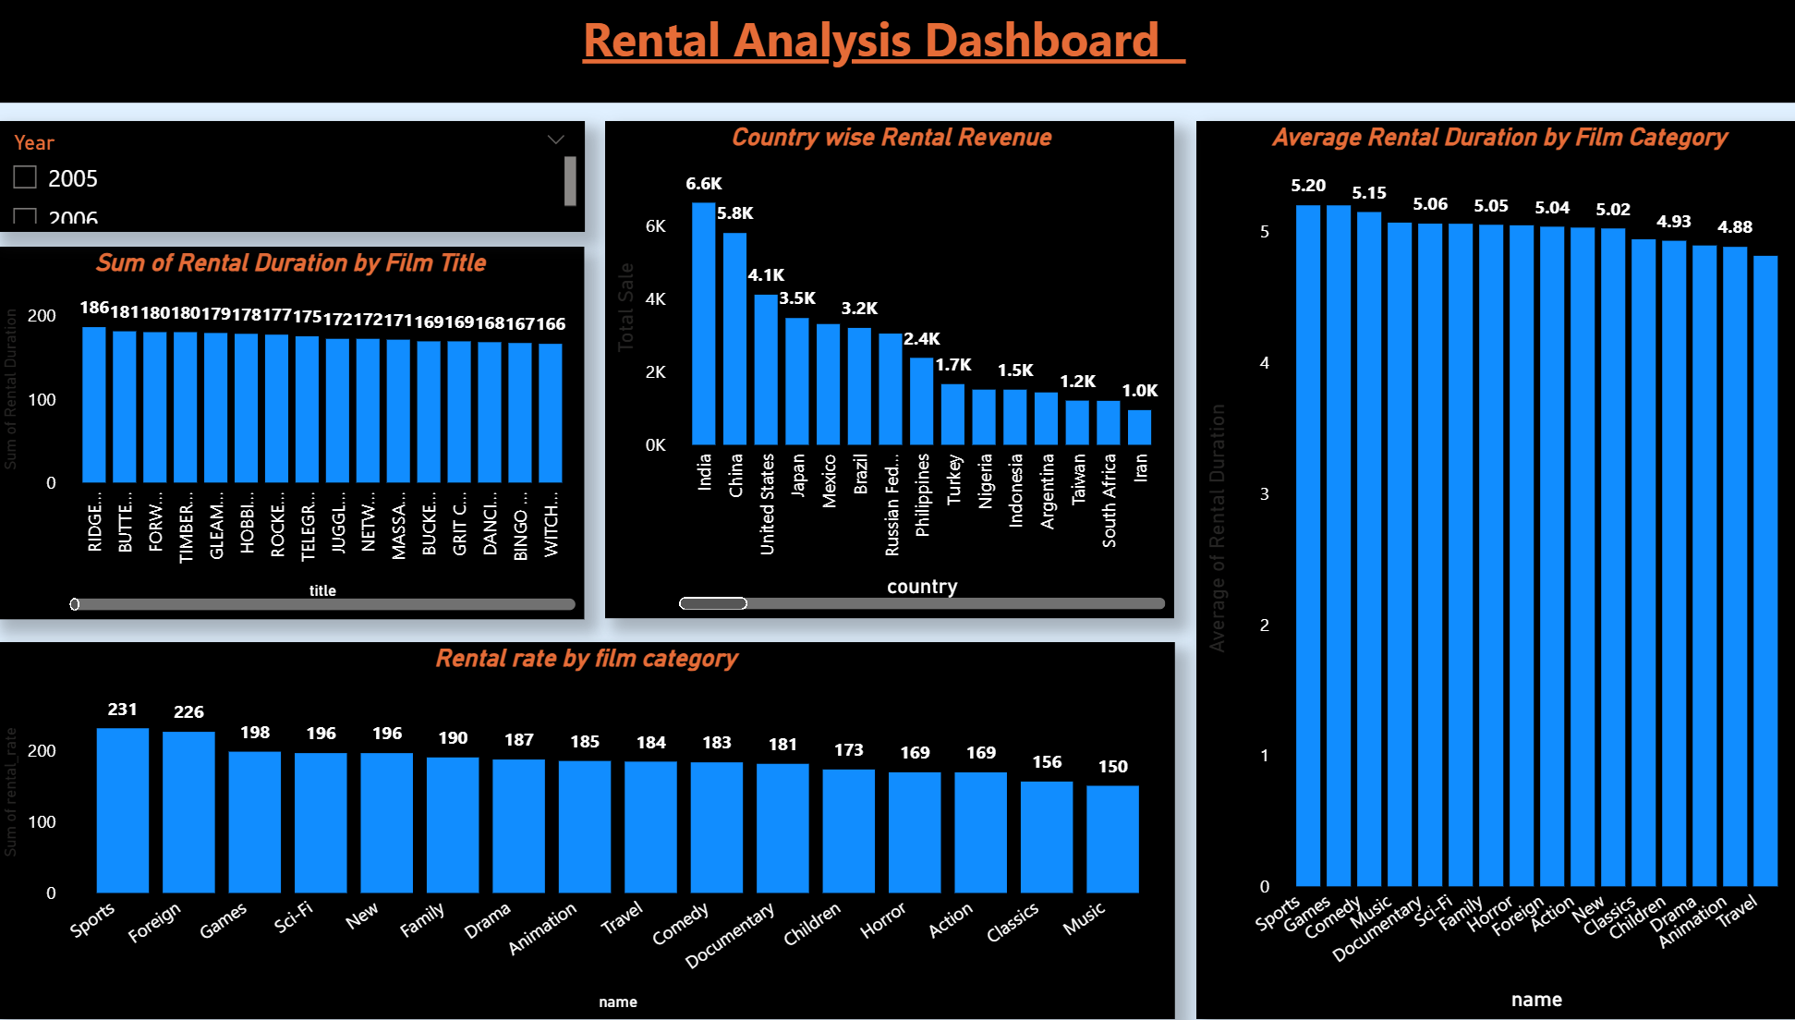

Slide 11
Staff Analysis Dashboard
1. Staff performance is measured by average rental duration.
2. Dashboard tracks key metrics across Sales, Film, and Rental data.
3. Performance is analyzed across multiple quarters (Q1-Q7).

Slide 12
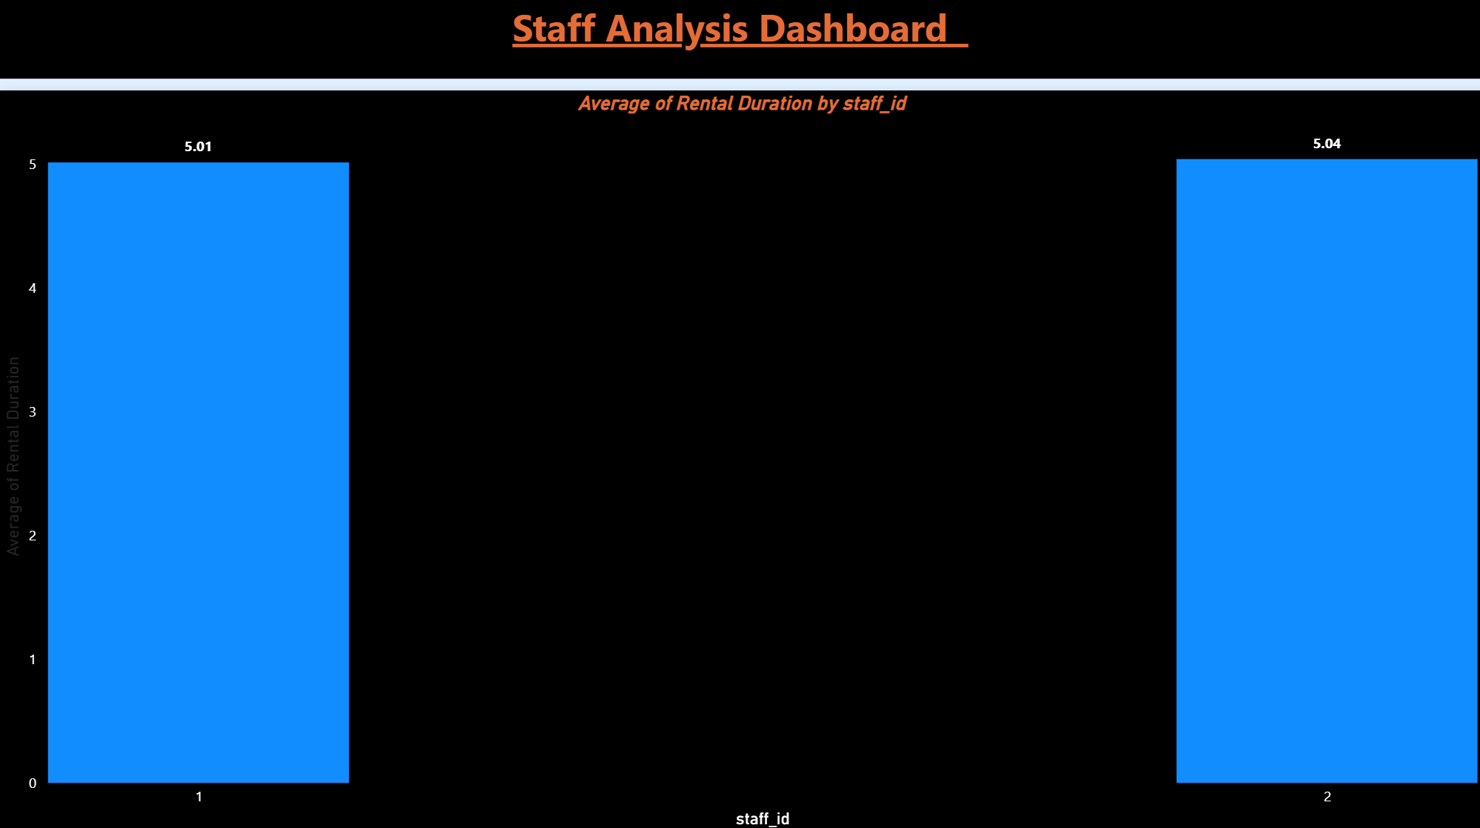

Slide 13
Store Analysis Dashboard
1. Total sales across all stores is $67.4K.
2. Buenos Aires (Argentina) is a top-performing district.
3. Store performance is tracked by city, district, and total sales.
4. Key districts include Barrios Aires, California, and São Paulo.

Slide 14
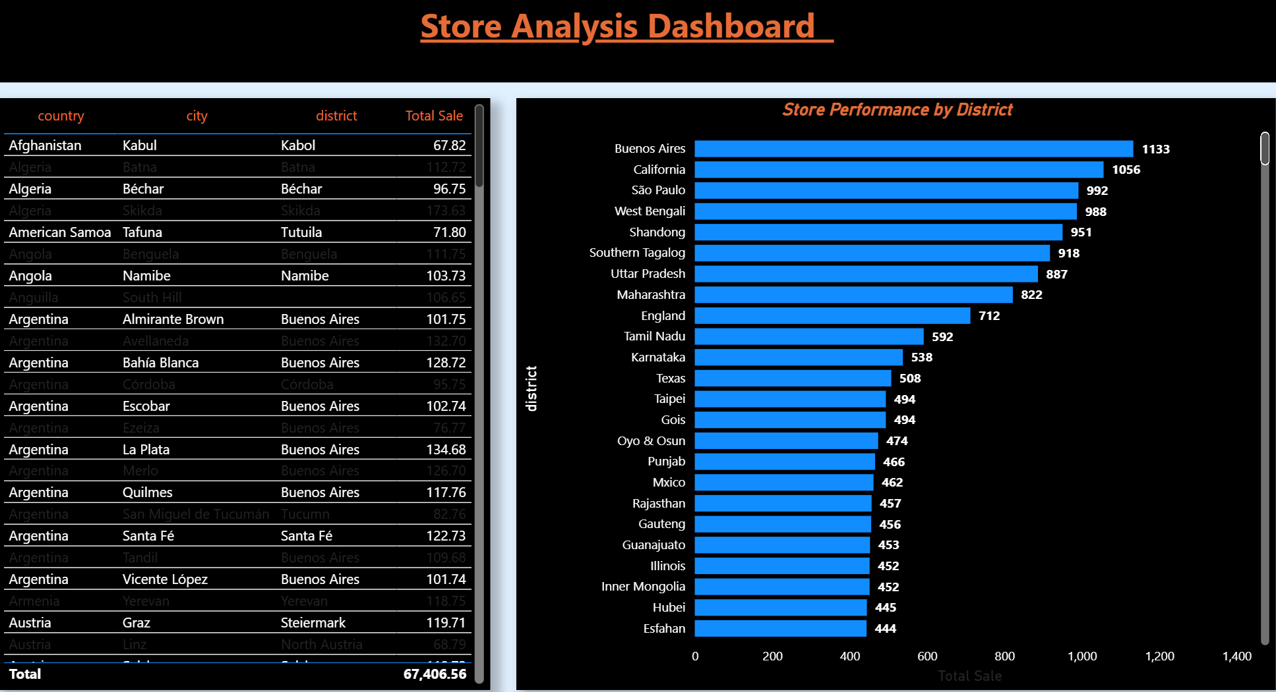

Slide 15
Customer Analysis Dashboard
1. Customer distribution is analyzed geographically across cities.
2. Customer rating data is tracked city-wise with consistent ratings (e.g., 8).
3. Includes global locations from India, Brazil, Middle East, and Europe.
4. Helps identify customer concentration and satisfaction by location.

Slide 16
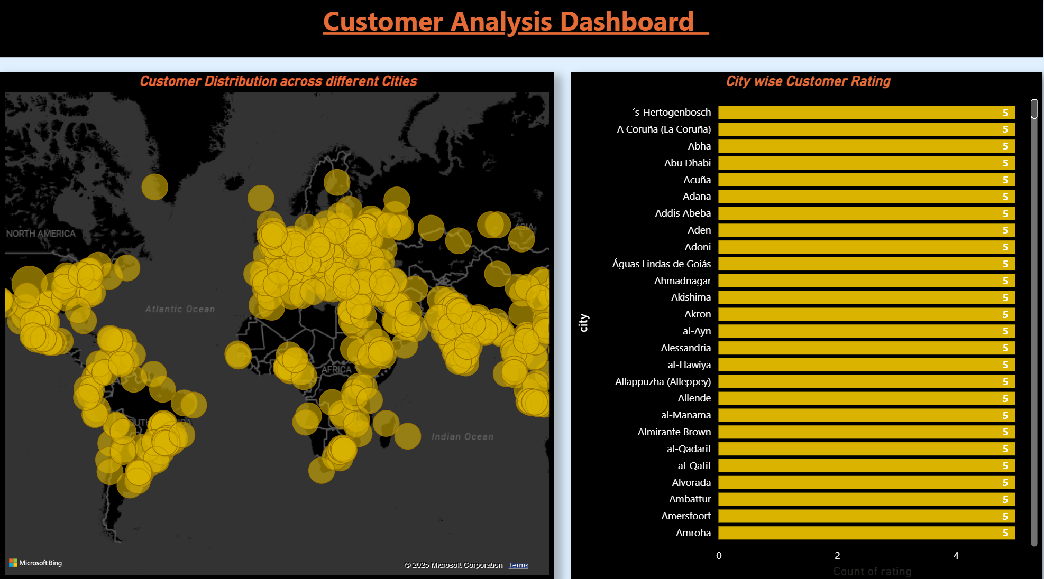

Slide 17
Conclusion
• Star schema ensures clean and optimized data modeling.
• MECE framework ensures structured analysis without overlap.
• Dashboard answers key business questions.
• Helps improve retention, inventory, staff efficiency, and profitability.

Slide 18


