Slide 1

Real-Time Pothole Detection
Using yolo
PRESENTATION 2026
Team Members
GitHub Repository
Guide
Shalini Tiwari
Rajan Sharma
Dhruv Rai
Akarsh Singh
https://github.com/Akarsh077/FinalProject7.git
Ankit Dixit

Slide 2
Real-Time Pothole Detection Using YOLO
PRESENTATION 2026
Team Members
GitHub Repository
Guide
Shalini Tiwari
Rajan Sharma
Dhruv Rai
Akarsh Singh
https://github.com/rajansharma630/project_for_internship.git
Ankit Dixit

Slide 3
Real-Time Pothole Detection Using YOLO
PRESENTATION 2026
Team Members
GitHub Repository
Guide
Shalini Tiwari
Rajan Sharma
Dhruv Rai
Akarsh Singh
https://github.com/rajansharma630/project_for_internship.git
Ankit Dixit

Slide 4
OUTLINE
Abstract of the Project
Problem Statement
Proposed Solution
System Architecture
Live Demo of the Project
Conclusion &Future Scope

Slide 5
ABSTRACT
There are many potholes present on roads, and they pose a serious threat to vehicle safety, often leading to major accidents, vehicle damage, and increased maintenance costs. Every year, thousands of accidents occur due to drivers being unaware of these road hazards in advance. To tackle and detect such potholes, we have come up with this project. The goal of this project was to create a real-time pothole detection and driver alert system that not only identifies potholes but also warns drivers before they reach them.
This model was developed using the YOLOv4-Tiny (You Only Look Once) algorithm, a lightweight and optimized version of YOLO designed for real-time object detection with low computational cost. It is capable of processing static images, pre-recorded videos, and live camera feeds to detect potholes accurately. Upon detection, the system analyses the bounding box size relative to the frame to classify the pothole's severity as Low, Medium, or High. Each detected pothole is logged into a database along with its GPS coordinates and timestamp for future reference.
To assist drivers in real time, a Live Map Dashboard was built using Streamlit and Folium, which tracks the driver's current location using browser-based GPS. The system calculates the distance between the driver and nearby high-severity potholes using the Haversine formula. When a severe pothole falls within a set warning radius (e.g., 50 meters), the system immediately triggers a visual warning banner along with an audio alert, giving the driver enough time to slow down or change lanes.
The system achieves high detection accuracy with low latency, making it a reliable, low-cost, and scalable solution for improving road safety and enabling smart, automated road monitoring.
Potholes → Road hazard → Accidents + Vehicle damage
Solution → Real-time Pothole Detection + Driver Alert System
Model Used → YOLOv4-Tiny → Fast + Lightweight + Accurate
Input → Image / Video / Live Camera → Detect Pothole
Analysis → Bounding Box Size → Severity: Low → Medium → High
Logging → Pothole Data → GPS + Timestamp → Saved to Database
Tracking → Live Map Dashboard → Driver's Real-time GPS Location
Distance Check → Haversine Formula → Driver ↔ Pothole Distance
Trigger Condition → Severe Pothole within 50m → Alert Activated
Alert Output → 🔴 Visual Banner + 🔊 Audio Beep
Outcome → High Accuracy + Low Latency → Safer, Smarter Roads

Slide 6
PROBLEM STATEMENT
9,438 deaths from pothole-related accidents in India (2021– 2025), Uttar Pradesh alone accounting for over half of these fatalities.
Lucknow's monsoon-affected roads + delayed civic repairs → frequent, unmarked hazards
Manual pothole inspection → slow, reactive, complaint- dependent
No real-time system exists to detect potholes and warn drivers in advance
Need: Automated, low-cost detection + real-time driver alert system.

Slide 7
PROPOSED SOLUTION
Real-time pothole detection using YOLOv4-Tiny (image, video, live feed)
Severity classification (Low/Medium/High) + GPS + timestamp logging → database
Live Map Dashboard (Streamlit + Folium) → tracks driver location in real time
Haversine formula → calculates driver–pothole distance, triggers alert within safety radius
Dual alert output → visual warning banner + audio beep → advance driver warning

Slide 8
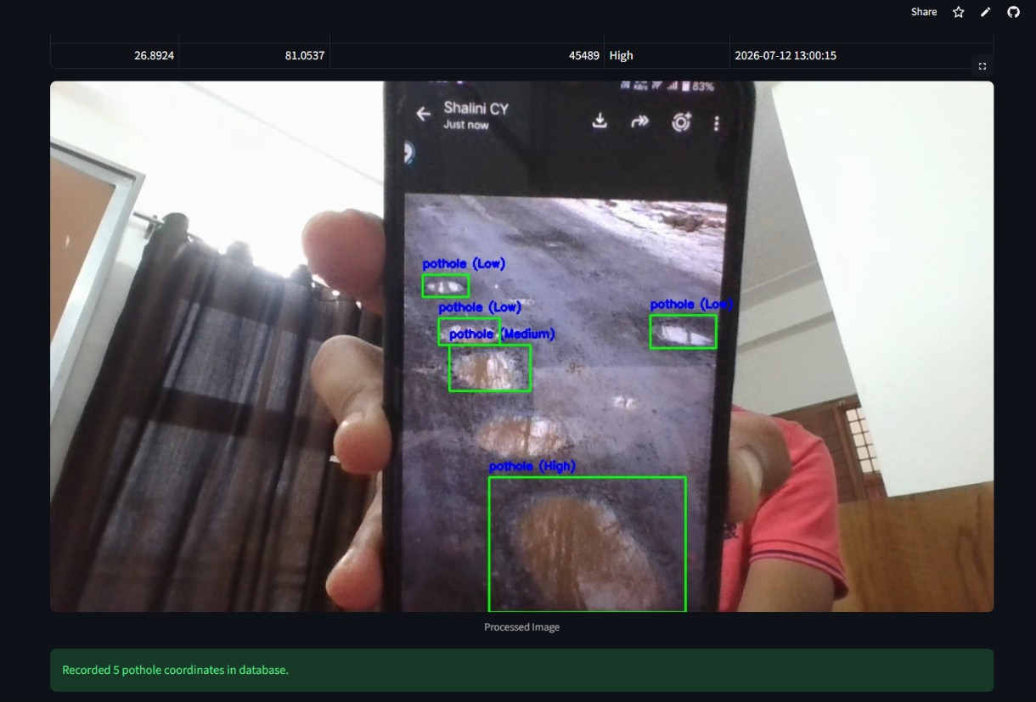
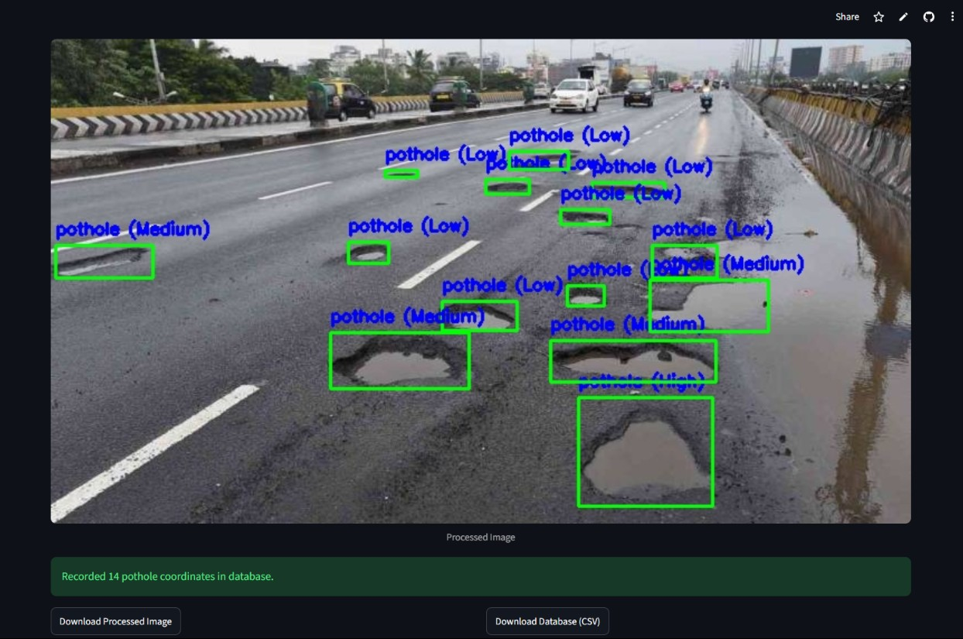
PROPOSED SOLUTION
Real-time pothole detection using YOLOv4-Tiny (image, video, live feed)
Severity classification (Low/Medium/High) + GPS + timestamp logging → database
Live Map Dashboard (Streamlit + Folium) → tracks driver location in real time
Haversine formula → calculates driver–pothole distance, triggers alert within safety radius
Dual alert output → visual warning banner + audio beep → advance driver warning

Slide 9
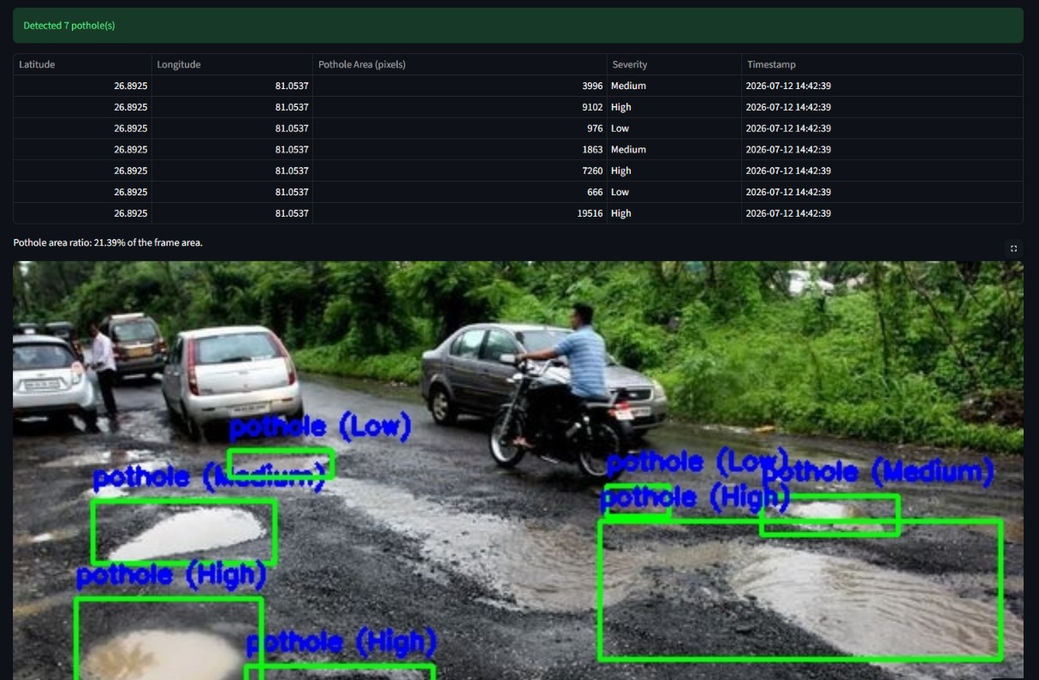
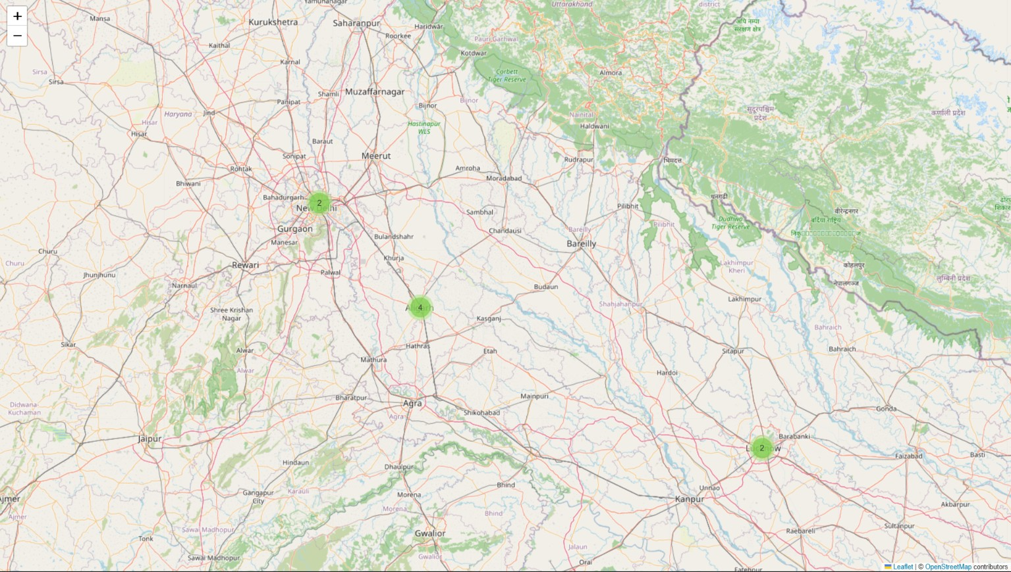
PROPOSED SOLUTION
Real-time pothole detection using YOLOv4-Tiny (image, video, live feed)
Severity classification (Low/Medium/High) + GPS + timestamp logging → database
Live Map Dashboard (Streamlit + Folium) → tracks driver location in real time
Haversine formula → calculates driver–pothole distance, triggers alert within safety radius
Dual alert output → visual warning banner + audio beep → advance driver warning

Slide 10
PROPOSED SOLUTION
Real-time pothole detection using YOLOv4-Tiny (image, video, live feed)
Severity classification (Low/Medium/High) + GPS + timestamp logging → database
Live Map Dashboard (Streamlit + Folium) → tracks driver location in real time
Haversine formula → calculates driver–pothole distance, triggers alert within safety radius
Dual alert output → visual warning banner + audio beep → advance driver warning

Slide 11
PROPOSED SOLUTION
Real-time pothole detection using YOLOv4-Tiny (image, video, live feed)
Severity classification (Low/Medium/High) + GPS + timestamp logging → database
Live Map Dashboard (Streamlit + Folium) → tracks driver location in real time
Haversine formula → calculates driver–pothole distance, triggers alert within safety radius
Dual alert output → visual warning banner + audio beep → advance driver warning

Slide 12
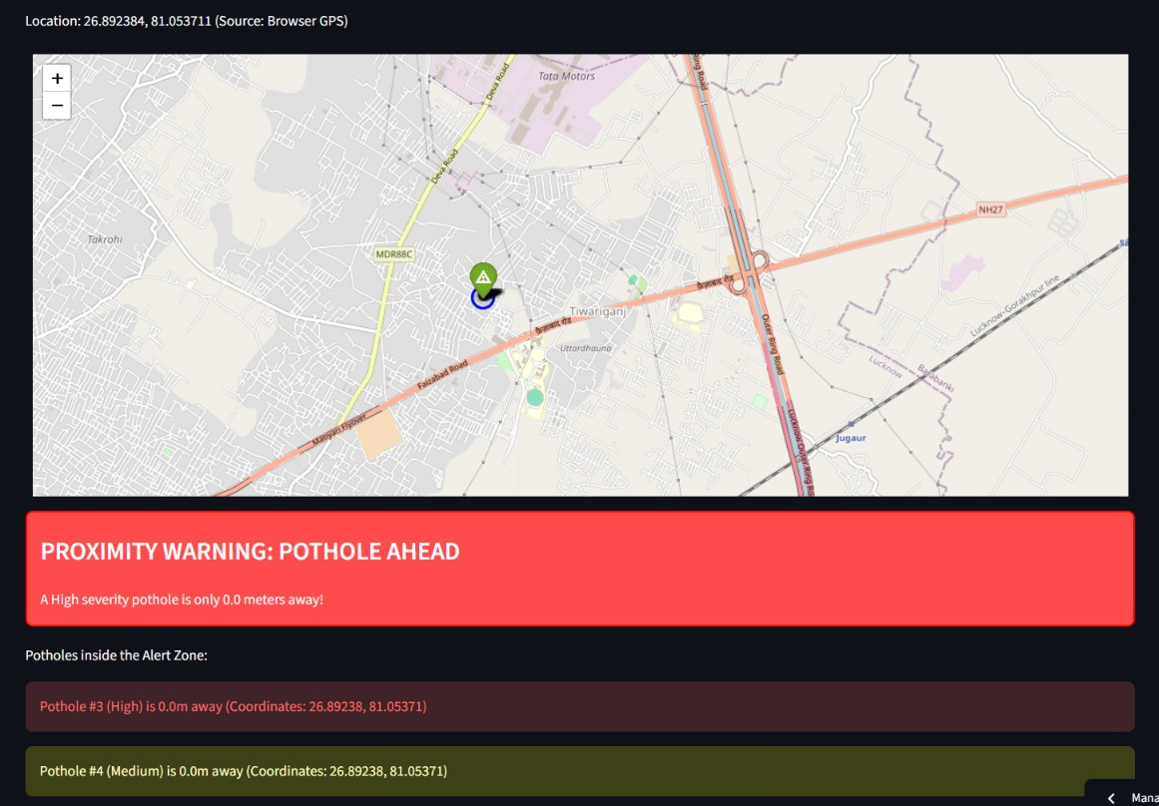
PROPOSED SOLUTION
Live Map Dashboard (Streamlit + Folium) → tracks driver location in real time
Severity classification (Low/Medium/High) + GPS + timestamp logging → database
Real-time pothole detection using YOLOv4-Tiny (image, video, live feed)
Haversine formula → calculates driver–pothole distance, triggers alert within safety radius
Dual alert output → visual warning banner + audio beep → advance driver warning

Slide 13
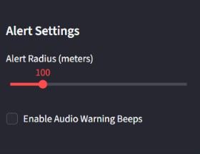
PROPOSED SOLUTION
Live Map Dashboard (Streamlit + Folium) → tracks driver location in real time
Severity classification (Low/Medium/High) + GPS + timestamp logging → database
Real-time pothole detection using YOLOv4-Tiny (image, video, live feed)
Haversine formula → calculates driver–pothole distance, triggers alert within safety radius
Dual alert output → visual warning banner + audio beep → advance driver warning

Slide 14
PROPOSED SOLUTION
Live Map Dashboard (Streamlit + Folium) → tracks driver location in real time
Severity classification (Low/Medium/High) + GPS + timestamp logging → database
Real-time pothole detection using YOLOv4-Tiny (image, video, live feed)
Dual alert output → visual warning banner + audio beep → advance driver warning
Haversine formula → calculates driver–pothole distance, triggers alert within safety radius

Slide 15
Live Demo
Deployed app link:-
https://team7phd.streamlit.app/

Slide 16
SYSTEM ARCHITECTURE
Input sources
Image, video, live feed
YOLOv4-Tiny detector
Real-time pothole detection
Severity Classification
Low, medium, high
GPS + database log
Coordinates, timestamps
Live map dashboard
Haversine distance check
Driver alert
Visual banner + audio beep
Input
Detection
Mapping
Alert

Slide 17
CONCLUSION & FUTURE SCOPE
Conclusion
Real-time pothole detection achieved using YOLOv4-Tiny → fast + accurate
Severity-based classification + GPS logging → structured geospatial database
Live map dashboard + Haversine-based alerts → effective driver warning system
Solution proves low-cost, scalable, and deployable for real-world road safety
Future Scope
Material cost calculator → estimate repair material (asphalt/bitumen) quantity + cost based on pothole size/severity
Integration with government/municipal complaint portals → auto-report severe potholes for repair

Slide 18
Thank You
Notes:
thank you very much for joining this PPT, keep learning.
18

Slide 19
Thank You
Notes:
thank you very much for joining this PPT, keep learning.
19

