Slide 1
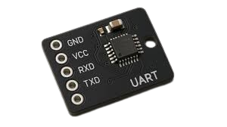
UART Verification System
Akarsh Chowdary Kondeti Bhuvana

Slide 2

Problem Statement
UART (Universal Asynchronous Receiver-Transmitter) communication is widely used in embedded systems, but testing and validation of UART links, protocols, and data integrity can be cumbersome and error-prone.
Ensuring correct configuration (baud rates, data bits, stop bits).
Verifying data integrity (e.g., handling random, large, or special character payloads).
Stress testing to evaluate system performance under continuous or burst traffic.

Slide 3
Objective
Develop a structured UART validation platform to streamline UART testing.
Provide both automated test suites for software developers and real-time communication validation for hardware engineers.
Ensure seamless testing of communication, configuration, and data integrity across various UART setups (USB-to-UART Loopback, 2 USB-to-UART Raspberry Pi GPIO UART).

Slide 4
Tech Stack
Testing:
Pytest– For running comprehensive test scenarios with modular setup.
Serial Communication:
Pyserial- Python pyserial for UART communication.
Frontend:
React– To create an interactive and responsive user interface.
Backend :
FastAPI – For building a lightweight and asynchronous API.
Database:
SQLite – For storing test results, logs, and communication data.

Slide 5
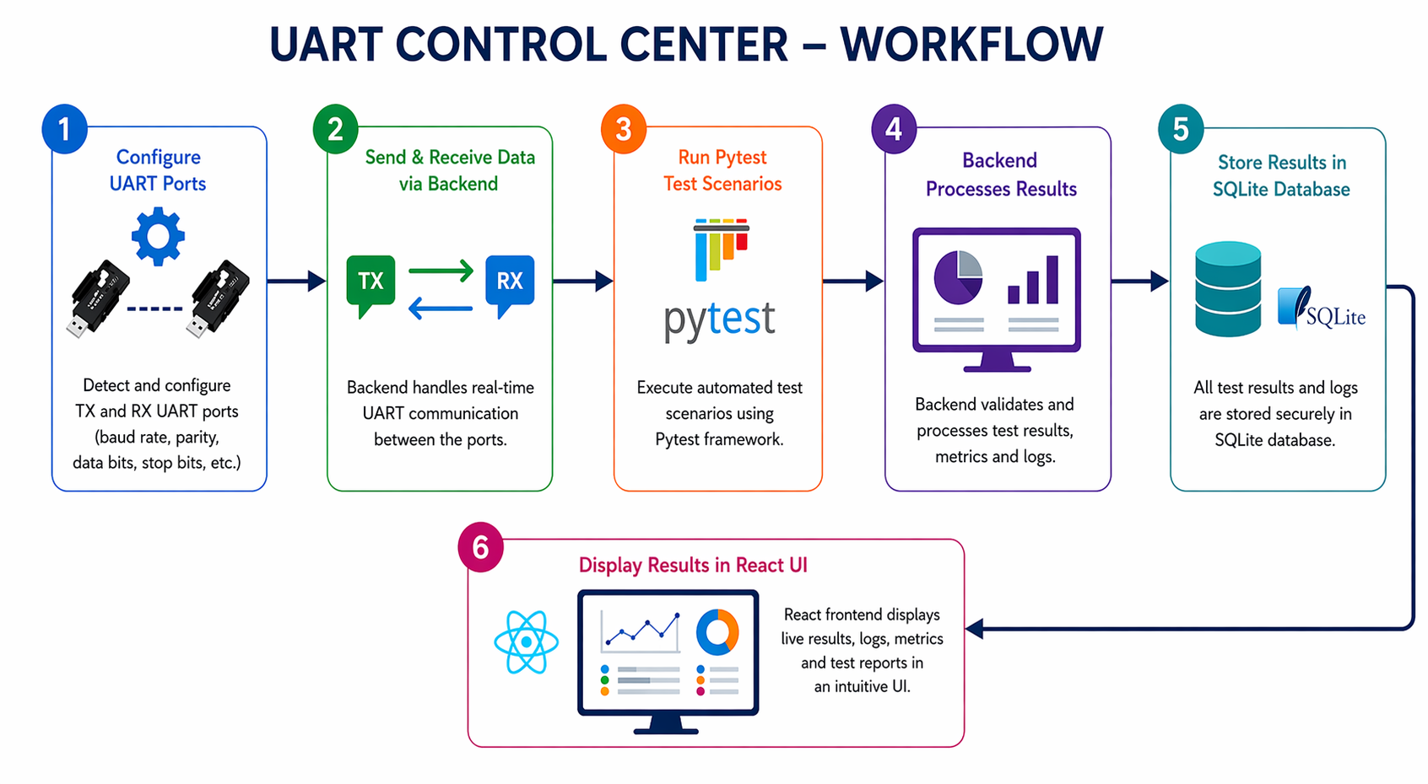

Slide 6
Test Scenarios
Basic Tests: Verify simple send/receive communication.
Configuration Tests:Check different baud rates, parity, data bits, and stop bits.
Integrity Tests: Validate data integrity under various conditions (large data, random data, binary data).
Timing Tests: Measure latency, throughput, and inter-byte delays.
Protocol Tests: Test CRC validation, framed command parsing.
Stress & Soak Tests: Assess performance under sustained traffic.

Slide 7
Project Outcome
Functional Test Suite:A complete automated test suite covering essential UART scenarios.
Real-Time Communication Control:Easy-to-use interface for configuring ports, sending/receiving data, and observing results in real time.
Extensibility:Framework supports easy additions of more test scenarios and hardware configurations.
Stability: Comprehensive stress testing ensures reliable UART communication under various conditions.

Slide 8


Advantages:
Comprehensive testing across a variety of UART configurations.
Real-time test monitoring and result visualization.
Easy-to-use interface for engineers and developers.
Supports multiple hardware setups (USB-to-UART, GPIO UART).
Disadvantages:
Limited to UART communication (no support for other protocols like I2C, SPI).
Setup requires knowledge of UART configuration and port permissions.
Hardware dependencies may restrict testing scenarios (USB-to-UART adapters or Raspberry Pi).

Slide 9
Future Scope:
Expanded Hardware Support:Integration of additional UART devices (e.g., Bluetooth UART, Wi-Fi UART).
Advanced Error Detection:Adding more sophisticated error-handling mechanisms and visual alerts for test failures.
Cloud Integration:Potential for cloud-based test result storage and collaboration.
Performance Benchmarks:Real-time performance monitoring, including advanced latency and throughput metrics.
Cross-Platform Support:Extending the solution to support non-Linux platforms like Windows or macOS.

Slide 10
Thank You

