Slide 1
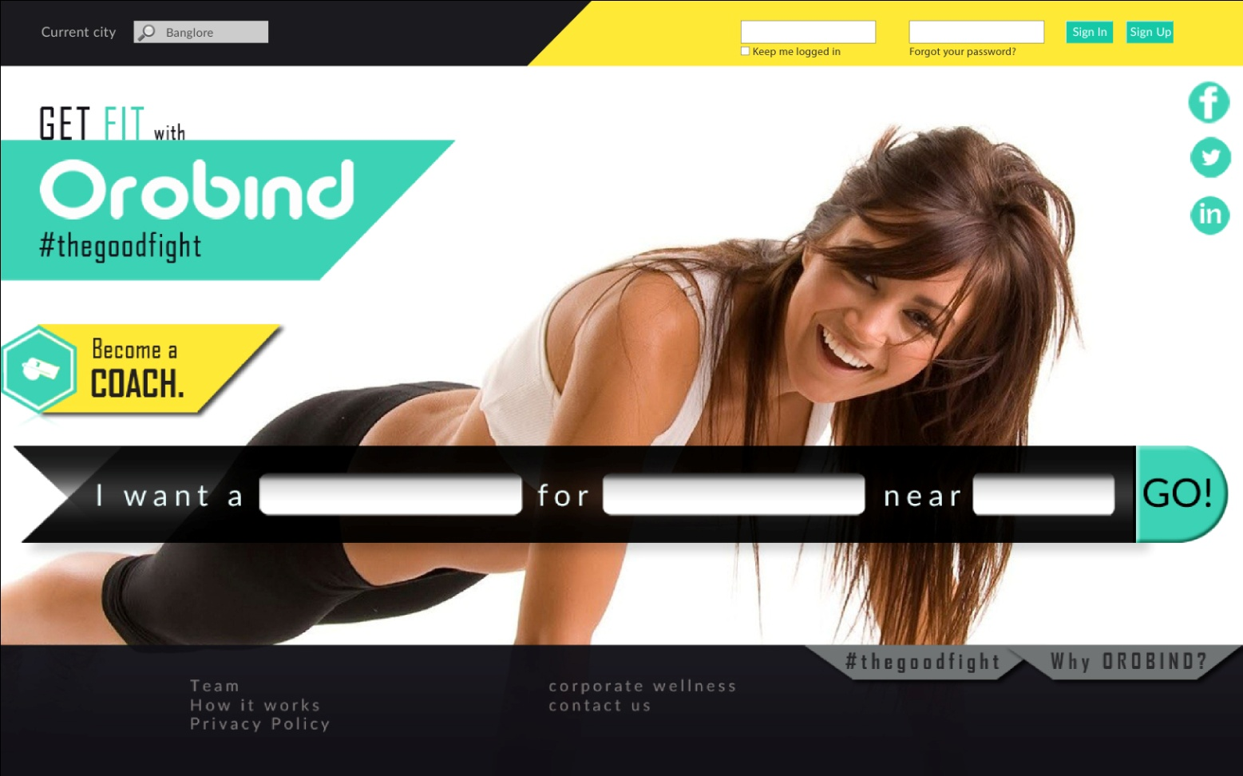
index
Cut a strip of yellow
And extend it
Keep all these intact and
align them left
search
-Keep everything 75% of there original size
-search bar(search arrow) should be cente alligned and use its complete png(each layer)
-footer icons should be of same color as given with shadows(make pngs )
-mke sure the tranparency of footer

Slide 2
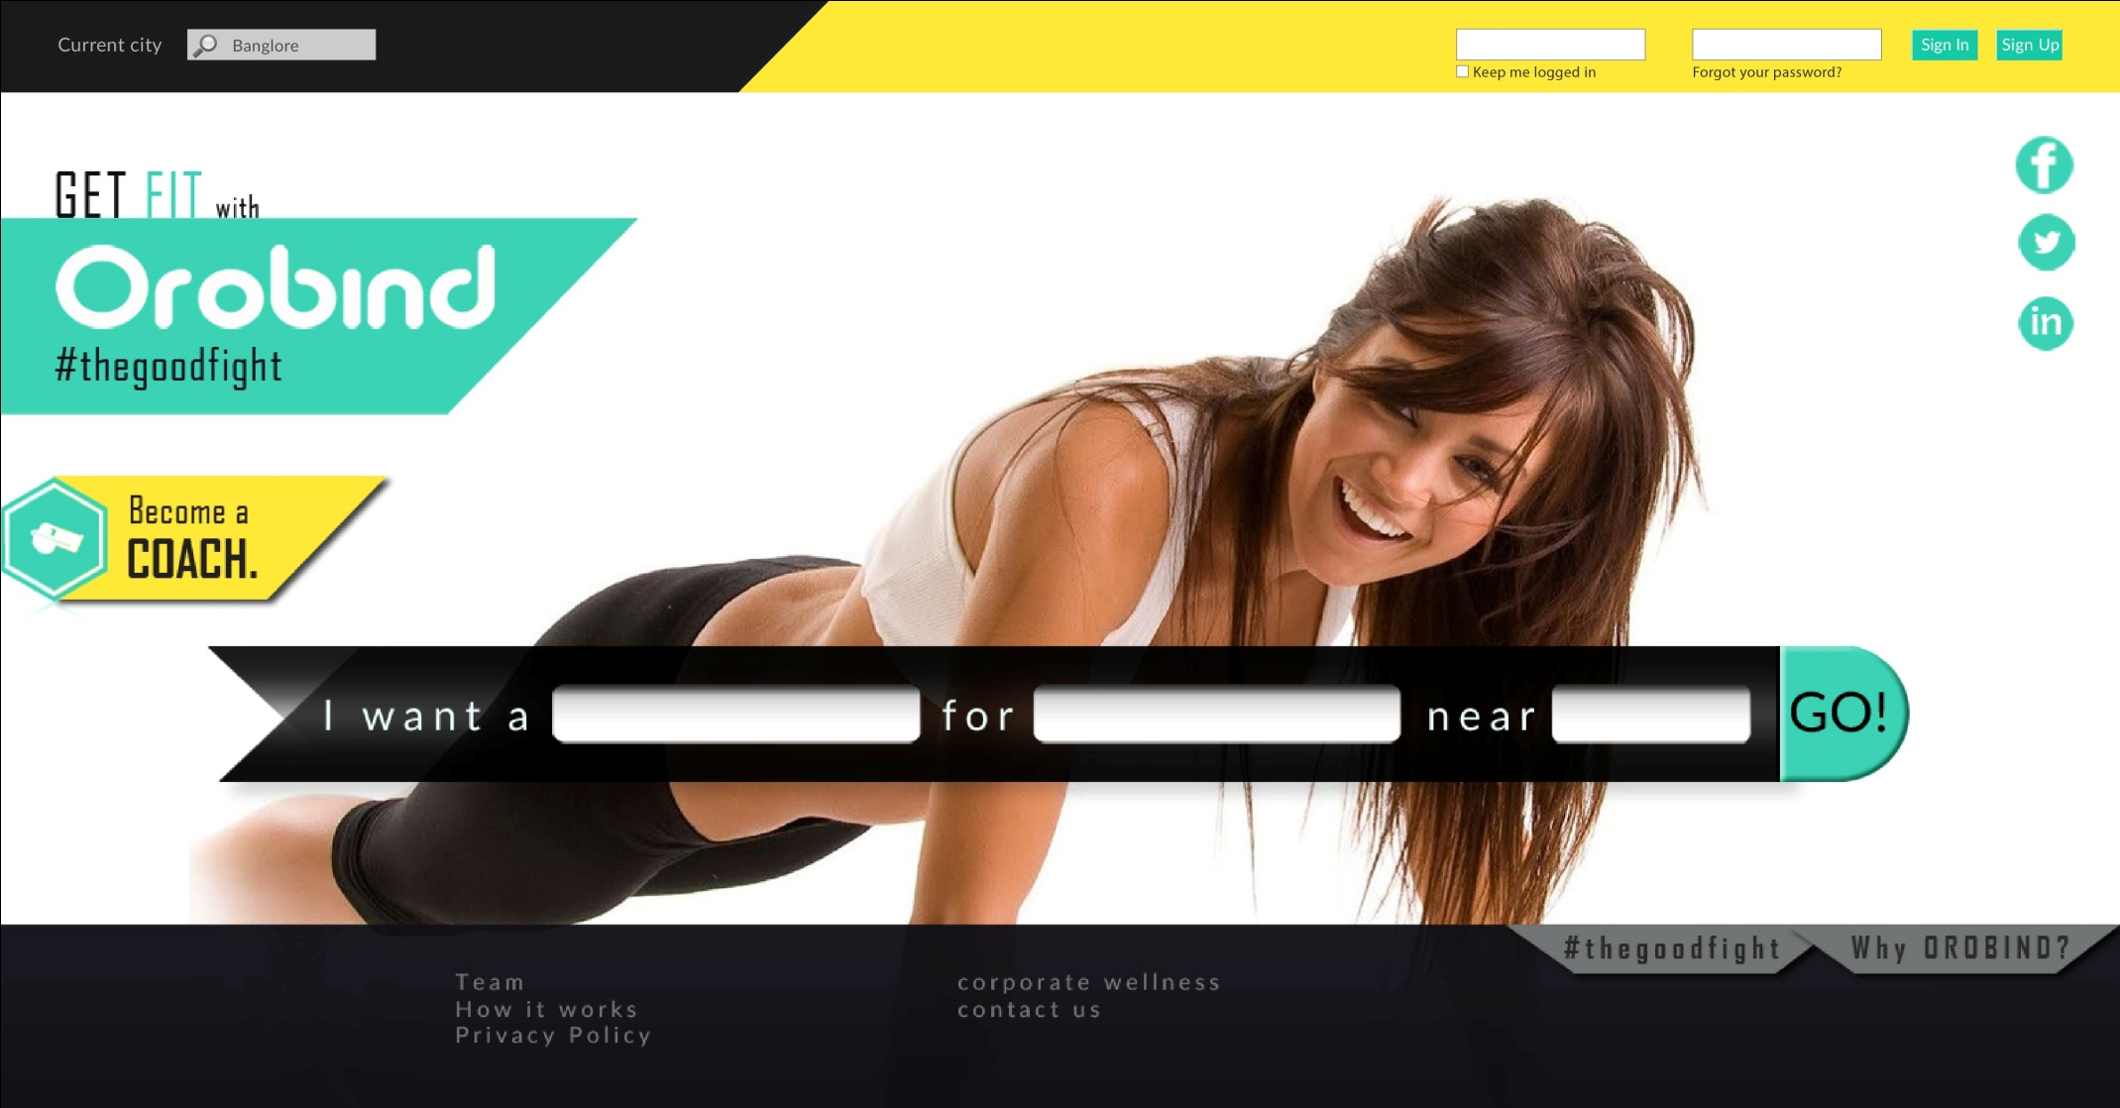
Expected Page

Slide 3

Page 2
Color of search box is greyish
Proper allignment
Please go through every layer
(slight shades of gray is given)
Observe the gaps and margin
carefully
allignment

Slide 4
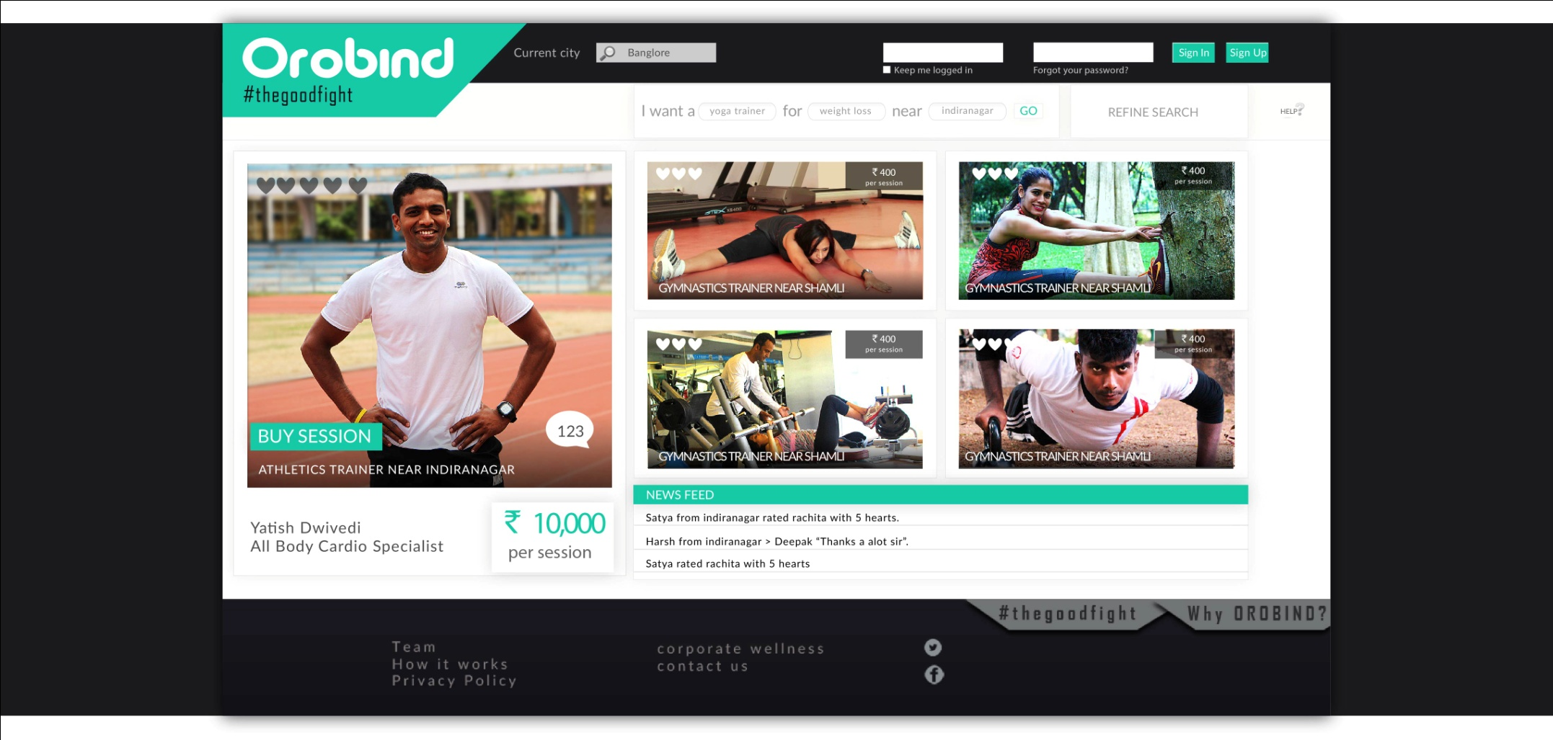
Expected page
This page and sign up page should be single fit page (80-85% will probably do) rest of the space
On both sides will be filled with the same color as that of header using shadow effect as shown

Slide 5
Helpful points( may be)
While extracting files in illustrator, firstly unlock each layer by object>unlock all.
Take care of colors
Side by side open the layer window so that u can see all the layers precisely.

