Slide 1



FRONTEND ENGINEERING
PROJECT
By - Akarshit Batra
2110990113
Group No - 5
year- 3rd year student(2021 batch)
Live Link - https://elector-x.vercel.app/
Submitted to - Lavish Arora Sir

Slide 2

CONTENT
01
INTRODUCTION
02
ROLE IN E-COMMERCE
03
KEY FEATURES
04
PROJECT TIMELINE
05
TECHNOLOGY STACK
06
CHALLENGES AND SOLUTION
07
CONCLUSION

Slide 3
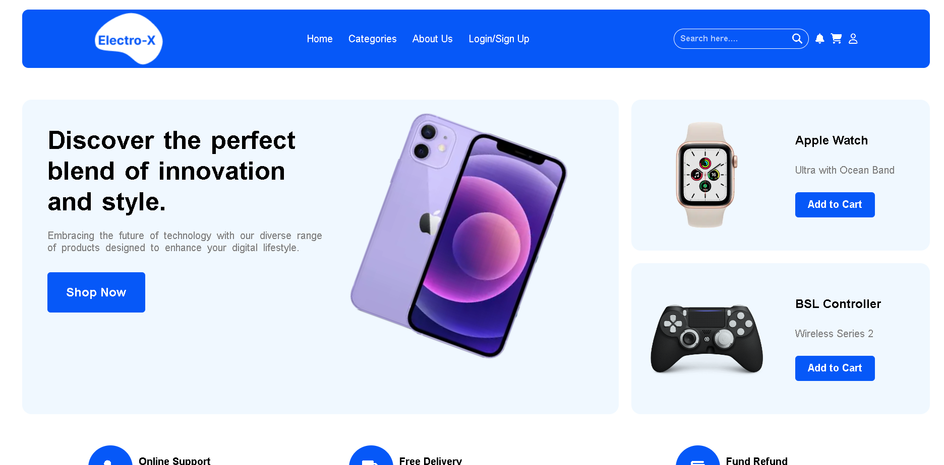

INTRODUCTION
Welcome to Electro-X, a pioneering e-commerce platform tailored to the world of electronic products. Electro-X is not just another e-commerce website; it represents a new era in online shopping, specifically designed to meet the needs of electronics enthusiasts.

Slide 4





ROLE IN E-COMMERCE
Electro-X's Unique Position
Electro-X occupies a vital role within the broader e-commerce landscape. What sets it apart is its dedicated specialization in electronic products. It's not just an e-commerce platform; it's a one-of-a-kind destination that caters exclusively to the diverse and evolving world of electronics.

Slide 5
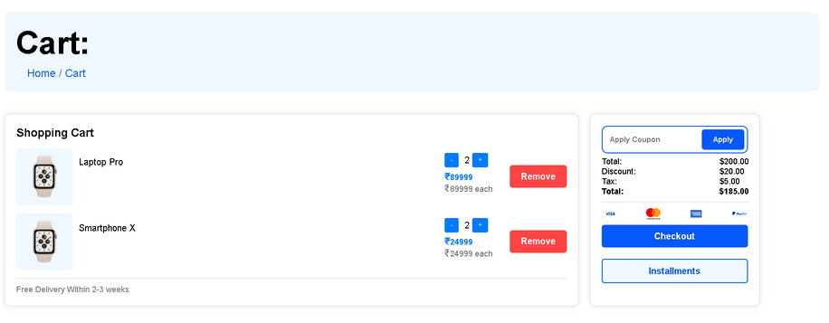


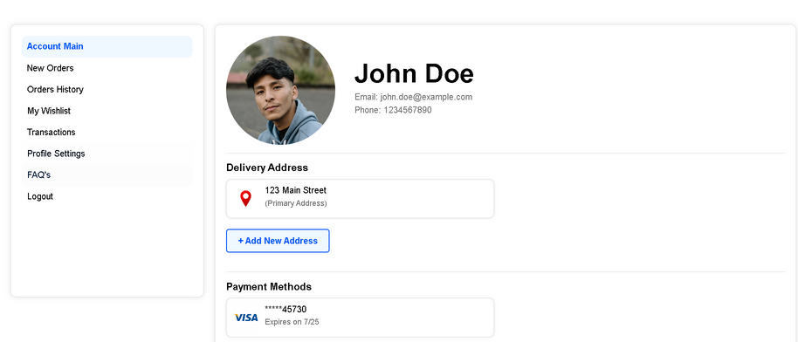
KEY FEATURES
Cart Feature
The cart feature in Electro-X allows users to gather and manage their selected electronic products before proceeding to a secure checkout, enhancing the shopping experience.
Electro-X's user dashboard offers a personalized space for customers to track orders, manage preferences, and access their purchase history, making their interaction with the platform more convenient.
User DashBoard

Slide 6
PROJECT TIMELINE
01
02
03
August
September
October
August will primarily focus on the initial stages of the project, including design conceptualization, mockup creation, and the development of the HTML structure. The goal is to establish a solid foundation for the website's visual appearance and structure.
September is dedicated to the integration of CSS into the project. It will involve adding styles to the HTML structure and ensuring a visually appealing and consistent design. Responsive design principles will also be applied to make the website adaptable to various screen sizes.
October marks the phase where JavaScript integration takes center stage. This month will involve adding interactive elements, enhancing user experience, and creating dynamic features on the website. Extensive testing and debugging will be carried out to ensure functionality.

Slide 7


TECHNOLOGY
STACK
HTML, CSS, and JavaScript were chosen as the core technologies for Electro-X due to their complementary roles. HTML provides the structural foundation, CSS enhances visual aesthetics and layout, while JavaScript adds dynamic functionality, ensuring a robust, responsive, and user-friendly e-commerce experience for our customers.

Slide 8
CHALLENGES AND SOLUTION
During the creation of Electro-X, we encountered a few hurdles. Keeping our website secure from cyber threats, ensuring it ran smoothly even during busy times, and making it user-friendly were some of our challenges. To tackle them, we used strong security measures, improved website performance, and gathered feedback to make the site easier to use. For example, we noticed that after these changes, more people enjoyed shopping with us, and our website handled a huge number of users during a big sale without any problems. Overcoming these challenges made Electro-X better for everyone

Slide 9
CONCLUSION
In summary, Electro-X isn't merely another e-commerce platform; it represents a revolution in electronics shopping. It embodies innovation, design, and technology, all working in harmony to make the lives of electronics enthusiasts easier and more enjoyable. We firmly believe that Electro-X will redefine the electronics e-commerce landscape, and today, we look forward to sharing more about this exciting project with you

Slide 10


THANK YOU
Larana, Inc.

