Slide 1

Arduino BASED Smart dustbin to detect waste level and alert user
Department of Computer Science & Engineering
Presented By:
Akarshit Verma
21DCS008
Submitted To:
Dr. Robin Singh Bhadoria

Slide 2
INTRODUCTION
With the rise in population, the amount of waste generated daily is also increasing, posing serious challenges to cleanliness and hygiene. Traditional dustbins often require manual contact, which can spread germs and lead to an unhealthy environment. To address this issue and support the goals of the Swachh Bharat Mission, we have developed a smart dustbin system using Arduino. This system uses an ultrasonic sensor and servo motor to automatically open and close the lid when someone approaches, ensuring a hands-free and hygienic experience. The aim is to promote eco-friendly waste management through automation, while keeping the design simple, user-friendly, and cost-effective.

Slide 3
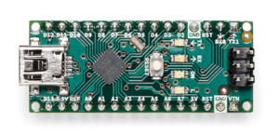
Components Required
• Hardware Requirements
Arduino Uno :
Arduino Nano is a microcontroller from Arduino Family, a friendly board based on the ATmega328.
Nano has 22 Input/Output pins. 14 are digital pins and 8 are analog pins.

Slide 4
Components Required
• Hardware Requirements
Ultrasonic sensor (HC-SR04):
It is a SONAR-based distance measurement sensor. It provides excellent non-contact range detection from 2 cm to 400 cm with high accuracy and reliable readings.
xServo Motor – SG90:
It is very small and lightweight with a high-performance servo motor. Works on 5V power supply. The Servo Motor rotates 180 degrees approximately.

Slide 5
Components Required
• Software Requirements
Arduino Ide:
Arduino IDE (Integrated development environment) is software that is used to dump the program into boards. Arduino- IDE’s major use is to build electronics-related projects. Arduino is an open-source platform simple and easy-to-understand platform for coding.

Slide 6
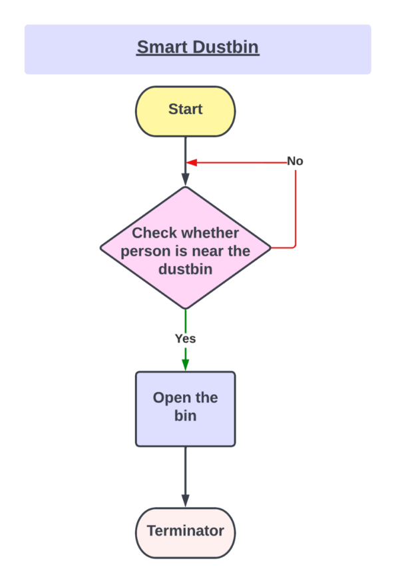
Flow Chart:
So as it starts, first, the ultrasonic sensor calculates the distance and checks whether the distance is less than a certain limit or whether a person is near the dustbin or not. If yes, the servo rotates to open the bin, and if no, it goes back to check the distance again and again.

Slide 7
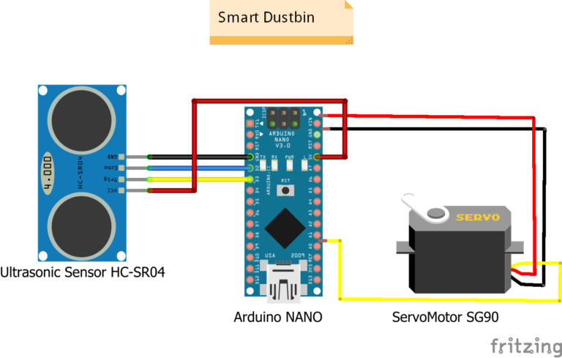
Circuit diagram:

Slide 8
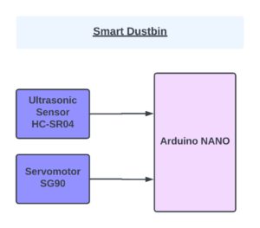
BLOCK DIAGRAM:
In the following block diagram the ultrasonic sensor is an input device and the servo motor is the output device interfaced with Arduino nano. Here Arduino nano will act as a controller which will send and receive the information. The ultrasonic sensor sends the information to the Arduino nano and the servo motor receives the information from the Arduino Nano.

Slide 9
WORKING
The next step after setting up the connection is to upload code to Arduino Nano and power it. When the system is turned on, Arduino continues to watch for anything that comes within a certain distance of the ultrasonic sensor.
When an object is detected by an ultrasonic sensor, such as a hand or another object, Arduino measures its distance; if it is less than a certain value, the servo motor activates and opens the dustbin Lid.
The lid will open for a predetermined period of time before closing on its own.

Slide 10
Conclusion
Smart dustbins offer a modern solution to waste management with features like automatic lid opening using sensors and Arduino. They promote hygiene by reducing contact. In the future, they can be enhanced with sensors to detect when full and integrated with IoT for real-time monitoring and smart waste tracking.

Slide 11
REFERENCES
[1] A. S. Berger, Embedded Systems Design: An Introduction to Processes, Tools, \& Techniques: CMP
Books, 2002.Very practical orientation, low level programming, ICE, JTAG, etc.
[2] Edgar H. Callaway, Jr., Wireless Sensor Networks: Architectures and Protocols: CRC Press,
2004.Focus on networking technology and power management.
[3] S. A. Edwards, Languages for Digital Embedded Systems: Kluwer Academic Publishers,
2000.Written by a Berkeley alumnus on the faculty at Columbia who teaches a course on embedded
systems. Academic orientation, but translated in real practice in Edwards' Columbia course.
[4] Raj Kamal, Embedded Systems: Architecture, Programming, and Design: McGraw Hill,
2008.Practical orientation, but without details of real systems.
[5] P. Marwedel, Embedded System Design: Kluwer Academic Publishers, 2003.A European
perspective, good buzzword-compliance (UML, SystemC, statecharts, speccharts). More oriented
towards industry, perhaps, but not as nuts-and-bolts as some of the others.
[6] T. Noergaard, Embedded Systems Architecture: A Comprehensive Guide for Engineers and
Programmers: Elsevier, 2005.Practical book oriented towards industrial practice. More emphasis on
hardware.
[7] J. S. Parab, V. G. Shelake, R. K. Kamat, G. M. Naik, Exploring C for Microcontrollers, Springer,
2007.Hands-on book, tutorial on C programming for MCS-51 using Keil IDE.
[8] Gregory Pottie and William Kaiser, Principles of Embedded Networked Systems Design: Cambridge
University Press, 2005.

Slide 12
Thank you

